Slide 1
Verifying the Application for ENERGY STAR® Tenant Space Recognition
Notes:
Good afternoon, and welcome to today’s webinar, How to Apply for ENERGY STAR Tenant Space recognition.
[Speaker introduction]

Slide 2
What is ENERGY STAR Tenant Space?
ENERGY STAR Tenant Space is a new EPA recognition for sustainability efforts in your leased office space.
Energy efficient office spaces can lead to lower utility bills and fewer greenhouse gas emissions in our atmosphere.
All applications for ENERGY STAR Tenant Space recognition must be verified by a Licensed Professional.
Notes:
First, let’s talk for just a minute about what a Tenant Space is. This is a relatively new recognition program launched on October 13, 2020, allowing commercial office tenants to earn ENERGY STAR recognition for their leased office spaces. Efficient office spaces of course lead to lower utility bills and lower energy use for the building as a whole, resulting in fewer greenhouse gas emissions. Once recognized, the tenant space will receive the decal shown here, which can be affixed to the entrance of the space.
To get to the point of recognition, though, a Licensed Professional needs to verify a tenant space’s application. If you’re familiar with ENERGY STAR certification for whole buildings, then you’re already familiar with this practice. This session will focus on the roles and responsibilities of the Licensed Professional, or LP, in the Tenant Space recognition process.

Slide 3
Agenda
Role and Responsibilities of the LP
Verifying the Application
Confirm Eligibility
Verify Metering Compliance
Review Tenant Space Information
Verify, Sign, & Stamp the Application
For detailed instructions on setting up your Tenant Space and applying for recognition, click here.
The Tenant Space LP Guide is available at www.energystar.gov/tenantlpguide.
Notes:
Today, we’ll very briefly go over the role of the Licensed Professional in the Tenant Space recognition process, then we’ll dive into a sample application and go over the details that the Licensed Professional will be expected to verify during their site visit to the space.
A copy of these slides will be sent around to all registrants after the session, so if you’d like to see more details on the actual application process, or if you’d like to review the Tenant Space Licensed Professionals’ Guide, which a lot of this webinar is based on, you’ll be able to access these links once you have these slides.

Slide 4
Role and Responsibilities of the Licensed Professional
Notes:
Now let’s talk about your role as the verifying Licensed Professional.​

Slide 5
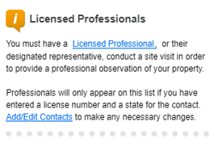
Licensed Professional (LP) Requirements
To verify applications for ENERGY STAR recognition, EPA requires an individual LP to meet the following qualifications:
Possess a current license in any U.S. State, Canadian Province, or territory of the U.S. or Canada as a Professional Engineer
(PE) or Registered Architect (RA) and be in good standing;
(Note: the LP does not need to hold a PE or RA license in the state in which the space he/she is verifying is located.)
Have a working knowledge of energy use in office spaces, including energy metering and lighting fixture types and controls.
Understand all applicable state and territorial engineering and architectural licensure laws, professional ethics requirements, and regulations prior to offering or performing services in a jurisdiction.
Only LPs meeting these qualifications are eligible to verify commercial Tenant Spaces for ENERGY STAR recognition.
LPs do not need to be from third-party organizations, and may be employees of the applicant organization, but they are to provide unbiased services and are bound by law to uphold strict ethical standards.
They must verify that the information contained in the application is accurate to the best of their knowledge, based on a site visit to the space, their technical expertise, and a good faith effort to comply with the given instructions.
More information at www.energystar.gov/tenantlpguide
Notes:
The LP needs to be either a Professional Engineer or a Registered Architect, licensed in any US state or territory, or Canadian province. They need to be in good standing with their licensing authority, and need to have a working knowledge of energy use and metering in office spaces, as well as applicable licensure laws, professional ethics requirements, and regulations.
More details on LP responsibilities can be found in the ENERGY STAR Tenant Space Guide for Licensed Professionals, which you can find at www.energystar.gov/tenantlpguide, but these are the basic eligibility requirements.
The bottom line is that EPA counts on the expertise and professional judgment of the LPs to ensure that information on the application is accurate, which helps to maintain program integrity and value.

Slide 6
Site Visits
Site visit to space must occur within 6 months prior to application submission
Walk through Tenant Space and building
Space can be vacant at time of site visit (lighting and metering must be installed)
Notes:
As the LP, your primary role is to visit the Tenant Space, or to remotely supervise a designated representative who conducts the site visit in your place, and to use your expertise as an Engineer or Architect to verify that all information reported on the application is accurate. The site visit needs to take place within 6 months prior to the application’s submission. In addition to walking the tenant space and confirming eligibility, metering, lighting, and equipment, you’ll need to verify information about the base building where the space is located, as well as the space’s envelope information. We’ll get into the details of this in the following slides.
Also, EPA acknowledges that site visits may be a little bit different at the moment due to the COVID-19 pandemic. For those of you familiar with ENERGY STAR certification for whole buildings, those applications require measurements to verify adequate indoor environmental quality, so the site visits can only be conducted when the building is occupied by at least some workers, so that the measurements can confirm whether the building systems can handle the full CO2 and thermal loads of occupancy. For Tenant Spaces, indoor environmental quality measurements are not required – most of the time, tenants will not have full control over the HVAC systems that would determine IEQ compliance, so the Tenant Space recognition doesn’t hold tenants responsible for that. For that reason, it is fine for site visits for Tenant Spaces to take place when the space is vacant, which may be the case for a lot of tenant spaces at the moment and for at least several more months. As long as the required metering is in place, lighting is installed, and the space is fit out and ready for tenant occupancy, then the space can still be eligible for recognition.

Slide 7
Verifying the Application
Notes:
Now that we know more about who can act as the LP, let’s talk about what they will be expected to do in that role and during the site visit.​

Slide 8
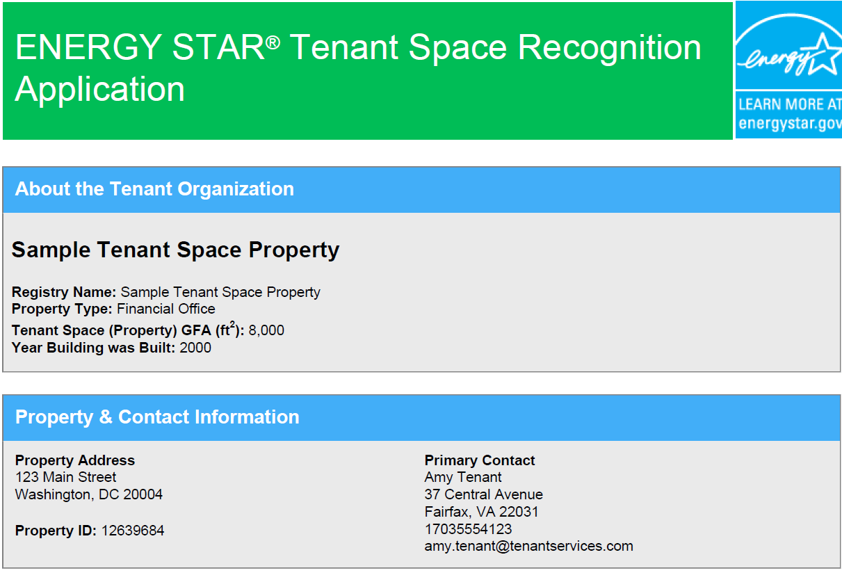
Tenant Space Recognition Application
Notes:
As discussed, your primary role as the LP is to verify the application’s information by conducting an in-person site visit. You can also use documentation or discussion with the tenant to verify certain details, but most of what you’re verifying will be confirmed during the site visit.
There will be some technical details to verify later on in the process, but the first thing to check is the basic information listed on the first page of the application, such as the name of the space, its property type – which, again, for Tenant Spaces, needs to be Office – as well as the space’s gross floor area, building address, and contact information.

Slide 9
Confirm Eligibility
Notes:
Once basic information has been confirmed, you’ll need to confirm the space’s eligibility to apply for Tenant Space recognition, so we’ll now go into those eligibility details.​

Slide 10
Confirm Eligibility
Notes:
On the application, the LP and the Tenant will both need to confirm that the property operates solely as Office space, that it represents all of the tenant’s usable square footage leased in the building, and that it’s located in the US. The Tenant will also need to confirm that they’re willing and able to share energy data and other information with their landlord upon request, but since that’s between the landlord and the tenant, the LP does not need to verify that. So, let’s go through these criteria one by one.

Slide 11
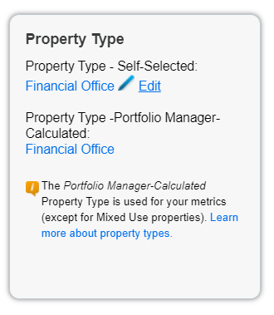
EPA-Calculated Property Type of Office/Financial Office
Notes:
First, you’ll need to verify that the space is an Office space. This can be general administrative office, financial office, or a non-diagnostic medical office. The space can also include a Data Center as long as the Data Center is separately metered. What this amounts to in Portfolio Manager is that your EPA-calculated property type must be either Office or Financial Office – this is the property type that’s based on the individual property uses you’ve entered in your Details tab. As the LP, it’s your job to make sure this classification aligns with reality – for example, make sure that the space in question doesn’t include warehouse space, retail store space, or any other significant non-office gross floor area.

Slide 12
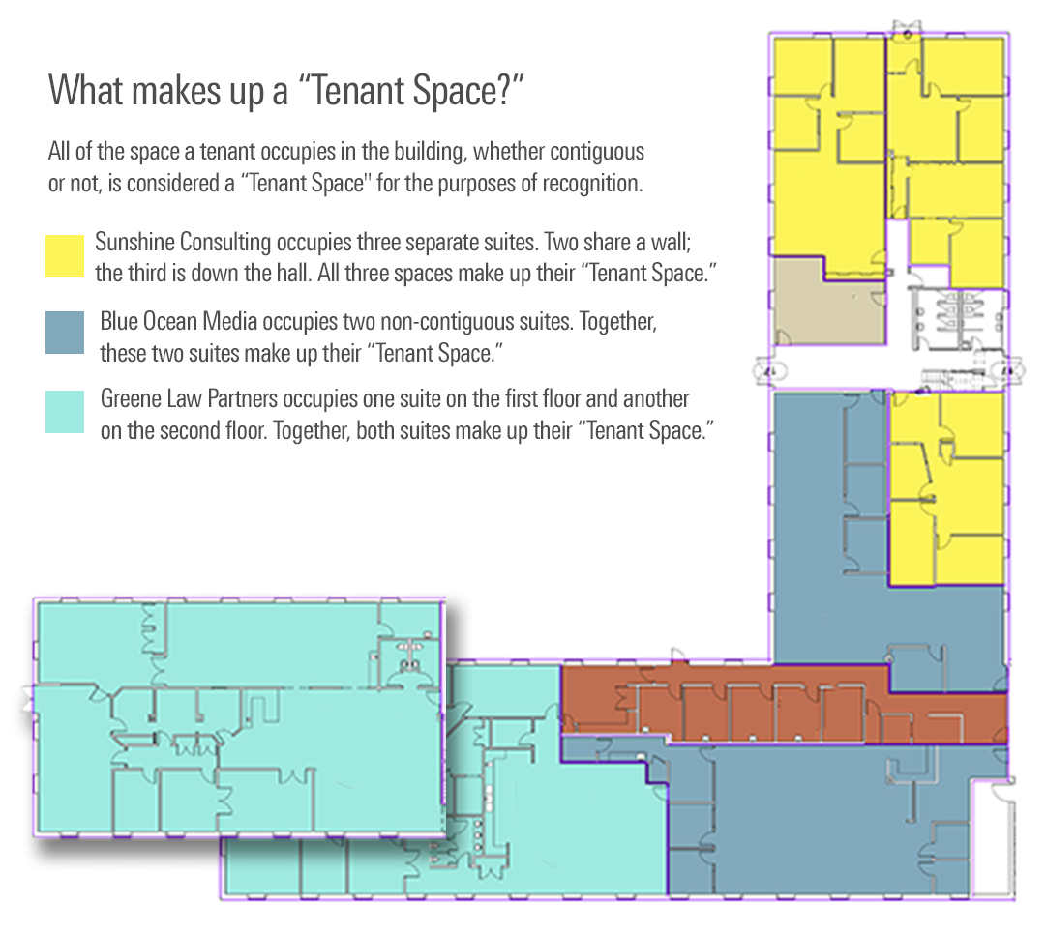
All Usable Square Footage Leased by Tenant
All of the space a tenant occupies in the building, whether contiguous or not, is considered a “Tenant Space” for the purposes of recognition
Notes:
Now let’s talk about the second requirement, that the space represent 100% of the tenant’s usable square footage in the building. A Tenant Space, for purposes of ENERGY STAR recognition, should include all of the Office space that a single tenant occupies within a building, whether that space is contiguous or not. This might just be a single suite or floor, or it might be multiple suites or floors. As the Licensed Professional, you’ll need to verify that this is the case.
The examples shown in this graphic illustrate a few different situations – Sunshine Consulting, in yellow, occupies three separate suites, all of which should be included in their Tenant Space. The same is true of Blue Ocean Media, in the darker blue – their two suites are non-contiguous, but both should be included in their Tenant Space. For the law office shown in turquoise, they occupy suites on two separate floors – again, even if those floors are non-contiguous, all of the space that they occupy in the building should be included in their Tenant Space.

Slide 13
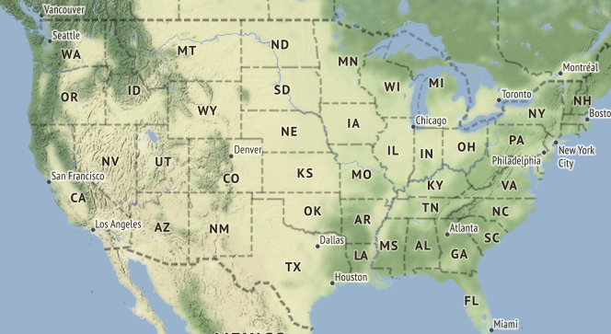
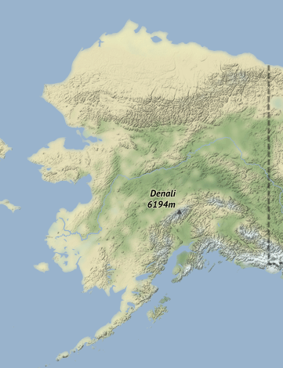
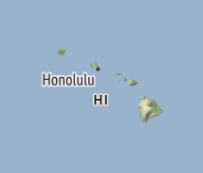
Located in United States
Notes:
Finally, the space needs to be located within the United States. This should hopefully be pretty easy to verify if you don’t need to cross an international border to perform the site visit. ☺

Slide 14
Verify Metering Compliance
Notes:
Now let’s move on to section 2 of the application, verifying metering compliance.​

Slide 15
Verify Metering Compliance
Notes:
Shown here is the Metering Compliance section of the application. Both the Tenant and the LP will need to verify two things: First, that meters are in place to measure and track all energy loads for which the tenant has full operational control, on at least a monthly basis. Typically this will include at least lighting and all plug loads. If all building HVAC comes from central systems controlled by the landlord, then the tenant doesn’t need to meter those, since they won’t have full operational control of those, but if there are any supplemental HVAC systems that serve exclusively the single tenant’s space, then those will need to be metered as well, for electricity as well as any other fuel types over which the tenant has control.
Note that these meters need to be permanently installed – data loggers or other temporary equipment does not meet this requirement.
Second, you’ll need to verify that the meters have been rated with an accuracy of plus-or-minus 2% by the manufacturer. This rating can be provided either by published specifications on the meter, or by a letter of attestation from the manufacturer.

Slide 16
Review Tenant Space Information
Notes:
After confirming that metering is in place, you’ll need to review the details of the tenant space itself. This will also include some verification of base building information.​

Slide 17
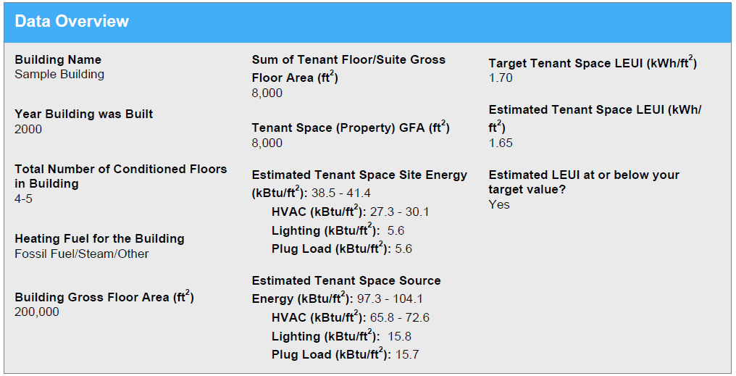
Building, Space, and Envelope Information
Notes:
The Data Overview, shown here, includes some information that’s input by the Tenant in Portfolio Manager, and some information that Portfolio Manager calculates based on those inputs. The items that you’re responsible for verifying in this section include the building name, year it was built, total number of conditioned floors, heating fuel for the building, and the total building gross floor area, all shown in the left column. You can verify the base building information using construction or stacking plans, tax records, utility bills, or physical inspection of the building. For the total building gross floor area, this is the total property square footage, as measured between the exterior walls of the building, and including all finished areas inside the building including supporting areas. For purposes of the Tenant Space application, it is okay if this value is approximated.
For the tenant space itself, you’ll also need to verify the total tenant space gross floor area, shown at the top of the 2nd column here – that sum of all floor and suite gross floor areas will need to match up with the property GFA listed just below it in order for the tenant to be able to begin the application process. You’ll verify the area floor-by-floor or suite-by-suite later on. Unlike the GFA for the base building, the GFA for the tenant space itself needs to be precise.
The rest of the values in this section are calculated by Portfolio Manager based on the remaining inputs, including the estimated tenant space site and source energy, breakdowns of those estimates by end use, and estimated lighting EUI. Since the application doesn’t require actual meter data, you’re not responsible for verifying that those values are accurate, since they’re just estimates generated by Portfolio Manager – but, you should review the values and use your experience as a PE or RA to ensure that they’re reasonable – if they’re not, that may be an indication that one of the other inputs that we’re about to go over may not be correct.

Slide 18
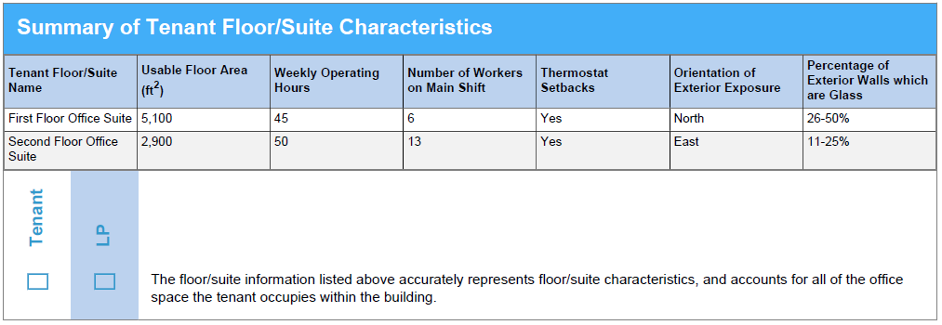
Tenant Floor/Suite Characteristics
Notes:
The next section asks you to verify some basic characteristics of the tenant floor or suite – these characteristics are used for the estimated tenant space energy use calculations shown on the previous slide.
In the example shown here, we have two suites that comprise the tenant space – first floor office suite and second floor office suite. As the LP, you’ll need to verify that the usable floor area for each of these suites is accurate. The usable area is the total square footage of all areas within the demising walls reserved for the exclusive use of the tenant. The total usable area of all floors or suites included in the application must represent all office space leased by the tenant in the building, as discussed earlier in the session. For tenant suites encompassing an entire floor, the useable floor area should include the building’s core and common areas located on that floor, such as hallways and restrooms.
You’ll also need to confirm with the tenant the number of weekly operating hours – this is the number of hours when the majority of workers are present in the space, so be sure to verify with the tenant that this isn’t another number like the HVAC runtime hours. You should also verify the number of workers on the main shift for each floor or suite. If there are multiple shifts of workers, such as for a call center or other 24/7 operation, only the number of workers on the primary or largest shift should be counted – that is, the number of workers that are in the space at one time. So if there are three shifts of 60 workers each, this value should be 60, not 180.
As the LP, you’ll also need to verify that thermostat setback conditions are correct as reported for nights and weekends, as well as the orientation of exterior exposure for each floor or suite. The examples shown here only have one orientation each, but that’s not always going to be the case – for example, if a tenant leases an entire floor, then that floor should be listed with North, South, East, and West exterior exposure.
Finally, you’ll need to verify that the glazing percentage for the suite’s exterior walls is accurate.

Slide 19
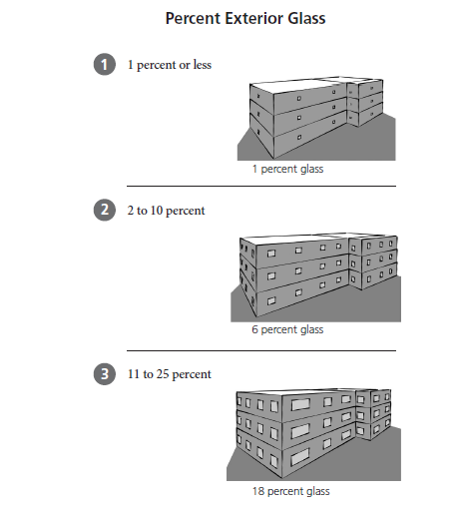
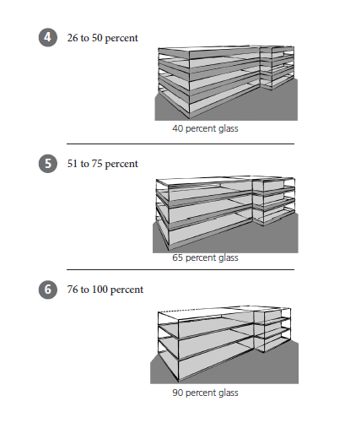
Percentage of Exterior Walls which are Glass
Notes:
For the percentage of exterior walls which are glass value, here’s a quick guide. You won’t need to determine the exact percentage, but you’ll need to estimate that percentage to fit into one of the six buckets shown here. And remember that this applies to the exterior walls only.

Slide 20
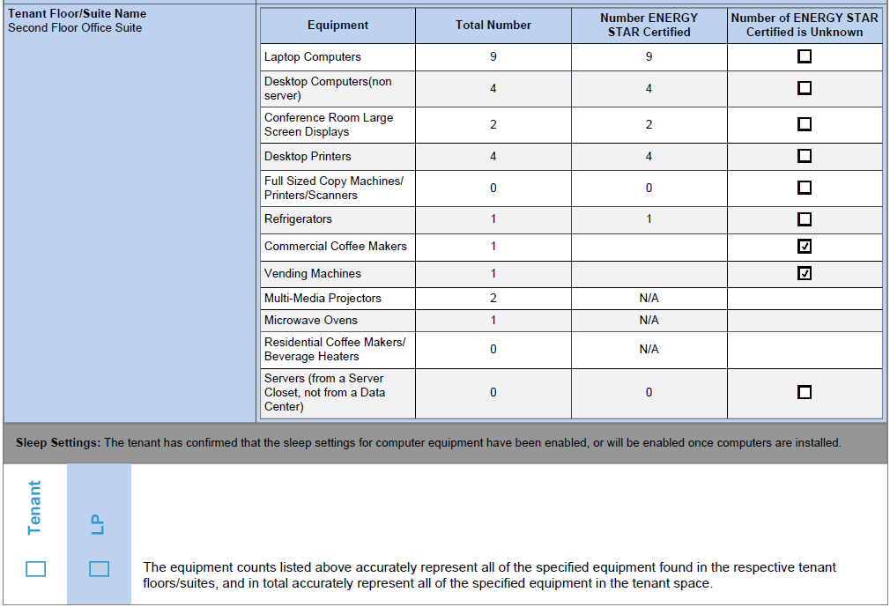
Tenant Equipment Information
Notes:
After verifying the basic tenant space and building characteristics, you’ll be getting into more granular details about the equipment in the tenant space. Each floor or suite will have a detailed equipment inventory like the one shown here, which includes a breakdown of laptops, desktops, servers, printers, conference room equipment, and basic kitchen equipment. There will be a table like this on the application for each floor or suite included in the Tenant Space.
For most of those types of equipment, you should also verify how many of each of those are ENERGY STAR certified, if you have that information. You can usually find that information on the product label, or else on the ENERGY STAR website. If you don’t know how many are ENERGY STAR certified, the tenant can check the box to indicate that. The bottom line is that your responsibility as the LP is to make sure that all of the reported values are accurate, so be sure to do a thorough walk-through of the space. If the tenant space is not occupied at the time of the site visit, the LP may use available tenant IT equipment inventories, fit-out documents, specifications, or invoices to verify equipment information.
The other important thing to point out here is the Sleep Settings line in grey below the table – having sleep settings enabled for computer equipment is a requirement for Tenant Space recognition, so be sure to confirm with the tenant that those have been enabled. You don’t necessarily need to have them open up their computer settings and show you, but you should make sure that they’ve confirmed those settings on their end.

Slide 21
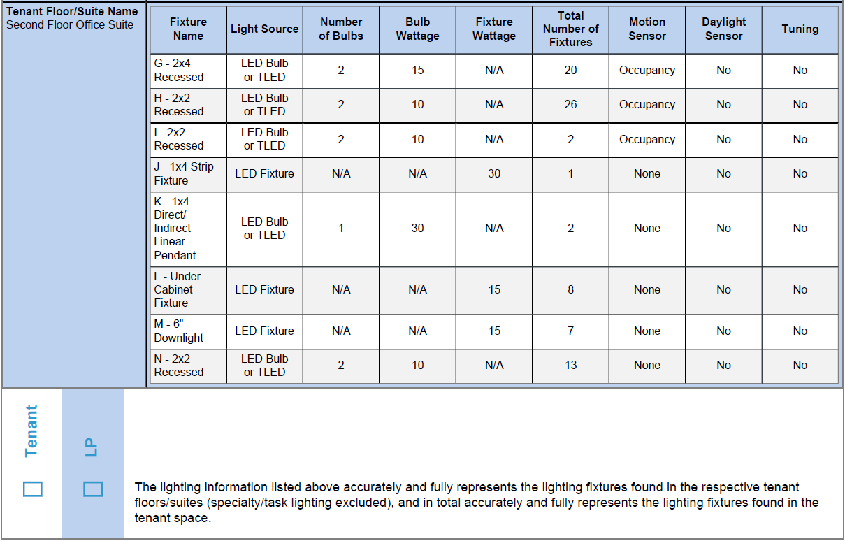
Tenant Lighting Information
Notes:
After verifying the equipment counts and settings are accurate, the last piece of technical information you’ll need to verify is the lighting. Just like with equipment, each floor or suite in the tenant space will have a lighting table like the one shown here. It’s extremely important to make sure that this information is accurate, because the information entered for lighting is what goes into Portfolio Manager’s calculation of the estimated Lighting Energy Use Intensity, or LEUI, and having an estimated LEUI that’s below the target value is one of the requirements for recognition. So be sure to review the lighting inventory for each floor or suite very carefully.
For each lighting fixture in the suite (except for exit lighting, which can be excluded), you’ll need to verify the source, number of bulbs or fixtures, wattage of each bulb or fixture, whether motion sensors are enabled, and whether each fixture has a daylight sensor and tuning system present. This is where your specialized experience as a professional engineer or registered architect will be really valuable, since a lot of this information isn’t easily discernible to the average office manager or tenant unless they were directly involved in the purchase or installation of the lighting.
It may be helpful to review recent purchase invoices, as-built tenant fit-out drawings, retrofit documents, contracts that detail lighting installation measures, and/or LEED documentation (if applicable) to support observations made during the site visit and walkthrough of the tenant space. For offices with the similar lighting specifications throughout, the LP may use a combination of these resources and sampling to verify lighting information.

Slide 22
Equipment Procurement Policy
Notes:
It’s worth noting at this point that before submitting the final application to EPA, the applicant will need to upload a written procurement policy that includes language specifying that the tenant space will procure ENERGY STAR certified equipment when available and whenever possible. The LP does not need to review the procurement policy, but you should ask the applicant to confirm that the policy is in effect and that they’re aware it will need to be uploaded with the application.

Slide 23
Summary
As LP, you will need to perform or supervise a site visit at the Tenant Space and verify:
Basic eligibility criteria
Office/Financial Office, all usable space in building leased by single tenant, located in US
Metering compliance
Meters rated accurate within +/-2%, in place for all loads over which tenant has full operational control
Building and Tenant Space information
Basic building information and GFA
Floor/suite usable area, workers, hours, orientation of exposure, glazing %
Equipment inventory, including computer sleep settings and presence of efficient equipment procurement policy
Lighting inventory
Notes:
And that covers everything you’ll need to verify during your site visit and discussions with the tenant. To quickly review, you’ll be verifying basic eligibility criteria for the tenant space to earn recognition, including verifying that the space consists of all the usable office space leased by that single tenant within the building. You’ll need to verify that meters are in place to measure all loads controlled by the tenant, rated accurate to within 2%. You’ll need to verify some basic information about the base building and the tenant space itself, things like area, number of floors, heating fuel, workers, hours, and envelope information, along with full equipment and lighting inventories.
Note that if you find any of this information to be incorrect on the application, you should inform the tenant and work with them to make updates to their tenant space property within Portfolio Manager. Once they’ve made the necessary corrections within the module, they will be able to generate a new application, which you should then re-verify to make sure all changes were made correctly.

Slide 24
Verify, Sign, & Stamp the Application
Notes:
Once all of that information has been confirmed to be accurate and no further changes are needed, you can move on to the final step before the application is submitted.​

Slide 25
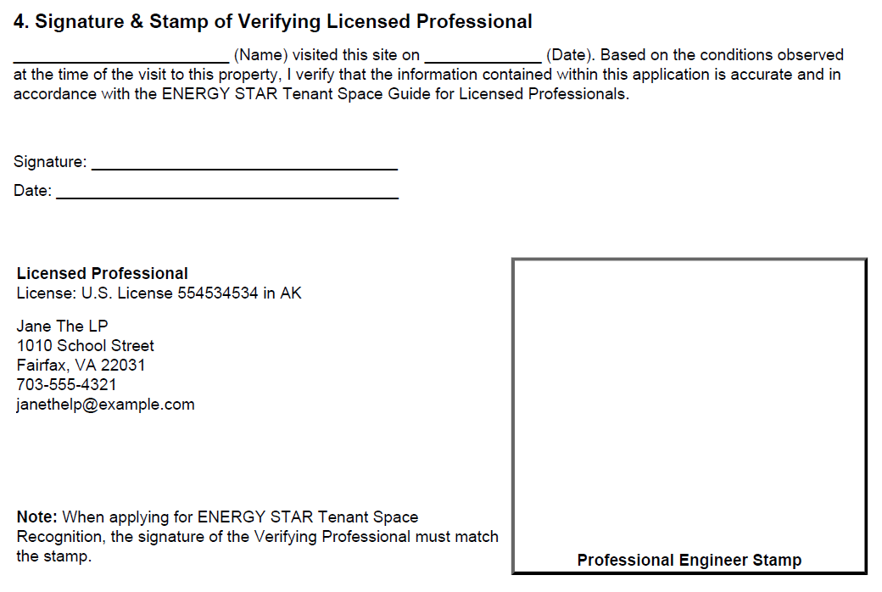
Sign and Stamp the Application
Notes:
In this section, you’ll indicate the name of the person who performed the site visit, as well as the date it was performed. Remember that this must happen within the 6 months prior to the application’s submission date, so if you perform your site visit on January 15, you need to make sure to submit the application no later than June 15. In many cases, you’ll be performing the site visit yourself, as the LP, but it is also fine for you to deputize someone else that you trust to perform the site visit in your place, as long as they’re operating under your control and supervision. This may be even more prevalent now due to COVID, but we’d encourage you to make use of things like video calling so that you can still see as much of the space and the building as possible.
Finally, you’ll sign and date the application and apply your professional stamp or seal. If you don’t have a government-issued PE or RA stamp or seal that’s fine, just be sure that your license number and state are listed accurately so that our review team can verify your active licensure online with the appropriate licensing board.
Once the application has been submitted, if there are any questions about the application from the review team, the LP will usually be cc’ed on the email to the primary contact for the application. The tenant may need to consult with you to answer the review team’s questions or resolve issues, so be sure to pay close attention to your email and look for messages from the ENERGY STAR Tenant Space recognition team.

Slide 26
View Tenant Spaces that have Earned Recognition
Tenant spaces that earn recognition will be listed on the Tenant space webpage:
https://www.energystar.gov/tenantrecognition

Slide 27
Polling Questions
A tenant space is required to meet which qualifications in order to apply for ENERGY STAR Tenant Space recognition? (select all that apply)
Which of the following checks is the LP responsible for when verifying the accuracy of applications for Tenant Space recognition? (select all that apply)
Which of the below is NOT required for ENERGY STAR Tenant Space recognition? (select all that apply)
Notes:
Now we’ll open up a poll to test your knowledge. You can find the questions in the polls tab on the right side of the screen. This will be open for about 30 seconds.

Slide 28
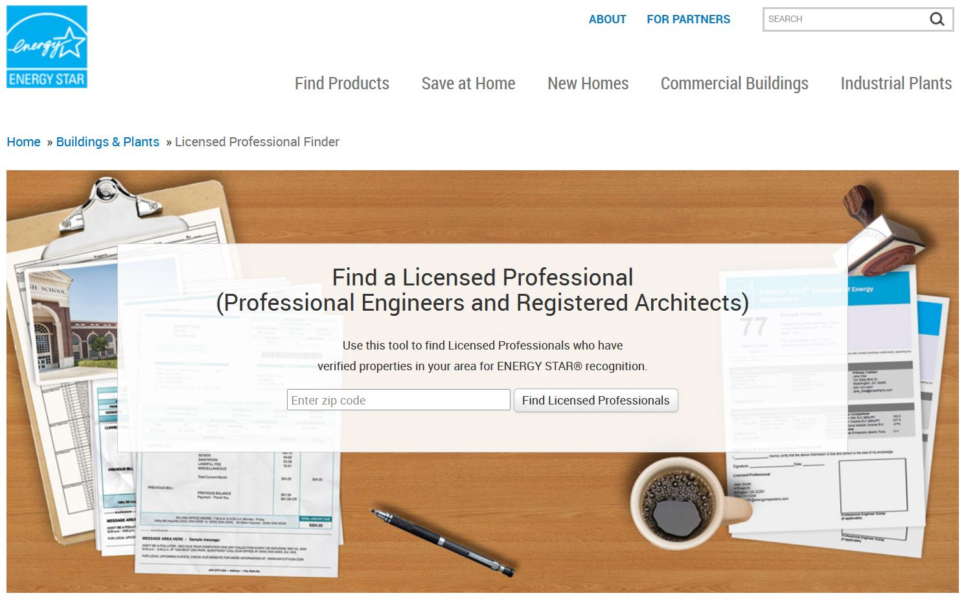
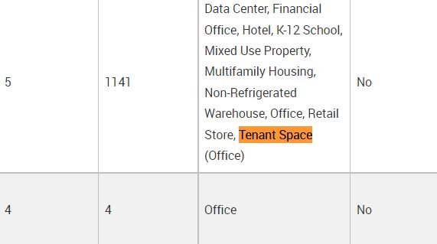
Featured in LP Finder!

Slide 29
Additional webinars and resources
How to Apply for ENERGY STAR Tenant Space Recognition – available at https://www.energystar.gov/buildings/tools-and-resources/presentation_how_apply_energy_star_tenant_space_recognition
Guidance on how to apply, LP verification, and more available at
www.energystar.gov/tenantrecognition

Slide 30
Questions?
Go to
www.energystar.gov/tenantrecognition
or email
TenantRecognition@energystar.gov
for more information

