Slide 1
Portfolio Manager 301: Spreadsheet Uploads, Setting Goals, and Creating Custom Reporting Templates
Notes:
Hello everyone and welcome to today’s ENERGY STAR webinar, “Portfolio Manager 301,” which is the last of three, hour-long presentations to familiarize you with Portfolio Manager. Thank you for joining us.

Slide 2
Learning Objectives
In this session, you will learn about EPA’s ENERGY STAR® Portfolio Manager® tool and how to:
Update data using the spreadsheet upload feature
Set baseline, goals, and targets to plan energy improvements
Create custom reporting templates
Use the Sustainable Buildings Checklist
Notes:
We’ll jump right into our learning objectives, under the assumption that you’re already familiar with Portfolio Manager basics. If you’re not, you may be interested in PM 101 to learn how to set up properties and PM 201 to learn how to maintain accurate property details and share records.
During PM 301 we delve into more detail about these learning objectives:
Using spreadsheet upload templates to update property data;
Setting goals and targets to plan energy improvements for properties;
Creating custom reports; and,
Using the Sustainable Buildings Checklist.

Slide 3
How To
Update data using the spreadsheet upload feature
Set baseline, goals, and targets to plan energy improvements
Create custom reporting templates
Use the Sustainable Buildings Checklist
Notes:
Let’s start with today’s first objective: using spreadsheet uploads to enter or update data in Portfolio Manager.

Slide 4
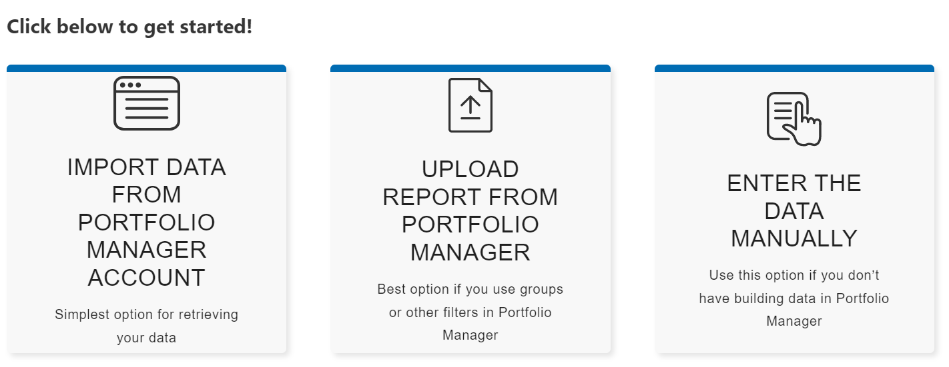
Click here to be taken to the
Buildings Emissions Calculator
Past, Current, and Future GHG Calculations
Estimate your building’s GHG emissions
Support GHG emissions inventories
Notes:
Estimates Past, Current and Future Emissions
The Building Emissions Calculator can estimate historical, current and future annual greenhouse gas emissions resulting from your building’s energy use. It can be utilized to baseline annual emissions, track changes over time, and evaluate the impacts of anticipated changes in energy use, fuel mix, green power, and emissions factors.
Leverages Your Portfolio Manager Data
If you already use ENERGY STAR Portfolio Manager to measure and track your building’s energy use, you can seamlessly pull your data into the Building Emissions Calculator. All you need is your Portfolio Manager username and password.
Allows Entry of Multiple Emissions Factors
Calculate your GHG emissions in several ways, using national, regional, supplier-provider, or locality-specified factors, such as those required under New York City’s building performance standard. You can also create scenarios using any emissions factors you choose.
Complies with GHG Accounting Protocols
Create, view and download emissions estimates consistent with the industry standard GHG Accounting and Report Standards(link is external), including both location-based and market-based inventories.
Supports a Single Building or Entire Portfolios
Estimate emissions for a single building, a set of buildings, or your entire portfolio of buildings.

Slide 5
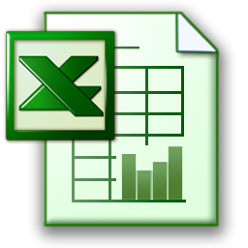
Update data using the spreadsheet upload feature
Action
Process
1
Create property records
(add new records to account)
a) Download spreadsheet
b) Fill in data
c) Upload to PM
2
Create meters
a) Select properties to update
b) Download custom spreadsheet
Fill in data
Upload to PM
3
Add consumption to meters
4
Edit basic property information
5
Update property use details
Notes:
Using a spreadsheet to upload data can be a time saving way to enter information for one or more properties.
With spreadsheets you can perform five tasks: 1) Create new property records and then for any property record created in PM you can 2) Create meters; 3) Add bills to meters; 4) Edit basic property information; and, 5) Update property use details.
The process is very straight forward. You simply download the spreadsheet in PM. Then fill in the data and upload the spreadsheet into PM

Slide 6
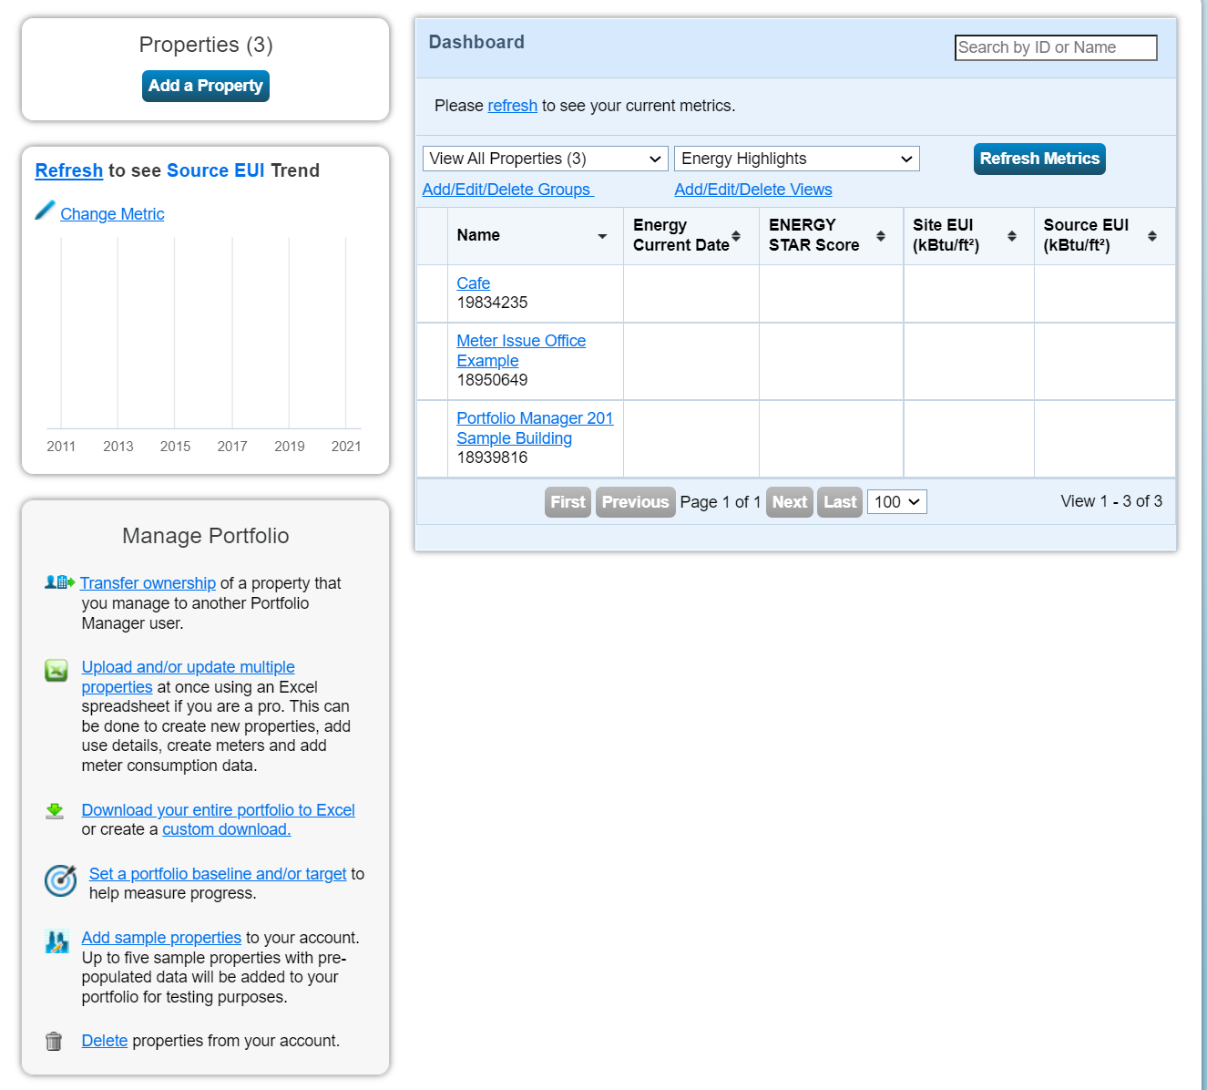
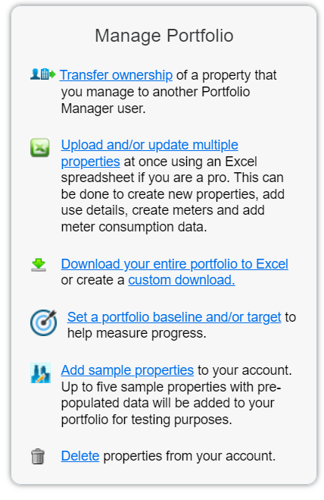
Update data using the spreadsheet upload feature
Scroll to Manage Portfolio menu
Notes:
Start Demo
Before we get started with our demo, if anyone would like to follow along with your own account please feel free to open that up!
To use a spreadsheet to enter or update information in Portfolio Manager, select “Upload and/or update multiple properties at once” from the Manage Portfolio menu on the bottom left of the My Portfolio Page.

Slide 7
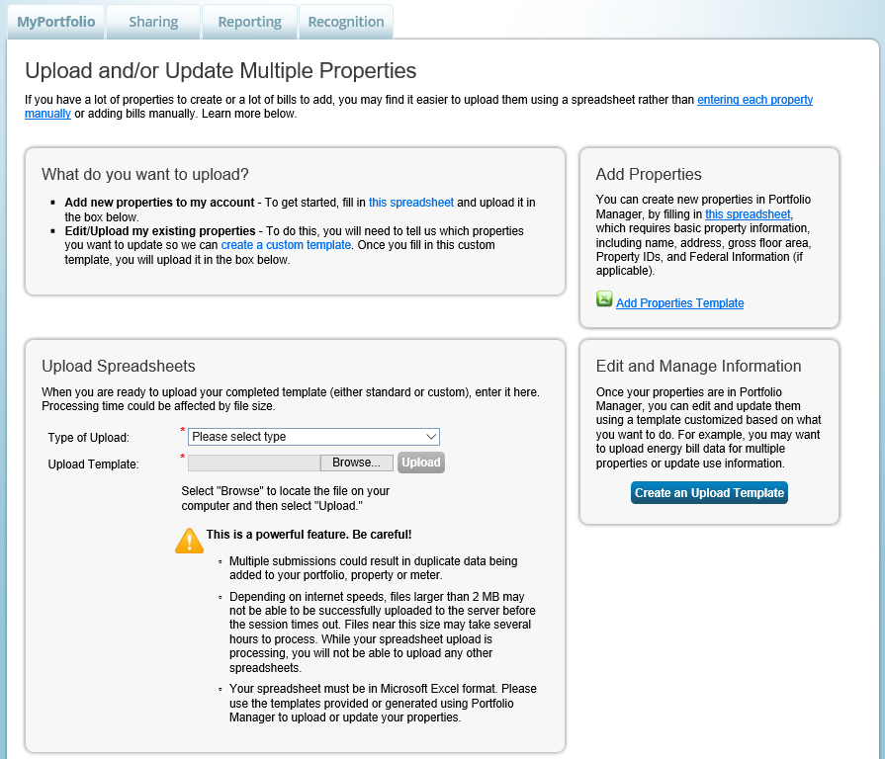
Spreadsheet Upload Overview
Notes:
From this page, choose the link “Add Properties Template” to add new properties to your account. Or, for existing records, select “Create an Upload Template” to take additional actions.
Let’s start with selecting “Add Properties Template”

Slide 8
Read the Instructions tab.
At a minimum, complete the green required fields on the Properties tab.
Don’t make any format changes to the spreadsheet.
Notes:
Make sure you enable editing when you open the document, and the en in the title is just for English
Portfolio Manager generates this spreadsheet after selecting the link.
It’s very important make sure to read the Instructions tab. If you do something that is not in the instructions tab, the upload won’t work
The green fields on the Properties tab are required. The rest of the tabs are optional, or conditionally optional based on your selections. If you are filling out any other tabs, make sure to copy the Property Names exactly as you have them entered on the Properties tab. There are other tabs, but we’ll stick to the properties tab for today.
When filling in the fields, note that numeric values should not include any formulas or formatting.
Do not make any changes to the format of the spreadsheet to avoid upload problems.

Slide 9
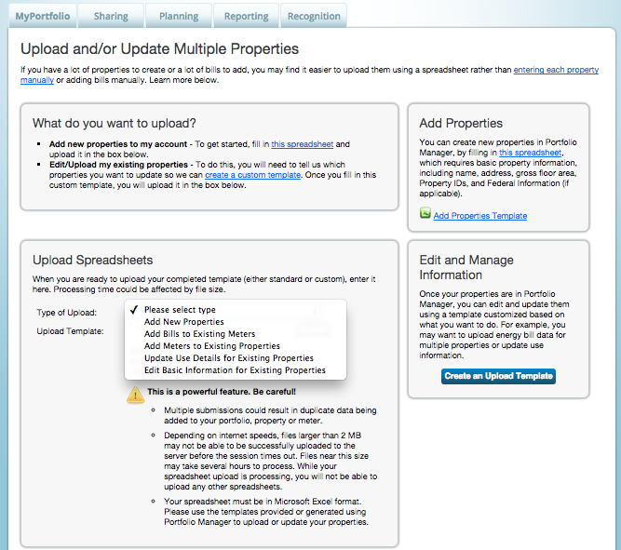
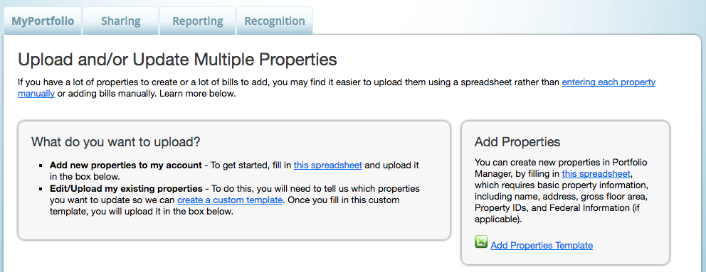
Add New Properties: Upload Completed Spreadsheet
Upload filled out templates:
Select
Template
Upload
9
Notes:
Once you have completed your template, save it to your computer.
In the “Upload Spreadsheets” section, select the type of template that you are uploading (in this case, it would be “Add New Properties).
Click “Choose File” to find the file location on your computer and then click Upload.

Slide 10
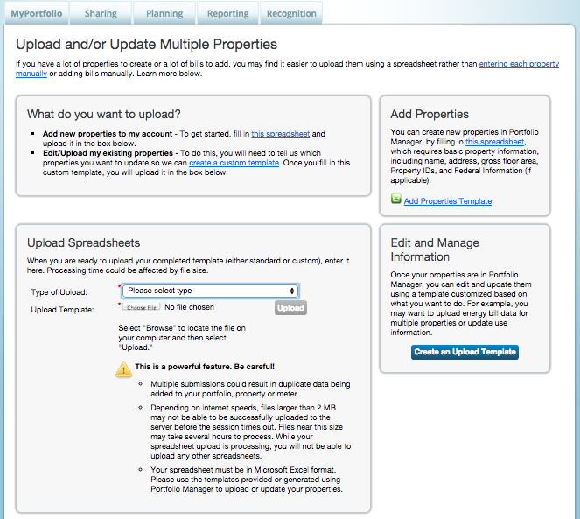
Add Meters/Add Bill Data/Edit Basic Property Info
10
Notes:
Once a record is created in Portfolio Manager, select “Create an Upload Template” to perform additional tasks.

Slide 11
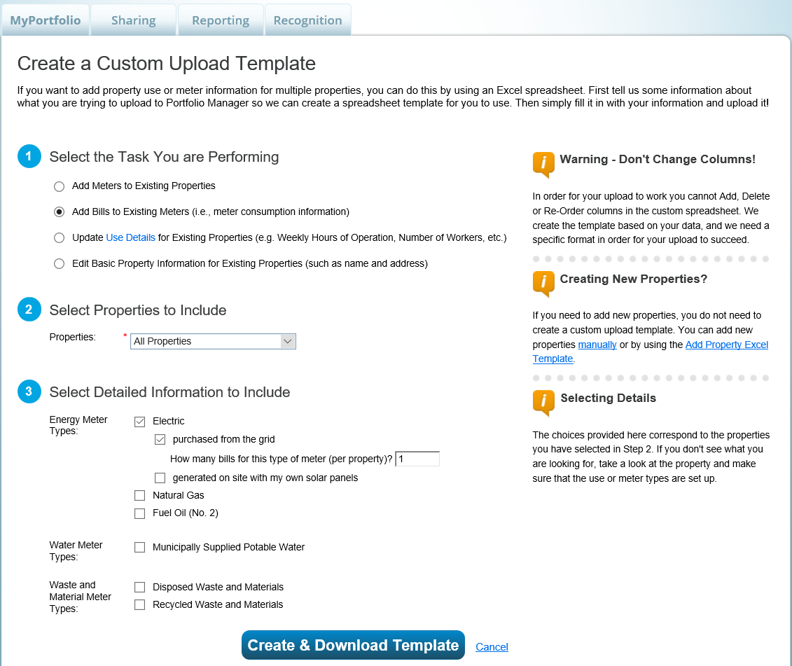
Add Bills to Existing Meters: Create Custom Upload Template
Notes:
On this screen, select a task to perform. Then select the properties for which you would like to perform the task. Next, if prompted, select additional detailed information to include. Finally, select Create and Download Template.
The example on this slide is the task “Add Bills to Existing Meters”.

Slide 12
Read the Instructions tab.
At a minimum, complete the green required fields.
Don’t make any format changes to the spreadsheet.
Notes:
The template for this task will be customized based on the properties, types of meters, and number of new meter entries you select.
Be sure to click enable editing
Just like any spreadsheet, read the instructions, complete the green required fields and do not change any formatting.
It is Simpler than the other one, it only has two tabs
It includes the most recent bill that has been entered for each meter, so you know you’re starting your update on the right date.
Just like any spreadsheet, read the instructions, complete the green required fields and do not change any formatting.

Slide 13
Status of upload appears here
Select the upload type then “Upload”
Notes:
Once you have entered information in your spreadsheet and saved it, upload it into your account using the “Upload Spreadsheets” drop down menu to select the upload type. Then, browse for the file on your computer and select it. Then, select “Upload”.
The table called “My Spreadsheet Uploads” displays a history of attempted uploads. A status column will show if the upload was a success or if it failed. If it failed, a link will appear to View Errors.
This is a powerful feature. Be careful!
Multiple submissions could result in duplicate data being added to your portfolio, property or meter.
Depending on internet speeds, files larger than 2 MB may not be able to be successfully uploaded to the server before the session times out. Files near this size may take several hours to process. While your spreadsheet upload
is processing, you will not be able to upload any other spreadsheets.
Your spreadsheet must be in Microsoft Excel format. Please use the templates provided or generated using Portfolio Manager to upload or update your properties.

Slide 14
Add Bills to Existing Meters: Upload Spreadsheet
Upload filled out templates:
Select Template
Upload
14
Notes:
That completes our first objective. Our second objective is learning how to set baselines, goals and targets to plan energy improvements.

Slide 15
Pop Quiz!
When using the spreadsheet upload feature, you should do which of the following?
Use the template provided in Portfolio Manager without making any changes to the format of the spreadsheet
Use your own template
Only fill out some of the required fields
Use formulas for numeric values
Notes:
Pop Quiz on Slide 15

Slide 16
Pop Quiz!
When using the spreadsheet upload feature, you should do which of the following?
Use the template provided in Portfolio Manager without making any changes to the format of the spreadsheet
Use your own template
Only fill out some of the required fields
Use formulas for numeric values
Using a different template, only filling out some required fields, or changing formatting or formulas can prevent your upload from being successful.
Notes:
Pop Quiz on Slide 15

Slide 17
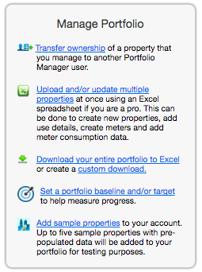
Set a Portfolio Baseline and/or Target
Notes:
In Portfolio Manager you can establish one baseline and target for all properties, or set different baselines and targets for each property. We will go over both today, but we’ll start by setting the same baseline and target for all properties. To do this, select “Set a portfolio baseline and/or target” from the Manage Portfolio menu on the bottom left of the MyPortfolio page.

Slide 18
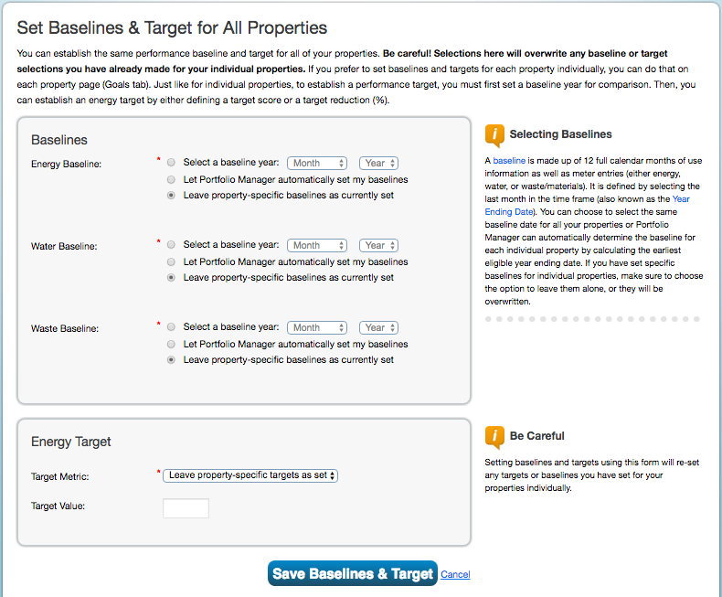
Set One Baseline and Target for All Properties
18
Notes:
From here you can set energy, water, and waste baselines for your entire portfolio. A baseline is made up of 12 full calendar months of data.
To select a baseline, enter the last month in the 12 mos. time frame, also known as the Year Ending Date.
Or, select that you would like Portfolio Manager to automatically set the baseline, which will be the earliest eligible year ending date, or in other words, the first 12 mos. for which you have complete consumption data and use details.
The third option is to leave property specific baselines as currently set. In other words, you may decide that you don’t want to set the same baseline across properties.
From this page you can also set a target for energy use for all properties, either a target ENERGY STAR Score, a % better than median, or % better than baseline.
When finished select “Save Baseline & Target”

Slide 19
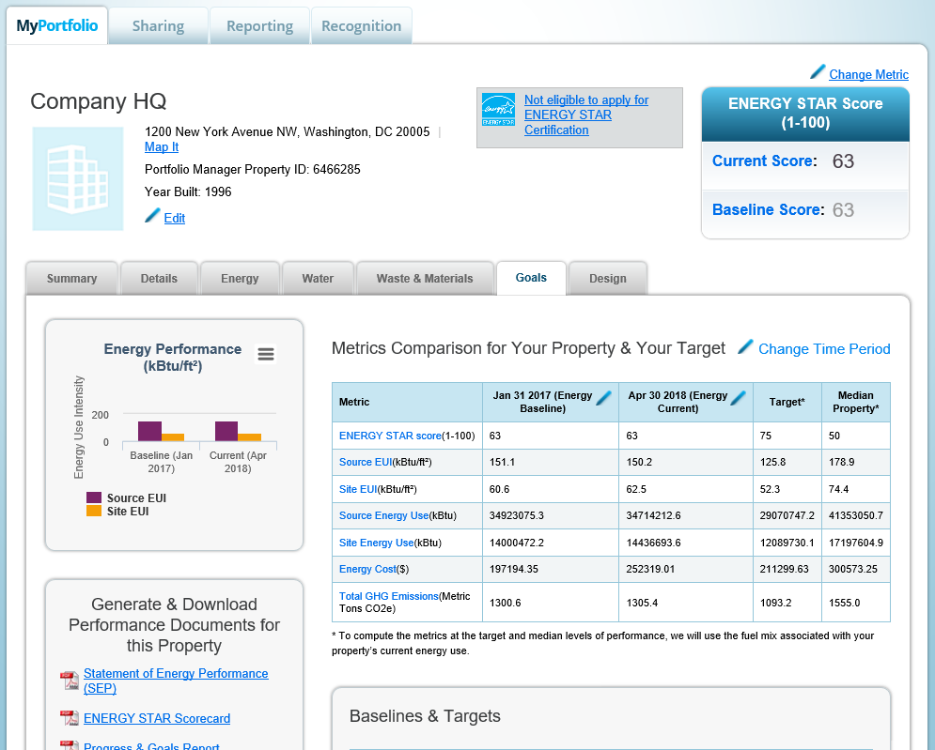
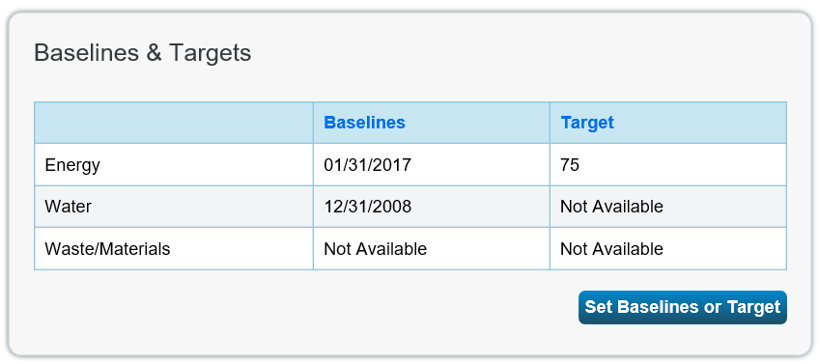
Property Goals Tab: View Specific Property Goals & Improvements
Goals tab at the Property level
Notes:
On the other hand, if you decide not to set the same baselines and targets for all of your properties, you can set individual ones for each property by selecting “Set Baselines or Target” from the Goals tab in any property record.

Slide 20
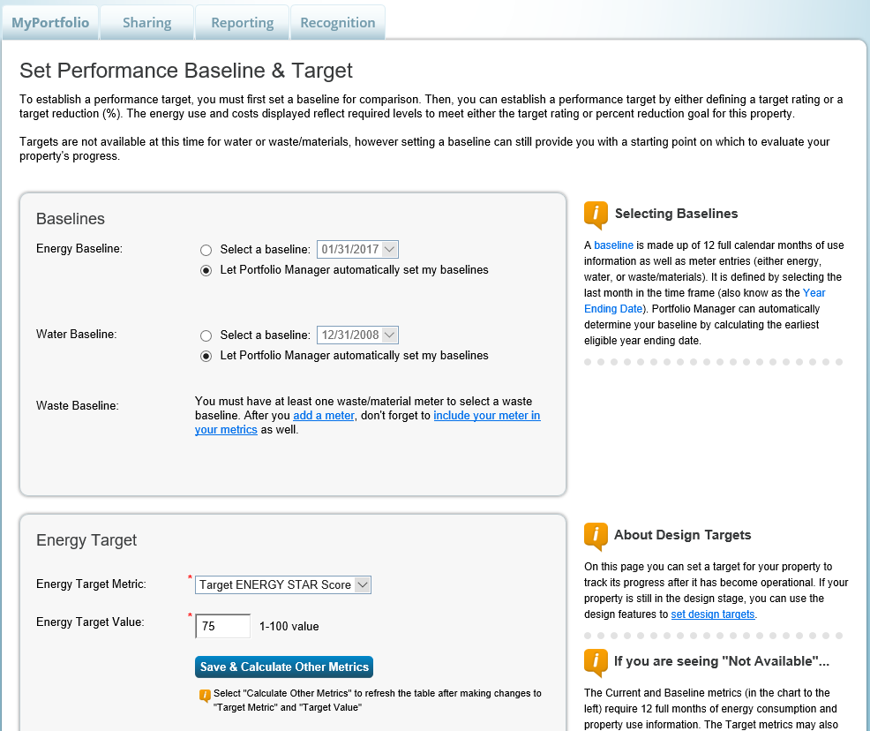
Add/Edit Baselines or Targets
Choose baselines or let Portfolio Manager select automatically
Target Options
Target ENERGY STAR Score
Target % Better than Baseline Source EUI
Target % Better than Median Source EUI
Notes:
On this page, if you want to set the baseline as a specific time (e.g. the date before upgrades were installed or the date a property became fully occupied), choose the “Select a baseline” option. The year starts on the first day of one month, and ends 12 months later on the last day of the last month (ex: 6/1/2015 – 5/31/2016). For example, if the Year Ending Date is 12/31/2016, that’s looking back 12 mos. to 1/1/2016.
You can also let Portfolio Manager decide the baseline. Again, this will be the earliest timeframe for which the property has 12 full months of data for all meters in the building.
A note about new construction, a baseline for new buildings is only available after 12 months of operation and the input of respective energy bills.
You can also choose from among 3 target options to track your properties’ progress towards your energy efficiency goals;
Target ENERGY STAR Score
Target % Better than Baseline
Target % Better than Median

Slide 21
Pop Quiz!
True or False: When setting energy and water baselines, you must select the same date for all properties in your Portfolio Manager account.
True
False

Slide 22
Pop Quiz!
True or False: When setting energy and water baselines, you must select the same date for all properties in your Portfolio Manager account.
True
False
You can choose to set baselines across your entire portfolio, or individually at the property level! At the portfolio level, you can select “Let Portfolio Manager automatically set my baselines” or “Leave property-specific baselines as currently set,” which will apply different baselines according to what is in each property record.

Slide 23
How To
Update data using spreadsheet upload feature
Set baseline, goals, and targets to plan energy improvements
Create custom reporting templates
Use the Sustainable Buildings Checklist
Notes:
That completes are second objective. Next, we’ll talk about using the custom reporting features in Portfolio Manager to analyze the progress and performance of your properties and portfolios.

Slide 24
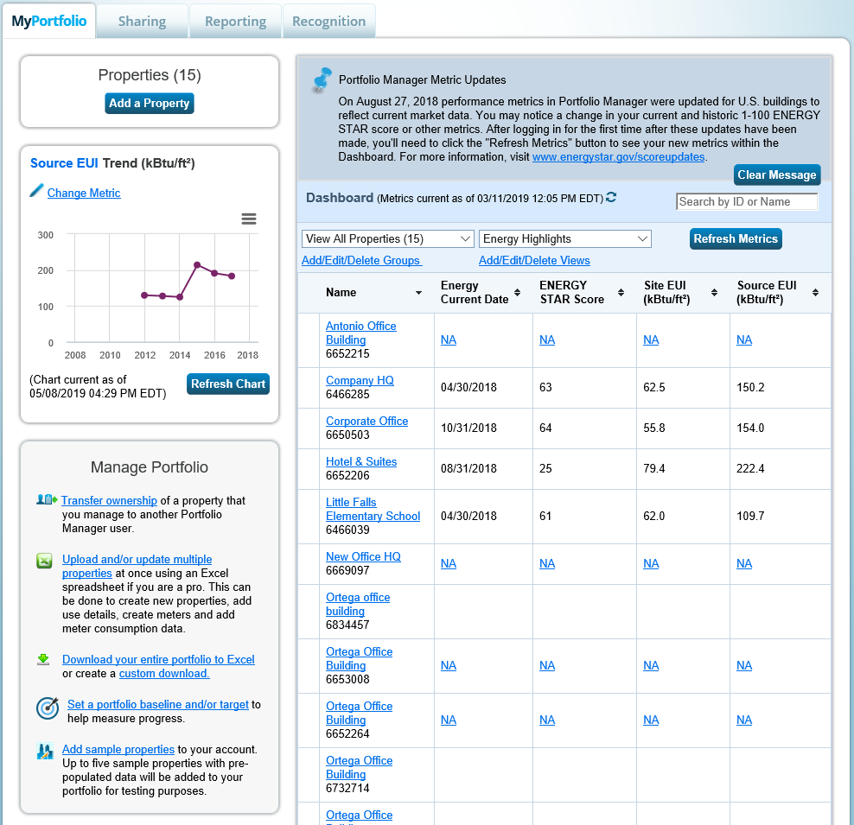
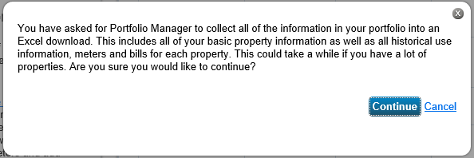
Download Entire Portfolio
Notes:
Before we review the custom reporting feature, we are going to look at a few ways to extract data from the Portfolio Manager Tool. We’ll start with your entire portfolio, and then work our way down in scope to individual meters. So, to extract data about your entire portfolio, you’ll select “Download Entire Portfolio” from the MyPortfolio tab.
The “Download Entire Portfolio” option is intended to help you back up your information.
Note that this report will include all of your basic property information as well as all Property Use Details, historical use information, and all meters and consumption data for each property. This could take a while to generate if you have a lot of properties.

Slide 25
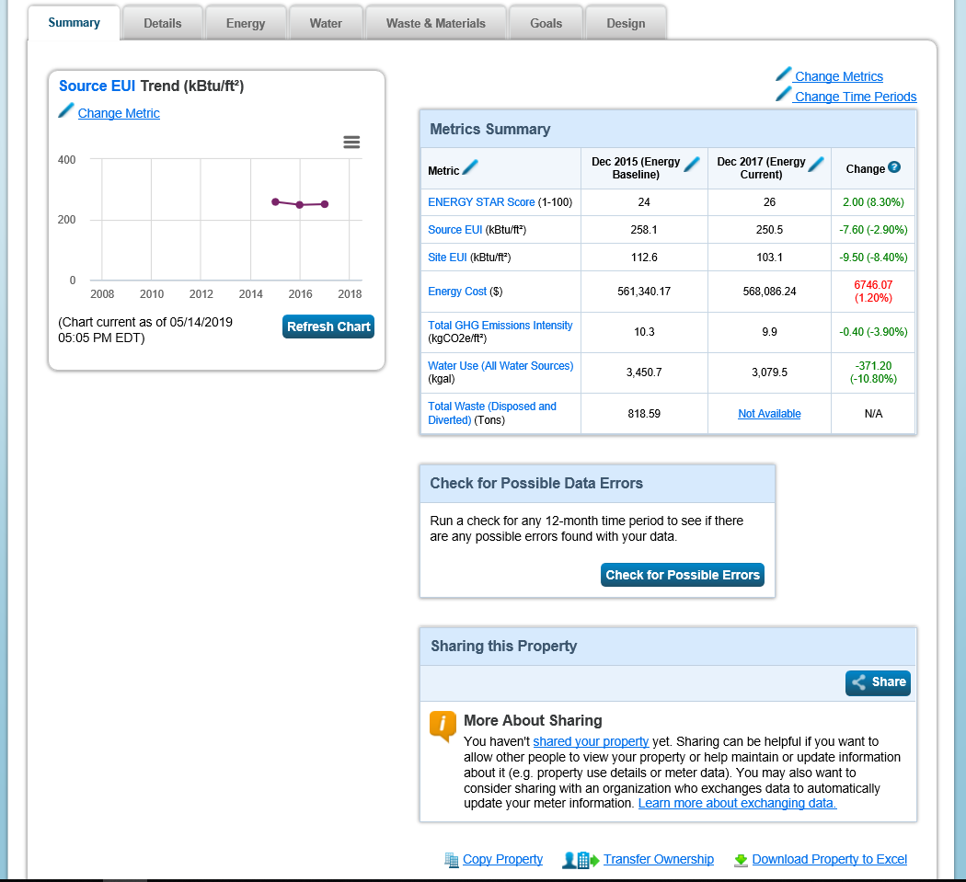
Download Property to Excel
Notes:
If you would rather have information about individual properties, you also download every detail about that property to excel. First, navigate to an individual property record, then scroll to the bottom of the Summary tab and select “Download Property to Excel”.

Slide 26
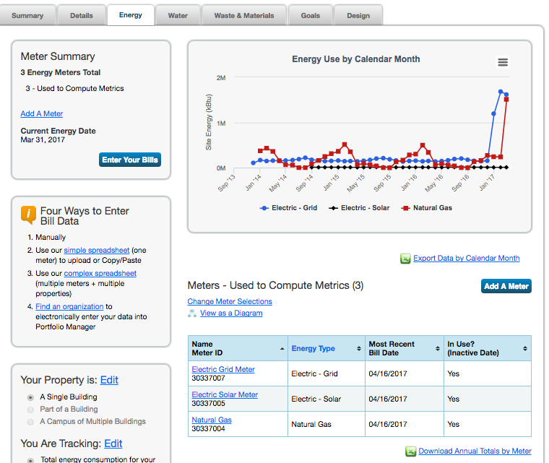
Energy Meter Tab
Notes:
At the smallest scale, you are able to export meter data. In your property record, navigate to the Energy tab. Scroll down to the meters, and you can see that you are able to download meter data to excel by calendar month and annual totals by meter.

Slide 27
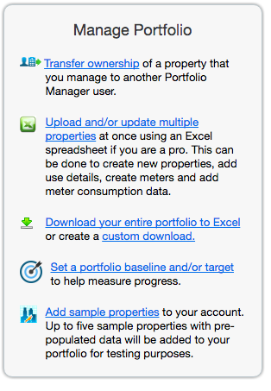
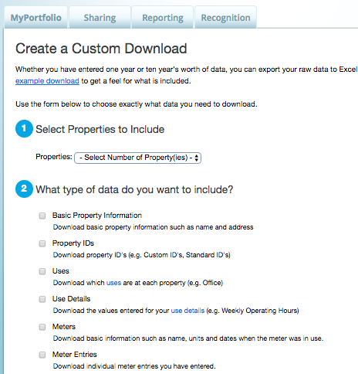
Manage Portfolio
Notes:
It is also possible to run a quick report by selecting “Create Custom Download” from the Manage Portfolio menu at the bottom left of the MyPortfolio page.
From here you can run very quick reports for one or more properties that include one or more of the items listed on this slide. For example, to quickly run a report to check the last meter entry for multiple properties and to see the targets and baseline established for properties, include “Meter Entries” and “Targets and Baselines” in the report.
Then, “Submit” to generate the spreadsheet.

Slide 28
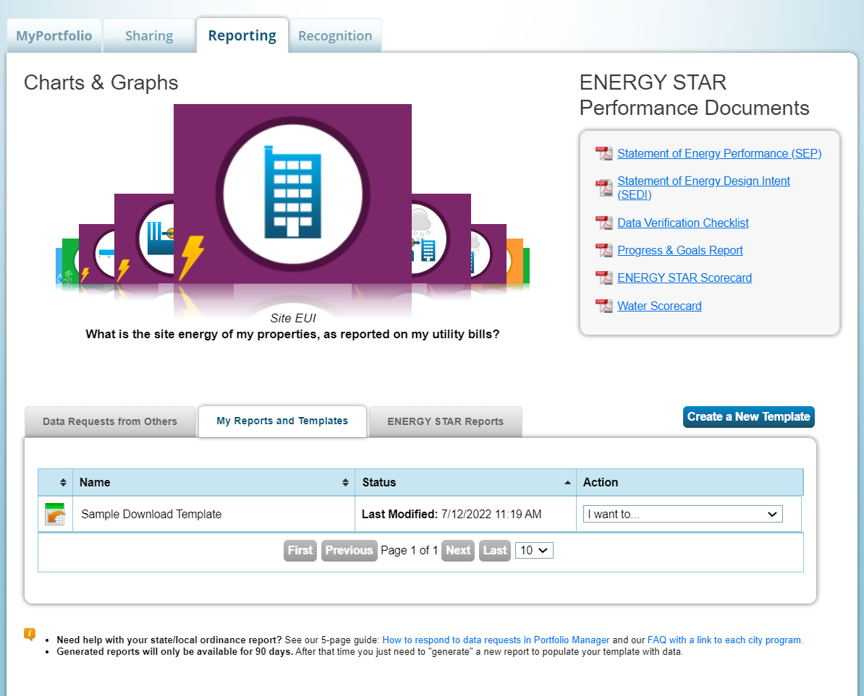
Analyze Progress and Performance on the Reporting Tab
Choose from Pre-set Chart & Graph Options
View and Download Performance Documents
View and Use Custom Report Templates
Generate
Custom Report
Templates
View and Use Standard Reports
Notes:
As you can see from the previous slides, Portfolio Manager makes it very easy to get data out of the tool. Another way to extract valuable metrics is to use the resources on Portfolio Manager’s Reporting tab.
Benchmarking can only drive action if your data can easily be accessed and interpreted. There are four features here on the reporting tab to help see the building performance across different metrics:
Performance Documents
Chart and Graphs
Standard Reports
Custom Report Templates
NOTE: As of January 2020, Portfolio Manager now offers tabbed browsing to separate “standard” (or “pre-loaded”) ENERGY STAR Report templates from those Custom Templates created by the Portfolio Manager user.

Slide 29
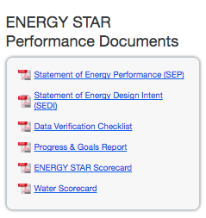
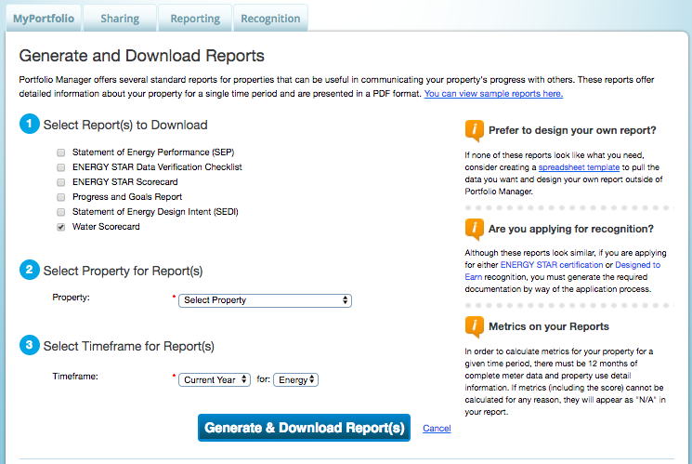
ENERGY STAR Performance Documents
Notes:
Performance Documents reflect details and performance about individual properties you have entered. There are six Performance Documents to choose from:
Statement of Energy Performance
Statement of Energy Design Intent
Data Verification Checklist
Progress and Goals Report
ENERGY STAR Scorecard
Water Scorecard
Click on the one you’d like to generate, then from the page Generate and Download Reports, select a report, a property or properties, and a timeframe.
To save the Performance Document save the .PDF on your computer. Generated Performance Documents are not saved in Portfolio Manager.

Slide 30
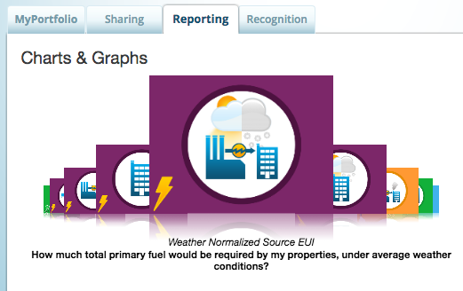
Charts & Graphs
Notes:
There are also nine portfolio-wide charts and graphs that include a pre-defined collection of metrics for at-a-glance results for all of your property records. Generate these charts by selecting the name of the chart or its icon. We talk in more details about these Charts and Graphs in PM 101.

Slide 31
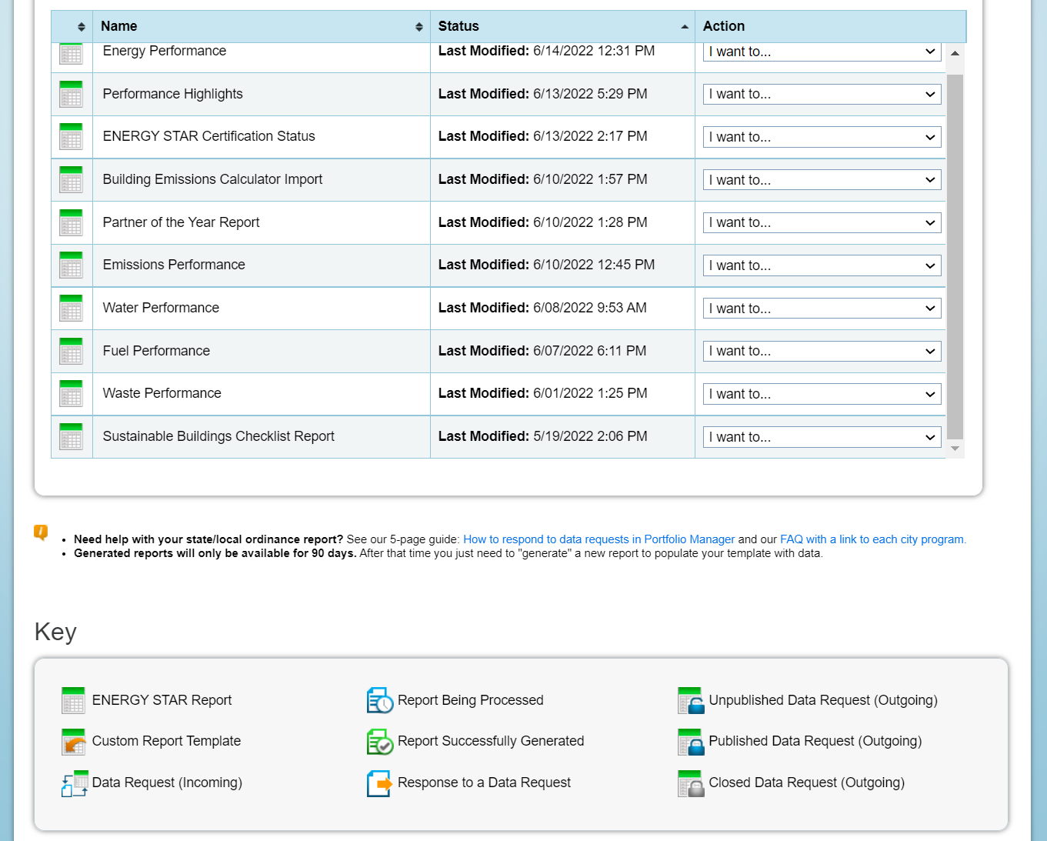
“Standard” ENERGY STAR Reports
Important Information Called Out in Bold
New Key Explains Report Icons
Notes:
Also in Portfolio Manager 101 we go over the details of Standard Reports, which can be found in the list below the “Charts and Graphs” section. This section is divided across two tabs. On the “ENERGY STAR Reports” tab, there are 10 pre-loaded reports to choose from, in order to quickly access popular combinations of metrics. You can find a complete list of these reports, with descriptions, at: https://www.energystar.gov/buildings/tools-and-resources/portfolio-manager-standard-reports
Also, the Building Emissions Calculator, which we discussed at the beginning of the presentation, will generate the Building Emissions Report.

Slide 32
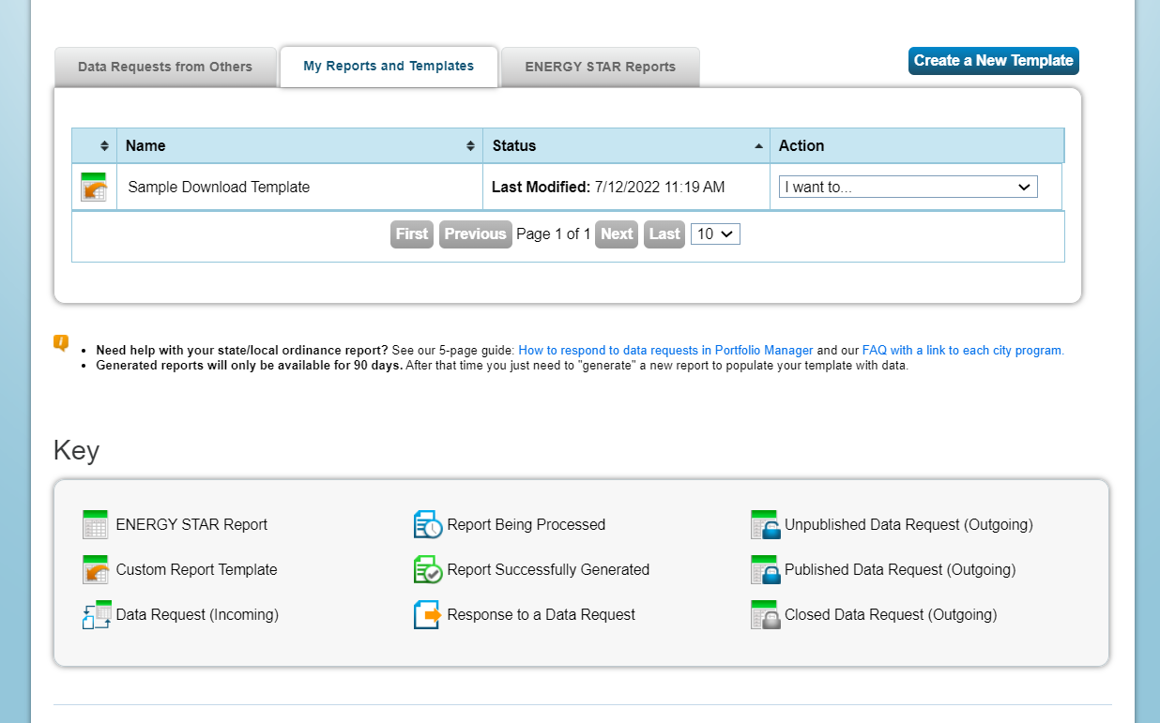
Custom Reports
Important Information Called Out in Bold
New Key Explains Report Icons
Notes:
On the “My Reports and Templates” tab, you will be able to view and access any Custom Templates that you have created for reporting purposes. We will discuss how to create these templates next.
You can use your template to
Generate a custom report
Share your template
Request data from others

Slide 33
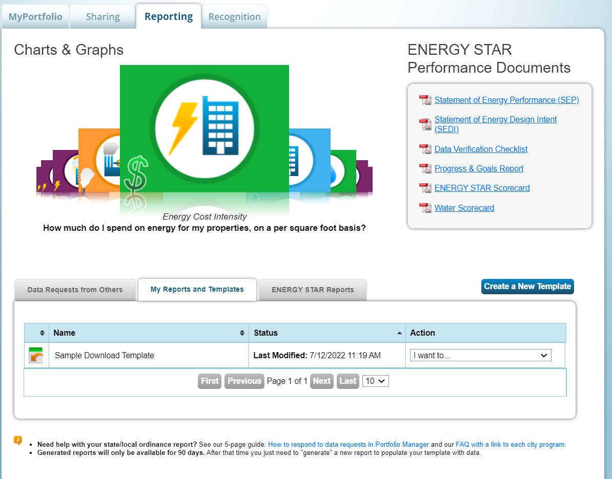
Custom Reporting
Generate
Custom Report
Templates
Notes:
This reporting feature recognizes that benchmarking can only drive action if you can easily access and interpret all of the data you’ve entered. The reporting feature is intended to help you clearly see how you’re performing on a variety of different metrics.
To do this, first select “Create a New Template.”

Slide 34
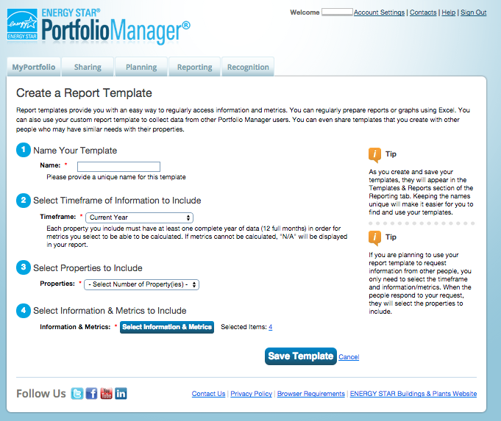
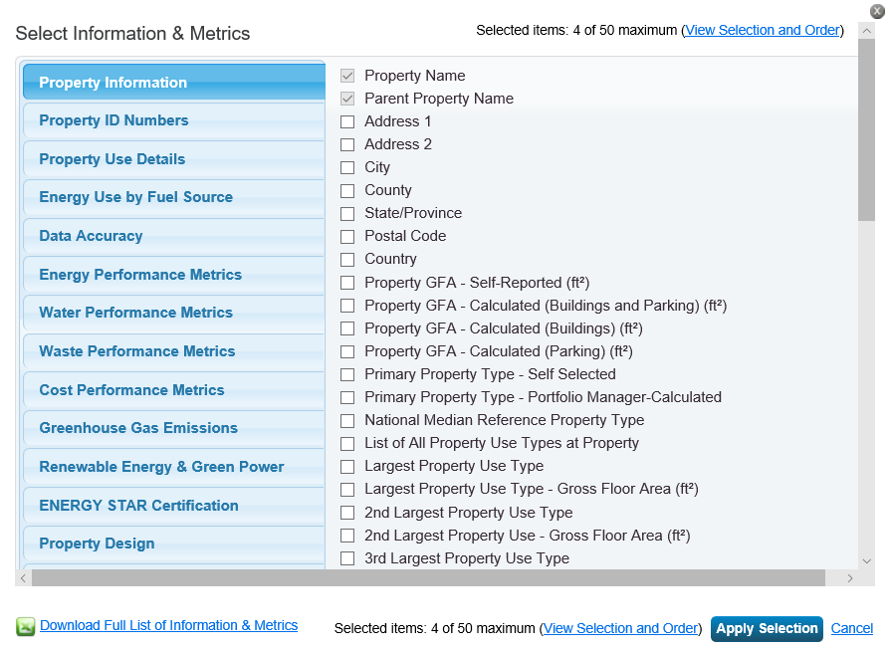
Custom Templates
Notes:
From the “Create a Report Template” page, choose a name for your template that will help you remember what you are going to use it for (for example, “Progress Towards XYZ Energy Challenge”).
Then, select a timeframe. You can run a report for any single 12 mos. period or to compare two or more 12 mos. periods.
Next, select the properties you would like to include.
Then, you can select up to 50 metrics from a list of 1,000+ to include, and even drag and drop metrics into your preferred order, and then “Apply Selection”.
Finally, “Save Template”.

Slide 35
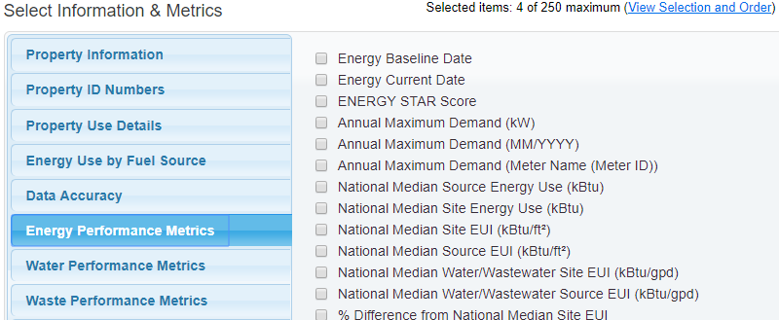
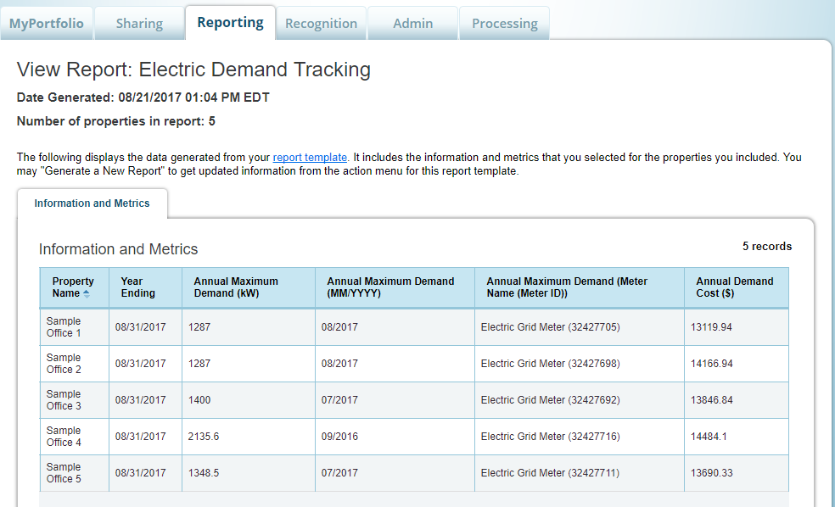
Electric Demand Metrics also available in custom reports
Notes:
A quick note that PM tracks demand and includes these three metrics in custom reports: Annual Maximum Demand (kW), Annual Maximum Demand (MM/YYYY), and Annual Maximum Demand (Meter Name (Meter ID))."
We have a How to Guide on this topic: https://www.energystar.gov/buildings/tools-and-resources/how_track_electric_demand_portfolio_manager

Slide 36
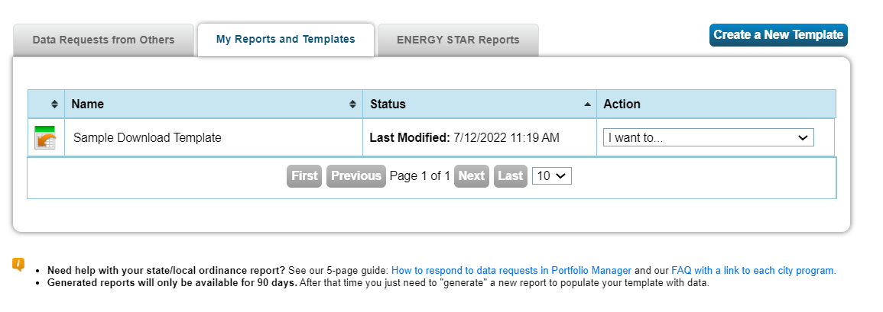
Use Your Template
Click links or use drop-down menu to share your template with others, request data from other users, or
generate a spreadsheet
New template appears on “My Reports and Template” tab
Notes:
Once your template is created, it will be added to the “My Reports and Templates” tab.
You can use the links in the green box that appears at the top of the Reporting tab, or you can use the Action drop down menu next to each report to:
Generate a new report (based on the template you just created)
Edit the template
Share the template with others
Request data from others using the template
Delete the template
View a link to share the template

Slide 37
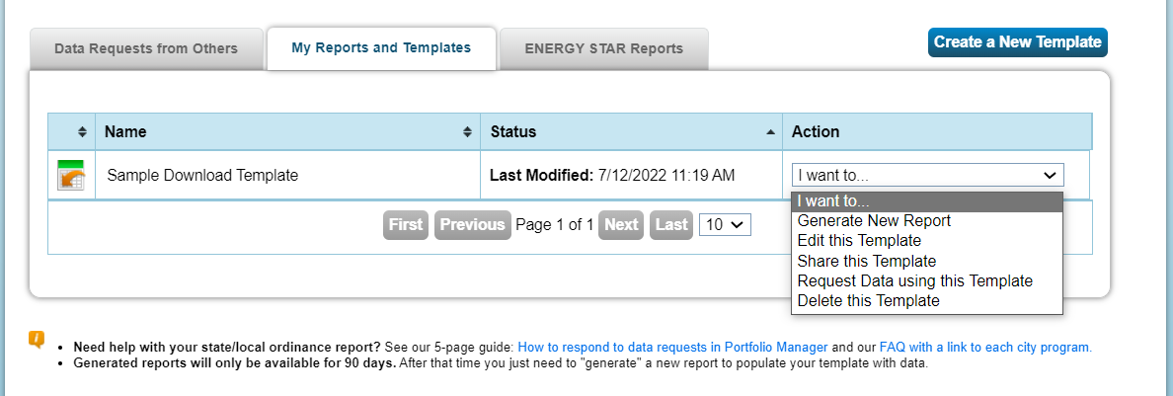
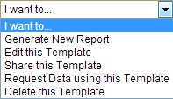
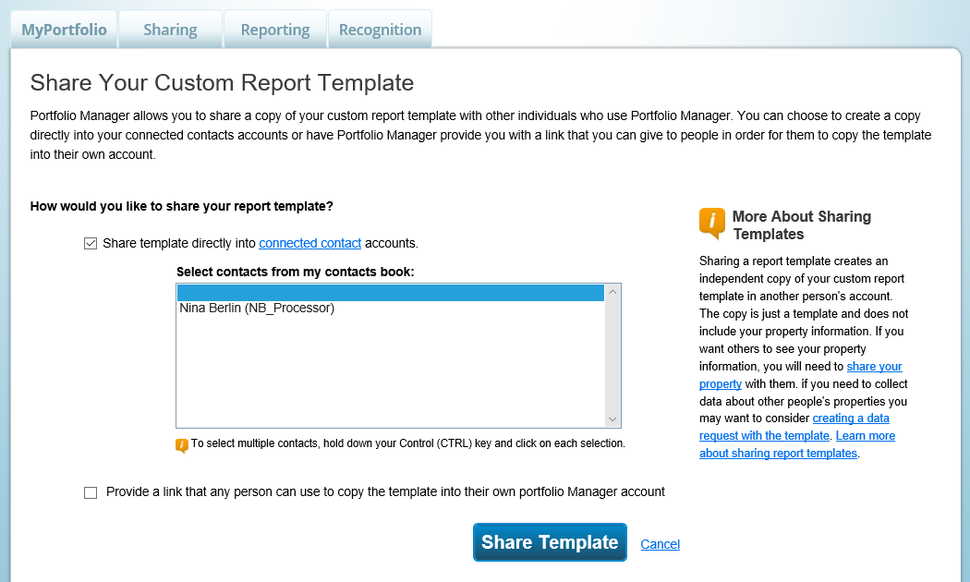
Share Template
Share with a Contact; or
Generate a link in Portfolio Manager that allows any user to copy the template to their account
Notes:
There are some cases where you might want to share the template that you have developed. For instance, a property manager might find a custom template particularly useful for their own quarterly reporting, and might want to share this template with colleagues who could benefit from using a similar reporting framework at their own properties.
To Share the template, choose “Share this Template”. Then select recipients from your list of contacts OR generate a url that you can email out which allows any user to log in and copy the template to their own account.
Once you have shared, your report template will show up in the recipient’s list of “My Custom Reports.” Note that any reports they run with that template, and any edits they make to the template, will not affect your original template or your data. Nor will sharing a template allow you to see the data they have entered. To do that, you need to make a data request, which we will cover next.

Slide 38
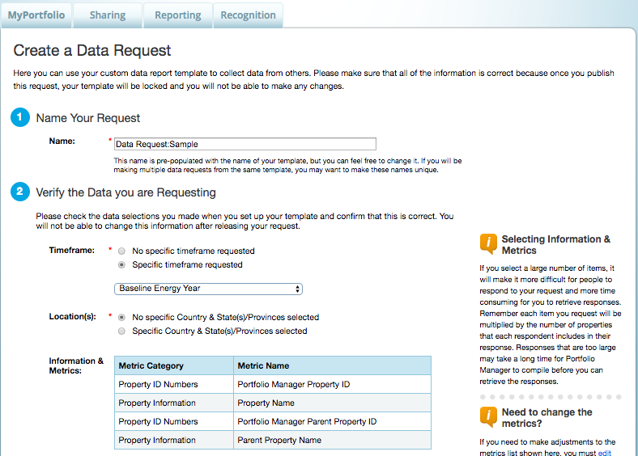
Request Data Using Template
Name Your Request
Verify Data
Timeframe
Locations
Info and Metrics
Notes:
The “request data” feature allows you to publish your template so that others can provide data on their buildings, according to the specific metrics that you specified. This approach may be favored in situations where you don’t want or need others to share their entire property with you, but rather just specific data points. Using this approach, you can specify exactly what information you need, and the respondent can know exactly what data they are releasing to you.
The “request data” feature can be useful for energy efficiency programs or other initiatives, such as benchmarking competitions, that need to collect data from a large number of participants. A number of jurisdictions with mandatory benchmarking and disclosure requirements are using this method.
To request data, select “Request Data using this Template.”
Name your request.
You can select a timeframe for the data request, if you want to ensure that all respondents are providing data for the same period. Otherwise, you can allow respondents to select their own time frames when they are responding to the request.

Slide 39
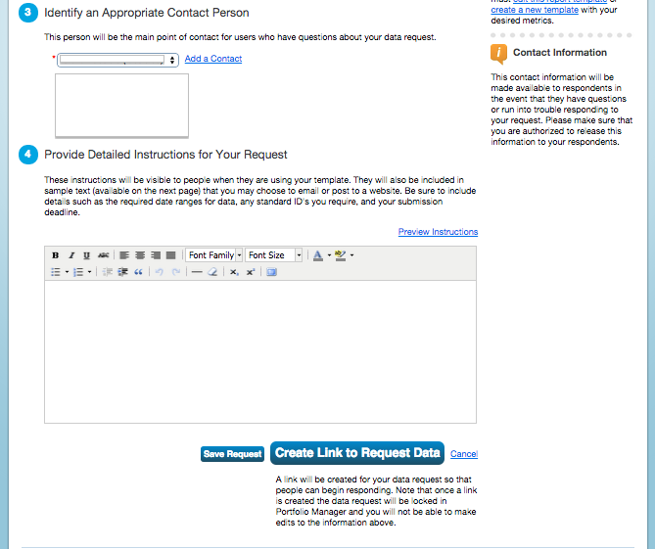
Request Data Using Template
Identify Contact
Provide instructions
“Save” or “Create Link” to request data
Notes:
Before you can complete and publish the data request, you will need to:
Select a main contact who will be able to field any questions regarding the request.
Provide detailed instructions on how recipients can respond to your request.
Selecting “Save Request,” will save it in your Templates & Reports section.
Selecting “Create Link to Request Data,” will generate a url that allows users to start responding to the request. You will need to post the url on the web or email it out to the audience that is expected to respond. They will need to click on the link – which directs them to login to Portfolio Manager – and follow the instructions that you have provided. The data request will appear on their Reporting tab, and they can access it to respond, or update a response, at any time.

Slide 40
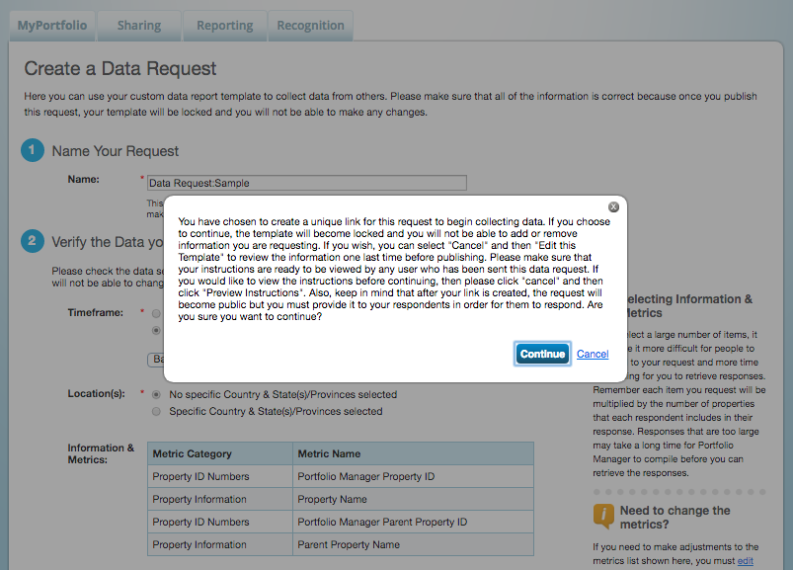
Publish Data Request
Notes:
Selecting “Create Link to Request Data” will publish and lock the request. From that point, the data request and the fields included in the request cannot be edited, however the original template can be edited at any time.

Slide 41
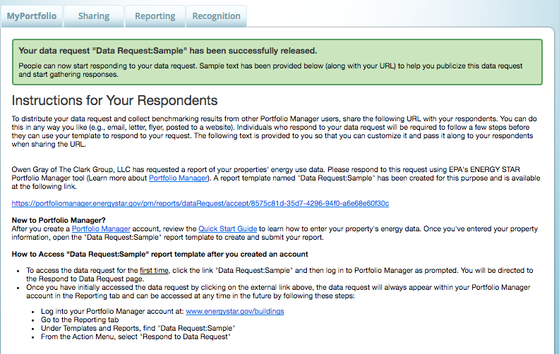
Data Request Created
Specific Instructions for your Respondents
Notes:
Once you publish your data request, you will be able to review any specific instructions you have created, and can copy your link to share with others (e.g., via email and/or by posting on a public website).

Slide 42
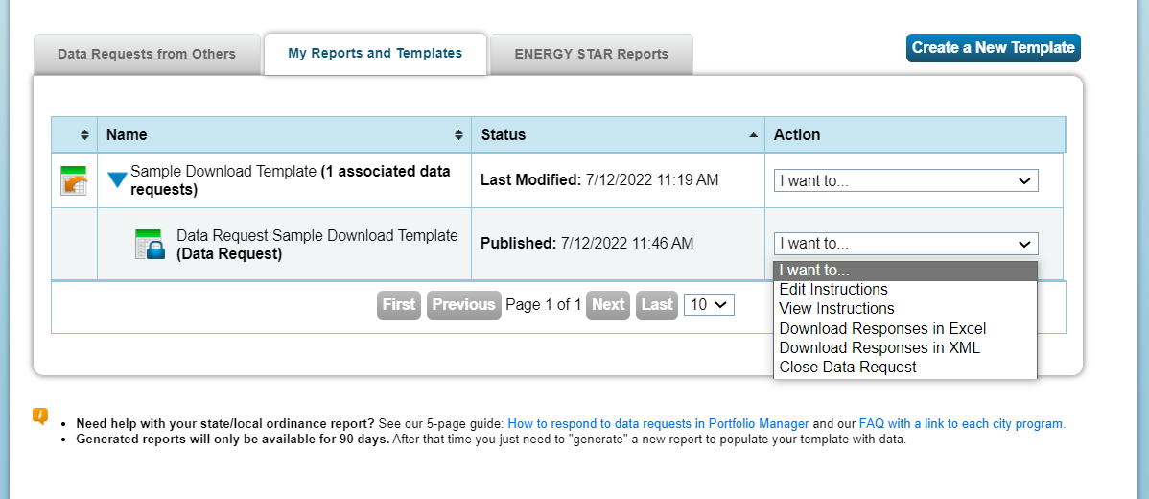
Managing Your Data Request
Notes:
Your published data request will then show up in your “My Custom Reports” tab, as a sub-heading under the template from which it was generated. From here, you can view instructions, edit instructions, download data request responses in Excel or XML, and close the data request.
As of January 2020, users who create a data request, and then close it, will have the option to delete it from their list.

Slide 43
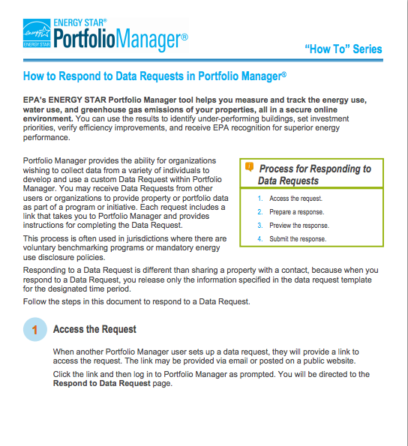
Responding to Data Requests
For more information on responding to data requests, please reference www.energystar.gov/buildings/training for:
Print resource titled: “How to Respond to Data Requests in Portfolio Manager”
5 minute video titled: “How to Respond to a Data Request in Portfolio Manager”
Notes:
The other side of the coin is responding to data requests. We won’t go over that today, but these two resources provide information on how to do that. (send links in chat)
https://www.energystar.gov/buildings/tools-and-resources/how-respond-data-requests-portfolio-manager
https://energystar-mesa.force.com/PortfolioManager/s/article/How-do-I-respond-to-a-Data-Request-1600088541059

Slide 44
Pop Quiz!
True or False: You can only generate reports in Portfolio Manager using the pre-defined templates.
True
False
If you need access to specific data points from properties outside your organization, which of the following is the best approach to obtain this information?
Have other Portfolio Managers share their property records with you
Initiate a Portfolio Manager Data Request
Have other Portfolio Managers transfer their property records to you

Slide 45
Pop Quiz!
True or False: You can only generate reports in Portfolio Manager using the pre-defined templates.
True
False
If you need access to specific data points from properties outside your organization, which of the following is the best approach to obtain this information?
Have other Portfolio Managers share their property records with you
Initiate a Portfolio Manager Data Request
Have other Portfolio Managers transfer their property records to you
You can create custom reporting templates on the “Reporting” tab.
Sharing and transferring property records will give you, at a minimum, read-access to the entire property. If you only need specific data points or metrics for your reporting, it is best to initiate a Data Request.

Slide 46
How To
Update data using spreadsheet upload feature
Set baseline, goals, and targets to plan energy improvements
Create custom reporting templates
Use the Sustainable Buildings Checklist
Notes:
That completes are third objective, creating and using custom templates. Let’s discuss today’s last learning objective, using the Sustainable Buildings Checklist.

Slide 47
What is the Sustainable Buildings Checklist?
United States Federal High Performance Sustainable Buildings Checklist (Guiding Principles Checklist) now available to all property types
Assist owners/managers with evaluating sustainability in existing buildings
Encouraged for all properties; used by U.S. Federal buildings to comply with requirements
Use the Sustainable Buildings Checklist to:
Conduct initial and final building walkthrough assessments
Track and easily view progress on each guiding principle
Upload compliance documents to the repository for record keeping
Create a portfolio-wide sustainability roll-up report
Review up-to-date energy and water metrics generated by Portfolio Manager
Notes:
This Checklist evaluates sustainability in existing buildings. It was originally developed for US Federal buildings managers for compliance with the Federal Guiding Principles for High Performance Sustainable Buildings. However, it is also a valuable tool for evaluating the sustainability of non-government buildings.

Slide 48
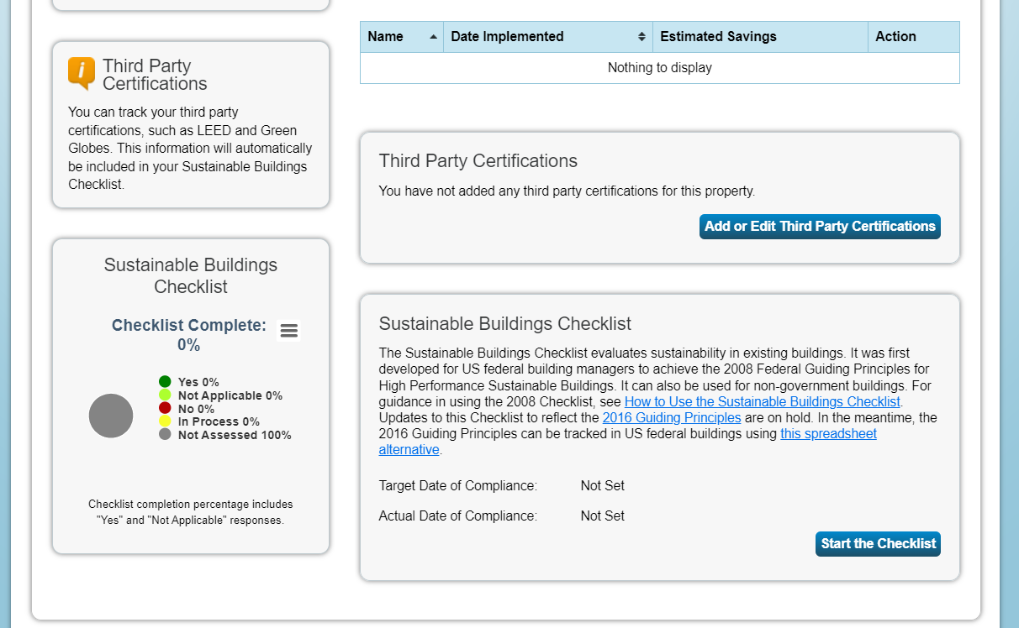
Access the Sustainable Buildings Checklist
Click on the “Goals” tab for a specific property and scroll to the bottom of the page
Notes:
To access the checklist, click on the Goals tab within a specific property’s page. The Sustainable Buildings checklist is located at the bottom of the page.
Click “Start the Checklist.”

Slide 49
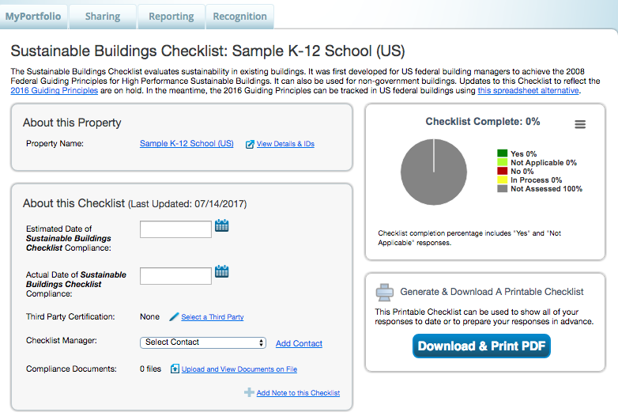
Start the Sustainable Buildings Checklist
Notes:
You will begin by entering basic information about your checklist. Note that you can use this page to upload any relevant documents associated with your efforts to achieve elements of the checklist.
From the top of this page, you can also view the status of your building’s progress through the Checklist.
You also have the option to download and print a PDF version of the checklist.

Slide 50
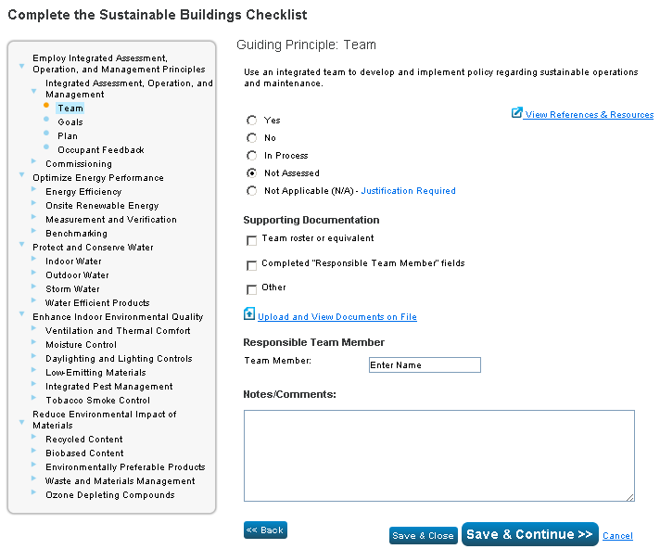
Complete Checklist Step by Step
Notes:
Using the grey box on the left of the screen, you can navigate through the various elements of the Sustainable Buildings Checklist, and indicate the status of your efforts.
At each step, you will be able to view reference documents and supporting resources.

Slide 51
Pop Quiz!
True or False: Using the Sustainable Buildings Checklist in Portfolio Manager is not required in order to obtain ENERGY STAR Certification for a property.
True
False

Slide 52
Pop Quiz!
True or False: Using the Sustainable Buildings Checklist in Portfolio Manager is not required in order to obtain ENERGY STAR Certification for a property.
True
False
You do not need to use the Sustainable Buildings Checklist to obtain ENERGY STAR Certification. However, it can be a valuable tool to evaluate your building’s sustainability.

Slide 53
Recap
In this training, we learned how to:
Update data using the spreadsheet upload feature
Set baseline, goals, and targets to plan energy improvements
Create custom reporting templates
Use the Sustainable Buildings Checklist
Notes:
To recap, today we discussed how to:
Update data using the spreadsheet upload feature
Set baseline, goals, and targets to plan energy improvements
Create custom reporting templates
Use the Sustainable Buildings Checklist

Slide 54
Extra Help
Visit www.energystar.gov/buildingshelp
Extensive list of FAQs
Online form to submit technical questions or comments
Additional Portfolio Manager training resources available at: www.energystar.gov/buildings/training
Step-by-step documents (PDF)
Access to recorded trainings and short videos
Information on upcoming trainings
Ask the Expert
Wednesdays at 12:00 noon ET. It's an open Q&A for Portfolio Manager questions.
https://energystar-mesa.force.com/PortfolioManager/s/article/When-are-the-Ask-The-Expert-webinars-1600088554111
Register for regular webinars at: https://www.energystar.gov/buildings/training/live_online_training
Portfolio Manager Technical Reference Series: https://www.energystar.gov/buildings/tools-and-resources?f0=im_field_select_primary_category:1522
Notes:
Please be aware of these additional resources, which will help you as you delve deeper into the new Portfolio Manager tool.

Slide 55
Thank you for attending!
Questions?
Slides will be sent to all webinar registrants after today’s session
If you have any questions on Portfolio Manager
or the ENERGY STAR program, contact us at: www.energystar.gov/BuildingsHelp

