Slide 1
ENERGY STAR for Buildings and Plants
Climate Protection Partnerships Division
U.S. Environmental Protection Agency
2019

Slide 2
Agenda
What is ENERGY STAR?
ENERGY STAR for Buildings & Plants
ENERGY STAR Portfolio Manager and benchmarking
Becoming an ENERGY STAR partner
Recognition opportunities
Tools & Resources
On the ENERGY STAR horizon

Slide 3


The biggest little label in energy efficiency
5.8 billion
products
35,000
buildings
190
industrial plants
1.9 million
homes
Notes:
For more than 20 years, EPA’s ENERGY STAR program has identified the most energy-efficient products, buildings, plants, and new homes – all based on the latest government-backed standards.
Today, every ENERGY STAR label is verified by a rigorous certification process.

Slide 4
For more than 20 years, EPA’s ENERGY STAR program has identified the most energy-efficient products, buildings, plants, and new homes – all based on the latest government-backed standards.
Today, every ENERGY STAR label is verified by a rigorous third-party certification process.
5.8 billion
products
35,000
buildings
190
industrial plants
1.9 million
homes

Slide 5

Recognized by more than 90%
of Americans
Notes:
ENERGY STAR is now recognized by more than 90% of American consumers.

Slide 6
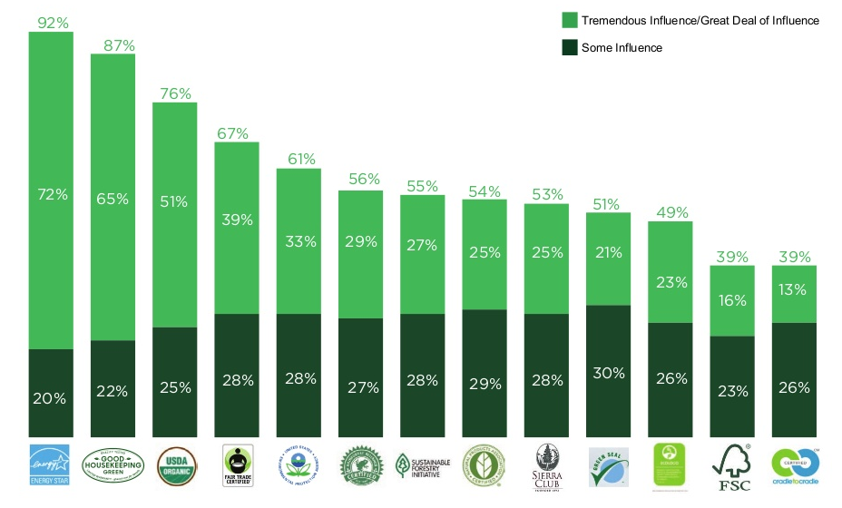
Brand trust among consumers
Source: Fairfield Research, July 2015 Survey of Good Housekeeping readers
Notes:
ENERGY STAR is a trusted environmental brand, ranking first among other green labels. 92% of survey respondents report that seeing the ENERGY STAR on a product influences their purchasing decisions. The vast majority of them report that it exerts a “tremendous among of influence.”

Slide 7
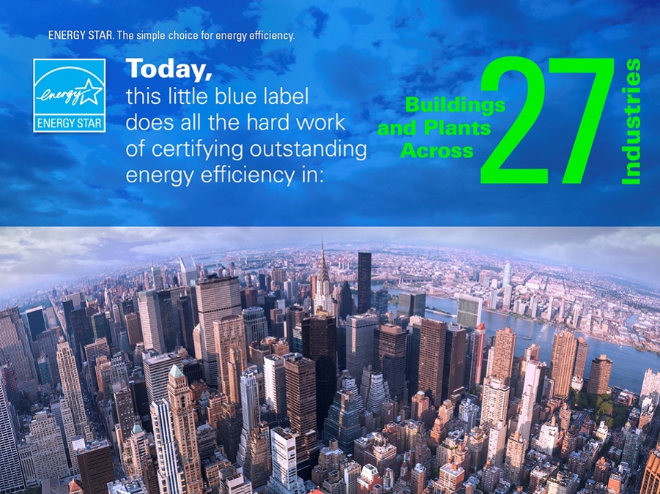

Slide 8

ENERGY STAR signifies superior energy performance
More than 30,000 ENERGY STAR certified properties

Slide 9

And it’s more than just a label…

Slide 10

To date, the ENERGY STAR
program has helped Americans:
Save $450 billion
Save 3.5 trillion kWh of electricity
Avoid 3.1 billion metric tons of GHG emissions

Slide 11

ENERGY STAR for Buildings & Plants
Helps American businesses and organizations reduce operating costs through energy efficiency in buildings and plants, across all commercial and institutional markets.
Offers the only government-backed certification for independently verified superior energy performance in buildings and plants.
Offers proven solutions and a holistic approach to help building owners and managers reduce energy consumption through:
  Operations and maintenance improvements
  Technology upgrades and retrofits
  Behavioral change

Slide 12
Why focus on buildings and plants?
Commercial buildings and industrial facilities generate about 45 percent of U.S. carbon dioxide emissions.
30 percent of energy consumed in commercial and industrial buildings is wasted.
Reductions of 10 percent or more in energy use can be possible with little or no cost.
  Energy is a controllable cost.
  Energy is a significant percentage of your operating costs and reduces operating profit.
  Any costs you shift from energy cost improve the bottom line.

Slide 13







Management Tool
  Assess whole building energy and water consumption, plus waste
  Track green power purchase
  Share/report data with others
  Track changes in energy, water, greenhouse gas emissions, and cost over time
  Create custom reports
  Apply for ENERGY STAR certification
Notes:
Management Tool
Assess whole building energy and water consumption, plus waste
Track changes in energy, water, greenhouse gas emissions, and cost over time
Track green power purchase
Share/report data with others
Create custom reports
Apply for ENERGY STAR certification

Slide 14





Hundreds of metrics, including:
  Energy use Source, site, weather normalized, demand
  Water use
  Water use intensity,
  Water Score
  (for Multifamily)
  Waste & Materials
  Waste intensity, diversion rate
  1-100
  ENERGY STAR score
  GHG emissions
  Indirect, direct, total, avoided
Notes:
Portfolio Manager offers users literally hundreds of metrics. Among them are energy consumption, water consumption, greenhouse gas emissions, and the 1 – 100 ENERGY STAR score.

Slide 15
Translate simple information into dozens of performance indicators
Energy Metrics (Site and Source)
  Total Energy Use (kBtu)
  Energy Use Intensity (EUI) (kBtu/Sq. Ft.)
  Weather Normalized EUI (kBtu/Sq. Ft.)
  National Median EUI (kBtu/Sq. Ft.)
  % Difference from National Median EUI (%)
Comparisons
  Total Energy Use (kBtu)
  Energy Use Intensity (kBtu/Sq. Ft.)
  Adjusted Energy Use (%)
  GHG Emissions (MtCO2e)
  Available against baseline or between any two periods.
Financial
  Annual Energy Cost
  Total Energy Cost per Sq. Ft.
  Cumulative Investment in Facility Upgrades
  Cumulative Investment per Sq. Ft.
Renewable Energy
  Total On-Site Electric Generation (kWh)
  Percent of Electricity from On-Site Renewable (%)
  Total Renewable Energy Certificates Purchased and Sold
  Total Avoided Greenhouse Gas Emissions from RECs (MtCO2e)
Notes:
These are just a handful of the hundreds of metrics available from Portfolio Manager, whether they be energy use information, comparative metrics, financial information, or metrics about renewable energy.

Slide 16
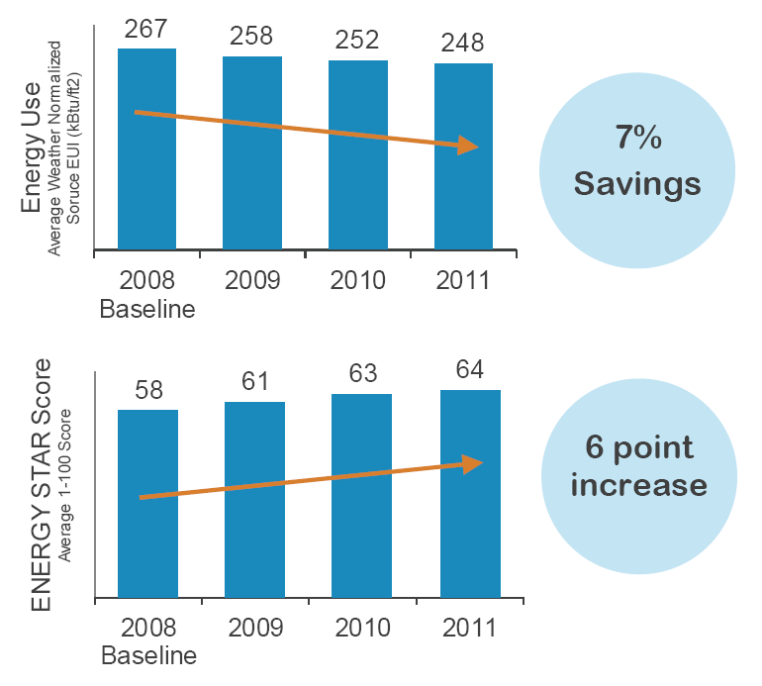
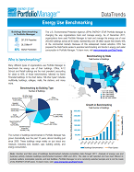
Value of benchmarking
Consistent benchmarking in buildings results in energy savings and improved performance.
DataTrends Reports
National trends
Sector-specific analyses
energystar.gov/
datatrends
Notes:
A recent EPA analysis of more than 30,000 buildings that consistently tracked energy consumption in Portfolio Manager over a three year span showed 7% average energy savings and a 6 point ENERGY STAR score increase from 2008-2011.
For more information, see www.energystar.gov/datatrends.

Slide 17
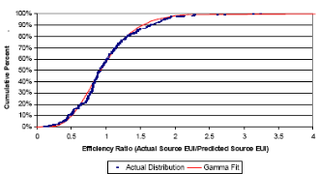
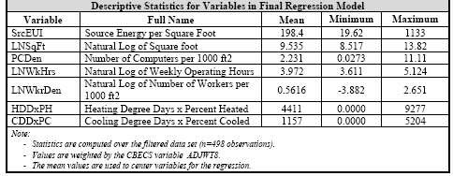
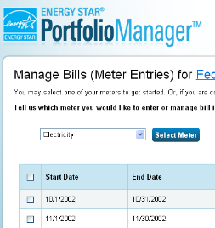

Developing a 1 – 100 ENERGY STAR Score
Data analysis
Nationally representative survey
Statistical modeling
Comparison between actual energy data and the modeled estimate
Notes:
Nationally representative survey - CBECS gathers data on building characteristics and energy use from thousands of buildings across the US
EPA analyzes & filters the data - ensuring data robustness and quality
EPA creates a statistical model that correlates the energy data of the property use details to identify the key drivers of energy use, accounting for weather variations
Compares the actual energy data for a building to the modeled estimate to determine where the building ranks relative to its peers

Slide 18



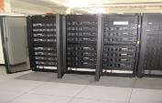















Property types with 1-100 ENERGY STAR scores
Bank Branch
Barracks*
Courthouses
Data Centers
Distribution Centers
Financial Offices
Hospitals
Hotels
K-12 Schools
Office Buildings
Medical Offices*
Multifamily Housing
Residence Hall/Dormitory*
Retail Stores
Senior Care Communities
Supermarkets
Warehouses
Wastewater Treatment Plants*
Wholesale club/ Supercenters
Worship Facilities
Notes:
* Building types with an asterisk are not eligible for ENERGY STAR certification.
18

Slide 19

Use Portfolio Manager to understand comparative performance
ANY building can be benchmarked
Benchmarking through Portfolio Manager enables you to:
$
73
88
21
Compare your building to a national sample of similar buildings
Compare your buildings of a similar type to each other
Identify underperformers in your portfolio and set priorities for the use of limited staff time and/or investment capital

Slide 20
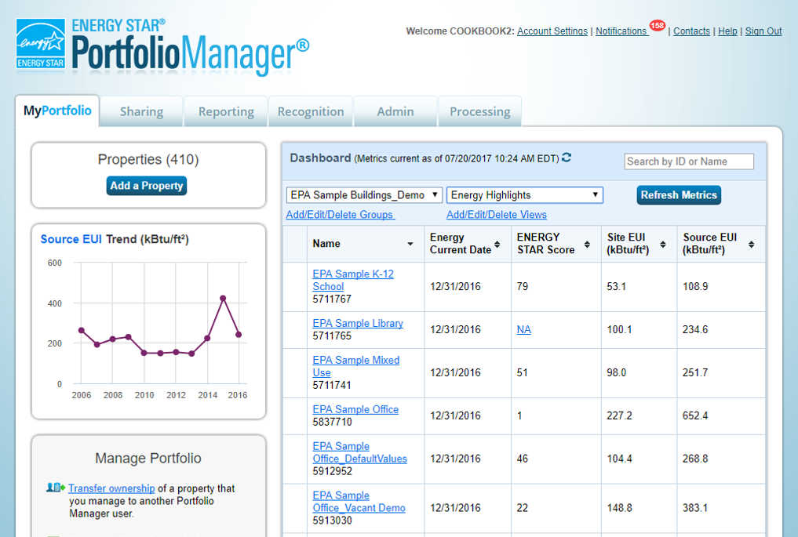
Monitor building energy, water, and waste performance in a central platform
All your performance data, all in one place!

Slide 21


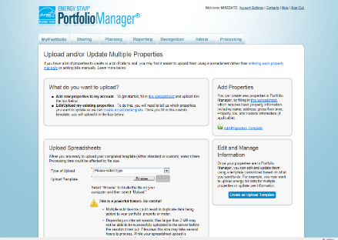
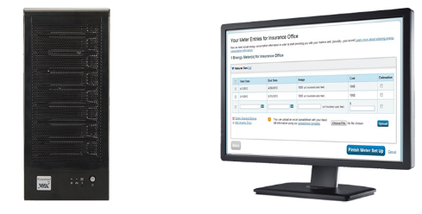
Choose the best data management method
Manual entry
Spreadsheet upload
Web services
Notes:
Input data manually
Upload spreadsheets of data (we offer a simple spreadsheet for one meter, or a complex spreadsheet if you have multiple meters or multiple properties)
Web services, which is where a third-party provider, such as a utility, will automatically exchange data with Portfolio Manager.

Slide 22
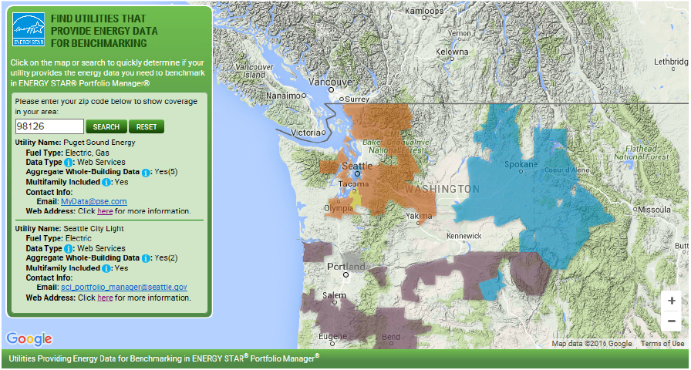
Find Utilities that Provide Energy Data for Benchmarking
www.energystar.gov/utilitydata
Notes:
Use EPA’s interactive map to quickly identify where energy data access solutions are available.
Search by zip code for available data services and view service territory, fuel type, data access type, and links to sign up for the utility service.

Slide 23
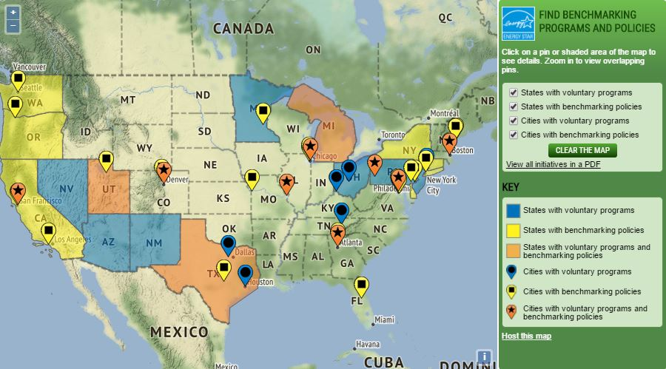
State and local benchmarking policies and voluntary programs
www.energystar.gov/policiesandprograms
Can be hosted on your site!
Notes:
The map shows a summary of national, state-level, and local efforts that use EPA’s ENERGY STAR Portfolio Manager to improve energy efficiency in commercial buildings
Click on shaded areas or pins to learn more about policies and programs, or download a PDF of all of the initiatives
Presented side by side with utility data access map

Slide 24
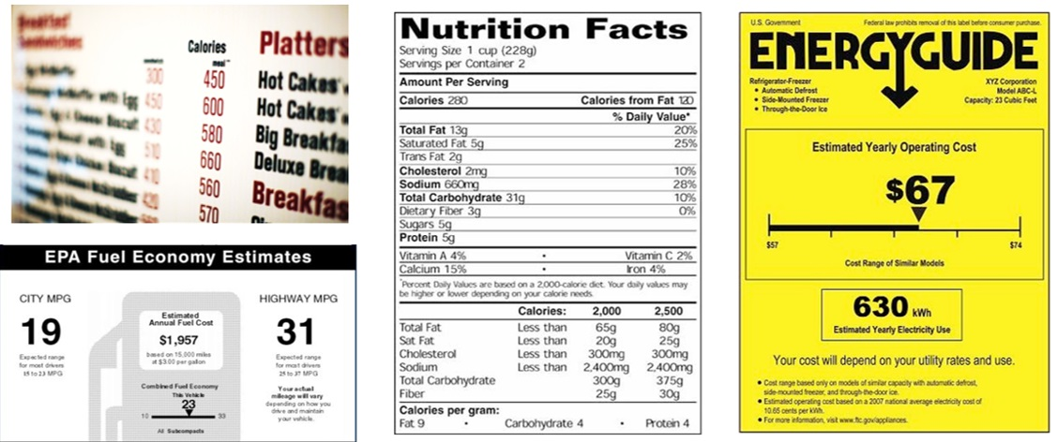

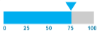
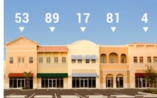
People (and markets!) respond to transparent information

Slide 25
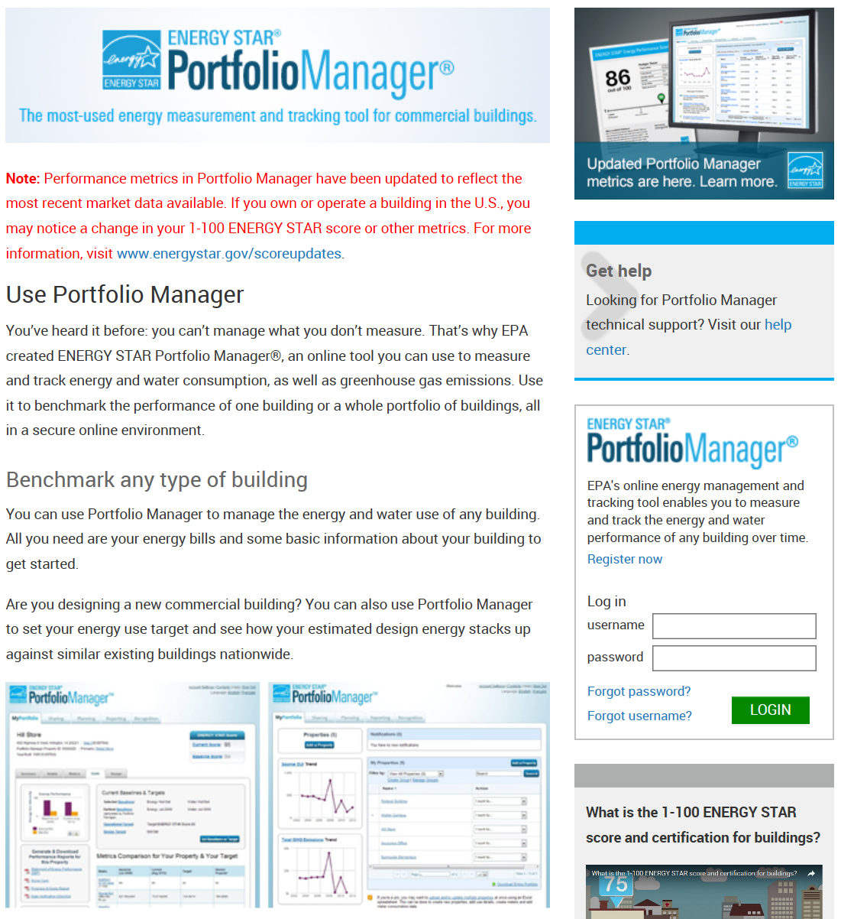
Get Started!
Sign Up and Login:
energystar.gov/portfoliomanager
Online Training:
energystar.gov/Buildings/Training
Help Portal:
energystar.gov/BuildingsHelp

Slide 26

























energystar.gov/join
Notes:
6,000+ Organizations Partner with ENERGY STAR for Commercial Buildings
Roughly 35% of the Fortune 500® is working with EPA to improve financial value, boost their bottom line, and manage risk by improving their facilities’ energy performance through ENERGY STAR.
So are eight of the 10 largest U.S. healthcare organizations, major league sports teams, colleges and universities, small businesses, and entire cities.
In total, more than 6,000 organizations are working with EPA and ENERGY STAR to make their properties more energy efficient.

Slide 27


Get expert help from experienced ENERGY STAR partners!
ENERGY STAR Service and Product Provider (SPP) partners
Businesses and organizations that use ENERGY STAR tools and resources to help customers:
  Benchmark their buildings
  Achieve energy performance improvements
  Earn ENERGY STAR recognition
Experienced with ENERGY STAR
Searchable on the ENERGY STAR website
For more information on ENERGY STAR SPPs, visit energystar.gov/ExpertHelp

Slide 28
What can ENERGY STAR partnership do for you?
Position your organization as a “market leader” in energy management and environmental stewardship.
Support your efforts to increase energy savings and reduce greenhouse gas emissions.
Increase customer and employee awareness of energy management efforts and achievements.
Encourage energy savings at work and home for employees and customers.
Learn more at https://www.energystar.gov/buildings/about-us/become-energy-star-partner

Slide 29
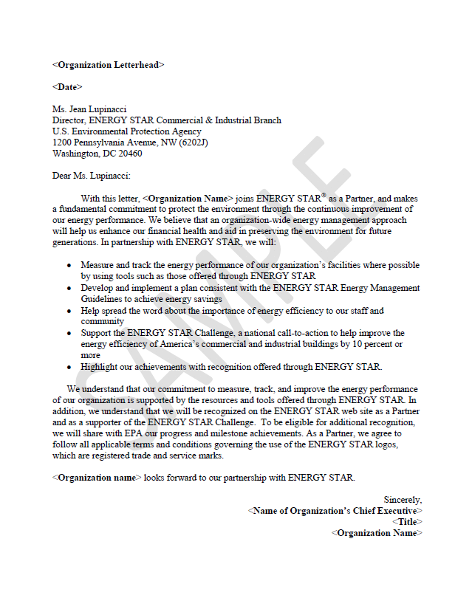

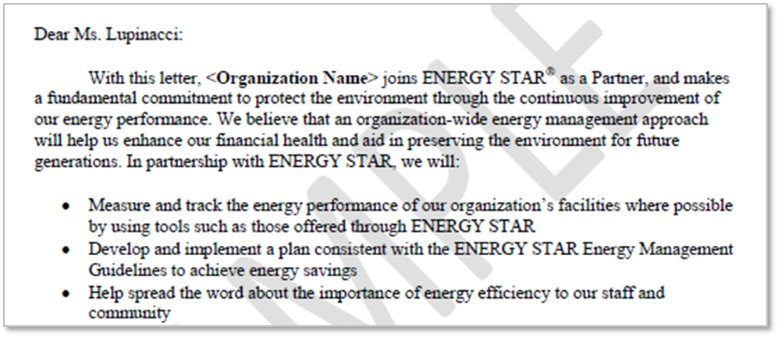
Show your commitment – Partner with ENERGY STAR

Slide 30

Show off your partnership – get creative (and have fun)

Slide 31
Recognition Opportunities

Slide 32

ENERGY STAR certification for existing buildings
Recognition for superior energy performance – score of 75 or above, as calculated in Portfolio Manager and verified by a Professional Engineer or Registered Architect
Based on a 12-month period of energy performance
Buildings can re-apply for certification every 12 months
1 to 100 ENERGY STAR scores
Superior Energy Performance!
National Average
1
50
75
100
Eligible to earn the ENERGY STAR
Find certified buildings and plants: energystar.gov/buildinglist

Slide 33
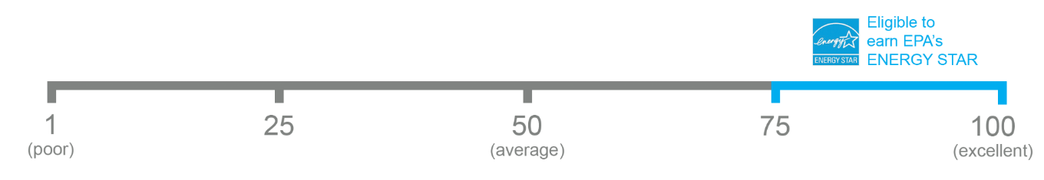
ENERGY STAR certification for industrial plants
Certification is also available to plants with an ENERGY STAR score of 75 or higher
Industrial plants do not use Portfolio Manager – scores are based on an industry-specific Energy Performance Indicator (EPI), which measure a plant’s energy performance compared to similar plants nationwide
Find certified buildings and plants: energystar.gov/buildinglist

Slide 34
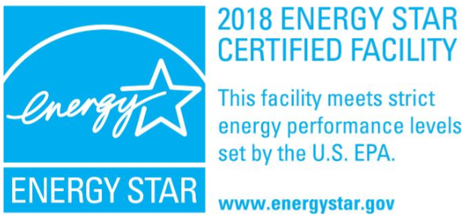
ENERGY STAR certification for industrial plants
Industrial plants can earn the ENERGY STAR for superior energy performance!
750+ industrial corporations are ENERGY STAR partners
ENERGY STAR works with specific industries to offer tailored energy-saving guidance and recognition, and to encourage networking and sharing of best practices in each industry:
Ammonia/fertilizer production
Cement
Commercial Baking
  Bread & rolls, cookies & crackers
Concrete
Corn Refining
Dairy
  Fluid dairy, ice cream, cheese
Food processing
  Frozen fruit & veggies, juice, potato products
Glass manufacturing
  Flat glass, container glass
Metal Casting
  Iron, investment steel, carbon alloy, aluminum
Motor Vehicles
  Assembly, Power Train
Petroleum Refining
Pharmaceuticals
Printing
Pulp & paper
  Integrated & pulp mills
Steel Mills
  Integrated & mini-mills

Slide 35

Showcase your certification!

Slide 36


10% improvement within 5 years
Notes:
The ENERGY STAR Challenge for Industry establishes a goal of 10% improvement in energy intensity within 5 years or less, calculated against an internal baseline.
Industrial facilities have taken the ENERGY STAR Challenge for Industry more than 1,400 times since 2010.
465 sites have achieved this goal, saving 76 trillion Btus of energy and more than $350 million. That’s equal to the annual wages of more than 7,600 manufacturing workers.
It’s an opportunity to gain recognition for industry achievements from a highly recognized federal program

Slide 37


Recognition for New Commercial Building Construction
Designed to Earn the ENERGY STAR
Awarded for building designs entered into Portfolio Manager
Must receive a score of 75 or higher based on total estimated energy use from energy models
Architects: Designed to Earn ENERGY STAR helps you deliver lasting savings to clients, validated by a nationally recognized brand
Owners: Designed to Earn ENERGY STAR helps you reap sustained energy savings while avoiding costly redesigns and retrofits

Slide 38
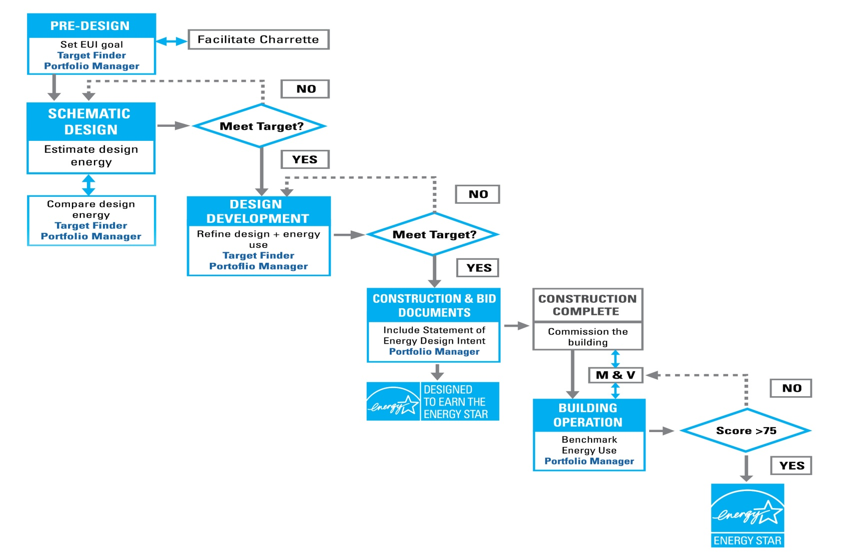



Recognition for New Commercial Building Construction
Set performance goals for your project
Estimate energy performance based on energy modeling data
Stay ahead of market demands for building efficiency and energy disclosure
You can also use:
The first step in the
ENERGY STAR lifecycle

Slide 39

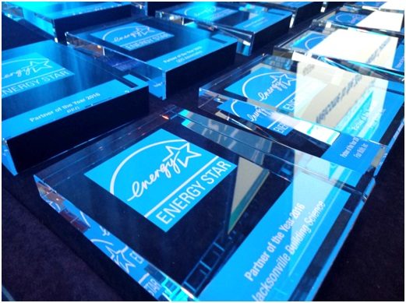

ENERGY STAR Partner of the Year
Recognizes world-class corporate energy management programs, in categories including:
Energy management
Energy efficiency program delivery
Climate communications
And more!
  energystar.gov/awards

Slide 40

Here are a few additional tools and resources
at energystar.gov…

Slide 41
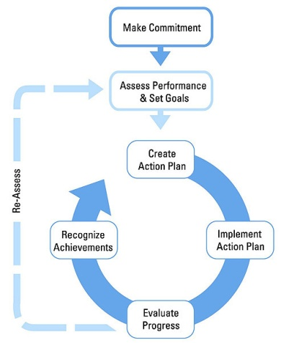
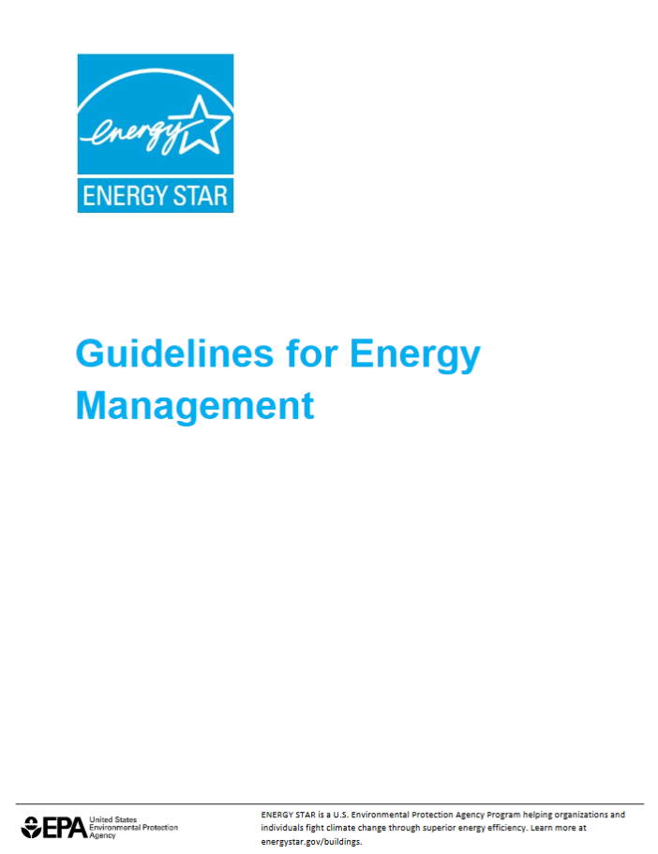
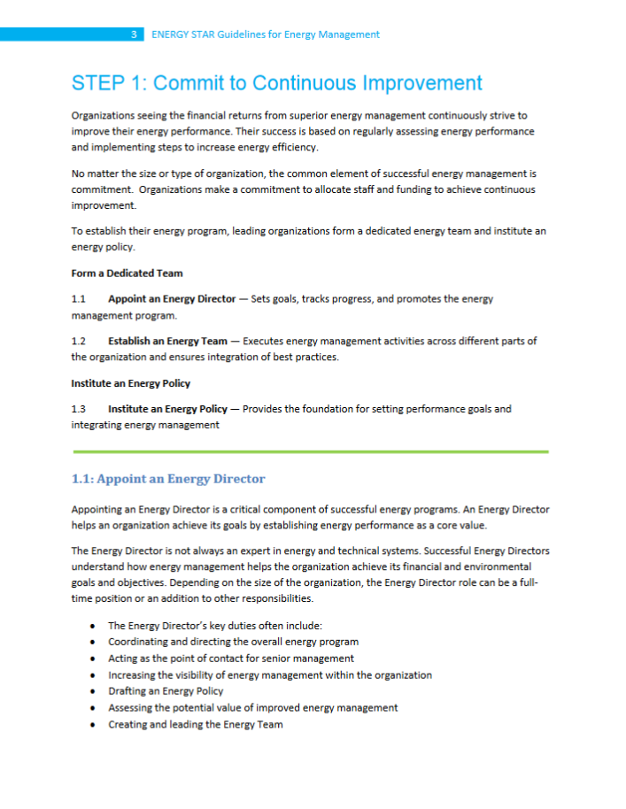
Guidelines for Energy Management
Strategic approach to building and continuously improving your energy management program
STEP 1: Make Commitment
STEP 2: Assess Performance
STEP 3: Set Goals
STEP 4: Create Action Plan
STEP 5: Implement Action Plan
STEP 6: Evaluate Progress
STEP 7: Recognize Achievements
EPA’s 43-page guide to continuous energy performance improvement, in seven steps
energystar.gov/
guidelines

Slide 42
Guidelines for Energy Management
Energy Strategy for the Road Ahead
Guidelines for Energy Management
Partnership letter
Portfolio Manager
1-100 ENERGY STAR scores
Benchmarking guidance
Building Upgrade Manual
Teaming guide
Service and Product Providers
Financial value calculator
ENERGY STAR building certification
Partner of the Year award
National Building Competition
Case studies
Partner mentoring
Communication tools
www.energystar.gov/guidelines
Portfolio Manager

Slide 43
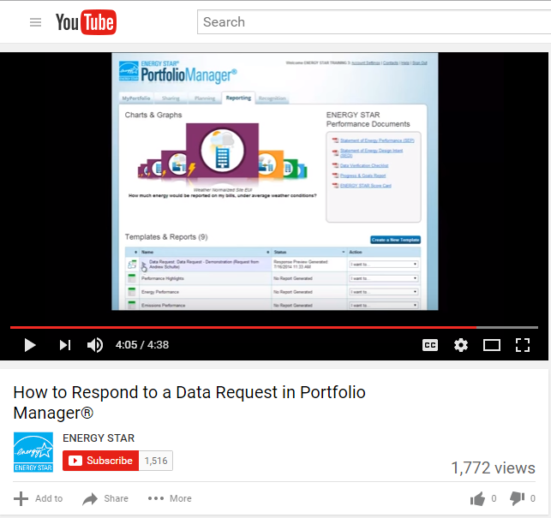
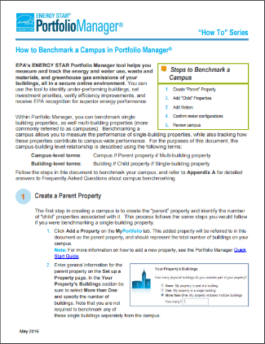
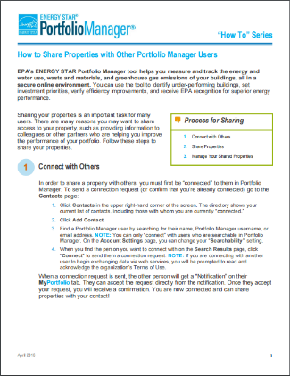
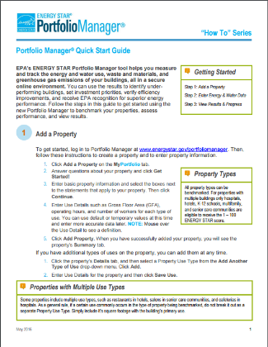
Portfolio Manager Training
Weekly live webinars available on the Trainings page
3-7 minute training videos on YouTube
Step-by-step training guides, FAQs, and technical reference documents

Slide 44
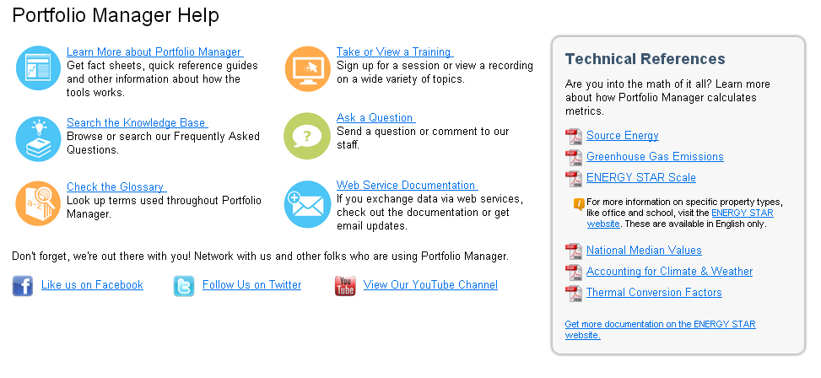
ENERGY STAR Help Desk
On-demand user support at energystar.gov/buildingshelp
Notes:
Our FAQ section is top-notch, with FAQs that are actually based on questions that our users ask, not ones that we make up. And we are literally adding questions and answers every day.
If you can’t find the answer to your question there, we have an awesome help desk that boasts a 95% customer satisfaction rate, with most questions responded to in under an hour.

Slide 45
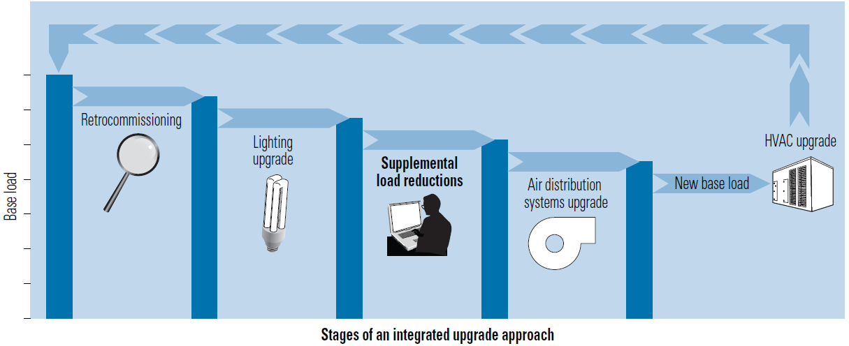
ENERGY STAR Building Upgrade Manual
Assists organizations in planning and implementing profitable upgrades
Includes a five-stage approach that increases the financial and environmental benefits realized:
energystar.gov/BldgManual

Slide 46
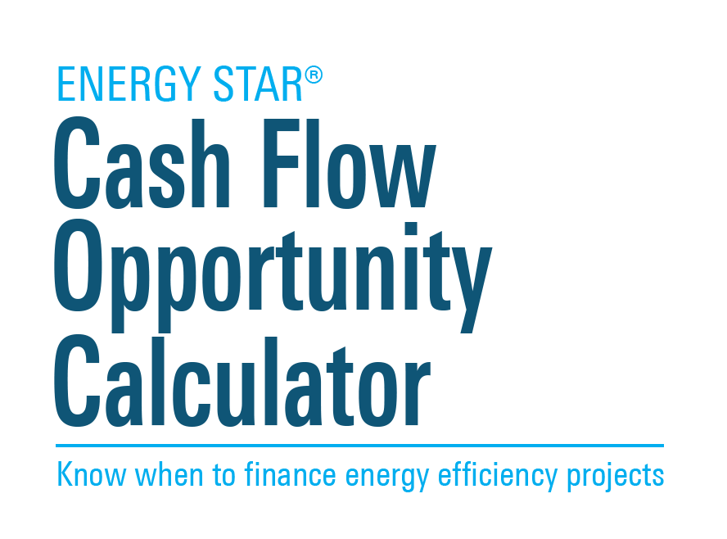
Go toe-to-toe with your CFO
Addresses the “we don’t have the money” objection
Translates energy savings into “financial speak”
Answers three questions:
How much new energy efficiency equipment can be purchased from the anticipated savings?
Should it be financed now, or is it better to wait and use cash from a future budget?
Will we lose money by waiting for a lower interest rate?
energystar.gov/buildings/FinancialEvaluation
Notes:
The Cash Flow Opportunity Calculator calculates the cost of delaying energy efficiency projects, and can be an effective measure against the “We don’t have the money now” objection.

Slide 47
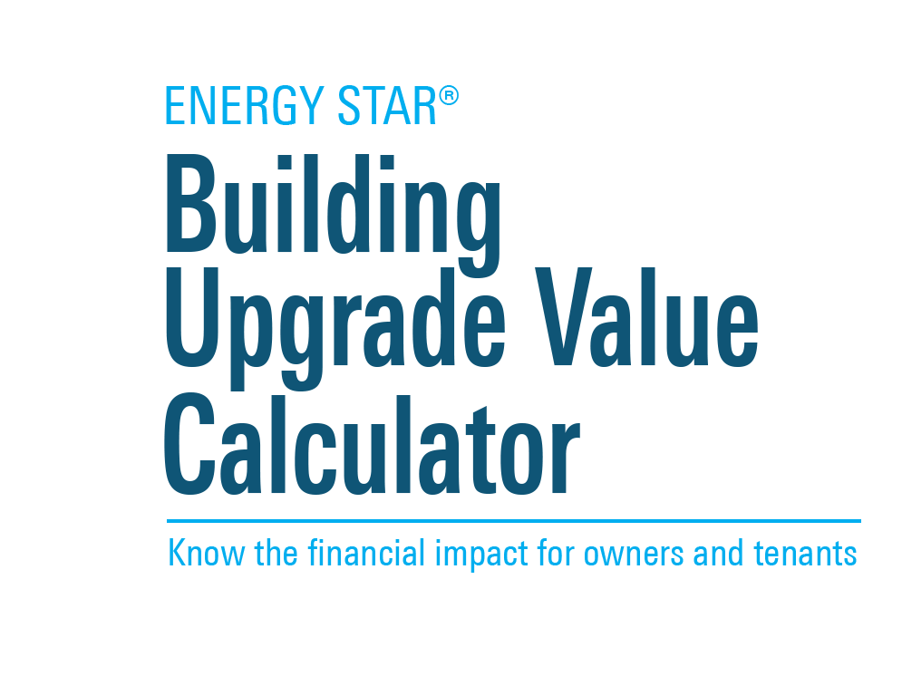
Evaluates costs and benefits of efficiency investments, for owner and each tenant
Quantifies expected changes in expense reimbursements under common commercial lease structures
Directly addresses “split incentive” barrier (who pays/who benefits) of efficiency investment in commercial real estate
Potentially opens dialogue for landlords and tenants to share savings from capital investments
Included in BOMA Energy Efficiency Program (BEEP) Course 5, Building the Business Case
energystar.gov/buildings/FinancialEvaluation
Notes:
A key feature of the original BUVC was that the tool would provide outputs not just in tabular form, but also as customized letters that the building operator (e.g., manager, engineer) could take to ownership. This feature has been preserved and expanded in the new BUVC: customized letters can now be created for each individual tenant, to serve as a starting point for conversations between property manager and tenant.
The BUVC can only be used for energy efficiency project made by the owner to the base building; it is not meant to calculate the impacts of energy efficiency improvements in specific tenant spaces.
A major goal of this tool is to enable and advance productive conversation between landlords and tenants beyond the traditional focus on the “split incentive,” whereby one entity (landlord or tenant) is presumed to pay for EE improvements, while the other is presumed to reap the savings. Rather, by illustrating where and how costs and benefits accrue to both parties, the tool can help to show how tenant-landlord collaboration can lead to shared savings over the course of a lease term.
Not every project will result in savings for both the owner and the tenants. That depends on lease specifics, how expenses are allocated and reimbursed, etc. However, the tool provides a means for landlords to hold meaningful conversations with tenants regarding “this is what we’re planning on doing, and this is how it will likely affect you.”

Slide 48
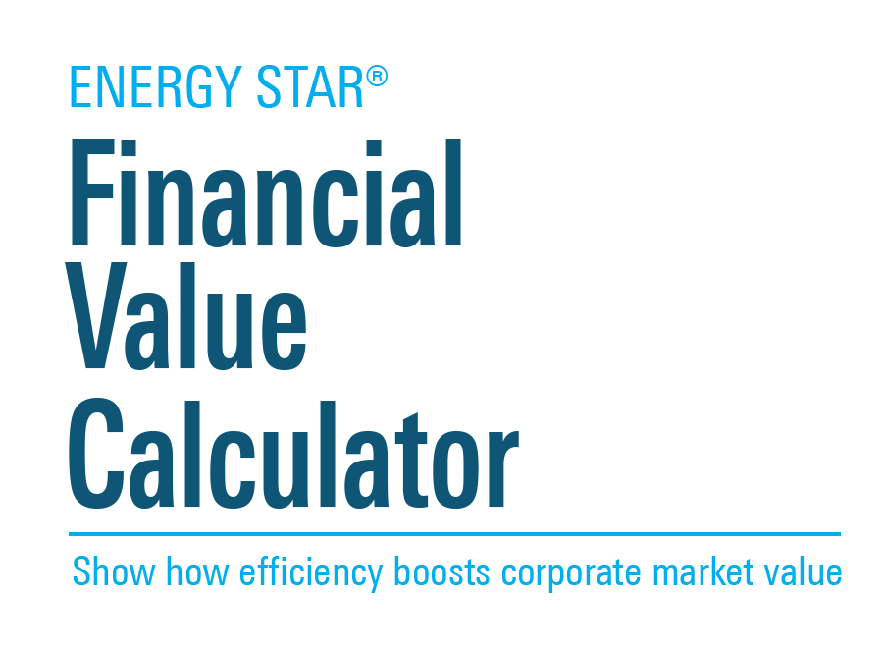
Quantifies the value of improvements in energy efficiency to your organization.
Uses the prevailing price/earnings ratio to estimate the market value of increased earnings that can result from increased energy efficiency.
energystar.gov/buildings/FinancialEvaluation
Notes:
The Financial Value Calculator was designed for owners and managers of corporate real estate. It quantifies the value of energy efficiency improvements to corporate market value.

Slide 49


Action Workbooks for Congregations and Small Businesses
Planning guides for increasing energy efficiency in small businesses and worship facilities.
energystar.gov/smallbiz
energystar.gov/congregations

Slide 50

Communications Strategy Planning Guide
Six-page worksheet for planning a communications strategy to engage stakeholders around energy efficiency
energystar.gov/buildings/tools-and-resources

Slide 51

Launch your own energy or water competition!
Step-by-step guidance on how to:
  Set Goals
  Define the Playing Field
  Dedicate Resources
  Recognize Participants
  Keep Score
  Plan the Launch
  Get the Word Out
www.energystar.gov/
competitionguide

Slide 52

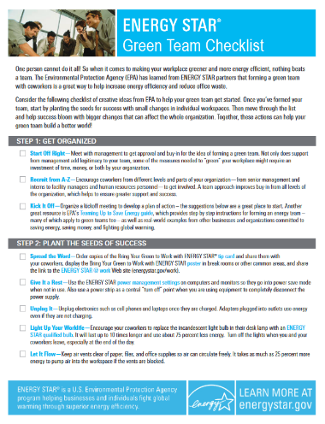
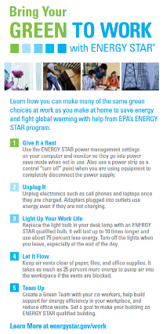

Engage employees with fun tools
Animated workplace tools
Green team checklist
Posters and tip cards
Building tour video
Energy quiz
Fast facts
… and more!
energystar.gov/work
Notes:
Our Bring Your Green to Work suite of tools was designed to make saving energy fun for everyone in an office or plant. With posters, tip cards, a green team checklist, an IQ quiz, and interactive games, this is an easy set of resources to help you engage employees and occupants.

Slide 53

Find more in the Tools & Resources Library
Quick start guides
Energy management guidance and best practices
Financing guidance and calculators
Success stories and best practices
Communication and educational materials and templates
Sector-specific energy management guidance
Technical documentation on ENERGY STAR
And more!
energystar.gov/buildings/tools-and-resources

