Slide 1
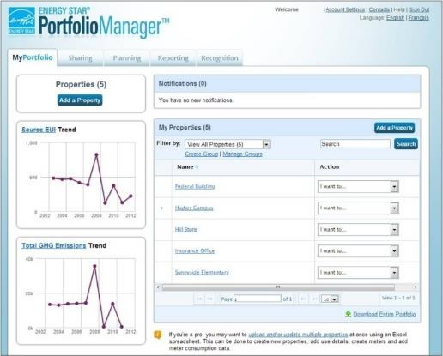
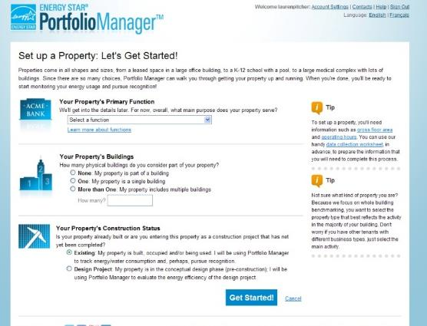
How to Track Waste and Materials Management in Portfolio Manager®
Notes:
Hello to everyone and welcome to today’s ENERGY STAR webinar, “How to Track Waste and Materials Management in Portfolio Manager.”

Slide 2
Agenda
Waste and Materials Management
Background on Portfolio Manager
Value of Tracking
Waste Tracking in Portfolio Manager
Overview and Terminology
Demonstration
Questions

Slide 3
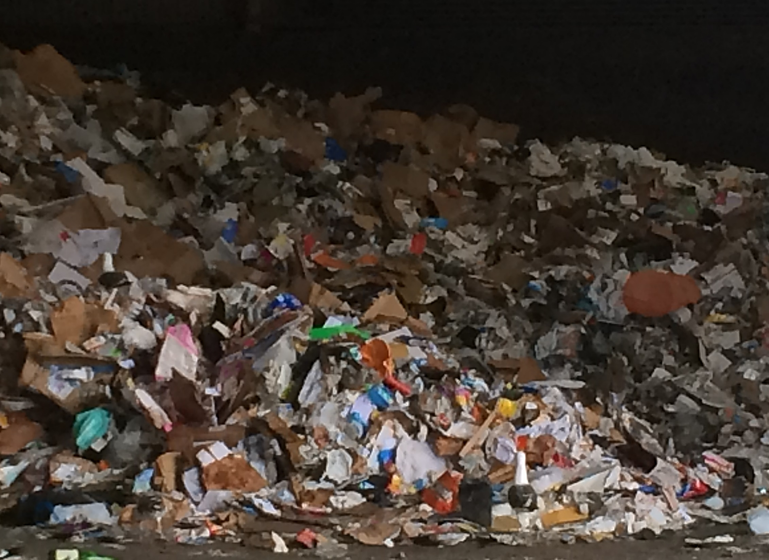
Notes:
When it comes to commercial buildings, why is it that we’re content with not knowing how much is generated and hauled away? We pay for the service, without really knowing exactly what we’re paying for.

Slide 4
Commercial Buildings & Materials
Buildings are major contributors to material use and waste
Responsible for roughly half of 170 million tons of materials landfilled and incinerated in U.S. in 2014
Tremendous opportunity for commercial buildings to reduce, reuse, & recycle
→ Measurement is the first step to sustainable management

Slide 5
Management Tool
Assess whole building energy and water consumption and waste & materials management
Track changes in energy, water, waste & materials, greenhouse gas emissions, and cost over time
Track green power purchasing
Share/report data with others
Create custom reports
Apply for ENERGY STAR certification
Metrics Calculator
More than 150 metrics available
Energy consumption (source, site, weather normalized)
Water consumption (indoor & outdoor)
Waste & materials management
Greenhouse gas emissions
ENERGY STAR 1-to-100 score for energy efficiency (available for many building types)
Accessible in a free, online secure platform
www.energystar.gov/portfoliomanager
Notes:
You’ve heard it before: “you can’t manage what you don’t measure”
That’s why EPA offers ENERGY STAR Portfolio Manager – a free, online tool you can use to measure and track energy, water, and waste. Use it to benchmark the performance of one building or a whole portfolio buildings, all in a secure online environment.
Portfolio Manager is both a management tool and a metrics calculator. As a management tool, it can be used to assess whole building energy and water consumption, waste & materials management, track changes over time, track green power purchases, share and report data with others, create reports, or apply for ENERGY STAR Certification. As a metrics calculator, Portfolio Manager helps you measure progress and can inform your sustainability strategy.
The waste tracking functionality is part of the management tools and metrics in Portfolio Manager that enable you to assess and measure your property’s performance.
As you know, Portfolio Manager, is a free, online, secure resource for benchmarking all types of properties.

Slide 6
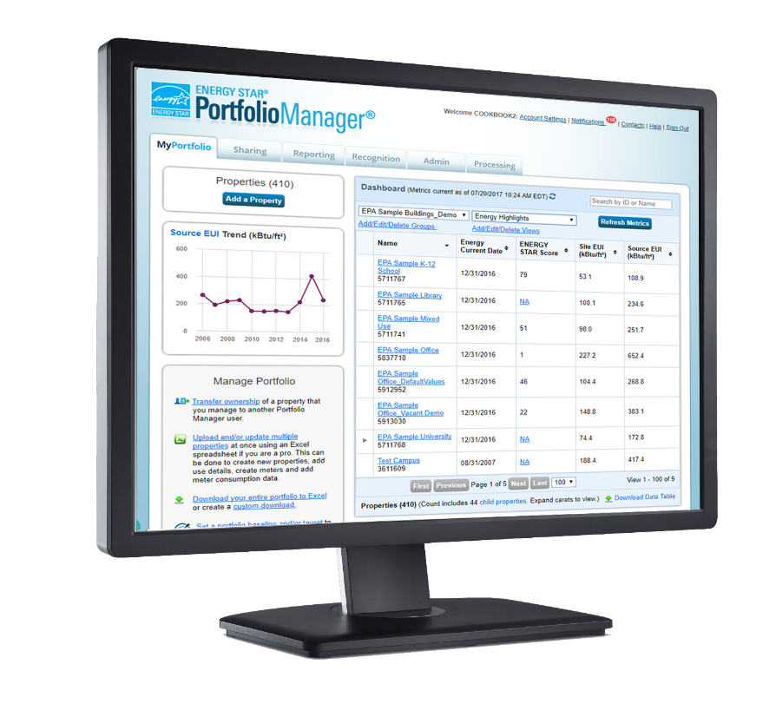
270,000 buildings last year
Two dozen local benchmarking policies
One foreign government (Canada)
Notes:
In 2018 alone, nearly 270,000 buildings, comprising 26 billion square feet of floorspace, used Portfolio to measure and track their energy use, water use, and waste and materials.
Not only that, but Portfolio Manager is the tool of choice among cities such as New York, Seattle, and Boston that have passed mandatory benchmarking laws, as well as the Canadian Government, which uses it for their national energy benchmarking program.
Today, Portfolio Manager is used by more than 45% of the commercial building market in the US and more than 500,000 buildings have benchmarked their energy use.

Slide 7
Notes:
The inclusion of waste tracking in Portfolio Manager represents the evolution of the tool over time from purely an energy benchmarking platform to a broader sustainability tracking tool. While building energy performance assessment is still the primary, and fullest, functionality of Portfolio Manager, EPA understands that many organizations are interested in measuring and tracking the performance of their properties across multiple resource streams, including energy, water, and waste. That is why EPA introduced water tracking functionality in 2006, in collaboration with EPA’s WaterSense, and introduced waste tracking functionality in 2016, in collaboration with EPA’s Office of Resource Conservation & Recovery – home of WasteWise, the Federal Green Challenge, and the Food Recovery Challenge.

Slide 8
Why Include Waste Tracking in Portfolio Manager?
ENERGY STAR Partners requested it!
See value in one sustainability platform to track and manage energy, water, and waste
Increasing demands for sustainability reporting, which Portfolio Manager can help streamline
Basic structure and focus on building-level operations supported addition of waste tracking
Opportunity to drive standardized waste/materials reporting in commercial buildings
Opportunity to reduce GHG emissions by fostering a move towards sustainable materials management
Notes:
The inclusion of waste tracking within the Portfolio Manager tool makes sense for a number of reasons….

Slide 9
The Value of Waste Tracking in Portfolio Manager
Encourages ongoing, monthly tracking of waste, which can lead to better management
Standardizes tracking across your portfolio for better uniformity
Distinguishes between measured and estimated values
Enables everyone involved with a property to be working from the same data
Begins a groundswell of organizations requesting better data from their haulers and technology providers
Supports an increase in the number of properties tracking their waste in Portfolio Manager, which can then feed into development of comparative metrics and data trends

Slide 10
The Value of Addressing Your Building’s Waste
Save money
Enhance sustainability
Conserve resources
Reduce greenhouse gas emissions
Knowledge is power
Notes:
In addition to the cost savings, there are more building-specific benefits to addressing waste, including:
Improving an organization’s sustainability which can boost its image, positively engage employees, and attract quality tenants
Reducing GHGs and conserving resources
Arming themselves with an understanding of the amount and types of wastes their organization produces so they can realize opportunities for waste reduction and ensure that hauling costs actually fit their organization’s needs
The first step to realizing these benefits is to track waste management activities. ENERGY STAR’s Portfolio Manager tool offers an easy to use platform to track buildings waste management activities, along with energy and water use.

Slide 11
Waste Tracking: Basic Terminology
Waste Material Type – The 29 different categories of materials that you can track (e.g. trash, mixed recyclables, batteries, food scraps, etc.)
Waste Management Method – One of 4 options for how you manage your waste and materials
Donated/Reused
Recycled
Composted
Disposed
Disposed Waste Destination – One of 4 options for where your disposed waste (e.g. trash) goes:
Landfill
Incineration
Waste to Energy (refers to incineration for energy recovery, not to landfill with gas recovery)
Other/Unknown
Waste Diversion – the sum of the Composted, Recycled, and Donated/Reused Materials (i.e. everything that is not disposed)
Notes:
Now, we are going to dive into a bit more detail regarding how you can use Portfolio Manager to measure and track waste and materials. To start, let’s look at a few of the terms that you will see in Portfolio Manager.

Slide 12
Materials for Tracking
Waste/Materials | Disposed | Donated/ Reused | Recycled | Composted
Appliances | x | x | x
Batteries | x |  | x
Beverage Containers (aluminum, glass, plastic) | x |  | x
Building Materials - Carpet/Carpet Padding | x | x | x
Building Materials - Concrete | x | x | x
Building Materials - Mixed/Other | x | x | x
Building Materials - Steel | x | x | x
Building Materials - Wood | x | x | x
Cardboard/Corrugated Containers | x | x | x | x
Compostable - Mixed/Other | x |  |  | x
Electronics | x | x | x
Fats/Oils/Grease | x |  | x
Food/Food Scraps | x | x |  | x
Furniture | x | x
Glass | x | x | x
Grass/Yard Trimmings | x |  |  | x
Lamps/Light Bulbs | x |  | x
Mixed Recyclables | x |  | x
Office Supplies | x | x
Pallets | x | x | x
Paper - Books | x | x | x
Paper - Copy Paper | x |  | x | x
Paper - Mixed | x |  | x
Plastics - Mixed | x |  | x
Plastics - Wrap/Film | x |  | x
Regulated Medical Waste | x
Textiles/Clothing | x | x | x
Trash | x
Other | x | x | x | x
29 Material Types
4 Methods of Management
Notes:
To develop the list of material types, EPA looked at the material categories most used by WasteWise partners, those in EPA’s Waste Reduction Mode (WARM), and also solicited feedback from Portfolio Manager users.
For materials or waste that don’t fit in any of the 28 material type categories, you would select “other”
Please note that EPA did not include categories for universal or hazardous wastes, as those are regulatory terms. Whether a waste is defined as a universal or hazardous waste depends on the jurisdiction, the type and amount of waste, and who or how it was generated.
For example, several states consider electronics to be universal or hazardous wastes.
If you want to track a material or waste that doesn’t fall in one of the 28 material type categories, then select “other.” You could then name the meter, whatever best describes what you’re tracking. For example, “Other – Used Pesticides.”

Slide 13
Methods of Data Entry
Regularly – Meters for materials that are picked up on an ongoing basis (e.g. weekly pickup of trash and recycling). There are two basic paths:
Measured – Requires a weight or volume for each entry
Can be marked as “estimated” if it is a weight that the you/your customer estimate on your own
Container Size – Based on the size of the container
You/your customer enters a container size, and specifies the number of times it was emptied and the percent full
Intermittently – Meters for infrequent or 1-time events (e.g. annual donation of electronics, or construction materials).
Notes:
When setting up tracking for a specific waste type in Portfolio Manager, you can indicate whether this material is collected on a regular/ongoing bases, or whether it is an infrequent or 1-time event.
For regular pickup, Portfolio Manager allows you to enter measured data (by weight) or to track based on container size (in which case Portfolio Manager will apply volume-to-weight conversions). We’ll talk more about this in a few minutes.

Slide 14
Step 1: Select Material & Management Method
Select the material you’re managing
Trash, Cardboard, Furniture, etc.
Select the Management method
Disposed, Recycled, etc.
Add up to 10 different meters at once
Notes:
The screen shot here shows the first step in setting up meters within Portfolio Manager to track different waste and material types. You will select the material type (from among the 29 categories shown earlier), as well as the management method.
Note that you can create up to 10 different waste meters at once. Ideally, you would have one or more waste meters defined in Portfolio Manager for each category of waste that you are tracking.

Slide 15
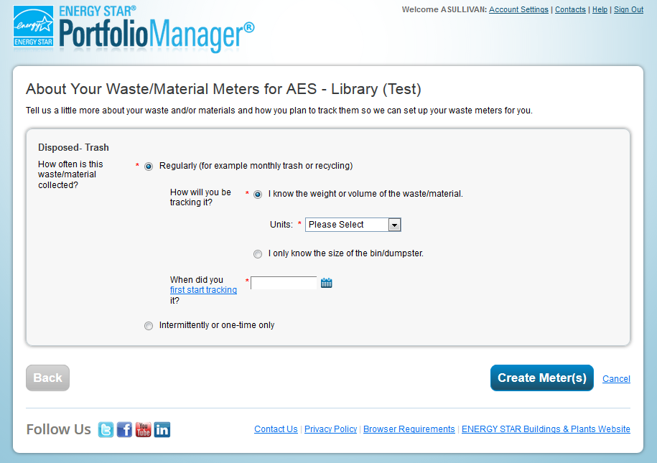
Step 2: Indicate Meter Type
First, select Regular or Intermittent
Page will dynamically change based on your choices
For Regular, chose whether you will enter with a quantity, or just tell us the size of your dumpster
Notes:
The next step allows you to provide a bit more detail for each of the meters that you defined in the prior step. In particular, you will tell Portfolio Manager whether this a given material is being tracked regularly or intermittently, and you can specify whether you will be entering data based on material weight or container volume. You’ll also need to indicate the date as of which you are first tracking waste. This should align with the start date of your first meter entry.
Note that this page is dynamic, so the items that you need to fill out may change based on choices that you make.

Slide 16
Meter Type Options
 | Regular Meter | Intermittent Meter
When to use | Dumpsters picked up regularly (e.g. 2x per week) | Infrequent or 1 time events (e.g. Furniture donation)
What the system will expect | Data will be present every month (no gaps/overlaps) | No minimum data requirements
How you will enter data | Two Options: Regular. Enter a quantity each month (e.g. 100 lbs, 3yd³) Regular Container. Tell us the size of your dumpster and how often it was emptied | One Option: Intermittent. Enter a quantity (e.g. 100 lbs, 3yd³)
Information required at meter setup | Regular The unit you will use to enter data The date for your first bill Container Size The size of your dumpster The date for your first bill | Intermittent The unit you will use to enter data (e.g. lbs, kg)
Notes:
This table provides a bit more detail as to setting up “regular” vs. “intermittent” waste meters. We will be providing a copy of these slides following the webinar, so you will be able to refer back to this table as needed.

Slide 17
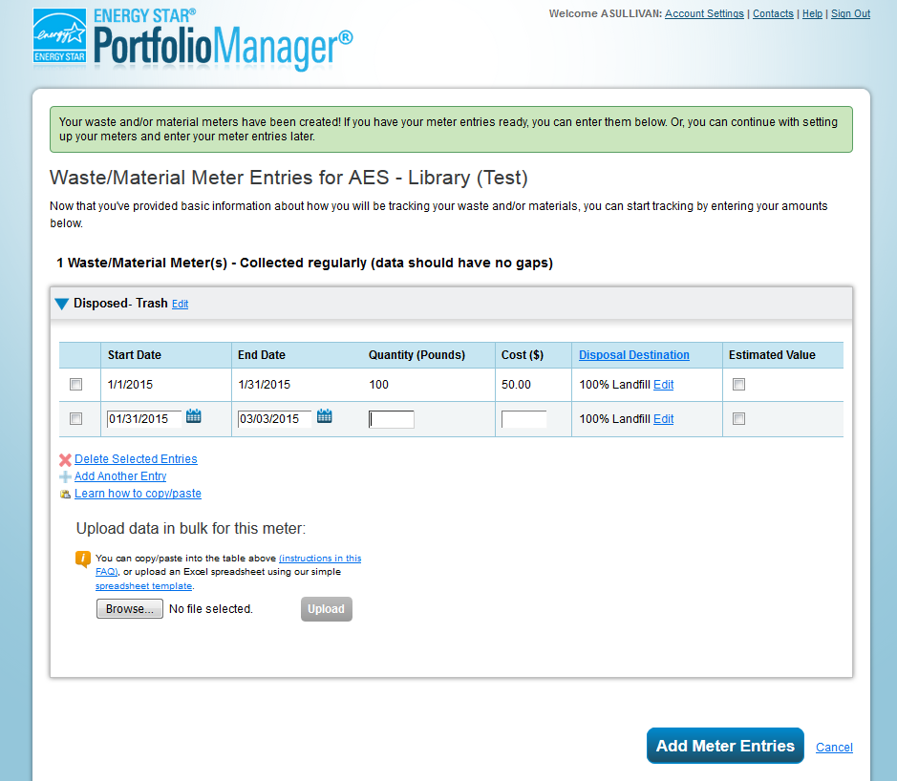
Step 3: Enter Monthly Data
Tables to enter records for each month
Similar to entering energy and water
Exact fields will depend on the meter type (regular, intermittent)
You do not need to complete this step to set up a meter
Come back and fill in later
Notes:
After you have set up and defined your meters, you will be able to fill in monthly records. The process for doing this is very similar to how you may already be tracking energy and water in Portfolio Manager. The exact fields that you need to enter may vary depending on the material type you are tracking and the management method and frequency that you selected earlier.
If you are not ready to fill in this information at the time you set up your waste meters, that’s fine. You’ll be able to come back later to fill in this information.

Slide 18
Data Required by Meter Types
Regular | Regular Container | Intermittent
Most like metered energy | Instead of a quantity, enter number of pickups & average percent full There is no “estimated” flag | Similar to bulk energy, with one date rather than a range
Start Date End Date Quantity Cost Disposal Destination (if applicable) Estimated (Y/N) | Start Date End Date Number of Times Picked Up Average Percent Full Cost Disposal Destination (if applicable) | Start Date Quantity Cost Disposal Destination (If applicable) Estimated (Y/N)
Note if the waste is disposed, additional data is required
% for each option: Landfill, Waste-to-Energy, Incineration, and unknown
% values must add to 100; can omit options that are 0%
Notes:
Here is another summary table to provide a quick reference regarding the specific consumption-level data that will be needed for each type of meter that you set up. Again, you will be able to refer back to this table later, after we send you a copy of today’s slides.

Slide 19
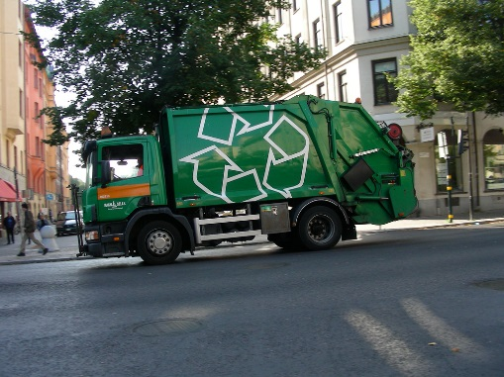
Where Can You Get This Data?
The goal of waste and materials management in Portfolio Manager is to help users start tracking information that may not be tracked (or available) today
Tips for participants:
Ask haulers if it is possible to measure the weight of their materials. This should be their long-term goal.
If they can’t get the weight, Portfolio Manager offers the “Container” option, which requires you to estimate a % full.
This may sound hard – how can they look at the dumpster every time it is picked up?!
The goal is to start to learn more about how much waste/material they have.
When they first start using Portfolio Manager, they can enter 100% for each month.
Notes:
We understand that you may not immediately have all of the data required to begin tracking waste and materials in Portfolio Manager. The goal is to start tracking what you do have, or are able to estimate, and then move forward in trying to obtain better data in the future. Ideally, you would know the weight of each pickup for each material type – but if this is not known, there are other workarounds, including the option to define pickups by container size and “percent full.”

Slide 20
Volume Conversions
Volume conversions
Used to convert volume into weight
Important because the main unit for metrics and reporting is tons
Materials without conversions
Cannot use “container size” option
These materials are required to provide a weight
If you need to estimate the weight, there is a way to mark each entry as estimated
Materials without Volume Conversions
Appliances
Batteries
Electronics
Furniture
Lamps/Light Bulbs
Office Supplies
Regulated Medical Waste
Other
Notes:
If you do opt to track according to container size, Portfolio Manager will apply standard volume-to-weight conversion factors that are specific to each material type. Of the 29 material types available in Portfolio Manager, 21 of these have established volume conversions. The remaining 8 material types must be tracked by weight if you are capturing them in Portfolio Manager. You can mark a weight as “estimated,” if necessary.

Slide 21
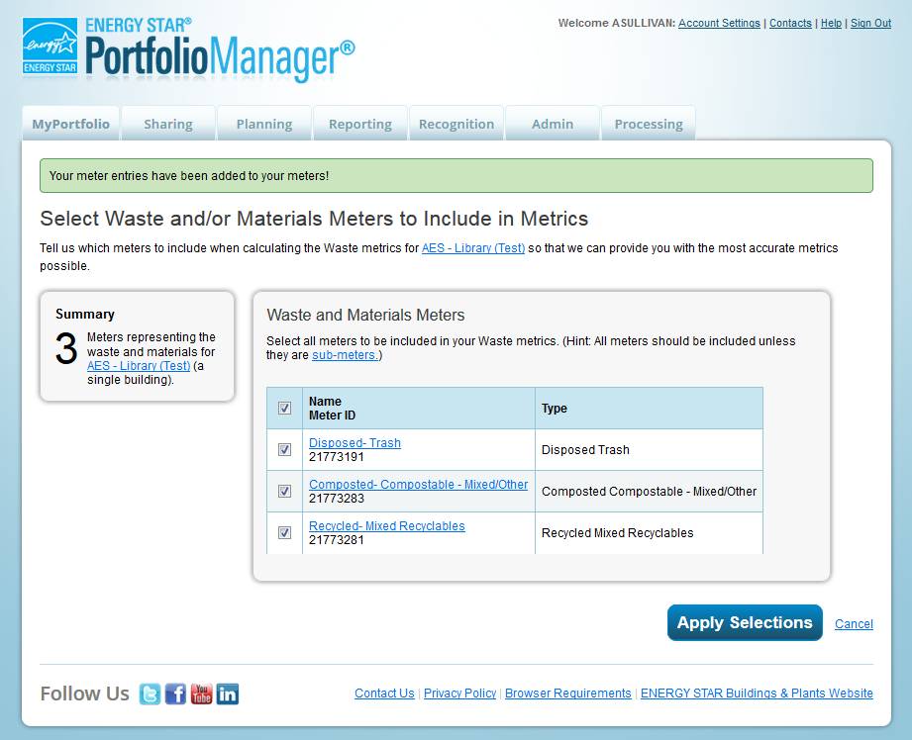
Step 4: Associate Your Waste Meters
Tell us which meters to add to your total
Similar to the process for energy and water
Usually, all of your meters will be associated
Notes:
Finally, once all of your waste & material meters are set up, you’ll need to associate these with your property. This is the process of telling Portfolio Manager which individual meters should be included in property-wide metrics for waste and material tracking. Typically, you would include any and all waste/material meters that you have set up. If you don’t associate your meters upon initial setup, you’ll have the opportunity to do so later.

Slide 22
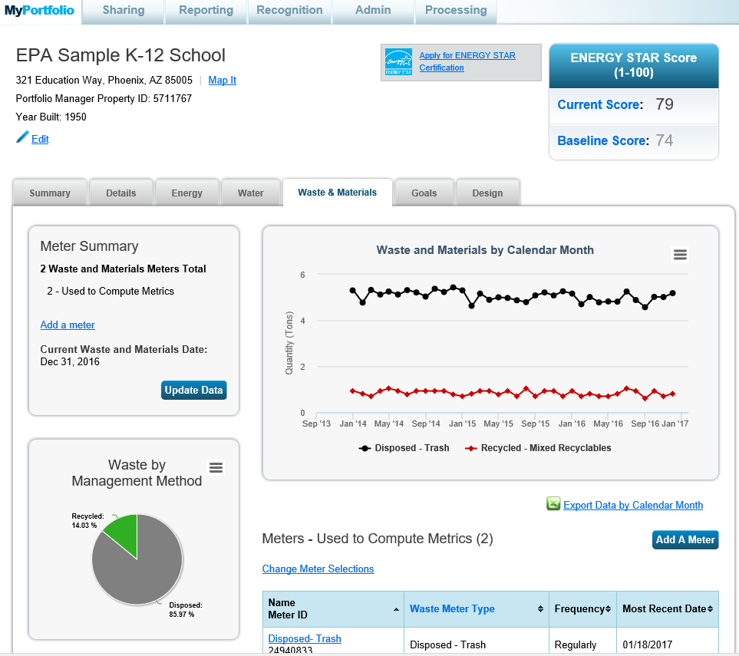
Notes:
Once all of your meters are collected and associated with the property, and you have a minimum of 12 months of data, you will be able to start reviewing performance metrics over time. This is a screen show of the “Waste & Materials” tab within Portfolio Manager – but further information can be obtained via the “Reporting” tab.

Slide 23
Waste and Material Management Metrics
Overall Aggregate Metrics
Total Waste (Disposed and Diverted)
Total Diverted Materials
Includes: Recycled, Composted, and Donated/Reused Materials Only
Does not include: waste-to-energy because in this case the waste is still destroyed
Total for each management method (e.g. Disposed, Recycled)
Total for each disposal destination (e.g. Landfill, Incineration, Waste-To-Energy)
Detailed Metrics each type of waste (e.g. Recycled – Cardboard)
Total Cost and Tons
Estimated Data Flag
All metrics can be pulled in a custom report and download to Excel
If you want to create different aggregate metrics you can
Can perform your own calculations for universal waste, energy recovery, or other areas of interest relative to your sustainability goals.
→ The waste data does not impact your ENERGY STAR score or calculated GHG Emissions
Notes:
This slide provides an overview of the waste and material management metrics that you can obtain through Portfolio Manager using the Reporting functionality.
Note that there is a pre-defined “Waste Report” in Portfolio Manager, which includes a number of property-level metrics related to waste and material quantity as well as disposal cost. This is useful if you want a high-level summary by waste management category. For more specific metrics, such as the total amount and cost of a particular material type, you would take advantage of the “custom template” functionality, which allows you to select up to 50 metrics for inclusion in your report.
It is important to note that the tracking of waste and materials in Portfolio Manager does not impact your property’s energy use intensity or ENERGY STAR score. Furthermore, the GHG metrics calculated by Portfolio Manager only pertain to building-level energy consumption at this time – they do not account for different approaches to waste management.

Slide 24
Let’s take a look!
Setting Up Waste Meters
Add 4 meters to a property, one for each management method
Assessing Waste Performance
Waste tab
Summary tab
Performance Highlights Report
Waste Report
Custom Report
Notes:
Having provided this overview, let’s take a quick look at what this process looks like as we move through Portfolio Manager. I’m going to take a moment to share my screen with you.

Slide 25
Helpful Resources
Waste FAQs
https://portfoliomanager.zendesk.com/hc/en-us/categories/202589637-Waste-Benchmarking
ENERGY STAR Buildings Training Page
https://www.energystar.gov/buildings/training
Additional Waste-Specific resources are being development
Managing and Reducing Wastes: A Guide for Commercial Buildings
https://www.epa.gov/smm/managing-and-reducing-wastes-guide-commercial-buildings
EPA’s conversion factors for waste
https://www.epa.gov/smm/volume-weight-conversion-factors-solid-waste
Notes:
As we wrap up today, we wanted to provide links to some helpful resources regarding waste and material tracking in Portfolio Manager. If there are any additional resources that you think would be valuable, please let us know in the post-webinar survey that will open in your browser when you exit today’s session.

Slide 26
Recorded Webinars Available
Rolling Out Waste Tracking Across Your Portfolio
Trends in tracking waste data in Portfolio Manager
Technology Solutions to Waste Tracking
Waste management: strategies for a successful recycling program
How to Reduce Waste and Track Progress: Ahold Delhaize's Approach
Notes:
This slide contains hyperlinks to a number of past ENERGY STAR presentations on waste tracking and Portfolio Manager that you may wish to review.

Slide 27
Thank you for attending!
Questions?
If after this webinar you have any questions on Portfolio Manager, contact us at: www.energystar.gov/BuildingsHelp
27
Notes:
With that, we have wrapped up our presentation for today. At this point, we will spend the next few minutes answering questions submitted by attendees during the session.

