Slide 1
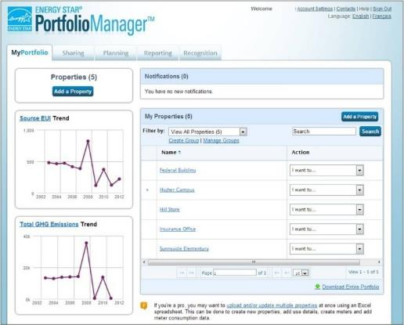
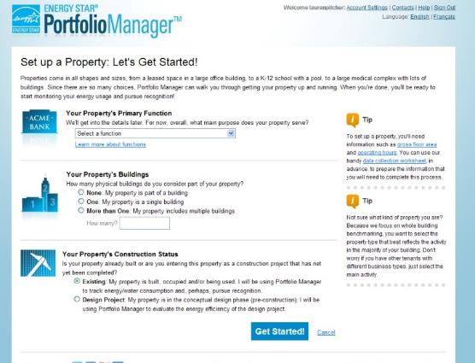

How to Apply for the ENERGY STAR®
^{for US Buildings}
Notes:
Good afternoon, my name is [ ] from ICF, an implementation support contractor working in support of EPA’s ENERGY STAR program.

Slide 2
Learning Objectives
To gain an understanding of:
  The value of the ENERGY STAR Certification
  Eligibility requirements for Certification
  How to apply for the ENERGY STAR Certification in Portfolio Manager
  How to track the status of applications
How to Apply for ENERGY STAR certification in Canada
  https://www.nrcan.gc.ca/energy/efficiency/buildings/energy-benchmarking/building/20525
If you’re brand new to Portfolio Manager, visit energystar.gov/buildings/training for the training resources that will help you get started
Notes:
In this training session you will gain an understanding of why to pursue ENERGY STAR Certification and the steps to apply for certification for your properties. Specifically, this presentation will go through the value of the ENERGY STAR certification; what it takes to be eligible for the certification; how to apply within Portfolio Manager; and finally, how to track the status of your application and see it through to receipt of the award.
If you’re brand new to Portfolio Manager, a good place to start is with the “Quick Start” Guide or the Portfolio Manager 101 session, which can be accessed at http://www.energystar.gov/buildings/training
The assumption of this session is that you already have your property set up with complete use details and energy information, and now you’re interested in learning more about how to apply for the ENERGY STAR.
Please note that this webinar is only for US building certification. If you are interested in learning about certification for buildings in Canada, please review the link in the slide for “How to Apply for ENERGY STAR certification in Canada”. https://www.nrcan.gc.ca/energy/efficiency/buildings/energy-benchmarking/building/20525

Slide 3
The Value of the
ENERGY STAR Certification
Notes:
To start, let’s discuss the value of receiving ENERGY STAR certification.

Slide 4

Recognized by more than 90%
of Americans
Notes:
According to a survey conducted in 2019, the ENERGY STAR label is recognized by more than 90% of American consumers and has continued to grow as the program has entered its second decade.
ENERGY STAR is one of the single most trusted environmental labels in the United States. It’s the nation’s symbol for superior energy performance.

Slide 5


The biggest little label in energy efficiency
7 billion
products
39,000
buildings
250
industrial plants
2.3 million
homes
Notes:
For more than 20 years, EPA’s ENERGY STAR program has identified the most energy-efficient products, buildings, plants, and new homes – all based on the latest government-backed standards.
Today, every ENERGY STAR label is verified by a rigorous certification review process. We’ll be focusing on the commercial buildings number here, which has certified almost 40,000 throughout the program’s history.

Slide 6
ENERGY STAR Certified Buildings
Floor Space (Million Square Feet)
Buildings Certified
Notes:
You can see from this chart that the number of certified buildings has been increasing steadily each year. You’ll also note that all of these bars cumulatively add up to more that 38,000 buildings. That’s because buildings need to recertify each year to maintain ENERGY STAR certification status. Just because your building was a superior energy performer last year doesn’t mean it’s performing the same this year. This comes down to continued O&M improvement among other efforts; as such, this program has an annual label to drive continuous and sustained energy efficiency performance.

Slide 7
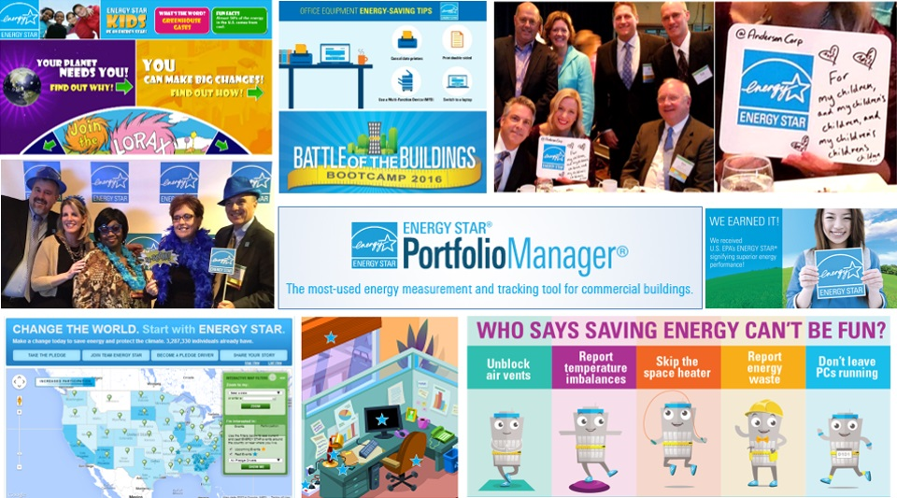
And it’s more than just a label…
Notes:
And for buildings, ENERGY STAR is more than just a label. It’s an entire framework upon which thousands of organizations have built their energy management programs. It’s also proven to be a bridge between engineering and facilities teams and everyone else – be they building occupants, employees, management, or customers. Everyone has a role to play in saving energy, and ENERGY STAR is what brings them in by making energy efficiency fun and accessible.

Slide 8
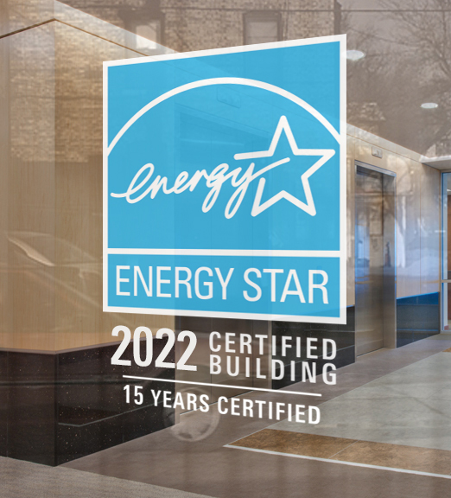
The Value of ENERGY STAR Certification for Commercial Buildings
Cost effective
Protect the environment
No trade-offs
Notes:
ENERGY STAR Certification carries three big messages about buildings:
That cost effective energy management is being practiced
That building management is taking concrete actions to protect the environment through energy efficiency
That building operations and occupant comfort and safety have not been sacrificed in the pursuit of energy efficiency.

Slide 9
The Value of ENERGY STAR
The Value of ENERGY STAR Certification for Commercial Buildings
Reduced operating expenses as compared to non-ENERGY STAR certified properties
Better control of operating expense escalations
Proxy for better functioning equipment
Proxy for overall management
Notes:
Additional values of earning ENERGY STAR Certification for your properties include reduced operating expenses as compared to non-certified properties, as well as the increased ability to control operating expense escalations.

Slide 10
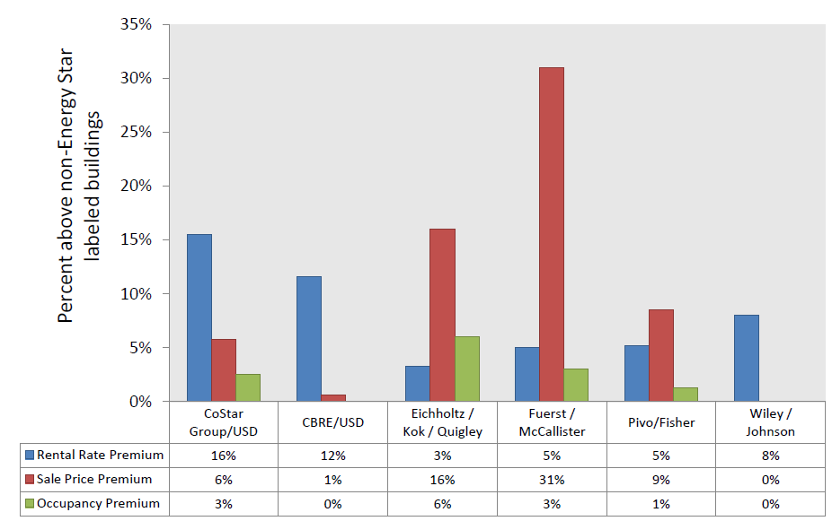
The Market Value of ENERGY STAR Certified Buildings
Source: Benchmarking and Disclosure: Lessons from Leading Cities, based on data from the Institute for Market Transformation
Notes:
We’re not going to go into this graph in great detail, but generally summarizes several studies that evaluated the added market value of ENERGY STAR certified buildings.
Rental premiums range from 5 – 16%
Sale price premiums range from 0 – 31%
Occupancy premiums range from 0 – 6%
Actual tangible value as seen in markets.

Slide 11

ENERGY STAR Certified Buildings
More efficient than 75% of similar buildings
Use 35% less energy
(on average)
Cause 35% fewer greenhouse gas emissions (on average)
Notes:
ENERGY STAR is the nation’s symbol of energy efficiency. When you see the ENERGY STAR on a building, it means that that building is more efficient than 75% of similar buildings nationwide. Additionally, ENERGY STAR certified buildings, on average, use 35% less energy and cause 35% fewer greenhouse gas emissions than their peers.
The building in this picture is Cambridge Savings Bank, which sits right in Harvard Square. It has the distinction of being the nation’s oldest ENERGY STAR certified building. It was built in 1820! Goes to show that a building doesn’t have to be new to be energy efficient.

Slide 12
Eligibility Requirements for ENERGY STAR Certification
Notes:
Now that we’ve discussed the value of the ENERGY STAR certification, let’s talk about what it takes to obtain it.

Slide 13
To Be Eligible for Certification
To be eligible for certification, a property must:
Be located in the United States, U.S. territories, or owned by the U.S. government
Meet the definition of one of the eligible property types
Receive an ENERGY STAR score of 75 or higher that reflects
      the whole property (or campus for Hospitals, Hotels, K-12 Schools or Senior Living Communities)
      all energy use on the entire property for 12 months
      accurate property use details (with vacancy accounted for in Offices and Medical Offices when appropriate)
  Property types eligible for certification in Canada can be found here: https://www.nrcan.gc.ca/energy/efficiency/buildings/energy-benchmarking/faq/3787#faq8
Notes:
These eligibility criteria only apply to EPA building certification.
You can find more information on property types eligible for certification in Canada using the link on the slide.
https://www.nrcan.gc.ca/energy/efficiency/buildings/energy-benchmarking/faq/3787#faq8
Portfolio Manager can be used to track the energy use of any property, but only those meeting certain requirements can be ENERGY STAR Certified.
To be eligible for certification, a property must be located in the United States, U.S. territories, or owned by the U.S. government.
It must also meet the definition of one of the eligible property types and receive an ENERGY STAR score of 75 or higher.
This score must reflect all energy consumption across the entire property for 12 consecutive months.
Only Hospitals, Hotels, K-12 Schools, and Senior Care Centers are able to earn certification as a campus. For these property types, you must include all of the parts of the property that are included in EPA’s definition of that property type.
For all other property types, only a single building can receive a score and earn certification
Lastly, the details of the property use must be accurate, with any vacancies accounted for, and without any default values.

Slide 14


















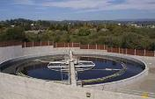
Property types with 1-100 ENERGY STAR scores
Bank Branch
Barracks*
Courthouses
Distribution Centers
Financial Offices
Score based on CBECS data
Hotels
K-12 Schools
Office Buildings
Medical Offices
Residence Hall/Dormitory*
Retail Stores
Supermarkets
Warehouses
Wholesale club/ Supercenters
Worship Facilities
Score based on other survey data
Data Centers
Hospitals
Multifamily Housing
Senior Living Communities
Wastewater Treatment Plants*
Notes:
Building types with an asterisk are not eligible for ENERGY STAR certification.
14

Slide 15
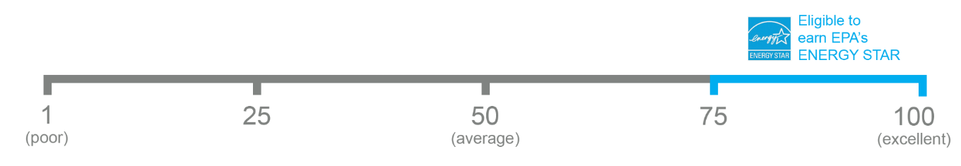

The 1–100 ENERGY STAR Score
One simple number
understood by ALL stakeholders.
Notes:
So, what is the ENERGY STAR Score?
The Score is a percentile ranking of your building compared to similar buildings nationwide.
The Score was developed to offer context for assessing the relative performance of a building compared to its peers and to provide one simple number understood by all stakeholders.
On this scale, 50 represents median performance. A score of 62 means that the property performs better than 62% of its peers and a 75 means that the property performs better than 75% of similar buildings nationwide, and is the minimum score required to earn ENERGY STAR Certification.

Slide 16
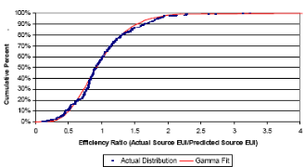
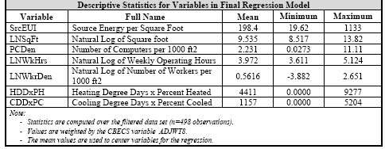
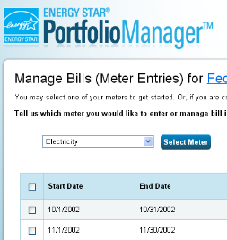

Developing a 1 – 100 ENERGY STAR Score
Data analysis
Nationally representative survey
Statistical modeling
Comparison between actual energy data and the modeled estimate
Notes:
Nationally representative survey - CBECS gathers data on building characteristics and energy use from thousands of buildings across the US
EPA analyzes & filters the data - ensuring data robustness and quality
EPA creates a statistical model that correlates the energy data of the property use details to identify the key drivers of energy use, accounting for weather variations. Use details are considered in Portfolio Manager to be the drivers of energy use in buildings. These details will change according to the property type. For example, the drivers of energy use in a Hospital will be different from those in an Office. Examples of use details in an office building include Operating Hours, Number of Computers, and Number of Workers on the Main Shift.
Compares the actual energy data for a building to the modeled estimate to determine where the building ranks relative to its peers.

Slide 17
How to Apply
Notes:
Now that we’ve discussed the value of ENERGY STAR certification, as well as some details about how you become eligible for certification, let’s cover how you would go about applying for certification.

Slide 18
Overview of the Application Process
Benchmark your property in Portfolio Manager® and achieve an ENERGY STAR score of 75 or higher.
Begin the online application in Portfolio Manager.
Have a Licensed Professional (LP) conduct a site visit, verifying the information in your application.
Complete the online application in Portfolio Manager, upload a scanned copy of the signed application, and submit the application electronically to EPA.
Respond to questions from EPA, if necessary.
Receive notification of the application’s status.
Notes:
First, you have to benchmark your property in Portfolio Manager to determine its score. Properties that receive a score of 75 or above are eligible to apply for ENERGY STAR certification. The score is calculated based on the information entered into Portfolio Manager, which includes 12 months of energy data for all fuel types, and the operational characteristics in effect during this time period.
If your property meets the minimum score, and meets all other eligibility criteria, the next step is to begin the online application in Portfolio Manager.
Then, a Licensed Professional (LP) must conduct a site visit to verify the information in your application. For the purposes of ENERGY STAR certification, ENERGY STAR defines a Licensed Professional as either a professional engineer or registered architect. An LP can be a third party that you have hired – or they can be part of your organization. No matter what, EPA recommends that they follow the guidance provided in The Licensed Professional’s Guide, which can be found online. Note that an LP can have someone under his or her direction conduct all or part of the site visit on their behalf, but the application submitted to ENERGY STAR must still bear the LP’s seal and signature.
After the LP (or the LP’s representative) has conducted the site visit, you can complete the rest of the application in Portfolio Manager. You will need to upload a scanned copy of the application that contains the LP’s signature and stamp as well as the signature of a direct employee of the building owner/manager.
After the application is submitted, EPA will contact you if there are any questions. You will be emailed and get notifications through Portfolio Manager and will need to provide any further information that is needed.
You can always track the progress of your application in Portfolio Manager, to see whether it is under review, escalated to expert, or approved.

Slide 19
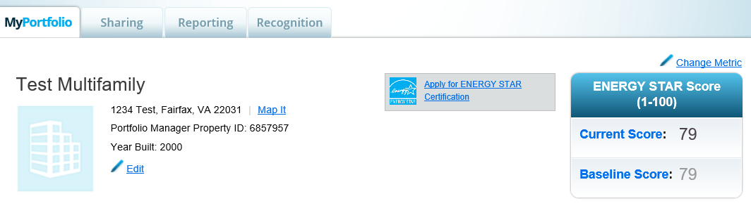
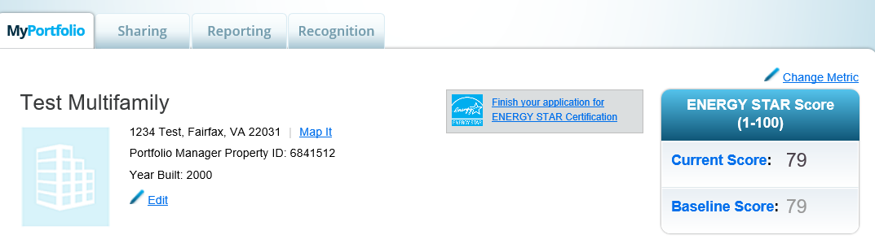
Access the Application Process
Notes:
Now, let’s show you the steps to apply for ENERGY STAR certification in Portfolio Manager.
For properties with a score of 75 or higher (and no other data flags), you will see the “Apply for Energy Star Certification” button near where your score is displayed.
If you need to stop in the middle of the application process, you may do so. When you return to your buildings profile you will see that the button has changed to “Finish your application for the ENERGY STAR Certification
This is how you begin or resume an application for your property.

Slide 20
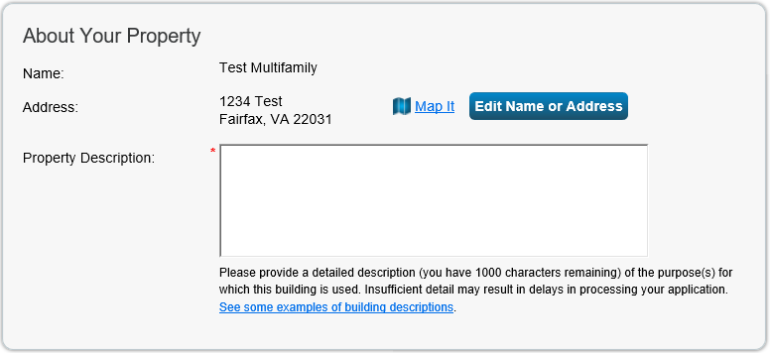
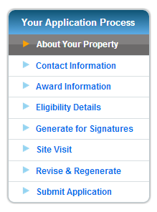
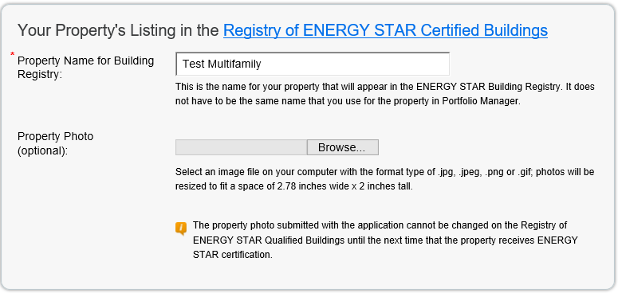
Apply for Recognition: About Your Property
Notes:
On the “About Your Property” page, the name and address of your building will be displayed (as defined by you in Portfolio Manager). You will need to provide a property description, which will not be posted publicly but will help application reviewers. If there are any specific characteristics of your building that you feel the application reviewers need to be aware of, this is where you should note them. If you’re not sure what to write, clink on the link to see some example property descriptions.
Under “Your Property’s Listing in the Registry of ENERGY STAR Qualified Buildings,” you should enter the name of the property as you want it displayed on the ENERGY STAR website. EPA recommends that the name is meaningful to the general public and others who view the Registry. For instance, if the property is called “Property 8675309” in Portfolio Manager, because that’s how it’s listed in your organization’s database, you can choose to have it displayed online as “Central Park Plaza” (or however it is known to the general public).
You also have the option of including a property photo in your property’s listing.

Slide 21
More Details: Property Description
Tips for a good property description:
Be detailed
Describe how the property is used or the services provided within the property
Describe who’s in the property – e.g., primary tenants, grades taught, retailers, etc.
Notes:
A good property description should be detailed and allow the reviewer to get a better understanding of how property is used and what services are provided there. Examples of useful details can include the primary tenants, the grades taught in schools, or a description of retailers. The description should make clear who is in the property and how they use it. Clearer applications will move through the review process more quickly.

Slide 22
More Details: Property Description (cont’d)
Good Examples:
“Kohl's Department Store 10605 Simi Valley is a 94,946 square foot retail store. Kohl's sells clothing, home goods, and exclusive brands.”
“180 Maiden Lane is a 41-story commercial office building located in the Financial District of Lower Manhattan. Its primary tenant is AIG Employee Services, Inc., and there are a handful of other smaller tenants that exist throughout the building. The building receives electricity, natural gas, and district steam utilities.”
“Grade K-6 school in the Whittier City School District in California. This historic school was put in service in 1947. It has 437 students and the supporting faculty and staff.”
Notes:
Here are a few examples of good property descriptions that are clear, informative, and help the application reviewers to understand the nature and function of the property that is under review for certification.

Slide 23
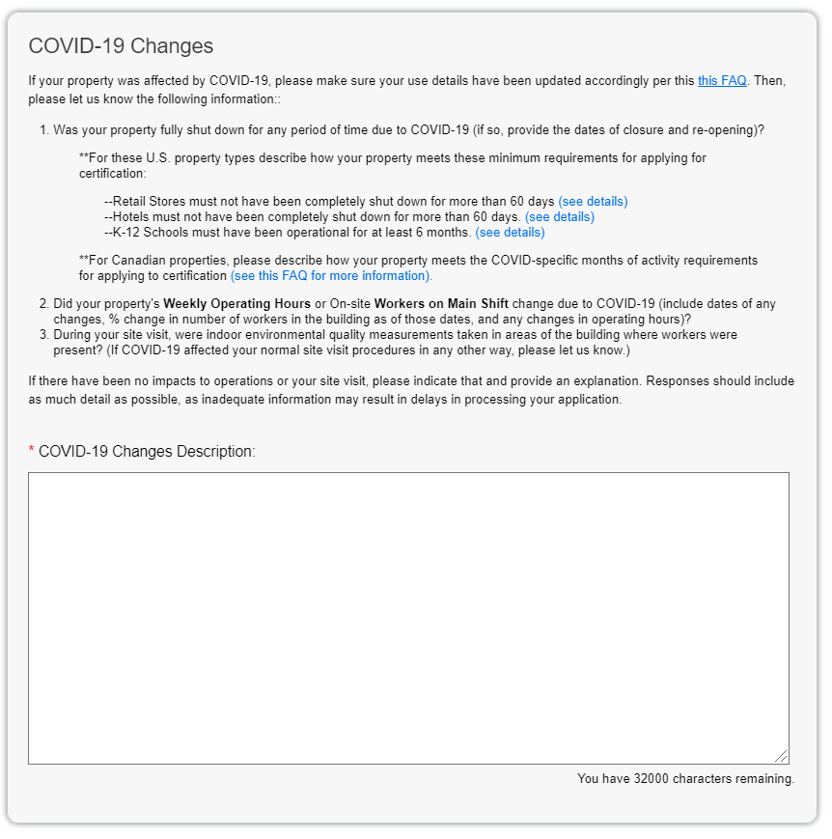
More Details: COVID-19 Changes
Notes:
A new field in the “About Your Property” page requests a description of COVID-19 related changes to the property’s operations. You will need to provide information on whether your property was fully shut down for any period of time due to COVID-19, whether there were any changes in your property’s Weekly Operating Hours or on-site Workers on Main Shift, and whether COVID-19 affected your normal site visit procedures. This explanation will also help clarify any COVID-19 related changes that are not captured in your application, that the application reviewers will otherwise follow up about.

Slide 24
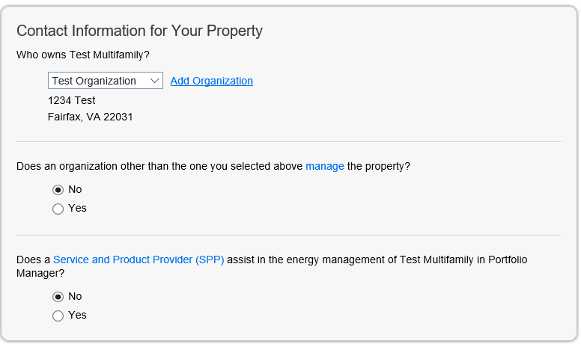
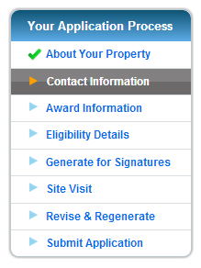
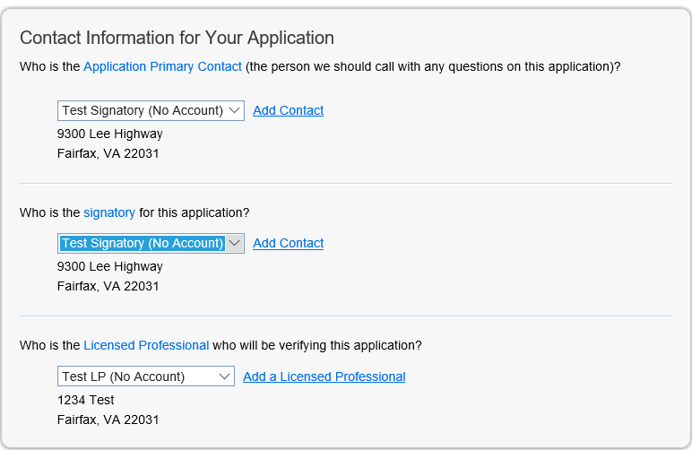
Apply for Recognition: Contact Information
Owner
Manager
SPP
(if applicable)
Primary Contact
Signatory
Licensed Professional
Notes:
The next step is filling out the contact information for your property. In general, the drop-down menu of choices for each contact type will list organizations and individuals that have already been entered into the contacts list for your Portfolio Manager account. An individual or organization needs to be listed as an account-level contact in order for you to select them on this page. You can add contacts to your contact list, if needed, by selecting “Contacts” at the top of the page or by using the links next to the drop down menus.
Choose the owner and manager of the property (these may not always be the same organization).
Select your Service and Product Provider, if applicable. This would be a third party organization that is helping you to manage your benchmarking information in Portfolio Manager.
Choose a primary contact. The primary contact should be a person who would be able to answer any questions the reviewers have about the property.
The second contact, the signatory, should be a representative of the property owner or manager.
The third contact you must list is the Licensed Professional that will verify your application. In many cases, the Primary Contact, Signatory, and LP will all be different people.

Slide 25
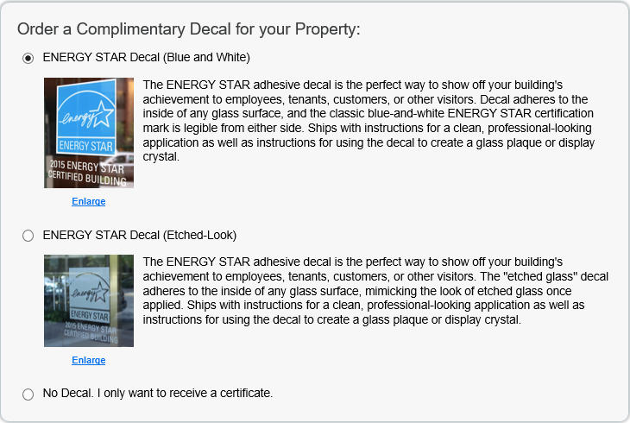
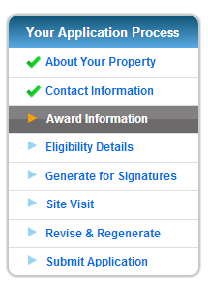
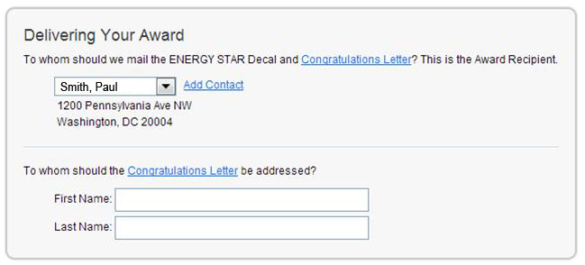
Apply for Recognition: Contact Information
Notes:
The next step is deciding which decal you would like for the property. Your options are “blue and white” or “etched look.” Your awards package will include a certificate, congratulatory letter, a decal, and anniversary decal (if your property has been certified previously)
Be sure to indicate where the award and decals should be sent. The drop down menu will allow you to choose someone in your contact book. Also specify to whom the congratulations letter will be addressed.
There is no charge for the decals that come with your ENERGY STAR award. If you damage or loose your awards package, you can request a new on at www.energystar.gov/buildingshelp

Slide 26
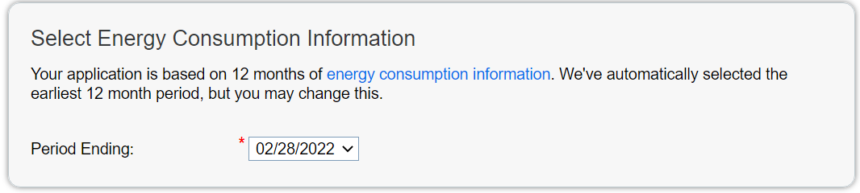
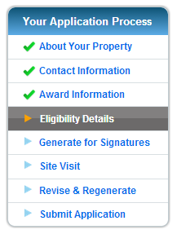
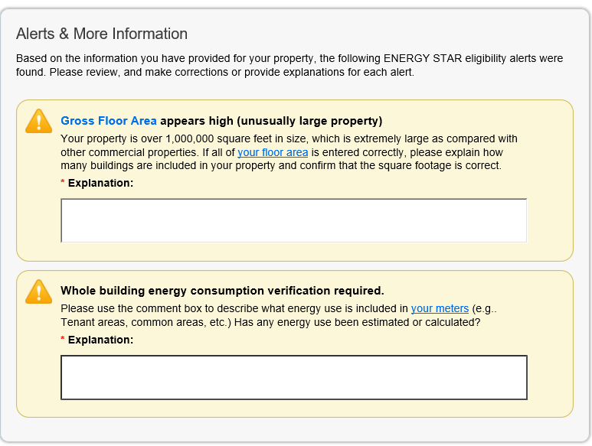
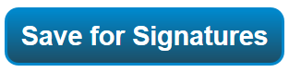
Apply for Recognition: Eligibility Information
Notes:
On the “Eligibility Details” page, you will be asked to select the 12 month period ending for your energy consumption information. Portfolio Manager will automatically select the most recent 12 month period for which complete data are available and for which your property’s score is 75 or higher. However, you have the option to select an eligible period ending date within the range of acceptable Period Ending Dates for that year’s certification. For the 2021 certification year, you can select a Period Ending Date as early as 10/31/2020.
Portfolio Manager will automatically run a series of checks on your property before you submit your application, and will flag anything that may prevent you from receiving recognition. In this example, an alert for unusually large Gross Floor Area as well as an alert for whole building energy consumption verification is shown. A box is available to provide an explanation for why this alert has gone off. If necessary you may go back and make corrections. You can then continue the application where you left off.
After addressing all alerts, select “Save for Signatures”

Slide 27
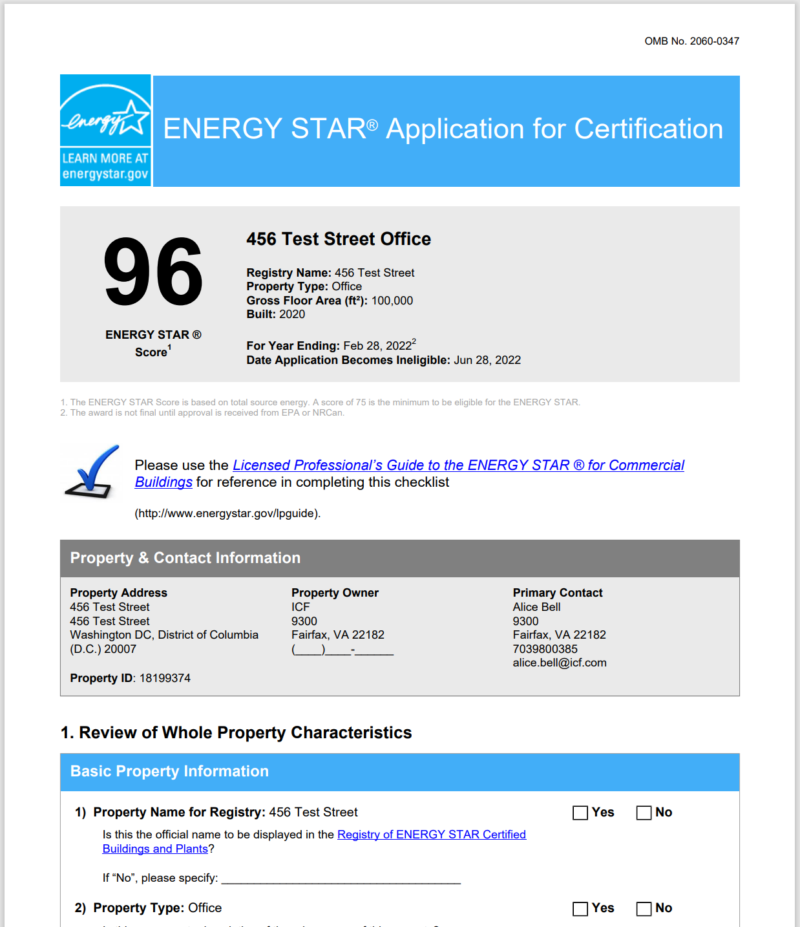
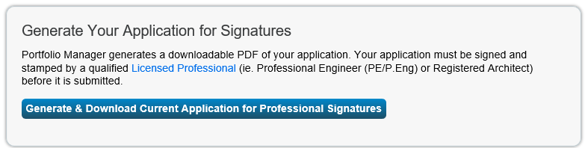
Apply for Recognition: Generate Application for Signatures
Notes:
Once saved, generate and download the application for signatures.
The score, period ending date, and date of application becomes at the top of the first page, followed by property characteristics.
During the site visit, the LP will verify each data point in the application by marking Yes or No, to confirm that the information provided is correct and complete. The LP must also verify that the property meets indoor environmental standards for air quality, temperature, and illumination.
Property use details are shown next, broken out by use type.
In the 3rd section of the application, the LP will be asked to verify the energy consumption data. Data for each energy meter present at the property will be reported here, as well as aggregate energy consumption data across all meters at the property.
The LP must check every box, sign, and stamp the application. The name of the person who conducted the site visit doesn’t have to match the name of the LP who signs and stamps the application (since this can be a person working under the direction of the LP). However, the LP is ultimately responsible for the ensuring the validity of the information on the application. The LP should ensure that the site visit and verification has followed all guidance in The Licensed Professional’s Guide: Understanding the Roles and Requirements for Verifying Commercial Building Applications for ENERGY STAR Certification. See link for details-http://www.energystar.gov/buildings/tools-and-resources/energy-star-guide-licensed-professionals)
A representative of the building other than the LP must also sign the application as the signatory.
At the bottom of each page is the application tracking number. Copy or write down this number, as it will be needed in subsequent steps.

Slide 28
More Details: Licensed Professional (LP) Qualifications
Only Licensed Professionals (LP) with the following qualifications may verify ENERGY STAR applications:
  Possess a current license as a Professional Engineer (PE) or a Registered Architect (RA) in any U.S. State, Canadian Province, or territory of the U.S. or Canada and be in good standing;
    The PE or RA does not need to hold a license in the same jurisdiction as the property he/she is verifying
  Have a working knowledge of building systems, ASHRAE Standard 55 and 62.1, and the IESNA Lighting Handbook; and
  Understand the jurisdiction’s engineering and architectural licensure laws, professional ethics requirements, and regulations
The Licensed Professional may be an employee of the company applying for the ENERGY STAR. However, they must carry out an unbiased assessment of the application.
Notes:
As mentioned before, a site visit must be performed by an LP (or someone working under the direction of the LP) to verify the property and energy information on the application.
The LP can be employee from your organization (e.g., does not have to be an independent 3rd party), as long as they comply with all guidelines and are willing to place their stamp and signature on the application. They must also carry out an unbiassed assessment of the application.
The LP must possess a current license and be in good standing, have a working knowledge of building systems, and understand their jurisdiction’s engineering and architectural laws, professional ethics requirements, and regulations.
ENERGY STAR will accept PE licenses from Canada.

Slide 29
More Details: Responsibilities of an LP
Follow the guidance in The Licensed Professional’s Guide: Understanding the Roles and Requirements for Verifying Commercial Building Applications for ENERGY STAR Certification
Conduct site visit
  Verify all data inputs
  Assess indoor environmental quality
Request that the applicant address any insufficiencies or errors in Portfolio Manager
Check re-generated documents, as needed
Sign and stamp the Application
Notes:
Here is a quick overview of the LP’s responsibilities.
Follow the guidance in The Licensed Professional’s Guide: Understanding the Roles and Requirements for Verifying Commercial Building Applications for ENERGY STAR Certification
Conduct site visit
Verify all data inputs
Assess indoor environmental quality
Request that the applicant address any insufficiencies or errors in Portfolio Manager
Check re-generated documents, as needed
Sign and stamp the Application

Slide 30
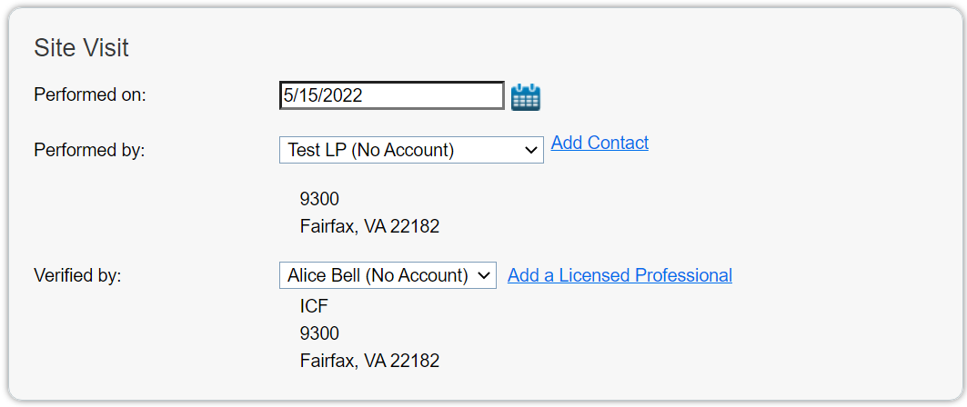
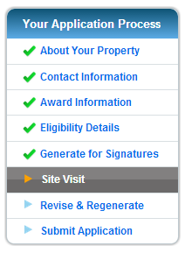
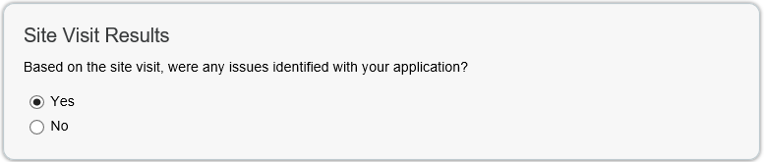
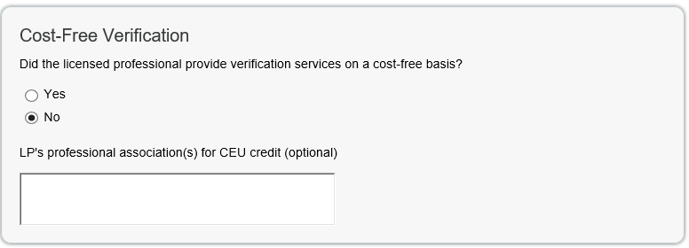
Apply for Recognition: Site Visit
Notes:
After the application has been generated for signatures and after the site visit, return to Portfolio Manager and complete the “Site Visit” portion of the application. Enter the date the site visit was performed and who performed it. If the licensed professional found discrepancies on the application during the site visit, select “Yes” under “Site Visit Results” to revise your Portfolio Manager record to correct mistakes accordingly and then regenerate your application with the corrected information. If there were no issues with the application, select “No.”
You can also indicate if the verification was done pro bono

Slide 31
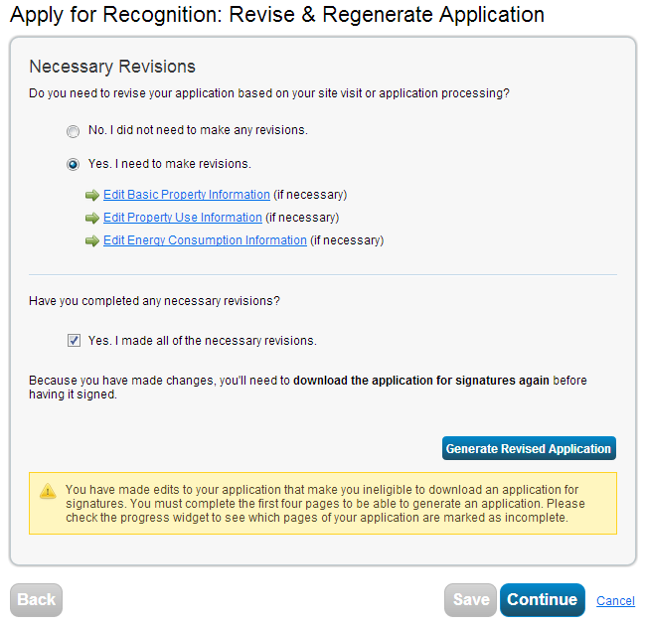
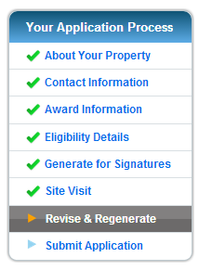
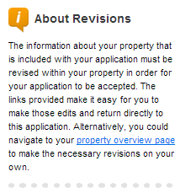
Apply for Recognition: Revise and Regenerate
Notes:
If you selected “Yes” on the previous screen, indicate whether revisions are necessary on the Revise and Regenerate page. If so, use the links provided to access the sections of your property record that need to be edited.
Once the edits are made, select the “Yes” checkbox under “Have you completed any necessary revisions?” and click the button to regenerate a Revised Application.
Select Continue.

Slide 32
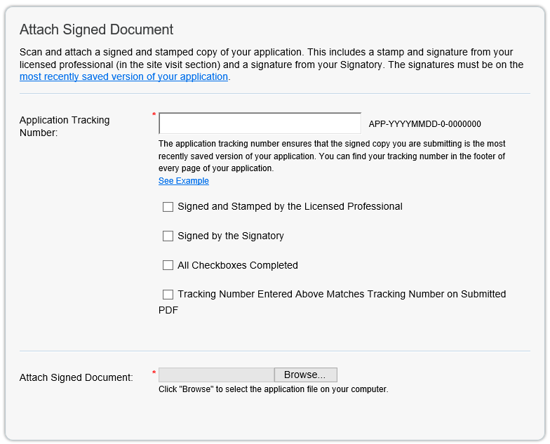
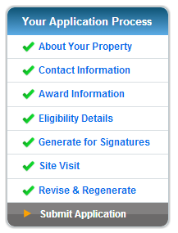
Apply for Recognition: Submit Application
Notes:
In the next section, “Attach Signed Document”, enter the application tracking number you copied from the generated application. You will then mark each checkbox to indicate the application is signed and stamped by the LP, signed by the appropriate signatory (who represents the building owner or manager), all checkboxes on the application are completed, and that the tracking number you entered matches the tracking number on the submitted application.
Attach the completed application file, which should be a scan of the signed and stamped application. Please note that the file can’t be more than 5 MB, and should be in PDF format. If the file is greater than 5 MB open it in Adobe Acrobat, and save it as a “reduced size pdf.” (File → Save As → Reduced Size PDF → Make Compatible with Acrobat 7.0 and later, then click Ok → Save)

Slide 33
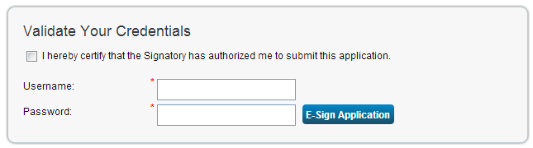

Apply for Recognition: Submit Application
Notes:
Enter your Portfolio Manager username and password to e-sign and submit to EPA. Then your application is complete!

Slide 34
See Your Application
Through to Award

Slide 35
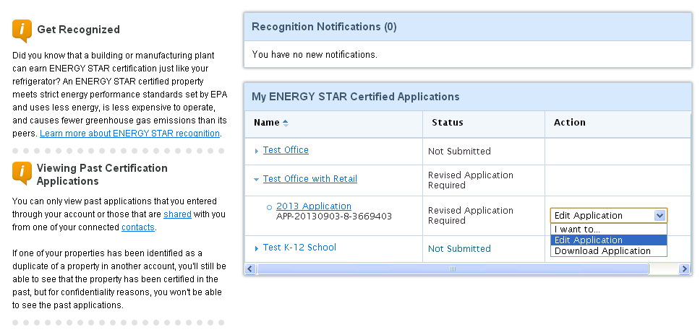
Track Your Application
Notes:
You can see the status of your applications on the Recognition Tab, which includes submitted, under review, escalated to expert, questions for applicant, revise and regenerate, not approved, or approved.
Please note that you will only see these statuses if your application has been generated. If you have not generated your application it will not be listed in your Recognitions tab

Slide 36
ENERGY STAR Certification Timeframes
Application turnaround time in 2022 will vary during the year based on volumes of applications received:
    Submissions in February-October: Review time is four business days
    Submissions in November – December: review time may take up to 4 weeks
Award packages are mailed weekly, so expect your package within 4 weeks of your application being approved
The year listed on the ENERGY STAR Certification is based on the year in which the application was approved
Notes:
You will get emails and notifications in Portfolio Manager if there are questions on your application. It typically takes 1-2 weeks to review and process an application, barring significant issues.
You have 30 days to respond to questions from EPA if there are any. If you don’t respond within that time, your application will be expired.
Once the application is approved, you should receive a letter of congratulations, certificate, and decals in 2-3 weeks.
Please note that processing time is typically longer at the end of the year.
The year listed on your ENERGY STAR certification is based on the year during which your application is approved, regardless of the period ending date on your application.
The ENERGY STAR certification is not a “forever certification.” It represents the accomplishment of a property in a given year. If you want to demonstrate continued superior energy performance and compliance with the ENERGY STAR requirements, EPA encourages you to reapply each year, or on whatever schedule fits your needs.

Slide 37
Communicate Your Achievements!
Display the ENERGY STAR decal at the entrance of your property
Take advantage of ready-to-use ENERGY STAR materials to communicate with stakeholders about your certified property
  Available at: http://www.energystar.gov/promote
Consider a newsletter article, email blast, website or blog post, article on an employee intranet, or other announcement to promote your certified property(ies)
Notes:
Now that you have received your award, you can communicate your achievements and tap into the broad public recognition of the ENERGY STAR. You are encouraged to display your decal near the entrances of your building. There are many ready-to-use materials that you can tailor to your organization to communicate your achievements to stakeholders.
Consider a newsletter article, email blast, website or blog post, article on an employee intranet, or other announcement to promote your certified property(ies).
For more ideas on how to promote your property’s success, including samples, templates, and other resources, are available on the ENERGY STAR website at http://www.energystar.gov/buildings/about-us/how-can-we-help-you/communicate/energy-star-communications-toolkit/earn-energy-star

Slide 38
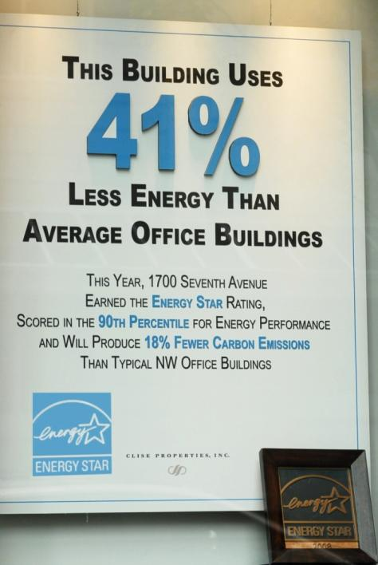
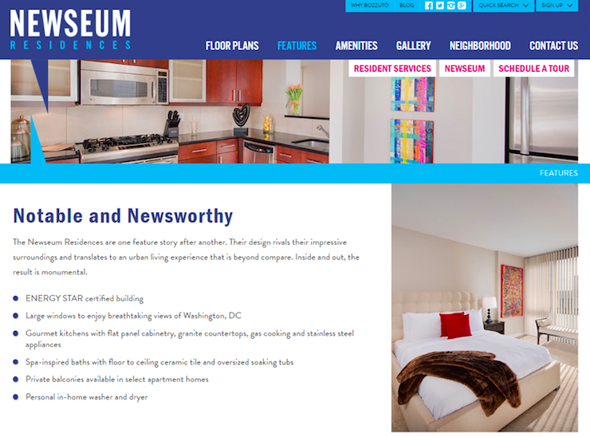
Communicate Your Achievements!
Notes:
Here are some nice example displays. You can show how much less energy your building uses compared to its peers, or equate energy savings to greenhouse gas reductions or equivalent trees planted.

Slide 39
Recap
We covered the:
  Value of the ENERGY STAR Certification
  Eligibility requirements for Certification
  How to apply for the ENERGY STAR Certification in Portfolio Manager
  How to track the status of applications
Notes:
In conclusion, let’s recap what we’ve covered. You’ve gained an understanding of:
The value of ENERGY STAR Certification, how it is recognized by over 90% of Americans, and how it communicates a lot of information regarding the superior energy performance of your building;
The eligibility requirements for certification, why its important for your property to meet the definitions, and why we ask for certain key factors about your building;
How to apply for the ENERGY STAR Certification within Portfolio Manager; and
How to track the status of applications and communicate your achievements.

Slide 40
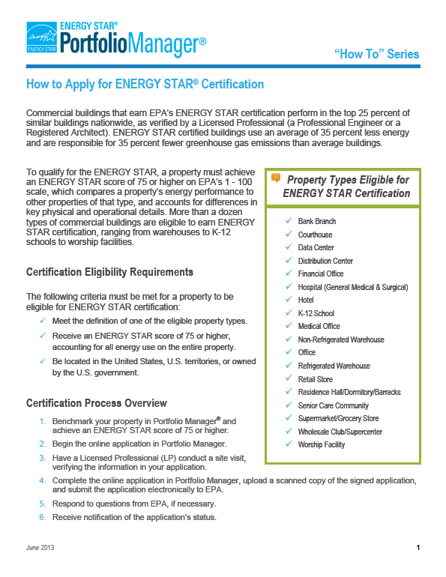
Extra Help
Visit: www.energystar.gov/buildingshelp
Guidance on ENERGY STAR certification available at: http://www.energystar.gov/buildings/building_recognition/building_certification
Additional Portfolio Manager training resources available at: www.energystar.gov/buildings/training
  How To documents (PDF)
Notes:
More guidance on this process is available through energystar.gov/buildingshelp, where specific questions can be submitted, and through energystar.gov/buildings/training where you can find step-by-step documents and webinar recordings.

Slide 41
Thank You for Attending!
Questions?
If you have any questions on Portfolio Manager or the ENERGY STAR program, contact us at:
www.energystar.gov/BuildingsHelp
Notes:
Thank you for attending!

