Slide 1
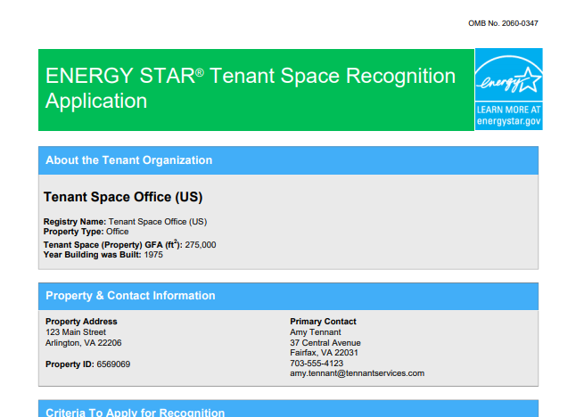
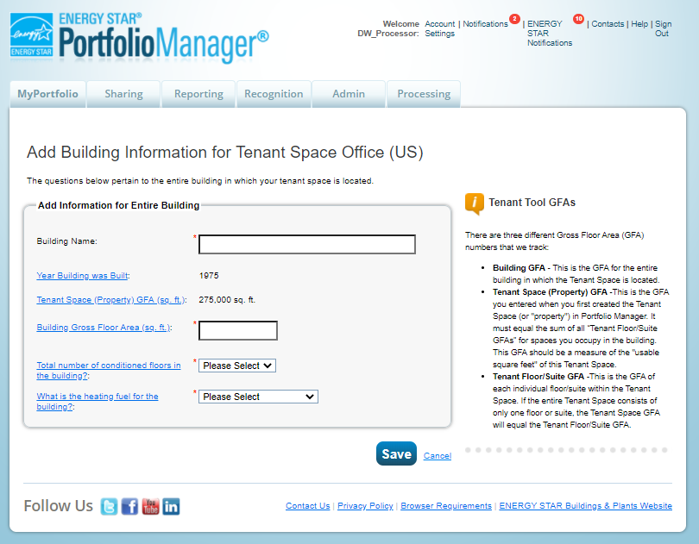
How to Apply for ENERGY STAR® Tenant Space Recognition

Slide 2
Agenda
Eligibility requirements for Tenant Space recognition
How to apply for ENERGY STAR Tenant Space recognition
How to track the status of applications
For detailed instructions on setting up your Tenant Space and applying for recognition in PDF format, click here.
Notes:
These slides present the eligibility requirements for earning ENERGY STAR recognition for Tenant Spaces. This includes a walk through of the application process in detail, including how to set up your tenant space property in Portfolio Manager. It also includes content on application status tracking and follow-up procedures.

Slide 3
What is ENERGY STAR® Tenant Space?
ENERGY STAR Tenant Space is a new EPA recognition for sustainability efforts in your leased office space.
Energy efficient office spaces can lead to lower utility bills and fewer greenhouse gas emissions in our atmosphere.
Notes:
Let’s consider what a Tenant Space is and introduce the new recognition program. The program launched on October 13, allowing commercial office tenants to earn ENERGY STAR recognition for their leased office spaces. Efficient office spaces of course lead to lower utility bills and lower energy use for the building as a whole, resulting in fewer greenhouse gas emissions. Once recognized, the tenant space will receive the decal shown here, which can be affixed to the entrance of the space.

Slide 4
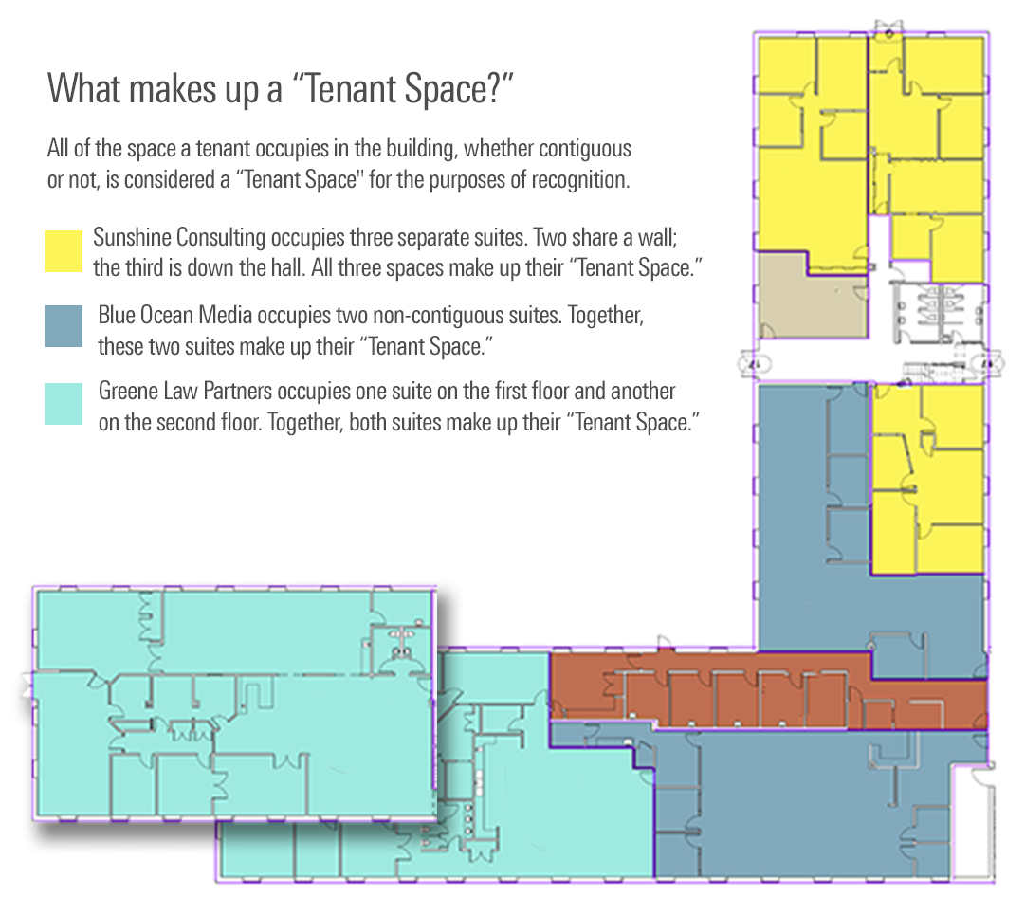
What is a Tenant Space?
All of the space a tenant occupies in the building, whether contiguous or not, is considered a “Tenant Space” for the purposes of recognition
Notes:
A Tenant Space, for purposes of ENERGY STAR recognition, should include all of the Office space that a single tenant occupies within a building, whether that space is contiguous or not. This might just be a single suite or floor, or it might be multiple suites or floors. The examples shown in this graphic illustrate a few different situations – Sunshine Consulting, in yellow, occupies three separate suites, all of which should be included in their Tenant Space. The same is true of Blue Ocean Media, in the darker blue – their two suites are non-contiguous, but both should be included in their Tenant Space. For the law office shown in turquoise, they occupy suites on two separate floors – again, even if those floors are non-contiguous, all of the space that they occupy in the building should be included in their Tenant Space.

Slide 5
Who is eligible to apply?
To access the Tenant module within Portfolio Manager, your Tenant Space must:
Be either a general administrative office, financial office, or a non-diagnostic medical office (such as a doctor’s office that does not include diagnostic equipment). It may include a data center.
In Portfolio Manager, the EPA-Calculated Property Type (based on the property uses entered in your Details tab) must be Office or Financial Office.
Represent all your usable office square footage in the building. Your usable square footage is defined as all areas within the demising walls reserved for your exclusive use.
In Portfolio Manager, the property must be designated “Part of a Building” in the Basic Information section on your Details tab.
Be located in the United States.
Notes:
This slide covers the eligibility criteria. First, before you’re able to access the Tenant module within Portfolio Manager, you need to make sure your space meets some basic requirements when you first set up the property. In terms of property type, the space needs to be Office space – this can be general administrative office, financial office, or a non-diagnostic medical office. The space can also include a Data Center as long as the Data Center is separately metered. What this amounts to in Portfolio Manager is that your EPA-calculated property type must be either Office or Financial Office – this is the property type that’s based on the individual property uses you’ve entered in your Details tab.
Next, the space needs to represent all of the usable office space footage that the single tenant occupies within the building, as we discussed on the previous slide. In Portfolio Manager, this means that when you set up the property, it needs to be designated as “Part of a Building,” rather than a whole single building or a multi-building campus.
And finally, the property needs to be located in the US.
Assuming your property meets these basic criteria in Portfolio Manager, you’ll then gain access to the Tenant module and continue with next steps toward recognition.

Slide 6
What are the criteria for recognition?
To earn ENERGY STAR Tenant Space recognition, you must:
Estimate energy use
Meter energy use
Light efficiently
Use efficient equipment
Your application will need to include a written procurement policy that specifies that the tenant will procure ENERGY STAR certified equipment wherever applicable.
Share meter data with the landlord (if requested)
Notes:
Once you’ve gained access to the tenant module within Portfolio Manager, you’ll need to meet a few additional requirements in order to gain access to the application for recognition, so let’s go through those now.
First, you’ll need to provide Portfolio Manager with some information to help it estimate the energy use for the tenant space. Understanding your energy use helps identify actions you can take to make the biggest impact. You will not have to meet an energy use target to qualify for recognition, but you’ll enter some basic information about the building and the space to help Portfolio Manager generate this estimate.
Next, you’ll need to meter energy use: You can’t manage what you don’t measure, so even though you don’t need to actually report your energy use to earn tenant space recognition, you will need to make sure that meters are in place for any loads controlled by the tenant.
Next, your space needs to have efficient lighting installed. Lighting is a major energy user and one of the most cost-effective upgrades. You will need to meet a lighting energy use target to qualify for recognition.
Next, your space will need to use efficient equipment: Upgrading equipment reduces the large energy draw from plug loads. You must have a procurement policy in place that specifies purchase of ENERGY STAR certified products whenever applicable, and you’ll also need to confirm that sleep settings have been implemented on computer equipment where possible.
And finally, you’ll need to commit to share meter data with the landlord (if requested): Your data may enable whole building benchmarking, which supports strategic investment in energy performance and is often needed for compliance with local laws and mandates.

Slide 7
Overview of the Application Process
Add your Tenant Space to Portfolio Manager
Access the Tenant module
Generate application for Tenant Space recognition
Have a Licensed Professional (LP) conduct a site visit, verifying the information in your application
Complete the online application and submit the application electronically to EPA
Respond to questions from EPA, if necessary
Receive notification of the application’s status
Notes:
Assuming you meet those criteria, you’ll gain access to the application for Tenant Space recognition. If you’re familiar with ENERGY STAR building certification, the application process will look familiar to you, but here’s a list of the basic steps. We’ve gone through the first two steps already, of adding your tenant space to Portfolio Manager and gaining access to the tenant module. After that, you’ll access the application and generate a PDF application for Tenant Space recognition. That application will need to be verified by a Licensed Professional, or LP – that LP will need to conduct or supervise a site visit in the tenant space to confirm all information on the application. Once the LP’s verification is complete, the tenant will complete and submit the application through Portfolio Manager. At that point, most of your work is done – you’ll just need to keep an eye on your email and respond to any questions from EPA about your application. Then, assuming all goes well, you’ll be notified of your applications approval, and the space will be listed on the Tenant Recognition web site.

Slide 8
Setting up your Tenant Space
Notes:
The next set of slides cover setting up your tenant space within the Tenant module in Portfolio Manager.

Slide 9
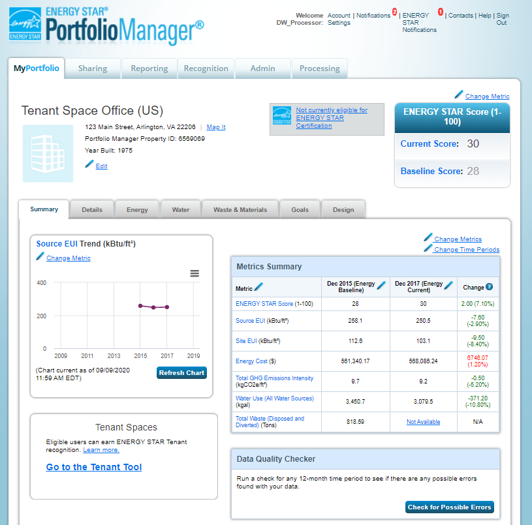
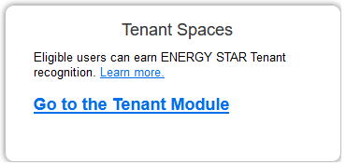
Access the Tenant Module within Portfolio Manager
Notes:
Once you’ve added your Tenant Space to Portfolio Manager and met the basic eligibility requirements covered earlier – that is, the EPA-calculated property type is Office or Financial Office, the property has been designated as “part of a building, and it’s located in the US - then the Tenant module will appear on the property’s Summary tab in the bottom left-hand corner of the window, as seen here. You’ll click that link to access the Tenant module.

Slide 10
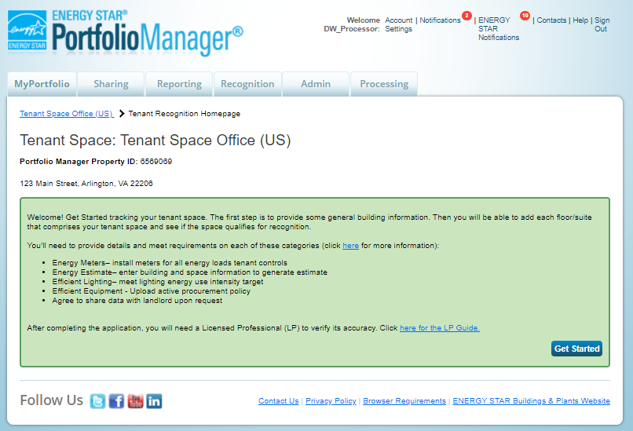
Access the Tenant Module within Portfolio Manager
Notes:
The first time you visit the Tenant module, you’ll be directed to the initial landing page. After initial set up, this will bring you directly to the Tenant Space homepage.

Slide 11
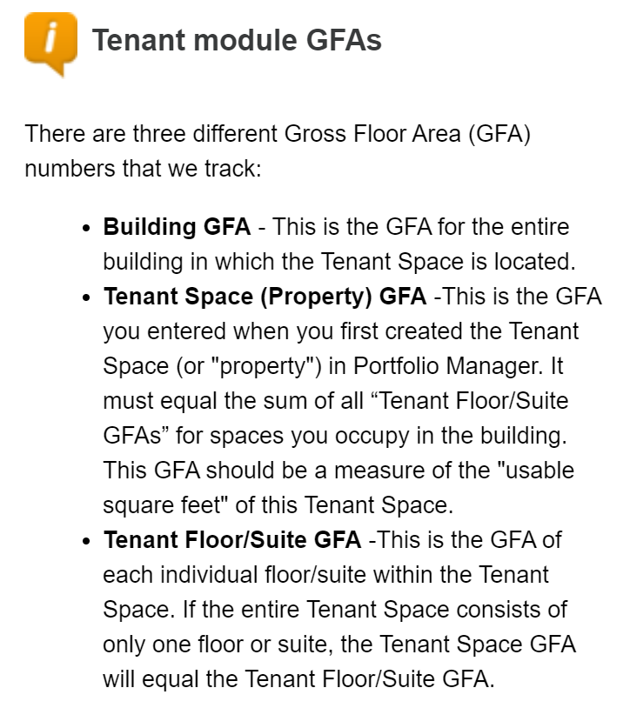
Tenant Module: Enter Information for Entire Building
Notes:
As a first step of the Tenant Space application process, and prior to entering information specific to your Tenant Space, you will need to answer a few questions related to the whole building. This information helps calculate many of the metrics needed for your Tenant Space as part of the application process. You may need to reach out to your landlord or property manager for the information that you will need, which will include the building name, gross floor area, total number of conditioned floors, and primary heating fuel.
When entering square footage information, refer to the information in the “Tenant Module GFAs” tip to understand different types of gross floor area calculations.

Slide 12
Tenant Module: Homepage
Notes:
Once building information is entered, you will be directed to the Tenant module home page, where you will enter information about each floor or suite that you occupy in the building. This home page also allows you to track your overall Tenant Space metrics (including estimated source and site energy and lighting EUI metrics), as well as edit floors or suites that have been previously entered. This is also where you will be able to see whether your Tenant Space is eligible for recognition (and, if so, begin the application process) once all floor and suite information has been entered.
Before you can apply for recognition, though, you’ll need to enter information for all the floors or suites you occupy in the building, so click on “Add a Tenant Floor/Suite” to get started.

Slide 13
Tenant Module: Add Floor/Suite Information
Notes:
After clicking “Add a Tenant Floor/Suite,” you can begin entering information about each floor or suite you occupy in the building. For each floor or suite included in your Tenant Space, you’ll need to provide the name of the floor or suite, its usable floor area, whether the required meters are in place, weekly operating hours, number of workers on main shift, and whether thermostats are set back on nights and weekends. Each of those pieces of information as shown here will link to the glossary definition, so if you need more information about exactly how to count weekly operating hours, or exactly what the required meters are, you can just click those links for more details.
Information on the building envelope is also needed on this page. You’ll need to provide the orientations for which the tenant floor or suite has exterior exposure, and the percentage of exterior walls that are glass

Slide 14
Tenant Module: Metering Criteria
Meters must be installed prior to application so that the LP may verify that the meters are in place.
Meters are required for all energy loads for which the tenant has full operational control, typically lighting and plug loads.
Individual energy loads do not have to be separately metered, except in the case of a data center (more detail later).
Other energy loads subject to the metering requirement may be metered separately or by a single meter.
The tenant must provide the LP with documentation that each meter in the space is manufacturer-certified to be +/-2% accurate.
Tenant organizations may need to contact the meter manufacturer directly in order to obtain this information.
Notes:
This slide covers metering criteria. Accurate measurement of energy use is critical to good energy management. Having meters in place to measure and track energy use in the Tenant Space will allow the applicant to establish an energy baseline, measure progress in reducing energy over time, and ultimately to determine how efficient the space is in operation.
Meters must be installed for all loads for which the tenant has full operational control – this will generally include lighting and plug loads, though if there is anything else that serves just your tenant space, like a rooftop unit or supplemental HVAC system dedicated to your space only, then that should be metered as well, for all fuel types.
EPA has included a requirement that meters be accurate to within +/- 2% as rated by the manufacturer. This requirement is intended to ensure that the meters are accurately measuring energy use, without specifying relatively costly utility grade meters. This performance specification should allow applicants to use newer and evolving meter technology that is flexible and cost-effective.
A best practice is to make sure the data reported by the meters is relayed to a dashboard or other system that provides the tenant with actionable information rather than raw data.

Slide 15
Tenant Module: Metering Criteria for Data Centers
If a data center is present in the space, it must be metered separately. Acceptable data center metering includes any metering configuration that allows separate tracking of IT energy use and/or total data center energy use. Note that a data center is intended for sophisticated computing and server functions which typically include:
High density computing equipment (such as server racks used for data storage and processing)
Dedicated power and cooling systems
A constant power load of 75 kW or more
Uninterruptible power supplies (UPS)
Raised floors
Notes:
If the tenant space includes a data center, then that’s fine, but the data center does need to be separately metered. As long as the metering configuration allows separate tracking of IT energy use or total data center energy, then it’s fine for purposes of Tenant Space recognition. Note that this is different from the requirements for ENERGY STAR building certification – for certification, there are very specific IT energy metering requirements for data centers. Those requirements don’t need to be met for purposes of Tenant Space recognition, but if you already have your data center set up with certification-compliant metering, then that will also satisfy the requirements for tenant space.

Slide 16
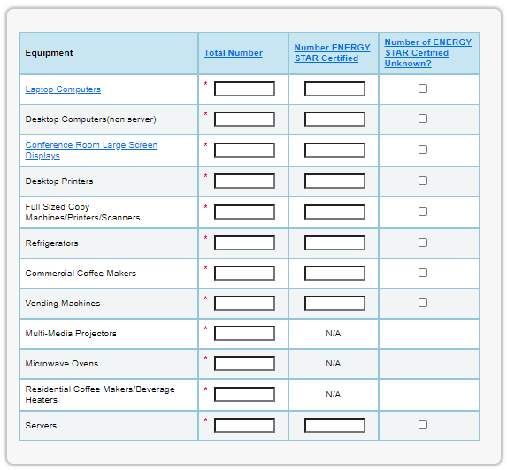
Tenant Module: Add Equipment Information
Notes:
The next piece of information needed is equipment, including computers, printers, and appliances. This information is used primarily for the energy estimate calculation. You’ll need to indicate any pieces of equipment that are ENERGY STAR certified, if you have that information available. You can usually determine if a product is ENERGY STAR certified by checking whether there’s an ENERGY STAR label or mark somewhere on the product, or else checking the ENERGY STAR efficient products page on the ENERGY STAR website and looking for the product by make and model.
If you can’t determine whether a piece of equipment is ENERGY STAR certified, you can indicate that the number is unknown by checking the box in the last column of the equipment table as shown here.

Slide 17
Tenant Module: Add Equipment Information, continued
See Activate Power Management on Your Computer for a guide on how to configure power management features on your computer.
Notes:
After entering equipment counts, tenants must affirm that sleep settings for computer equipment have been enabled, or will be enabled once computers are installed. EPA has a guide on how to activate power management on your computer that’s linked here, so when the slides are sent out, you can click that link to learn more about enabling these settings.

Slide 18
Tenant Module: Add Lighting Information
Notes:
Lighting information is the next section needed to set up your Tenant Space. This information is required to generate an estimated Lighting Energy Use Intensity (LEUI), which is used in the evaluation of the lighting requirement.
Portfolio Manager calculates the tenant’s target LEUI and estimates whether the actual LEUI in the space is at or below this target. The target LEUI is based on the size of the space and the hours of operation and reflects a lighting power density 25% below the ASHRAE 90.1 2013 level. The actual LEUI is based on hours of operation as well as the type and quantity of light fixtures and controls in the space.
This is where it will be especially helpful to have the assistance of a Licensed Professional, who should be able to help you accurately inventory all lighting fixtures in the Tenant Space, by floor or suite. To accurately track lighting information, you’ll need to enter:
Fixture name (this can be anything that the user wants to enter)
Light source (LED bulb, LED fixture, fluorescent tube, CFL, incandescent, halogen, etc.)
Number of each type of bulb
Bulb wattage (if applicable)
Fixture wattage (if applicable)
Total number of fixtures
Motion sensor (Vacancy, Occupancy, or None)
Daylight sensor (Yes/No)
Tuning (Yes/No)

Slide 19
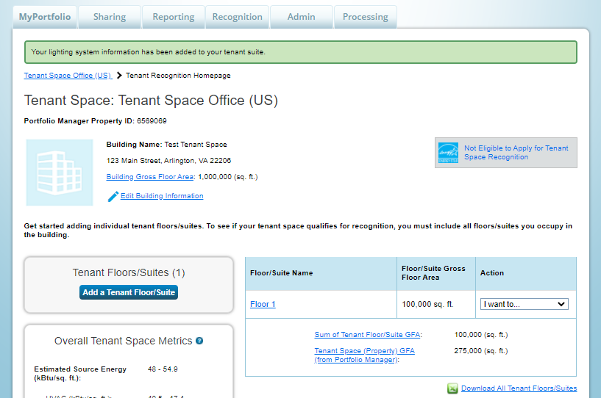
Tenant Module: Add All Floors/Suites
Notes:
After lighting information is entered, you will have completed the information requirements for the first floor or suite in your tenant space. When you click Continue, you will be brought back to the Tenant Space home page.
If your Tenant Space consists of multiple floors or suites, then you’ll repeat the previous steps to add more suites or floors until your entire Tenant Space is accounted for.

Slide 20
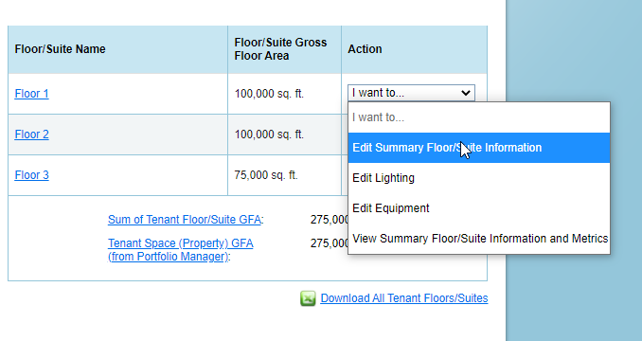
Tenant Module: Review All Floors/Suites
Notes:
To double check the details you just entered for a given floor or suite, click on the floor or suite name in the blue box in the Tenant module, or use the drop-down menu to directly access and edit specific sections.

Slide 21
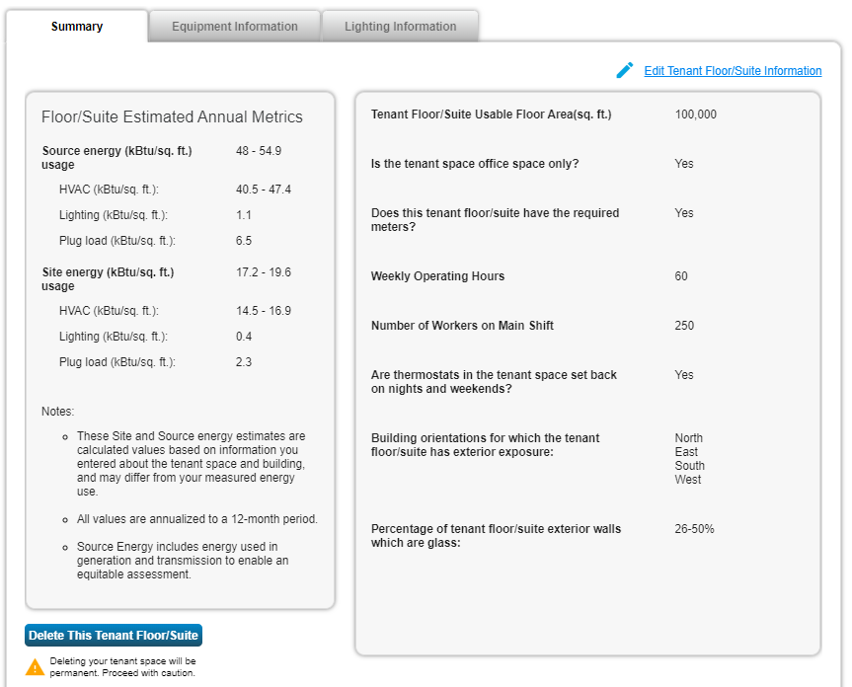
Tenant Module: Summary of Floor/Suite-level Metrics
Notes:
Clicking the name of the Tenant Space (or selecting “View Summary Floor/Suite Information and Metrics” in the drop-down menu) will take you to a summary page that describes the information you just entered in the prior three sections: tenant floor/suite information, equipment information, and lighting information. From there, you will be able to review and, if necessary, edit all information entered.
This page can also be used to assess performance on a suite-by-suite or floor-by-floor level.

Slide 22
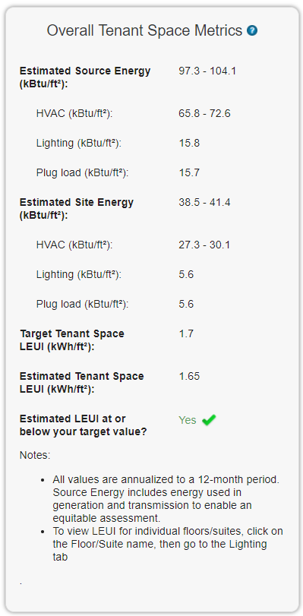
Tenant Module: Summary of Overall Tenant Space Metrics
Notes:
To keep track of how your overall Tenant Space metrics are calculated, you can view the overall metrics summary box in the lower left side of the Tenant module home page.

Slide 23
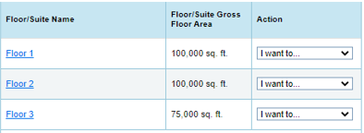
Tenant Module: Tips & Tricks for Multiple Suites/Floors
If your Tenant Space includes multiple floors/suites, choosing names for each floor/suite in advance will help organize the information, ensuring that all space has been accounted for.
The evaluation of the lighting requirement (for purposes of determining eligibility for recognition) is based on a weighted average of all your tenant floor/suites.
Your estimated LEUI needs to be below your target LEUI for the entire Tenant Space only – you won’t be ineligible if one floor/suite does not meet the LEUI target, as long as the other floors/suites are efficient enough to compensate.
Notes:
Here are some things to keep in mind if your tenant space includes multiple floors or suites:
First, be sure to have an accurate and descriptive naming convention in place for your floors or suites to make sure the right attributes are being entered for the right spaces.
Also, the lighting evaluation for purposes of recognition eligibility is based on the weighted average lighting EUI for your entire tenant space – that is, your estimated LEUI needs to be at or below the target for the entire space only. If a single floor or suite is above the target, the space as a whole may still be eligible for recognition as long as other floors or suites are efficient enough to compensate.

Slide 24
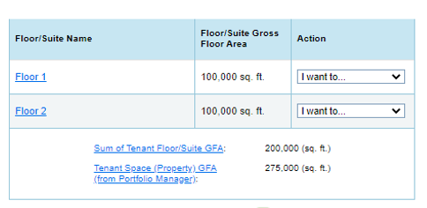
Tenant Module: Tips & Tricks for Multiple Suites/Floors
After you enter your first floor/suite, you will note that below the floor/suite table on the Tenant Home Page, there are two Gross Floor Areas (GFAs) displayed:
Sum of Tenant Floor/Suite GFA
Tenant Space (Property) GFA from Portfolio Manager (The value you entered when you first set up your property, before accessing the Tenant module)
To be eligible for recognition, these values need to match up
For example, below “Floor 1” & “Floor 2” only account for 200,000 sq. ft. out of the total 275.000 sq. ft. that this tenant occupies in the building. Remaining floors/suites will need to be added to account for the missing 75,000 sq. ft.
Notes:
Gross floor area can be a bit of a confusing topic since there are multiple GFAs that Portfolio Manager looks at. On your Tenant module home page, after entering all your floor or suite information, you’ll see two GFA values: The sum of tenant floor/suite GFA, and the property GFA from Portfolio Manager. The latter of these values is the GFA that you entered for the property when you initially set it up, before even gaining access to the tenant module. In order to be eligible for tenant space recognition, these two values need to match up. So if you set up your property with a gross floor area of 275,000 square feet but your floors and suites only add up to 200,000 square feet, you won’t be able to apply for recognition – you’ll need to keep adding floors or suites until all of your 275,000 sq. ft. tenant space is accounted for, or you’ll need to go back and correct your property GFA if 200,000 sq. ft. is actually the right value.

Slide 25
Tenant Module: Tips & Tricks for Multiple Suites/Floors
Notes:
When adding your additional floors or suites, if they are similar or identical to one you’ve already entered, you can use the “copy” button to copy the information to a new floor or suite, which should speed up the setup process. If the floors are similar but not identical, be sure to then modify the necessary items in the newly copied floor or suite to account for the differences..

Slide 26
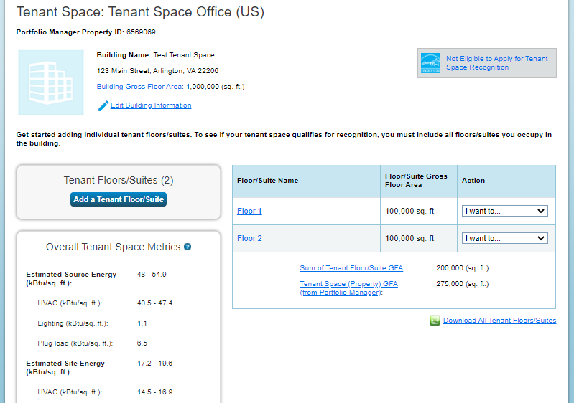
Tenant Application: “Not Eligible”
Notes:
At this point, if your tenant space is eligible for recognition, you’ll see the link to apply in the Tenant Space module home page.
If your Tenant Space is not eligible to apply for recognition, you will instead see a link that says “Not Eligible to Apply for Tenant Space Recognition.” There are a number of reasons why your Tenant Space may not be eligible, including a mismatch between the property GFA and the sum of floor/suite GFAs, LEUI exceeding the target value, lack of required meters, or lack of sleep settings for computer equipment. You can click that link to find out more – if it’s something that can be corrected, you can update your tenant space information and apply later on once the space is eligible.

Slide 27
How to Apply for Recognition
Notes:
Now that your tenant space has been set up, we can get into the details of how to apply for recognition.

Slide 28
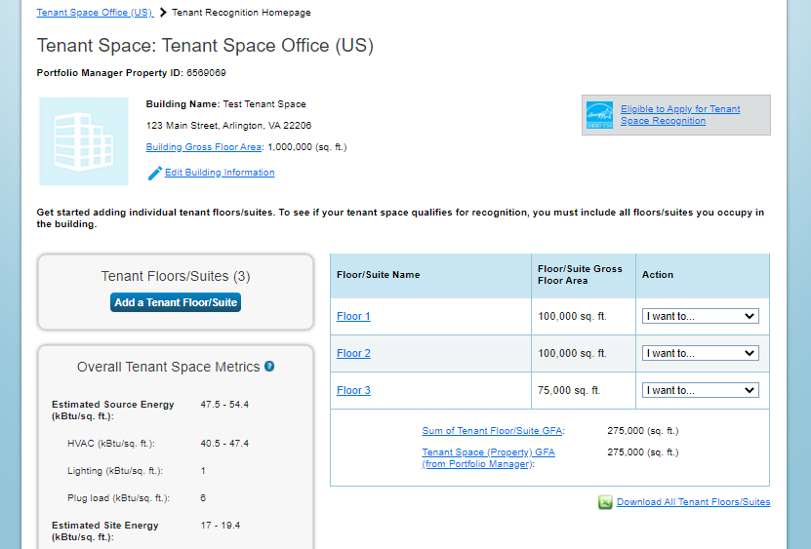
Tenant Space Recognition Application: Getting Started
Notes:
To get started, click the “Eligible to Apply for Tenant Space Recognition” link at the top-right corner of the Tenant module home page to open the application portal.

Slide 29
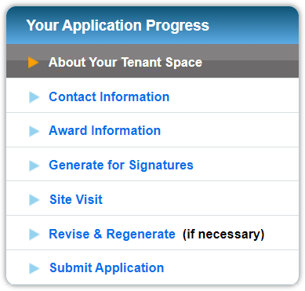
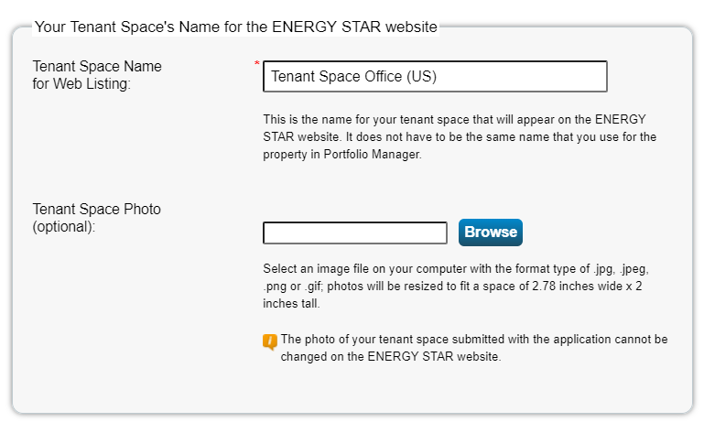
About Your Tenant Space
Notes:
This page is where you can review your basic Tenant Space and floor or suite information and make edits as needed. You can also provide a customized property name for the tenant space’s listing on the Tenant Recognition website, as well as a photo of your space if you’d like.

Slide 30
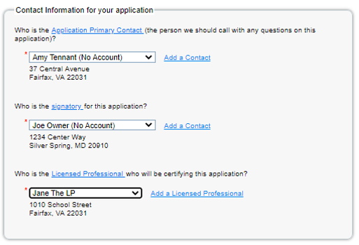
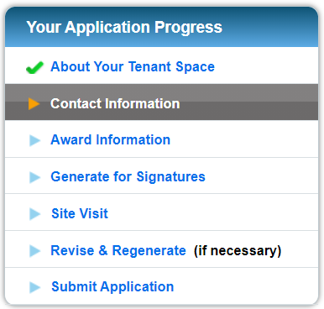
Contact Information
Notes:
In the next step, you’ll be asked to select the Primary Contact for the Application - this is the person who will receive emails with any questions about the application, so they’ll need to monitor their email closely after the application is submitted. You’ll also select the Signatory - this should be a direct employee of the tenant organization, not a consultant or SPP. Finally, you’ll choose the Licensed Professional who will perform or supervise the site visit and verify the application contents.
You can choose contacts from the drop-down menus provided, if they’re already in your Portfolio Manager contacts, or add a new one. If you choose from existing contacts in Portfolio Manager, ensure that all contact information (including email addresses) are up to date for that contact.

Slide 31
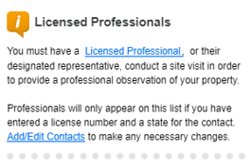
More Details: Licensed Professional (LP) Requirements
To verify applications for ENERGY STAR recognition, EPA requires an individual LP to meet the following qualifications:
Possess a current license in any U.S. State, Canadian Province, or territory of the U.S. or Canada as a Professional Engineer
(PE) or Registered Architect (RA) and be in good standing;
(Note: the LP does not need to hold a PE or RA license in the state in which the space he/she is verifying is located.)
Have a working knowledge of energy use in office spaces, including energy metering and lighting fixture types and controls.
Understand all applicable state and territorial engineering and architectural licensure laws, professional ethics requirements, and regulations prior to offering or performing services in a jurisdiction.
Only LPs meeting these qualifications are eligible to verify commercial Tenant Spaces for ENERGY STAR recognition.
LPs do not need to be from third-party organizations, and may be employees of the applicant organization, but they are to provide unbiased services and are bound by law to uphold strict ethical standards.
They must verify that the information contained in the application is accurate to the best of their knowledge, based on a site visit to the space, their technical expertise, and a good faith effort to comply with the given instructions.
More information at www.energystar.gov/tenantlpguide
Notes:
This slide covers the requirements for the Licensed Professional. The LP needs to be either a Professional Engineer or a Registered Architect, licensed in any US state or territory, or Canadian province. They need to be in good standing with their licensing authority, and need to have a working knowledge of energy use and metering in office spaces, as well as applicable licensure laws, professional ethics requirements, and regulations.
More details on LP responsibilities can be found in the ENERGY STAR Tenant Space Guide for Licensed Professionals, which you can find at www.energystar.gov/tenantlpguide. We’ll also be giving a webinar on verifying the tenant space recognition application next week, which is geared toward LPs, so you can find out more there as well.

Slide 32
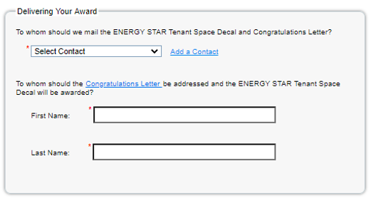
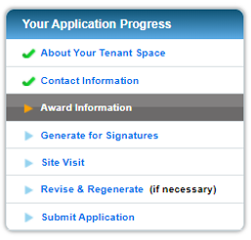
Award Information
Notes:
Next, you’ll select where you would like the ENERGY STAR Tenant Space Decal, Certificate, and Congratulatory Letter mailed (again, be sure that the address is correct for any pre-populated contacts in Portfolio Manager). Also enter the name of the person to whom the letter should be addressed.

Slide 33
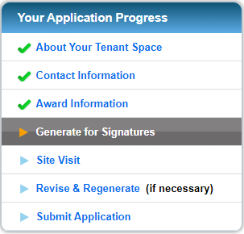
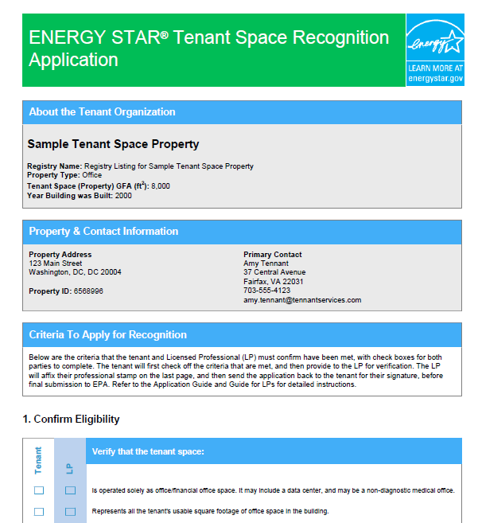
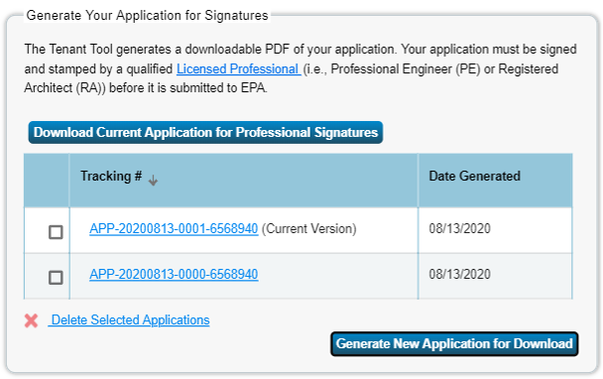
Generate Application for Signatures
Notes:
In the next step, you will generate your PDF application for review and signatures. The PDF that you generate at this step should be provided to the Licensed Professional for review during the site visit so that the LP can verify all information. Assuming no issues are found during the site visit that require correction, the LP can then sign and stamp the application and pass it along to the Signatory for their signature as well. If issues are found that require correction, a new PDF can be generated once corrections have been made.

Slide 34
Site Visit
Notes:
In the next step, you’ll be asked to provide details on when the site visit was performed, who performed it, and who verified it (this should be the Licensed Professional). You will also be asked if the LP found any issues during the site visit.
Site visits must be performed during the 6 month period prior to the application‘s submission.

Slide 35
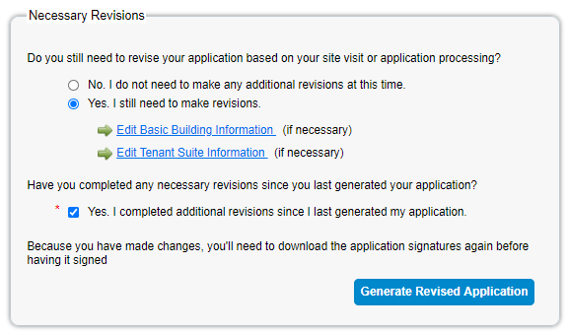
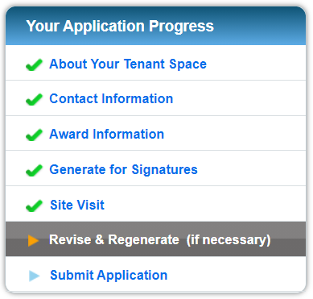
Revise and Regenerate
Notes:
If you selected “Yes” to the final question in the Site Visit step, indicating that issues were found, you’ll be directed to the Revise & Regenerate step. In this step, you’ll indicate the areas where corrections need to be made. If revisions were made since you last generated your PDF application, you’ll be able to generate a new PDF with updated information for the LP and Signatory to complete and sign.

Slide 36
Submit Application
Notes:
In the final step of the application process, you’ll enter your application tracking number – you can find this in the lower right-hand corner of your final signed and stamped PDF application. If you generated multiple PDFs during the course of the application process, please be sure that the number you enter matches the final, correct, signed version. You’ll also attach a copy of the completed PDF application at this stage.
You will also be prompted to upload your efficient equipment procurement policy here. The policy may be specific to the Tenant Space or adopted at a higher level of the organization leasing the space (i.e., corporate-wide). The policy must contain language that confirms that the Tenant will procure ENERGY STAR Certified equipment whenever possible, or substantially similar language.

Slide 37
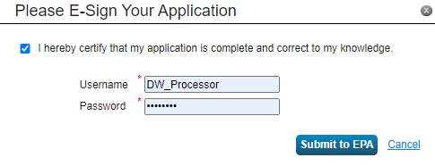
Submit Application
Notes:
Once your application and procurement policy have been uploaded, you’ll click “Submit.” Then you’ll e-sign your application with your Portfolio Manager credentials and click “Submit to EPA” to finalize your submission.

Slide 38
See Your Application
Through to Award
Notes:
Most of your work at this point is finished, but there may be a few more steps needed to see your application through to its award if there are questions from the review team.

Slide 39
Check for Email Notifications
Applications will be reviewed within 1-2 weeks of submission.
The Primary Contact for the Application should keep an eye out for an email from the ENERGY STAR Tenant Space Recognition Team, which will contain notice of the application’s approval or follow-up questions requiring a response.
Within 4-6 weeks of approval, the designated Award Contact will receive an award package containing certificate, congratulatory letter, and decal.
Notes:
Once your application has been submitted, please be sure to have your Primary Application Contact pay close attention to their email and watch out for questions from our review team. You should keep an eye out for emails from ENERGY STAR Tenant Space recognition, or tenantrecognition@energystar.gov. Please be sure to respond to emails promptly. If there are no follow-up questions, then you should receive notification within 1-2 weeks of the application’s approval, and within 4-6 weeks after that, you’ll receive your award package, including the award letter, certificate, and the decal shown here.
If you have any questions about your application or the process in general, please submit a support ticket at www.energystar.gov/buildingshelp.

Slide 40
View Tenant Spaces that have Earned Recognition
Tenant spaces that earn recognition will be listed on the Tenant space webpage: www.energystar.gov/tenantrecognition

Slide 41
Additional webinars and resources
Verifying the Application for ENERGY STAR Tenant Space Recognition – Oct 20, 2020 webinar slides will be posted on the Trainings page:
https://www.energystar.gov/buildings/training/slide_library
Guidance on how to apply, LP verification, and more available at
www.energystar.gov/tenantrecognition

Slide 42
Questions?
Go to
www.energystar.gov/tenantrecognition
or email
TenantRecognition@energystar.gov
for more information

