Slide 1

AEP Ohio AEP Texas Central Air-King, Ltd. Allergan Ameren Missouri American Society for Healthcare Engineering (ASHE) Andersen Corporation Arizona Public Service AT&T Austin Energy AZ Energy Efficient Home Baltimore Gas and Electric Company (BG&E) Beacon Capital Partners, LLC Beazer Homes USA, Inc Beko US Inc. - Arcelik A.S. Bentall Kennedy Best Buy Co., Inc. Best Energy Rating and Consulting LLC Big Ass Solutions BOMA International Bozzuto Management Company Brighton Homes Bristol-Myers Squibb Building Energy Burton Energy Group CalPortland Company CAMBA Housing Ventures, Inc. Canon U.S.A., Inc. CBRE Celanese Corporation Cenergistic CenterPoint Energy Chinburg Properties City of Chicago City of Seattle CodeGreen Solutions Colgate-Palmolive Company Columbia Gas of Ohio, Inc. (a NiSource company) ComEd Consumers Energy Corning Incorporated Cushman & Wakefield Delaware Sustainable Energy Utility Delmarva Power Delta Products Corporation Des Moines Public Schools DPIS Engineering, LLC E3 Energy LLC E3 INNOVATE, LLC Eastman Chemical Company EATON Ecova Efficiency Vermont Energize Connecticut in partnership with Eversource, United Illuminating, Connecticut Natural Gas, and Southern Connecticut Gas Energy Incentives, Inc. Energy Inspectors Corporation Energy Upgrade California EnergyLogic, Inc. EnergyPrint EnerNOC, Inc. Evergreen Public Schools Eversource Energy Fairfax County Public Schools Fannie Mae Focus on Energy Food Lion, LLC Four Walls, Inc. Fulton Homes GDS Associates GE Lighting General Motors Company Goby Inc. Grede Holdings LLC greeNEWit GreenSavers Gresham-Barlow School District Guaranteed Watt Saver (GWS) Habitat for Humanity of Greater Nashville Hanesbrands Inc. HCP, Inc. Hines Hoshizaki America, Inc. Houston Habitat for Humanity HP Inc. Illinois Office of Energy & Recycling at the Department of Commerce and
Congratulations 2017 ENERGY STAR®
Partner of the Year Award Winners!
Economic Opportunity Intertape Polymer Group, Inc. IREM ITW Food Equipment Group Ivey Residential, LLC J.C. Penney Company, Inc. Jacksonville Building Science JLL KB Home Kenton County School District Kentucky School Boards Association Kilroy Realty Corporation Koch Industries, Inc. Kohl's Department Stores, Inc. Loudoun County Public Schools Mandalay Homes Manitowoc Foodservice, Inc. Mansfield Independent School District Maximum Energy Professionals MaxLite Memorial Hermann Healthcare System Merck & Co., Inc. Meritage Homes Metro Lighting National Grid (MA) National Grid (RI) National Multifamily Housing Council Nationwide Marketing Group New Tradition Homes New York State Energy Research and Development Authority (NYSERDA) NH CORE Utilities Nissan North America, Inc. Olin Brass Panasonic Eco Solutions North America Parmenter Patuxent Environmental Group Pentair Aquatic Systems Potomac Electric Power Company (Pepco) Principal Real Estate Investors, LLC ProVia Providence Homes Public Service Company of Oklahoma (PSO) Raytheon Company Ricoh USA, Inc. Salt River Project Agricultural Improvement and Power District Sears Holdings Corporation Servidyne SkyeTec Energy Rating Services Soft-Lite LLC Southern Maryland Electric Cooperative (SMECO) Southwestern Electric Power Company (AEP SWEPCO) Staples the Office Superstore, LLC Sustainable Investment Group Target Corporation Texas-New Mexico Power Company The Home Depot The Lighting and Products Sponsors of Mass Save Thermo-Scan Inspections (TSI Energy Solutions) TIAA Tishman Speyer Top Build Home Services USAA Real Estate Company Virginia Beach City Public Schools Virginia State Corporation Commission Whirlpool Corporation

Slide 2
Today’s agenda
ENERGY STAR Update
Lightning Round: 3 Ideas You Can Implement Tomorrow
Eco-Treasure Hunts: Staples, Inc.
ENERGY STAR messaging: Gresham-Barlow School District
Industrial Showcase: CalPortland Company
Polling & Discussion: The Future of Energy Management for High-Performing Portfolios
Introduction by Target Corporation
Lightning Round: 3 More Ideas You Can Implement Tomorrow
ForeverGreen tenant program: Bentall Kennedy
Chase the custodian: Virginia Beach City Public Schools
Pro bono verification: Goby Inc.
Polling & Discussion: Communicating Data to Spur Improvement
Introduction by City of Seattle
Wrap-up and Digital Poster Session with AEM Interns

Slide 3

ENERGY STAR Update

Slide 4

Best practices
LED retrofits
Energy performance reports
Employee engagement
Solar/renewable energy
Demand response
Community showcases

Slide 5

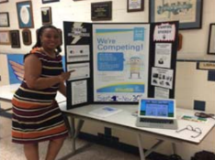
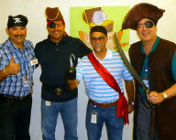
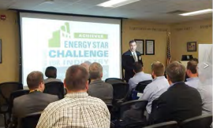
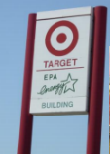

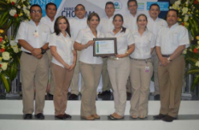
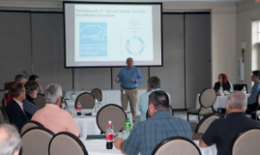
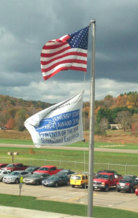
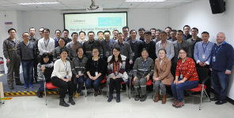
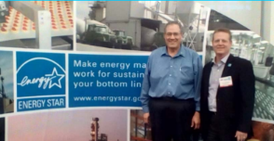
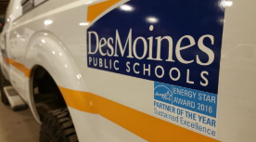
You’ve been busy

Slide 6
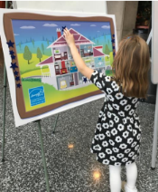
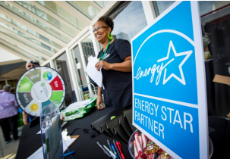

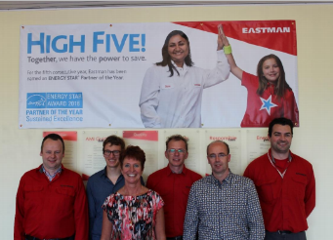
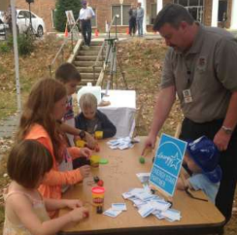
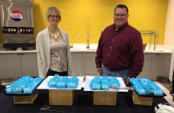


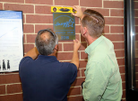
Very busy!

Slide 7

ENERGY STAR partnership
A win-win relationship that benefits business and society

Slide 8

Our accomplishments
ENERGY STAR for commercial buildings
$7.8 billion in energy costs
7,500+ buildings earned the ENERGY STAR
ENERGY STAR for industrial plants
$2.6 billion in energy costs
87 industrial plants earned the ENERGY STAR
46 industrial plants achieved the Challenge
Notes:
ENERGY STAR for commercial buildings
• The ENERGY STAR program for commercial buildings helped businesses and organizations save $7.8 billion in energy costs in 2015, contributing to cumulative energy cost savings of $144 billion since 1992.*
• On average, ENERGY STAR certified buildings use 35% less energy than typical buildings nationwide.
• More than 7,500 buildings earned the ENERGY STAR in 2016, bringing the total to 29,500.
ENERGY STAR for industrial plants
• The ENERGY STAR program for industrial plants helped businesses save $2.6 billion in energy costs in 2015, contributing to cumulative energy cost savings of $37 billion since 1992.*
• 87 industrial plants earned the ENERGY STAR in 2016.
• 46 industrial plants achieved energy use reductions in the 2016 ENERGY STAR Challenge for Industry campaign.

Slide 9

Floor Space (Million Square Feet)
Buildings Benchmarked
Notes:
• By the end of 2016, nearly 500,000 properties—representing 50% of the nation’s commercial building floor space—were using EPA’s ENERGY STAR Portfolio Manager® tool to measure, track, assess, and report on their energy and water consumption.

Slide 10
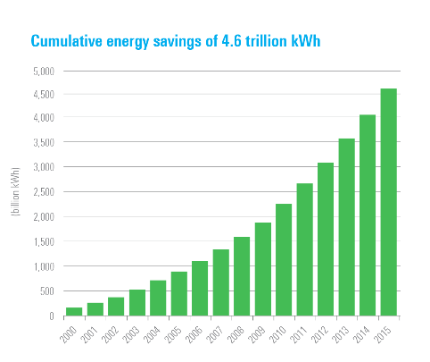
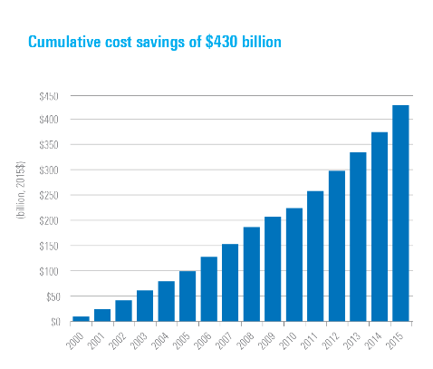
Our accomplishments

Slide 11

THANK YOU
2017 ENERGY STAR Award Winners

Slide 12
ENERGY STAR Commercial & Industrial
Plans for 2017

Slide 13

Partner Meetings
New: Commercial partners
  Oct. 23-24, 2017
  Chicago, IL
Industrial meeting
  Sept. 27-29, 2017
  Atlanta, GA

Slide 14

Tenant Recognition
Specification for recognition for design and construction completed
Pilot phase coming in the summer

Slide 15

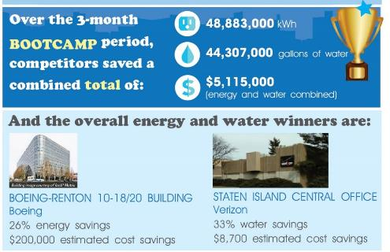
BOOTCAMP winners

Slide 16





New phase for National Building Competition
Help support your own competitions
Many winners have supported competitions:
  Local community
  Trade association
  Internal to organizations

Slide 17
General updates/progress
1-100 ENERGY STAR score updates across commercial properties in 2018
New Industrial focus industries and networking groups
1-100 Water Score for multifamily coming in fall
Water and waste focused webinar series
Sustained Excellence application streamlined

Slide 18
Today’s objectives
Hear about practices that represent strategies many are pursuing – but with their own spin
Discuss trends partners are pursuing to capture savings and keep programs future focused
Network to learn more

Slide 19
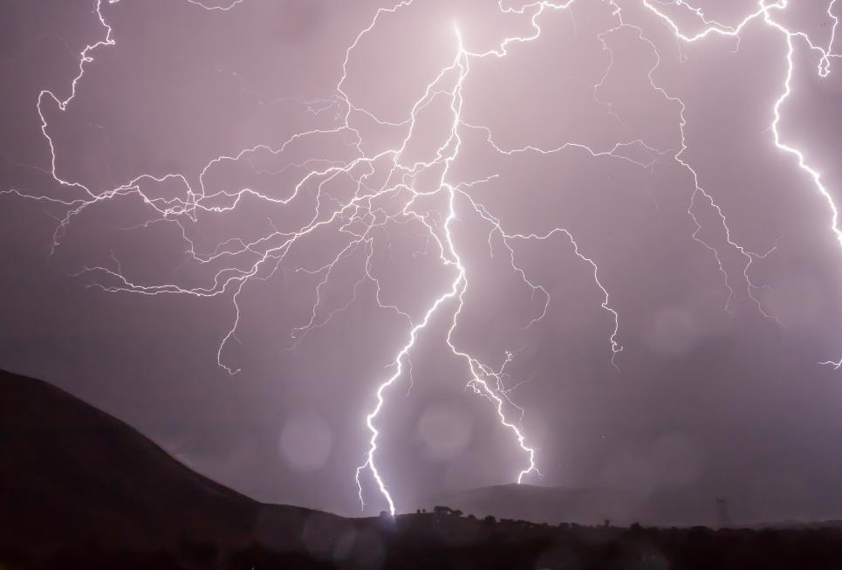
Lightning Round
Three ideas you can implement tomorrow

Slide 20


Staples Treasure Hunts Overview
Bob Valair
Director of Energy & Environmental Management

Slide 21
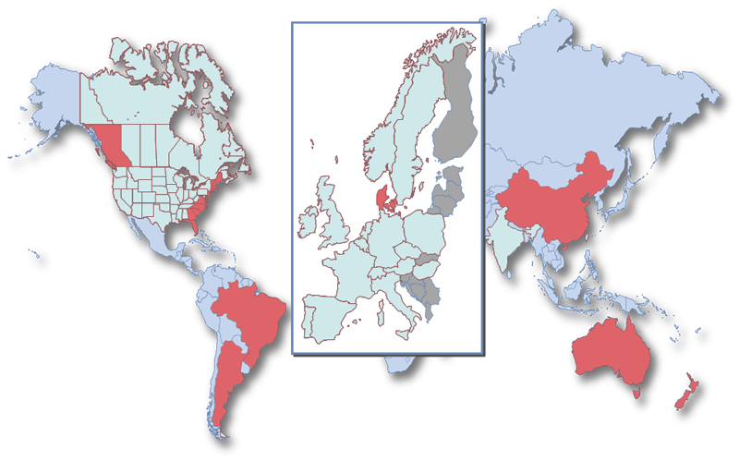

Staples is a Global Company
26 Countries
World ’s Largest Office Supply
$26 Billion
First store 1986
5 Continents
88,000 Employees

Slide 22
What is a Staples Treasure Hunt?
3 Day Treasure Hunt to Identify Energy & Water Savings
Treasure Hunt Goals
  Understand the facility (function & usage of utilities)
  Work together to find opportunities
  Report out opportunities and pay back periods
  Before event & after acquire capital funds
  Follow up – not one and done

Slide 23
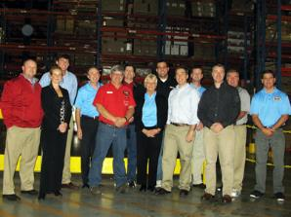
Treasure Hunt Teams
Team Members:
  Staples Energy Team
  Staples Facilities
  Vendors
Team Categories:
  Lighting
  HVAC
  Energy Mgmt. Systems
  Water
  Plug Load/Material Handling
  Incentives & Rebates
  Communications

Slide 24
What is the Process?
Pre-visit and calls 4 weeks prior to treasure hunt
3-day treasure hunt
Day 1 – Walk facility in shut down mode, identify potential
Day 2 – Walk facility in start up to fully operational mode
Day 3 - Report findings and opportunities
Find Better Ways to do Business
& Engage Employee Awareness

Slide 25
Each Facility is Different
Always understand this particular facility
How does it operate? Hours, Staff, Footprint, Usage
Historical and current data
Maintenance program
Current programs in place
Capital projects completed or in the forecast
On-site maintenance teams

Slide 26
What are the Results?
Average energy saving is about 10-20% reduction
Establish Best Practices
Build Relationships
Follow up
Continuous Improvements
Better Vendor Maintenance
Overall Energy & Water Reduction

Slide 27
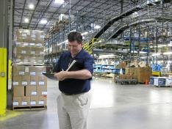
Staples Treasure Hunts Projects
Orlando, Florida Distribution Center
Coppell, Texas Fulfillment Center
Quill Coppell Texas, SDO
Montgomery, NY Fulfillment Center
London, Ohio Distribution Center
Hagerstown, Maryland Distribution Center
Exelon Constellation Energy, Business Centers
More….

Slide 28
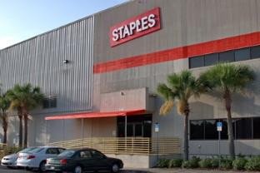
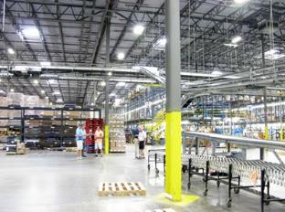
Report Out Summaries
Orlando, FL
Coppell, TX

Slide 29
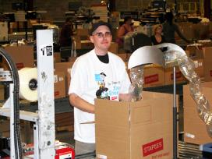
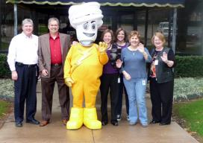
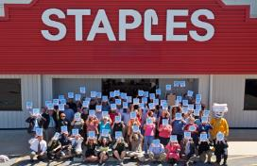
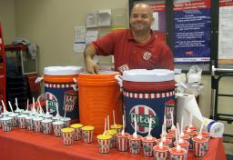
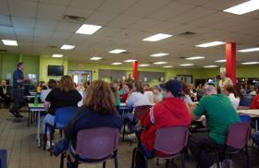
Employee Engagement
Employee engagement is critical to success Worth at least 10% savings immediately
Employee rally – What Can They Do
T-shirts
Posters
Mouse pads, calendars, light switch covers
Energy contest all week – best ideas get $50 gift cards
Manager and employee interviews on camera
Energy campaign with handouts, posters, giveaways
Customized for each acility

Slide 30
Things You Can Implement Today
Analyze your portfolio in terms of energy usage
Choose top high users (3-5 facilities) for treasure hunts
Based on facility operations – choose a team of experts
Set up a meeting with facility
Start discussing a plan
Implement treasure hunt day or days
Benefit energy reduction
Communicate results to executives and finance

Slide 31
Lightning Round
Three ideas you can implement tomorrow

Slide 32

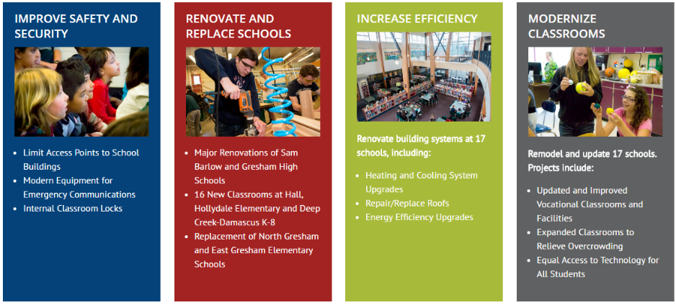
2016 GOAL
Pass a $291 million bond measure

Slide 33
MESSAGE TESTING
We asked 400 people: What would be the most influential message?
  Test scores higher than state averages
  High school graduation rates are up
  We have an Oregon Teacher-of-the-Year-Award winner
  Olympic gold medal winner from our high school
  Average age of our schools is 51
  9x ENERGY STAR POY winner, saving over $1 million per year (equal to more than 20 teachers)

Slide 34

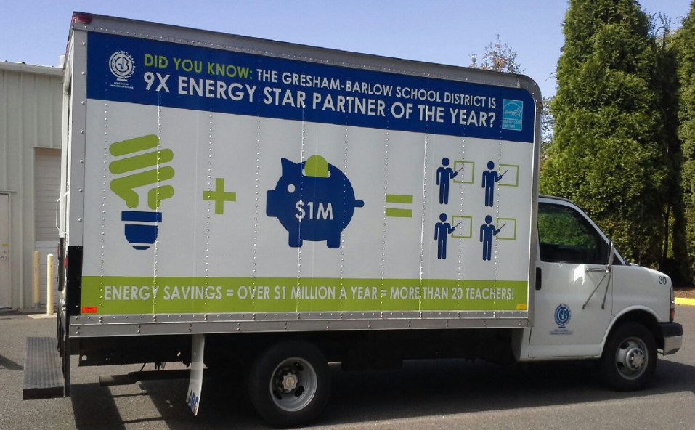
THE WINNER

Slide 35
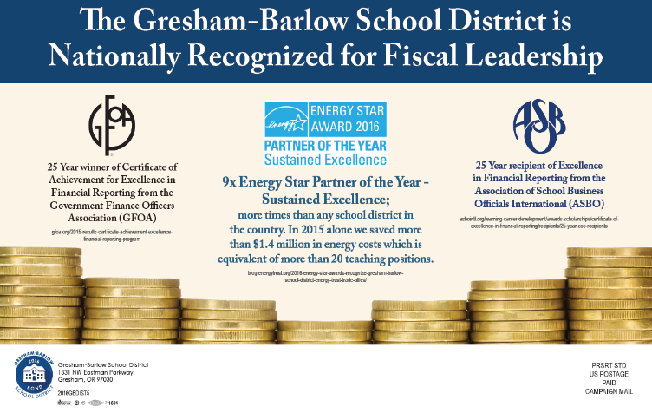
POSTCARD MAILING

Slide 36
OTHER TACTICS
School outdoor reader boards
Presentations
Two-page “Fast Facts” handout

Slide 37
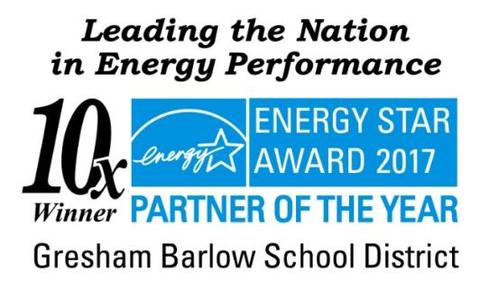
RESULT
Bond measure approved!

Slide 38
TAKEAWAY
Don’t underestimate the power of energy savings to rally support for your organization’s initiatives

Slide 39
Lightning Round
Three ideas you can implement tomorrow

Slide 40

CalPortland Rillito Industrial Showcase
ENERGY STAR ® Industrial Focus Meetings
Bill Jerald (Chief Energy Engineer)
CalPortland Company

Slide 41
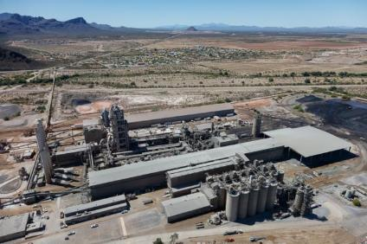
CalPortland Rillito Cement Plant
Located in Rillito, AZ just NW of Tucson, AZ and bordering with the Town of Marana, AZ
Producing Portland Cement since 1948
Approximately a 24 MW Electrical load with capability of producing over 1 Million tons of Cement per year

Slide 42
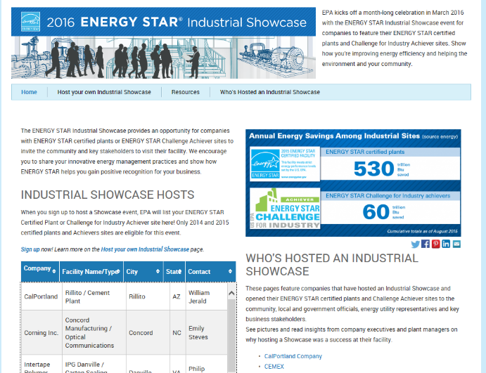

Taking on the Challenge!
CalPortland was the first company to volunteer to perform an Industrial Showcase, here you can see us first on the list !
What did I just get myself into!

Slide 43
First Steps
After signing up for the showcase, I had to go out and seek permission to do it!
The showcase had a March calendar restriction, which perfectly fit with our pre scheduled maintenance outage. The facility is extremely congested and unpresentable during that time
We were off track before we even started!!
Luckily other facilities had the same issue and we were allowed to pick our own date that fit to our needs
We had to pick a date in May to allow for the plant to clean up and recover from the lengthy maintenance outage that included a major equipment upgrade to the plant

Slide 44

We started to publicly broadcast the invitation to the local community and customers, taking registrations on a google registration form. The QR code was a link that allowed a user to register via phone

Slide 45
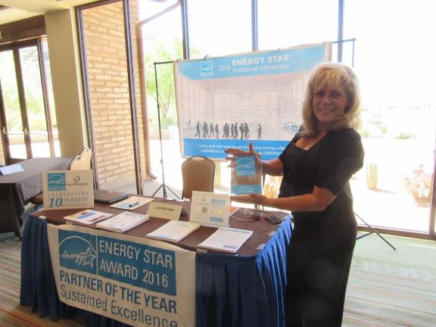
We had a booth at the Marana Chamber of Commerce “State of the Town” registering Industrial Showcase guests

Slide 46
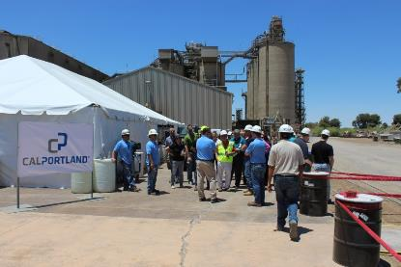
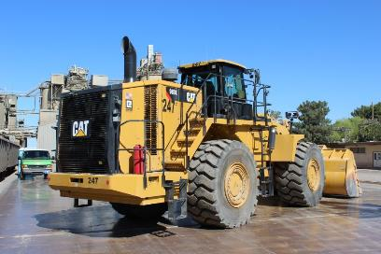
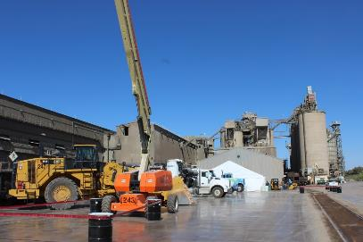
The Showcase was held at the plant with a large Tent for housing the guest tables
Some of the fleet equipment was on display, including a modern Wheel Loader with multiple efficiency features

Slide 47
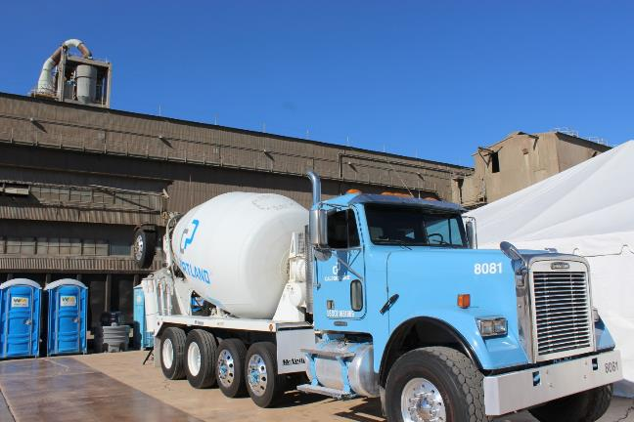
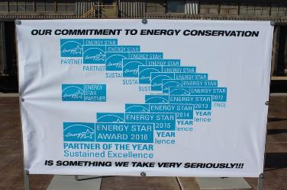

Slide 48
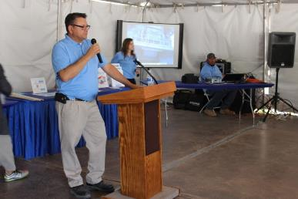
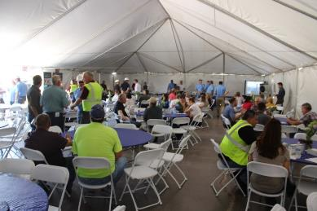
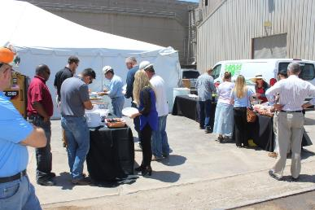
The Event had speeches from multiple executives including our CEO Allen Hamblen

Slide 49
Showcase Expo Booths
Tucson Electric Power Provided their energy efficiency outreach group to man a booth
Border States Electric and Dial Light provided information on LED lighting
Westland Resources provide information on Variable speed drive efficiency
CalPortland hosted an ENERGY STAR outreach booth
CalPortland Rillito Plant provided an educational booth on Cement Chemistry

Slide 50
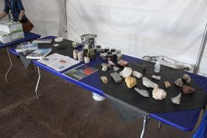

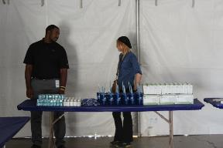
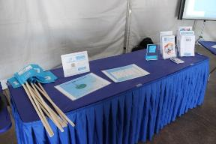
Showcase Expo Booths

Slide 51
Plant Tour
Plant tour followed a route that allowed guests to see major components of the plant
Large informational signs were placed near various energy efficiency projects
Tour guides were given a script for describing the energy efficiency projects

Slide 52
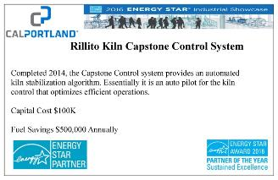
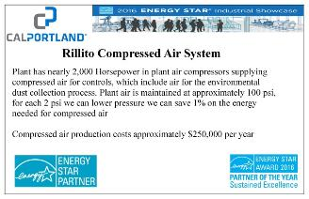


Energy Efficiency project signs

Slide 53



Educating the Showcase Guests

Slide 54




Slide 55



Industrial Showcase celebration with ENERGY STAR representative Karen Butler

Slide 56

Showcase guests were given ENERGY STAR information brochures and CalPortland gift items

Slide 57
Summary
The event was an amazing success
The plant was very proud to show off to the local community
We received many thanks from those in attendance
The cement sales team reported very positively
The hard work was worth the effort

Slide 58
Polling & Discussion
The Future of Energy Management for High-Performing Organizations

Slide 59
2017 C & I Partner Meeting
Energy Management at Target

Slide 60











Reducing Greenhouse Gas Emissions
Running on Solar Power
Earning the Energy Star
Reducing Waste
Enhancing Communities
Conserving Water
Stormwater Management Systems
More Efficient Transportation
Growing Responsibly
Chemical Management

Slide 61




Slide 62



Slide 63


Slide 64
Lightning Round
Three more ideas you can implement tomorrow

Slide 65
Bentall Kennedy
ForeverGreen Tenant Program
ENERGY STAR Partner of the Year
Commercial & Institutional Partner Meeting
April 26, 2017

Slide 66
Goals
Provides a communications platform that demonstrates our sustainability commitment and provides added value to tenants.
Increases tenant loyalty and drives value for our clients
Guides tenants towards behavioral changes that will improve the sustainable performance of buildings
Reduces redundancy of local/regional efforts to create sustainability content
Provides a standard platform across portfolios

Slide 67
Core Components
Energy Efficiency & Carbon Reduction
Waste Diversion
Water Conservation
Healthy Workplaces

Slide 68




Property Management Team Resources
POSTERS

Slide 69

Property Management Team Resources
NEWSLETTERS

Slide 70


Property Management Team Resources

Slide 71
3 ideas you can implement tomorrow
Create resource materials
Customize as much as possible
Collaborate and make it fun!

Slide 72
Lightning Round
Three more ideas you can implement tomorrow

Slide 73



VBCPS
“Chasing the Custodians”
Jim Morris
Assistant Director, School Plant Services
Environmental and Energy Management

Slide 74



Some Background
Energy Star Partner since 2011
95 facilities, ~11M SF
Reduced energy use ~27.5% since 2006 – SF increased 7%, technology increased
  How we build our buildings
  How we maintain our buildings
  How we operate in our facilities

Slide 75

“Chasing the Custodians”
Day & Night Crews Work in Buildings – HVAC on occupied until ~9:00 pm
  Night Custodial crew does Team Cleaning – all clean in one area, move to the next
Looked at tightening up buildings to follow Custodians through each school
  HVAC provided zone maps of each school
    Assistant Director sent email to each Principal/Assistant Principal:
      Proposed tighter times with each zone to closely follow cleaning schedule
        Once confirmed, HVAC programmed

Slide 76


How’d it work?
BEFORE:
AFTER:

Slide 77



What’s Next?
Using utility savings dollars to pay for breaking out zones further in each building
  Focusing on buildings with the lower Energy Star scores
Re-Assess - Going back and re-checking zones and how they are working

Slide 78
Lightning Round
Three more ideas you can implement tomorrow

Slide 79
Goby’s pro bono journey with 1+
Celia Landesberg LEED AP O+M

Slide 80
What is 1+
theoneplus.org
The largest design marketplace in the world
connects nonprofits with pro bono architecture and design services
Pro bono design serves a critical need for nonprofits with unmet environmental and facility needs. Design is a wholly underutilized tool for achieving social outcomes

Slide 81
Hope Christian Reformation Church
Wanted to take tangible steps to reduce carbon footprint
Moral responsibility: responding to climate change
Decided to start with energy consumption

Slide 82



Connecting with Goby on 1+
Built ESPM profile
Connected
With Goby on 1+
Kickoff!

Slide 83






Strategies
Motion-sensored
lights
LEDs
new roof
with added insulation
water heater
temp
low-flow
faucet aerators
New boiler

Slide 84
The results
78 83

Slide 85
Tips for a streamlined process
Be proactive, prepare in advance
  Digital copies of utility bills
  Records of building square footage
  Set up the Portfolio Manager profile in advance
Spread the word!
  Share your success with a case study, social media, press release

Slide 86
Sign up today!
Celia Landesberg LEED AP O+M
linkedin.com/in/celia-landesberg/

Slide 87
Polling & Discussion
Communicating Data to Spur Improvement

Slide 88


Energy Benchmarking
Seattle Office of Sustainability and Environment
4.26.17
Communicating Data to Spur Improvement

Slide 89

Performance Ranges
www.seattle.gov/energybenchmarking

Slide 90

Seattle Dashboard
www.seattle.gov/energybenchmarking
90

Slide 91

Performance Profiles
Prepared for five building types, some by size:
Hotel
Retail
Large office 100K+ SF
Mid size office 20-100K
Low rise multifamily 1-4 stories
Mid rise multifamily 5-9 stories
High rise multifamily 10+ stories
www.seattle.gov/energybenchmarking
www.seattle.gov/energybenchmarking

Slide 92

Performance Profiles
Tailored call to actions based on performance.
Utility incentives, BOC training and ENERGY STAR certification promoted on the back.
www.seattle.gov/energybenchmarking

Slide 93

Performance Profiles
Highest performing office buildings were sent version that specifically promoted ENERGY STAR certification.
SAMPLE SENT TO BUILDINGS WITH EUIS IN 25TH PERCENTILE (EXCLUDING OUTLIERS)
www.seattle.gov/energybenchmarking

Slide 94


Transparency
www.seattle.gov/energybenchmarking

Slide 95

Visualization Website
www.seattle.gov/EnergyBenchmarking

Slide 96


Rebecca Baker
Benchmarking & Tune-Ups Program Manager
www.seattle.gov/energybenchmarking
96
www.seattle.gov/EnergyBenchmarking

