Slide 1


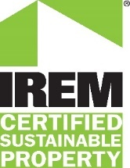

ENERGY STAR® and Green Building Rating Systems
USGBC Leadership in Energy and Environmental Design (LEED®) v4
Green Globes™
IREM Certified Sustainable Properties (CSP)
BOMA BEST®
U.S. Environmental Protection Agency (EPA)
2019
Notes:
Hi! I am [Name] from ICF, supporting trainings for EPA's ENERGY STAR program.
The purpose of this training is to provide you with a conceptual overview of how ENERGY STAR integrates with each of these rating systems. These rating systems include:
USGBC Leadership in Energy and Environmental Design (LEED)® v4
Green Globes™
Institute of Real Estate Management (IREM) Certified Sustainable Properties (CSP)
BOMA BEST

Slide 2
Agenda
Overview
  ENERGY STAR
  Green Building Rating Systems
ENERGY STAR Tools
  Portfolio Manager
  Target Finder
  Sustainable Buildings Checklist
Using ENERGY STAR Tools
  LEED
    Building Design + Construction (BD+C) v4
    Building Operations + Maintenance (O+M) v4
    Green Globes
      New Construction
      Existing Buildings
    IREM Certified Sustainable Properties (CSP)
    BOMA BEST
  Question & Answer Session
Notes:
This webinar will cover:
(READ SLIDE)
In each section, we will provide a general description of the rating system and outline how ENERGY STAR and its tools and resources can be used to earn the rating. It is important to note that even if your building cannot earn an ENERGY STAR score, ENERGY STAR and its tools and resources can still be used to earn certification for each of these rating systems.

Slide 3

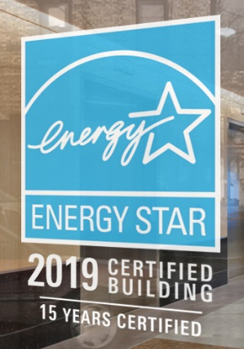


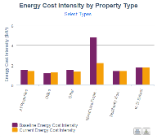
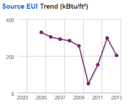
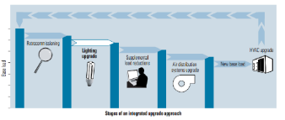


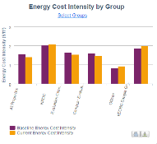
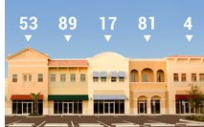


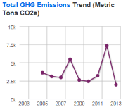
ENERGY STAR for Buildings and Plants
Voluntary EPA program that delivers environmental benefits and financial value through superior energy efficiency.
Notes:
ENERGY STAR is a voluntary EPA program
We offer:
1) information to assess how your building or plant is actually performing, including the nation’s only comparative building metric, which we’ll talk about a bit later.
2) Tools that help get you get buy-in from the board room to the water cooler---from business cases and financial calculators to occupant-friendly behavior-change tools.
3) Access to a national network of Service and Product Providers who can help you improve the efficiency of your facility
4) And finally, we offer recognition for outstanding performance
All this is offered free-of-charge!

Slide 4
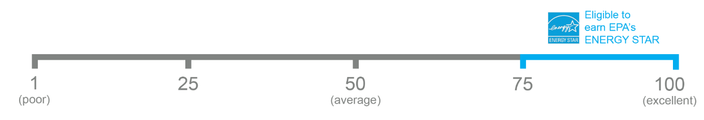
The 1-100 ENERGY STAR Score
Notes:
In order to assess the relative performance of a building or plant, you need context. This is why, 20 years ago, we created the 1 – 100 ENERGY STAR energy performance scale. On this scale, 50 represents median performance. A score of 75 means that your facility performs better than 75% of similar buildings nationwide, and is the minimum score required to earn ENERGY STAR certification.

Slide 5














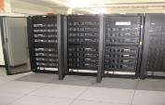



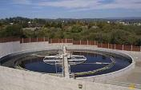
Property types with 1-100 ENERGY STAR scores
Bank Branch
Barracks*
Courthouses
Distribution Centers
Financial Offices
Score based on CBECS data
Hotels
K-12 Schools
Office Buildings
Medical Offices*
Residence Hall/Dormitory*
Retail Stores
Supermarkets
Warehouses
Wholesale club/ Supercenters
Worship Facilities
Score based on other survey data
Data Centers
Hospitals
Multifamily Housing
Senior Care Communities
Wastewater Treatment Plants*
Notes:
This slide shows the property types that are eligible to earn the ENERGY STAR score generated by Portfolio Manager.
Building types with an asterisk can obtain a 1-100 score, but are not eligible for ENERGY STAR certification.
Properties that cannot be scored on the 1-100 scale can still use Portfolio Manager to benchmark and track energy consumption, costs, weather-normalized energy intensity, and greenhouse gas emissions over time.
If your building is ineligible to earn an ENERGY STAR score, ENERGY STAR and its tools and resources can still be used to earn certification for rating systems discussed in this training.
5

Slide 6
Green Building Rating Systems Overview
 | LEED | Green Globes | IREM CSP | BOMA BEST
Property Types Eligible | All | All | Office, Multi-family, Shopping Center | All
Building Types Eligible | New & Existing Buildings | New & Existing Buildings | Existing Buildings | Existing
Assessment Process | Submit templates documenting building design and management practices | Self-reported questionnaire process | Excel-based checklist with documentation requirements | Online assessment with compliance documentation requirements
Criteria | Prerequisites and Credits | Credits | Prerequisites and Credits | Prerequisites and Credits
Verification | LEED accredited professional | Assessor | IREM Board | BOMA BEST Verifier
Time & Cost | Medium | Low | Low | Medium
Use ENERGY STAR as a standard within energy category | Yes | Yes | Yes | Yes
Notes:
These green building rating systems have developed customized ratings for new and existing buildings, and are holistic and “multidisciplinary,” covering a variety of credit categories, including energy performance. The choice of a green building rating system depends on factors such as building use type, certification process considerations including price and ease of use, and popularity. Each of these rating systems offers recognition for building design and operation, and rely on ENERGY STAR tools to earn recognition for energy.
LEED works for all buildings – from homes to corporate headquarters – at all phases of development. LEED process is conducted online, through documentation of building design and management practices.
Green Globes is an online, self-reported questionnaire process that transitions to documentation and site/building verification by the involvement of a hands-on assessor.
Similar to Green Globes, IREM Certified Sustainable Property program is an online, excel-based platform that helps existing office buildings, multi-family communities and shopping centers gain recognition for sustainability achievements.
BOMA BEST is a certification program focused on sustainable energy management and operations. As Canada’s largest energy performance platform, BOMA BEST certification is structured as an online assessment tool that completes with an on-site building verification.
Most certifications include mandatory prerequisites to achieve credit in certain areas. While projects can pick and choose the credits they want to pursue certification, prerequisites are required. They set the minimum requirements that all buildings need to meet in order to achieve certification. Think of them as the foundation.
ENERGY STAR certification is a “stand alone” certification verifying superior energy performance in eligible buildings
U.S. green building rating systems cover many disciplines
They all use ENERGY STAR for Commercial Buildings as a key standard within their energy performance categories

Slide 7
Why Do Green Building Rating Systems Use ENERGY STAR?
Trusted mark of energy efficiency for over 20 years
Based on frequently-updated data gathered through credible processes with transparent statistical methods
Tools such as Portfolio Manager are no-cost, easy-to-use, and universally accessible
Portfolio Manager “normalizes” data to account for
    Location/climate
    Building size
    Building occupancy
    Hours of operation
    And more (depending on property type)
Notes:
ENERGY STAR certification is a “stand alone” certification verifying superior energy performance in eligible buildings.
So, why do other green building rating systems use ENERGY STAR and Portfolio Manager?

Slide 8

ENERGY STAR Tools
Portfolio Manager
Target Finder
Sustainable Buildings Checklist
Notes:
The ENERGY STAR program has several resources that can be useful throughout a building's lifecycle from building design through operations, namely, Portfolio Manager, Target Finder, and the Sustainable Buildings Checklist. These tools can assist you with achieving the green building certification of your choice.

Slide 9
Portfolio Manager for Benchmarking Existing Buildings
Portfolio Manager helps operations teams
  Benchmark the energy use of all properties in their portfolio
  Compare one building against a national sample of similar properties
  Track changes in energy and water use over time in a single building, groups of buildings, or entire portfolios
  Track and report cost savings and CO₂ emissions
  Set priorities for use of limited staff time and/or investment capital
  Receive an energy use intensity (EUI) value for each property
  Apply for the ENERGY STAR certification
http://www.energystar.gov/benchmark
Notes:
Portfolio Manager is a leading tool to benchmark existing buildings. It supports energy management, assesses performance, and evaluates results.
For operations teams, Portfolio Manager is a no-cost online tool for measuring and tracking the energy (and water and waste) performance of existing facilities. The tool allows you to benchmark the energy use of all your buildings. Once your data is entered into Portfolio Manager, all buildings will receive an energy use intensity (EUI).
For eligible buildings, the energy performance score will tell you how your building measures up compared to a national average of similar space types. Receiving a score of 50 means that you are at the national average, while a score of 75 or better can make you eligible for ENERGY STAR certification.
In addition, Portfolio Manager helps you to track changes in energy and water use and waste over time in single buildings, groups of buildings, or entire portfolios. The tool also allows you to track cost savings, CO₂ emissions, and other types of data. Finally, if any of your buildings are eligible for ENERGY STAR certification, Portfolio Manager is the tool you use in the application process.
To help you get started with benchmarking using Portfolio Manager, there are recorded trainings and webinars available through the ENERGY STAR website that will guide you through this process. Links to these resources are provided in a slide later in the presentation.

Slide 10
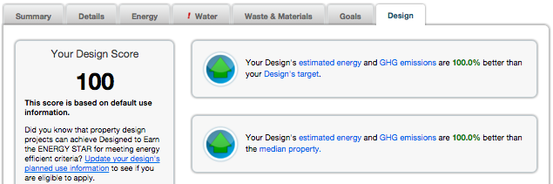
Portfolio Manager for Projects in Design Phase
Portfolio Manager’s “Design” tab allows to you to save energy and property information for your new building design project for future comparison against actual performance
Compare your energy estimates with your design target and the national median for your property type
Compare between estimated, as-designed, and actual energy consumption once the property is built and occupied
Generate documentation for energy certification recognition
Notes:
[READ SLIDE]
Additionally, the design tab within Portfolio Manager incorporates “Target Finder” functionality (discussed in detail next). This allows you to design buildings with energy saving targets, pursue “Design to Earn the ENERGY STAR” recognition, and maintain your project design data as your building goes into operation and begins benchmarking.

Slide 11
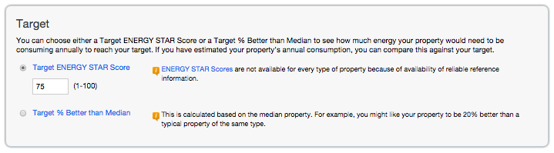
Target Finder for Projects in Design Phase
  Target Finder is an energy performance calculator built into Portfolio Manager’s Design tab, and is also a stand-alone tool. Target Finder calculates:
    Energy use intensity (EUI)
    Absolute energy required to achieve goal
    Estimated ENERGY STAR score (1-100) of design
    Energy costs and GHG emissions associated with design
  “Target Finder” is the term used by LEED, Green Globes, and CHPS
Notes:
Target Finder is a calculator that helps assess the energy performance of commercial building designs and existing buildings. Target Finder is incorporated into the “Design” tab in Portfolio Manager, and allows you to design buildings with energy saving targets, and save the data for comparison once the building goes into operations.
Additionally, Target Finder can be used as a standalone tool with no login required, which makes Target Finder useful for quick-and-easy calculations and “what-if” scenarios. Although “Target Finder” functionality has been integrated into the broader Portfolio Manager platform, “Target Finder” is still the name referenced by LEED, Green Globes, CHPS and others.
There are two basic ways to use Target Finder:
First: See what annual energy usage you need to achieve to meet a target– If you enter basic information about your business activity and set a target, you can see what this target means in terms of energy use, cost, and greenhouse gas emissions.
Second: Evaluate estimated energy use – If you already have a design or retrofit project and know its estimated energy use, you can calculate the corresponding efficiency metrics. In addition, you can see the projected costs and greenhouse gas emissions.

Slide 12
Sustainable Buildings Checklist in Portfolio Manager
The Sustainable Buildings Checklist helps Federal agencies and non-Federal buildings
    Conduct initial and final building walkthrough assessments
    Track and easily view progress on each guiding principle
    Upload compliance documents to the repository for record keeping
    Create a portfolio-wide federal building sustainability roll-up report
    Review up-to-date energy and water metrics generated by Portfolio Manager
Notes:
The Sustainable Buildings Checklist was first developed for US federal building managers for compliance with the Federal Guiding Principles for High Performance Sustainable Buildings. The Guiding Principles are intended to help federal agencies establish common strategies for operating and maintaining buildings in a sustainable manner, and include a focus on energy efficiency, water conservation, and indoor environmental air quality. The Guiding Principles are required by law for implementation across U.S. government buildings. The Checklist is a valuable tool for evaluation of the sustainability of existing building of all kinds, not just U.S. federal buildings.
(READ SLIDE)
Note: the Sustainable Buildings Checklist is based upon the 2008 version of the Federal Guiding Principles. Per the FAQ at https://portfoliomanager.zendesk.com/hc/en-us/articles/115000239152-Are-the-2008-or-2016-Guiding-Principles-in-Portfolio-Manager-,
The Guiding Principles were updated by the Council on Environmental Quality (CEQ) on February 26, 2016. But Portfolio Manager has not been updated with the 2016 updates. These updates to Portfolio Manager are currently on hold.
Since the 2016 Guiding Principles are not in Portfolio Manager, they can be tracked by using the DOE Federal Energy Management Program’s spreadsheet.
The 2008 Checklist in Portfolio Manager is available for use where appropriate. See this guide for How to Use the Sustainable Buildings Checklist.

Slide 13
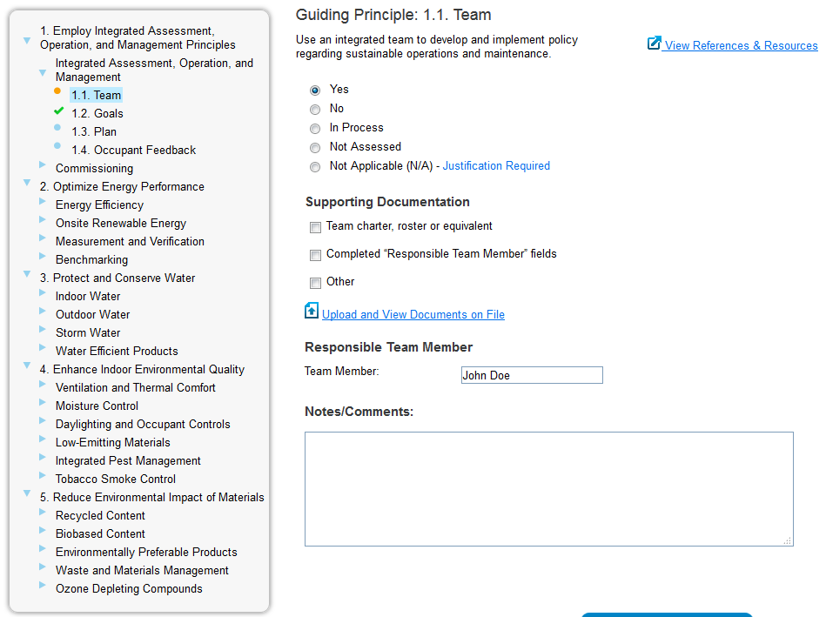
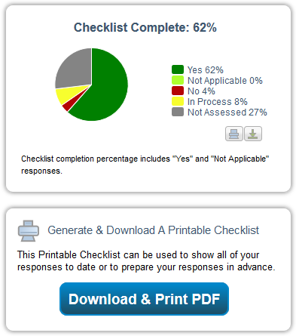
Sustainable Buildings Checklist
https://www.energystar.gov/buildings/tools-and-resources/how-use-sustainable-buildings-checklist-0
Notes:
The checklist explains each guiding principle to let you track your sustainability within the 5 guiding principles:
Employ integrated design (Design)
Optimize energy performance (Energy)
Protect and conserve water (Water)
Enhance indoor environmental quality (Environmental Quality)
Reduce environmental impact of materials (Materials)
Portfolio Manager tracks metrics for the energy and water, and will populate this information within the Sustainable Buildings Checklist to help facilitate compliance tracking and documentation.
The Sustainable Buildings Checklist is pre-populated with individual building information from Portfolio Manager in the upper left portion of the screen next to the pie chart representation of the Guiding Principles completion status. The pie chart categorizes your completion percentage in each of the 5 categories.
Use the link at the bottom of the page to access How To - resources for using the sustainable buildings checklist.

Slide 14
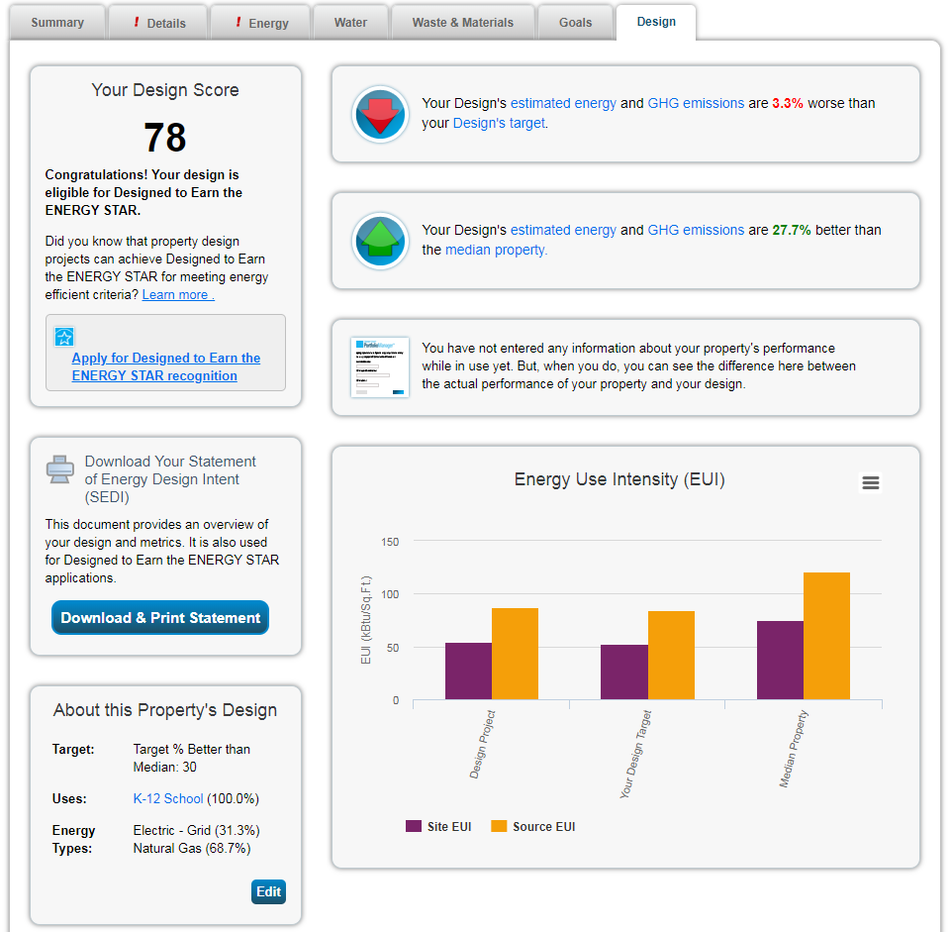
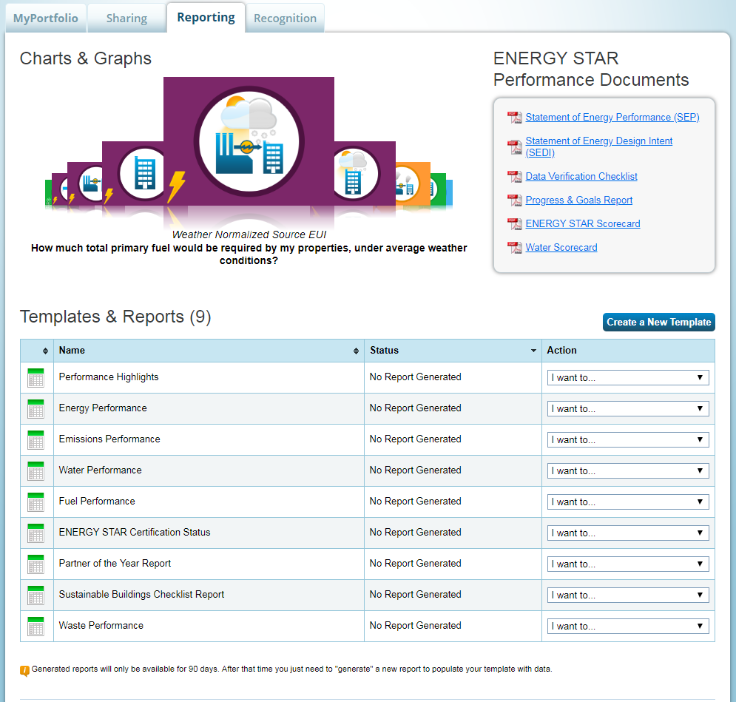
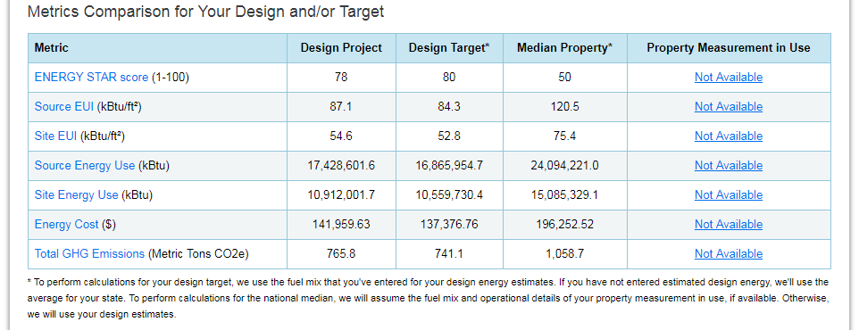
Results and Metrics Comparisons
Notes:
For all the tools just described, Portfolio Manager Reporting functionality can help you to prioritize activities and investments, identify trends, share information with others, and establish more robust benchmarks.
ENERGY STAR performance documents can help you to:
Satisfy LEED for Existing Buildings (LEED-EB: O&M) requirements
Document performance in energy service contracts
Communicate energy performance with tenants, owners, and potential buyers or renters
Provide transparency and accountability to demonstrate strategic use of capital improvement funding
Quickly and accurately demonstrate savings for an individual building

Slide 15
ENERGY STAR Resources
Training Resources
  Access “How-to” guides and video training: https://www.energystar.gov/buildings/training
  Register for webinars: http://esbuildings.webex.com
  Access Tools and Resources:
  https://www.energystar.gov/buildings/tools-and-resources
Help Desk:
  http://www.energystar.gov/buildingshelp
Notes:
In addition to the resources we just discussed, ENERGY STAR’s website is filled with additional resources to assist you. These include:
Webinars and Video Training: EPA offers web-based training on a range of energy efficiency topics — from the ins and outs of ENERGY STAR's Portfolio Manager to guidance on improving the energy performance of your buildings and plants.
How-To guides: EPA offers brief documents that provide step-by-step guidance of ENERGY STAR tools and resources.
Help Desk: The Help Desk includes categorizes of FAQs to help you work with ENERGY STAR’s tools and resources. This also includes an “Ask a Question” section where you may submit a question to Help Desk staff, and typically get a response that same day

Slide 16

Using ENERGY STAR Tools
LEED for Building Design + Construction
(BD+C) v4.1
LEED for Building Operations + Maintenance
(O+M) v4.1
Notes:
LEED, or Leadership in Energy & Environmental Design, is a green building certification program that recognizes best-in-class building strategies and practices. To receive LEED certification, building projects satisfy prerequisites and earn points to achieve different levels of certification. Prerequisites and credits differ for each rating system, and teams choose the best fit for their project. For the purposes of this presentation, we will be discussing how ENERGY STAR tools can support the following certifications: Building Design + Construction (BD+C) and Building Operations and Maintenance (O+M) for existing buildings.
In this section, we will provide an overview of how LEED incorporates energy into their certifications followed by highlighting how the Building Design + Construction and Building Operations and Maintenance certifications utilize ENERGY STAR’s tools and principles.
In this presentation, we are going to focus on LEED v4.1, which was released in April 2019. As part of this release, there are no longer any specific requirements related to ENERGY STAR performance, as there were with v4. However, there are a number of points in v4.1 where the use of ENERGY STAR Portfolio Manager and/or Target Finder continues to be recommended, and we want to be sure to call those out. For those of you who are interested in how ENERGY STAR and LEED v4 align, we invite you to review a prior recording of this training, available at:
https://esbuildings.webex.com/ec3300/eventcenter/recording/recordAction.do?siteurl=esbuildings&theAction=poprecord&ecFlag=true&recordID=18600927&internalRecordTicket=4832534b00000004a1e00b9e5c83808676cc7ea1cadecd9f1b6371e96d34786d60fc097486d11aef

Slide 17
The LEED v4.1 BD+C and O+M Rating Systems
Multidisciplinary credit categories
  Location and Transportation (LT)
  Sustainable Sites (SS)
  Water Efficiency (WE)
  Energy and Atmosphere (EA)
  Materials and Resources (MR)
  Indoor Environmental Quality (EQ)
  Innovation (IN)
  Regional Priority (RP; in BD+C only)
  Integrative Process (RP; in BD+C only)
  Prerequisites (no points awarded; required) and credits (points awarded)
Notes:
LEED offers multidisciplinary credit categories for building design and new construction as well as for existing buildings. Credits such as WE and EA encourage the pursuit of energy and water efficiency through benchmarking and metering using Portfolio Manager.
Many of these credits require prerequisites. While projects can pick and choose the credits they want to pursue for certification, prerequisites are required. They set the minimum requirements that all buildings need to meet in order to achieve LEED certification.
For the BD+C, we will focus on how ENERGY STAR and its resources can be used to obtain the Energy and Atmosphere (EA) and Integrative Process credits and their associated prerequisites.
For O+M we will discuss ENERGY STAR resources in the context of EA and Water Efficiency credits.

Slide 18
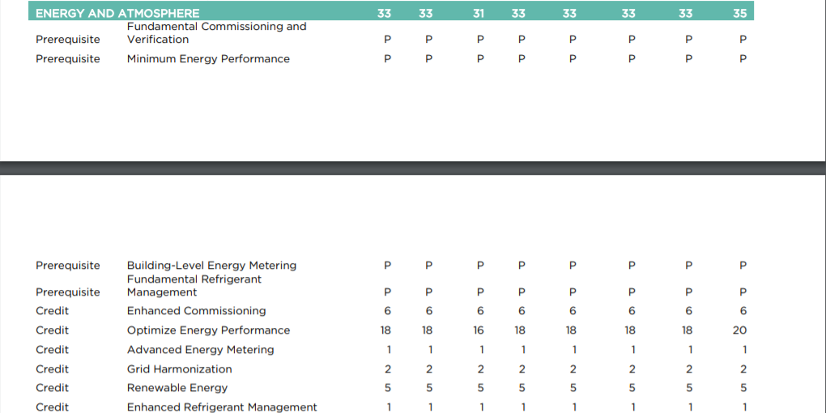
Energy and Atmosphere for LEED BD+C
LEED Guide for Building Design and Construction (LEED v4.1)
Notes:
The Energy and Atmosphere (EA) category approaches energy from a holistic perspective, addressing energy use reduction, energy-efficient design strategies, and renewable energy sources. For BD+C certification, EA credits and prerequisites encourage the use of Portfolio Manager’s Target Finder functionality to inform energy management early in the design process.
The goal of EA prerequisite ”Minimum Energy Performance” is to reduce the environmental and economic harms of excessive energy use by achieving a minimum level of energy efficiency for the building and its systems. This requires you to identify [the] energy use target for [the] building.
To complete this prerequisite, LEED recommends that users “consider using ENERGY STAR’s Target Finder to develop the EUI goal that will meet the credit requirements.”

Slide 19
Energy and Atmosphere for LEED BD+C
LEED Guide for Building Design and Construction (LEED v4.1)
Notes:
The intent of the “Optimize Energy Performance” credit is to 1) Achieve increasing levels of energy performance above the baseline in the prerequisite and 2) Reduce environmental and economic impacts associated with building energy usage.
For users seeking to meet this credit through Option 1, “Energy Performance Compliance,” Target Finder results and summary are considered “required documents” for applicable building types.

Slide 20
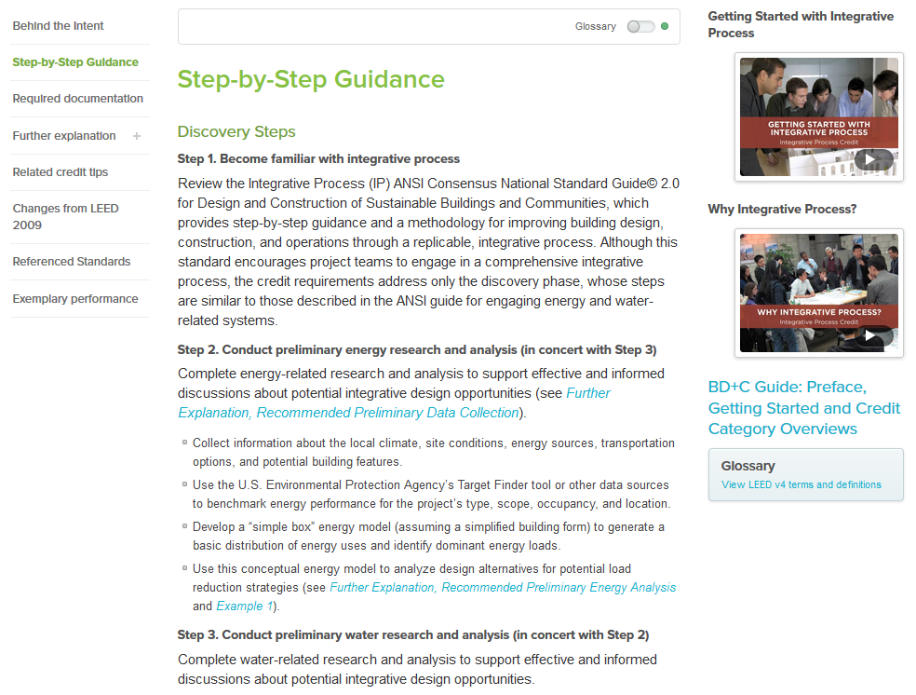
Integrative Process in LEED BD+C
Notes:
For BD+C, the purpose of the Integrative Process credit is “to support high-performance, cost-effective project outcomes through an early analysis of the interrelationships among systems”
As part of achieving this credit, you must first conduct "discovery” including “preliminary energy research and analysis.” This could involve using the Target Finder tool to benchmark energy performance for the project's type, scope, occupancy, and location."

Slide 21
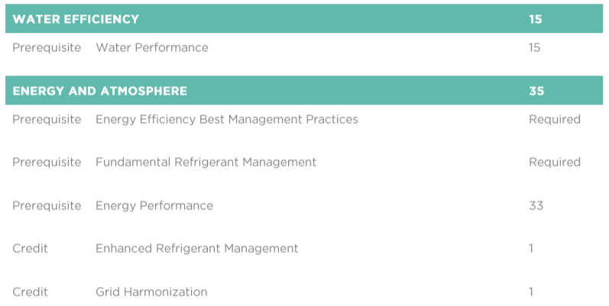
Energy and Atmosphere (EA) and Water Efficiency (WE) in LEED O+M
LEED Guide for Operations & Maintenance: Existing Buildings (LEED v4.1)
Notes:
Now we will transition to talking about ENERGY STAR and LEED for existing buildings. For O+M certification, the credits discussed and their prerequisites promote the use of Portfolio Manager to support utility data collection and benchmarking.
For example, the EA prerequisite, “Energy Performance,” has a goal to “support energy management and reduce the environmental and economic harms of excessive energy use by reducing greenhouse gas emissions and achieving higher levels of operating energy performance.” Under this prerequisite, it is required that the applicant measure energy consumption for a full year, which is then “translated into an energy performance score comprised of two sub-scores: a Greenhouse gas emissions score and Source energy score.” In order to input energy use data, USGBC has developed a process by which applicants can share energy data from EPA’s Portfolio Manager tool (see https://www.usgbc.org/resources/v41-instructions-share-data-energy-star-portfolio-manager).
The WE prerequisite, “Water Performance,” has a goal to “support water management and reduce water consumption.” Under this prerequisite, it is required that the applicant measure total potable water use for a full year, which is then “translated into a water performance score.” In order to input energy use data, USGBC has developed a process by which applicants can share water data from EPA’s Portfolio Manager tool (see https://www.usgbc.org/resources/v41-instructions-share-data-energy-star-portfolio-manager).

Slide 22
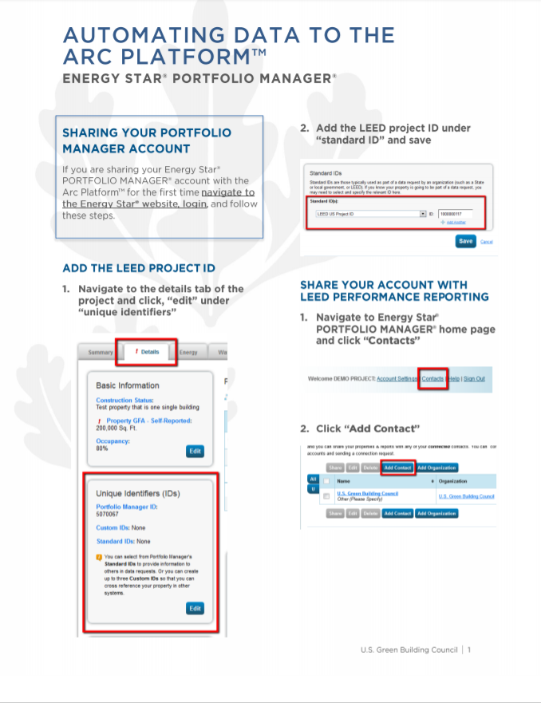
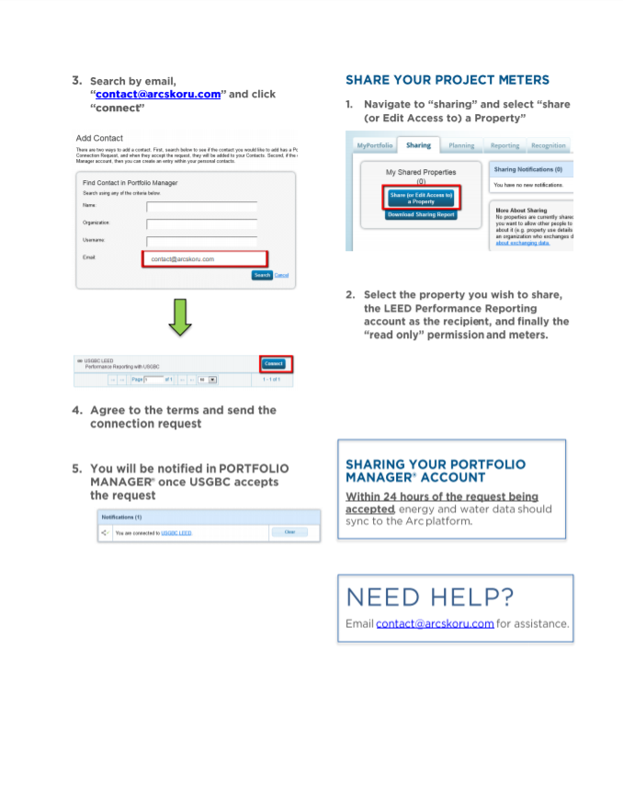
Energy and Atmosphere (EA) and Water Efficiency (WE) in LEED O+M
https://www.usgbc.org/sites/default/files/USGBC%20Connection%20Guidance.pdf
Notes:
This is a screen shot of the guidance that USGBC prepared to help applicants pull data from EPA’s Portfolio Manager tool into their LEED applications.

Slide 23

Using ENERGY STAR Tools
Green Globes
New Construction
Existing Buildings
Notes:
Green Globes was developed in 2000 for commercial buildings and was structured as a self-assessment to be done in-house using a project manager and a design team. Thus, it tended to be used for projects with limited budgets, based on the premise that the system could be done without the need for consultants to manage the certification process.
In this section, we will discuss how Green Globes incorporates energy and ENERGY STAR into the certification program generally. Next, we will discuss how ENERGY STAR tools are incorporated in the New Construction certifications and the Existing Buildings certification.

Slide 24
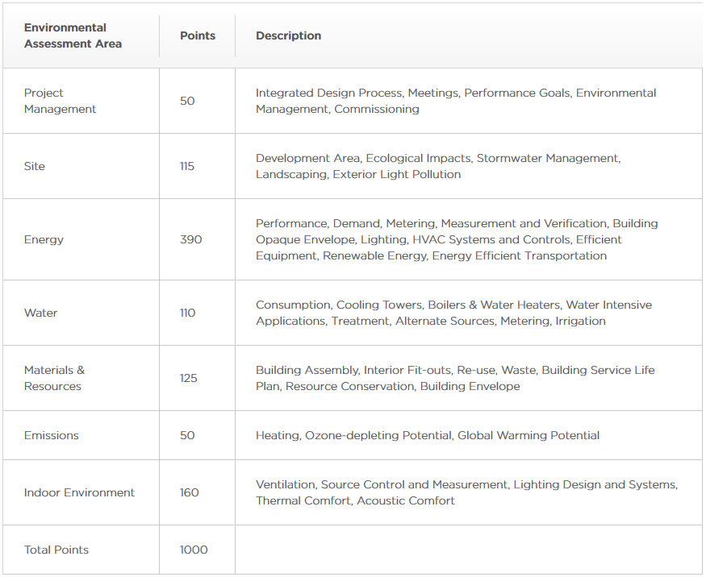
Green Globes
Notes:
Green Globes is a 1000 point system that strongly emphasizes energy; this includes CO₂ metrics and ENERGY STAR benchmarking.
24

Slide 25
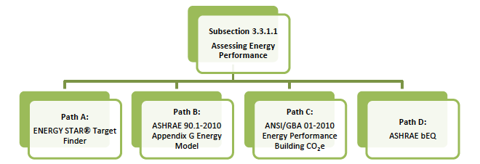
Energy Performance and Green Globes New Construction
Green Globes provides four paths for assessing energy performance
Path A, ENERGY STAR Target Finder, is worth a maximum of 100 points
Path C, ANSI/GBA 01-2010 Energy Performance Building Carbon Dioxide Equivalent Emissions Reduction, uses Target Finder to establish a Baseline Equivalent Emission Rate
Notes:
Green Globes New Construction provides four paths for assessing energy performance. Path A and C incorporate ENERGY STAR’s Target Finder to establish baselines.
For Path C, users must conduct Baseline Equivalent Emission Rate (BER) Calculations using the baseline building’s site EUI in Target Finder.

Slide 26
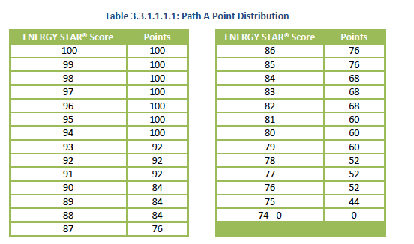
Energy Performance and Green Globes New Construction
Notes:
Path A relies on ENERGY STAR’s scoring system to inform their Point A Point Distribution.

Slide 27
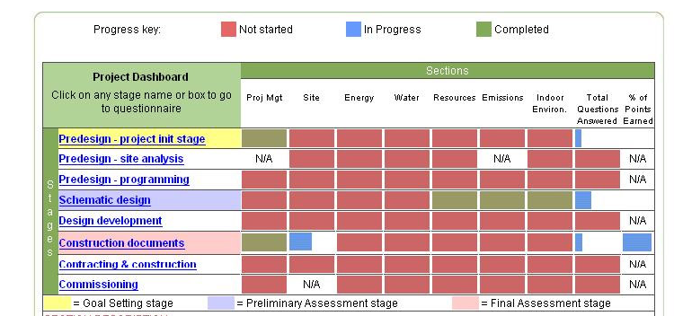
Green Globes New Construction: Dashboard Keyed to Design Stages
Notes:
Additionally, Green Globes incorporates the use of Portfolio Manager and Target Finder into its dashboard tool. For every new construction project entered in the Green Globes profile, a dashboard tool (shown here) is created. The dashboard lists the different phases under which the project will be assessed. For example, the phases include:
Pre-design-site analysis
Pre-design-programming
Schematic design
Design development
Commissioning
Within these phases, the user is prompted to answer questions and enter data regarding 7 categories including: Project Management, Site, Energy, Water, Resources, Emissions, and Indoor Environment. Often, users are asked to enter Portfolio Manager data, including providing direct links from the Green Globes profile to user’s Portfolio Manager account. Data from Portfolio Manager can be easily integrated into the Green Globes online assessment tool.
To illustrate this, we have provided several examples in this section.
27

Slide 28
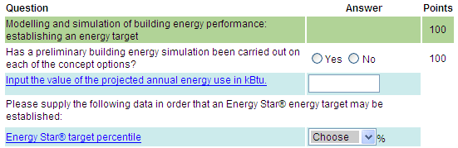
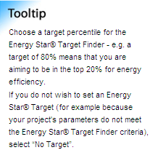

Green Globes New Construction:
Schematic Design
Notes:
Example 1:
This shows the Green Globes Online tool, within the Energy section of the Schematic Design Phase. The first set of questions in this sub-section asks users to enter their projected annual energy usage and then prompts the user to enter Portfolio Manager data. This section provides a direct link from the Green Globes profile to one’s Portfolio Manager account.
Later on this page, the user is prompted to enter several types of information, including the projected annual energy use, information about optimization of space, responses to microclimate, and daylighting features for the project.
The first set of questions in this sub-section asks users to enter their projected annual energy usage and then prompts the user to enter Target Finder data. This section provides a direct link from the Green Globes profile to one’s Target Finder data. Data from Target Finder can be easily integrated into the Green Globes online assessment tool.

Slide 29
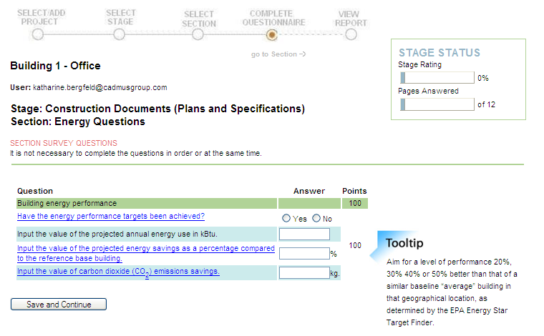
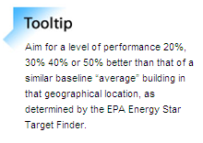
Green Globes New Construction:
Design Development
Design Project pathway
in Portfolio Manager
Notes:
Example 2:
This shows the Energy portion of the Construction Documents Phase in the Green Globes Online Tool.
Here, the goal is to evaluate the design strategies to minimize the building's energy consumption using the site's features. We again see a direct correlation in the Green Globes Design Development phase to Portfolio Manager’s Design tab and Target Finder. The Online Green Globes NC tool asks for users to enter the energy savings as a percentage compared to a reference base building. And as the Tooltip on the side shows, Green Globes is aiming for a performance 20%, 30%, 40%, or 50% better than that of a similar building, as determined by Portfolio Manager. Again this data can easily be integrated from a Portfolio Manager account, as well.

Slide 30
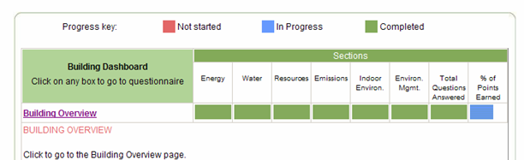
Green Globes Existing Buildings
Dashboard
Notes:
Green Globes for Existing Buildings also incorporates the use of ENERGY STAR tools. The online dashboard is similar to that of Green Globes NC, but a little less extensive. Instead of listing the different phases of design and construction, it simply lists a Building overview tab, where users enter in data and information regarding six different categories: Energy, Water, Resources, Emissions, Indoor Environment, and Environmental Management. We’ll be entering into the Energy section to take a closer look at how the Green Globes system correlates with ENERGY STAR.

Slide 31
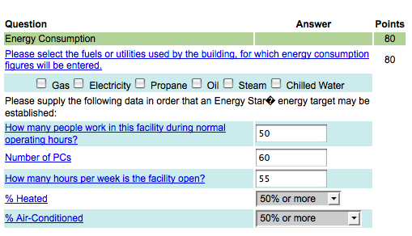
Green Globes Existing Buildings
Notes:
You can also use Portfolio Manager to aid in achieving Green Globes certification for existing buildings. As stated before, one of the many highlights of the Green Globes rating system is that it takes advantage of the ENERGY STAR tools. In the Energy section, the tool asks several questions, surveying the user about the energy efficiency mechanisms put in place for the building. The energy consumption questions are identical to those posed in Portfolio Manager, and the same assessment criteria are used as comparison for the building.

Slide 32
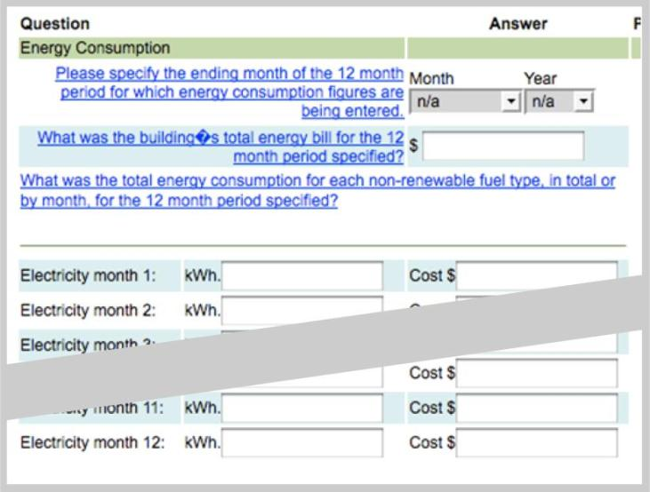
Green Globes Existing Buildings
Requires 12 months of data
Notes:
Moving through the Green Globes assessment tool, we see even more similarities to Portfolio Manager. Here you can see that once a fuel choice is chosen in the first Energy survey questions, users are prompted to enter their monthly energy usage, much like what is found in Portfolio Manager. Green Globes offers a direct link to Portfolio Manager data, so that users can integrate information from their Portfolio Manager account into their Green Globes account.

Slide 33

Using ENERGY STAR Tools
Institute of Real Estate Management (IREM) Certified Sustainable Properties (CSP)
Existing Buildings
Notes:
Next we will talk about the IREM Certified Sustainable Properties program for existing buildings.
IREM or the Institute of Real Estate Management is an international community of real estate managers who are dedicated to improving and promoting ethical business practices through education and information sharing.
IREM has developed a recognition program for existing office properties, multi-family communities and shopping centers. This certification program - allows property managers to work towards sustainability goals that are meaningful, while still being achievable and affordable.
This program is perfect for properties that don’t have an existing sustainability program in place. Through benchmarking, policies and self-assessment, this program can be done in-house without the need to hire a consultant.
This program prides itself on being accessible to properties for which other certification programs are too far out of reach or that don’t make financial sense.

Slide 34

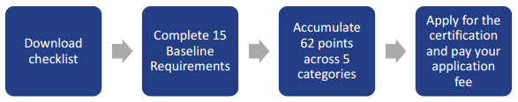
IREM Certified Sustainable Properties – Credit Categories
Notes:
What’s distinguishes the CSP program, is that they have found a way to incorporate other benchmarking and certification programs, most notably the ENERGY STAR Portfolio Manger tool, as a verification option in their credit requirements.
All properties must satisfy baseline requirements and earn points across 5 credit categories to gain recognition for sustainable energy performance. Properties need to earn 62 points out of 88 possible points across these 5 categories – energy, water, health, recycling and purchasing. Additionally, at least 2 points must be earned in each category to be eligible for certification.
Where other certification programs may be out of reach or not make financial sense, all of the certification materials for the CSP program are available online, at no cost, to help guide you through the process. This poses a perfect opportunity for you to involve your staff in the certification process and use it as an educational tool.
There is only one level of certification that buildings can achieve, but, what’s unique to this program is that their certification is awarded for 3 years.
Energy 21 pts
Water 16 pts
Health 21 pts
Recycling 20 pts
Purchasing 10 pts
34

Slide 35
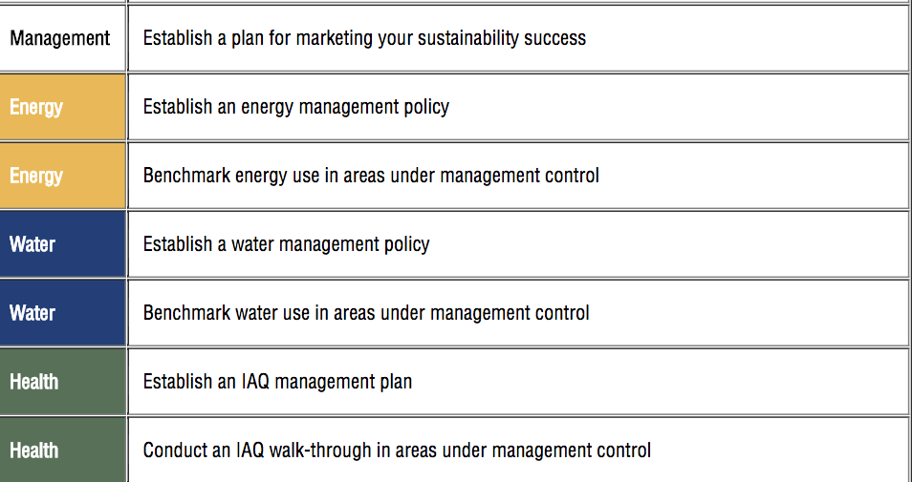
IREM Certified Sustainable Properties – Baseline Requirements
Notes:
Looking at the baseline requirements, all properties must complete 15 basic requirements in order to be eligible for certification.
Included in these baseline requirements are measures for establishing energy and water benchmarks. The CSP program strongly encourages the use of ENERGY STAR’s Portfolio Manager benchmarking tool to track and manage the energy and water use at your property.
Most users are able to submit standard reports from ENERGY STAR Portfolio Manager, such as the Energy and Water Performance Report, to prove that they have achieved the benchmarking requirements.
35

Slide 36
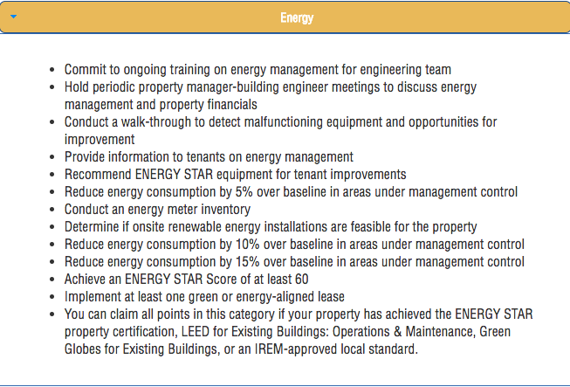
IREM Certified Sustainable Properties – Credit Requirements
Notes:
Taking a look at the Energy requirements for multi-family properties, you’ll notice how ENERGY STAR’s tool have been integrated into the credit criteria.
This program encourages and awards points for improvements that bring properties to new levels of sustainability. This progress can be measured using ENERGY STAR’s Portfolio Manager tool to achieve a level of energy use reduction 5%, 10%, or even 15% over the baseline building. ENERGY STAR’s performance reports are a great way to show compliance with this requirement.
What’s unique about this program is that this certification recognizes past action – so my customers are able to claim credit going back 3 years for these energy and water use reductions.
Staying on this slide for a minute, I’ll point out that office properties and multifamily communities can also earn points toward certification with a minimum ENERGY STAR score of 60 and above.
Additional credit is awarded for committing to install ENERGY STAR products and appliances throughout the building during the 3-year certification. This progress is measured during the annual sustainability survey.
Most importantly, if your property is ENERGY STAR certified, you can claim all 21 of the Energy category points — immediately satisfying about 35% of the points required for CSP certification. The same is true for LEED O+M properties.
Attaining multiple Green Building certifications is a great way to promote the sustainability of your building and put your property ahead of the competition.
36

Slide 37
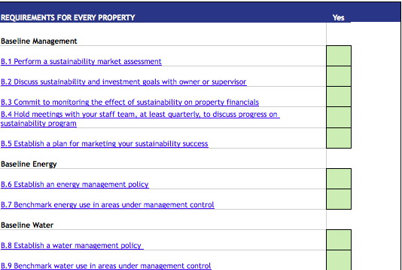
IREM Certified Sustainable Properties – Property Requirements
Notes:
Here is a snapshot of the property checklist tool. Outlined in the spreadsheet, you have each of the credit categories listed and checkboxes to track your progress in each section.
Each requirement and activity is hyperlinked to a downloadable word document that includes instructions and guidance, a tool for completing the requirement or activity, and options for alternative documentation.
Focusing on the documentation piece, here is where we see the ENERGY STAR Portfolio Manger tool integrated into this certification.
37

Slide 38
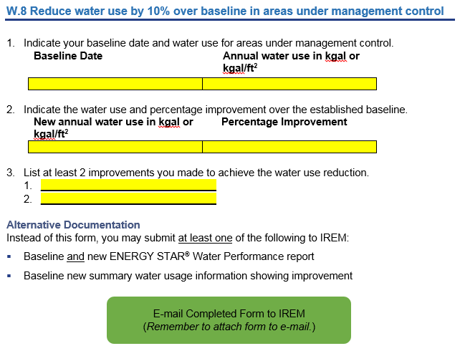
IREM Certified Sustainable Properties – Tools and Documentation
38
Notes:
Each of the hyperlinked sections opens up a document similar to the one shown on this slide.
Using the water efficiency example, we see that the form asks the applicant to enter baseline and current water consumption data in additional to other building information.
For properties with an ENERGY STAR Portfolio Manager account, you are able to just submit the ENERGY STAR Report as proof of compliance. The tool makes it easy and it’s as simple as clicking the green box and attaching the form to the email.
The ENERGY STAR Reporting features, namely the Statement of Energy Performance Report as well as the Energy and Water Performance Reports – can be used to satisfy the documentation requirements for 2 of the baseline requirements and up to 6 of the Energy and Water requirements.
This just reaffirms, that if you have entered your property into ENERGY STAR’s Portfolio Manager, then the documentation component is easy.
38

Slide 39

Using ENERGY STAR Tools
Building Owners and Managers Association (BOMA) BEST Program
Existing Buildings
39
Notes:
BOMA BEST is Canada’s largest environmental assessment and certification program for energy performance in existing buildings.
Since 2005, over 5,000 buildings have obtained certification or recognition for the best in building environmental standards.
BOMA BEST is unique in that it focuses on creating a management roadmap to improve the operation and performance of buildings. This certification program provides a framework for buildings to develop and implement a sustainable, long-term energy management plan.
BOMA BEST 3.0, which launched in October 2016, represents a complete update of the BOMA program as it existed in 2012. The updated program has expanded to include building certifications in the US and it includes new categories, certification levels and BEST Practices.

Slide 40
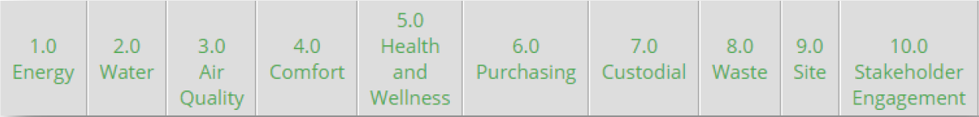

BOMA BEST: Programs
BOMA Sustainable Buildings Program: track energy and water performance for:
  Single Buildings – 3-year certification managed by local BOMA associations
  Portfolio Program – 1-year certification managed by BOMA Canada
40
Notes:
BOMA BEST has two programs or “streams” to help companies and organizations manage their building and energy performance.
The Sustainable Buildings program is structured as an online Portal which allows building managers to track energy and water performance for a single building or a portfolio of buildings.
For both of these streams, the energy and water metrics are tracked using the Portfolio Manager benchmarking platform.
There are no minimum performance standards required to participate, but all BOMA Buildings must comply with BEST practices which set the energy management requirements.
Within the BOMA BEST certification, buildings earn points across 10 areas of environmental performance and management categories to achieve one of 5 levels of certification: certified, bronze, silver, gold and platinum.
The BOMA BEST certification is a 1,000 point system and 40% of these total points are awarded for energy and water management.
40

Slide 41
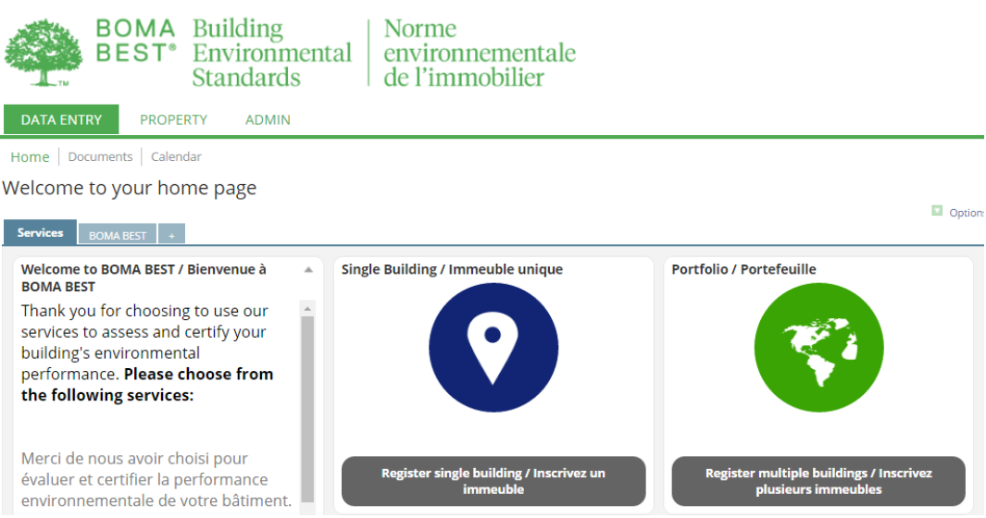
BOMA BEST: Verification and Certification
Steps to Verification and Certification
Register in the BOMA BEST Online Portal
Complete assessment questionnaire - synchronize your Portfolio Manager account and use your ENERGY STAR Score to report performance metrics.
Request verification
On-site third party verification
Achieve certification
41
Notes:
After you register in the Online Portal, you complete the BOMA BEST Questionnaire. This questionnaire includes mandatory BEST practices and self-reported performance metrics.
There are 6 building specific questionnaire templates and 1 universal template available for different building types.
When entering performance metrics, you will be asked to enter your Energy Use Intensity, your ENERGY STAR Score (if applicable), and your water use intensity as reported in your ENERGY STAR Portfolio Manager account. Depending on the questionnaire you are using, points will be allocated for these values.
BOMA BEST has made this really easy and you can synchronize your BOMA building account to push and pull data directly from your ENERGY STAR Portfolio Manager account.
After completing the questionnaire, you submit your request for third party verification of your properties. Every building that completes the online assessment must undergo on-site verification before the final score and certification are issued.
41

Slide 42
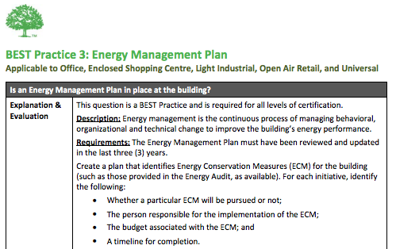
BOMA BEST: BEST Practices
BEST Practices present minimum requirements for all buildings
Upload documentation demonstrating each BEST Practice to the questionnaire
All buildings must achieve BEST Practices for their asset class to achieve certification.
42
Notes:
Shown on the slide is a screen shot of the application guide, which is one of the many resources available on the BOMA Best website to help guide you through the certification process.
As you can see, the BEST practices are outlined and each one is divided into 5 parts where you have demonstration of intent, assessment, operations and management, building systems, and innovation.
BOMA Best Practices outline the performance and environmental standards that buildings must achieve in order to gain points towards certification. These practices form the foundation of the BOMA Program, which is focused on providing low cost, high value opportunities to improve management.
In general, there are 14-16 BEST Practices in place for most of the property types in this certification program.
The image above shows a BEST Practice applicable to: offices, enclosed shopping centers, light industrial, open air retail, and universal property types. In this example, uploading an energy management plan would demonstrate this BEST Practice.
42

Slide 43
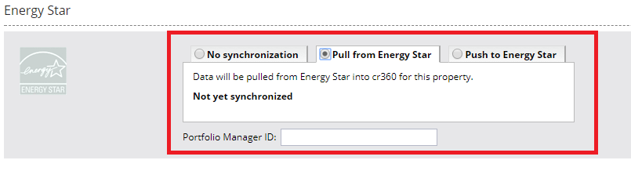
BOMA BEST: Energy and Water Benchmarking
Additional points are available if building benchmark their energy and water performance.
Benchmarking must be performed by either the BOMA BEST Online Portal or the ENERGY STAR portal. In both cases, the ENERGY STAR methodology is used to calculate performance.
43
Notes:
For these next three slides, we’ll take a look at how the BOMA BEST Platform integrates with the ENERGY STAR Platform.
To satisfy the energy and water benchmarking requirements, the BOMA BEST Tool is able to push and pull data from your Portfolio Manager account.
Benchmarking can be performed using the BOMA BEST online portal or the ENERGY STAR portal, and all of your data can be transferred to the other platform.

Slide 44
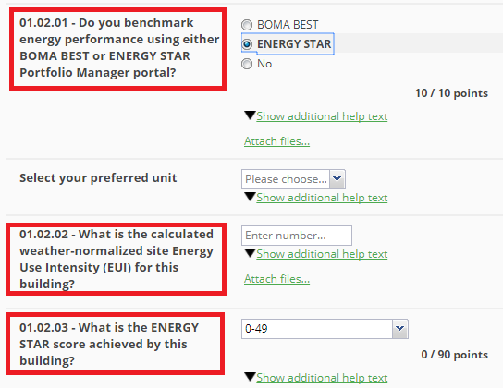
BOMA BEST: Energy Performance
Energy performance is based on ENERGY STAR Score.
Points are also available if users can provide a weather-normalized site EUI.
44
Notes:
Here we see the energy category, where points are awarded based on your ENERGY STAR score. This is because office buildings, multifamily, and shopping centers are all eligible to receive an ENERGY STAR score within Portfolio Manager.
Additional points are available for providing the weather normalized site energy use intensity, which is also generated from your Portfolio Manager account.

Slide 45
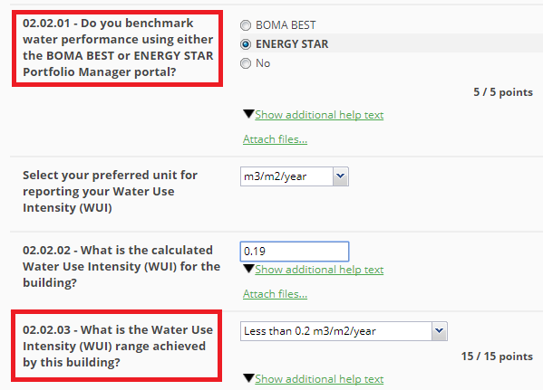
BOMA BEST: Water Performance
Water performance is based on Water Use Intensity.
45
Notes:
Similarly, in the water performance category, points are awarded for the water use intensity of the building. This metric is calculated using ENERGY STAR and can be pulled right in using that synchronization tool.

Slide 46
ENERGY STAR and Green Building Rating Systems
Conclusion
  ENERGY STAR has resources to help you earn LEED, Green Globes, CSP, or BOMA BEST recognition for building design and existing buildings
  EPA’s Portfolio Manager tool can be used to obtain certification related to both building design and operations.
  Portfolio Manager is the leading tool to support utility data tracking for operations and benchmarking for existing buildings.
  Portfolio Manager’s “Design” tab and Target Finder functionality can be used to support certifications related to both building design and operations, because it informs energy management early in the design process, as well as setting energy management goals
46
Notes:
(READ SLIDE)

Slide 47
Thank You for Attending!
Questions?
If you have any questions on Portfolio Manager or the ENERGY STAR® program, contact us at:
www.energystar.gov/BuildingsHelp
47

