Slide 1
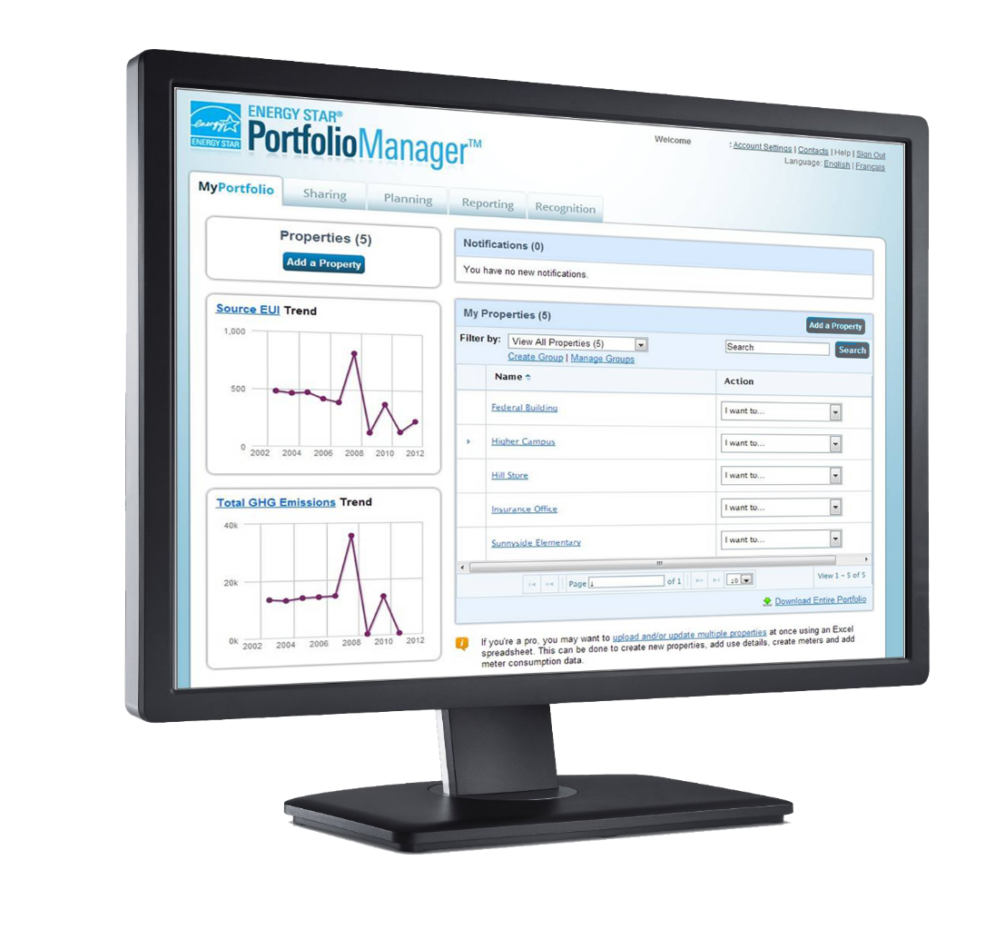




What is ENERGY STAR® Portfolio Manager ®?
  Assess energy, water and waste/materials consumption
  Track changes over time
  1-100 ENERGY STAR score (available for many building types)
  Apply for ENERGY STAR certification
www.energystar.gov/benchmark
Notes:
ENERGY STAR Portfolio Manager is a no-cost online tool provided by the U.S. Environmental Protection Agency to help building owners and managers assess and track energy, water, and waste across an entire portfolio of buildings … all in a secure online environment. Portfolio Manager provides literally hundreds of metrics. Among them are energy consumption, water consumption, greenhouse gas emissions, and the 1 – 100 ENERGY STAR score, which is available for certain property types. This score compares your building’s energy performance to similar buildings nationwide. A score of 50 represents median energy performance, while a score of 75 means your building performs better than 75 percent of all similar buildings nationwide — and may be eligible for ENERGY STAR certification.

Slide 2
What is getting updated in ENERGY STAR Portfolio Manager?
On August 26, 2018, EPA is releasing updated metrics to the tool as part of its standard process to keep ENERGY STAR metrics as current as possible:
  1-100 ENERGY STAR score models (based on CBECS 2012)
    Bank branches
    Courthouses
    Financial offices
    Hotels
    Houses of worship
    K-12 schools
  National source energy factor
  Data center benchmarking options
    Offices
    Retail, including retail store and warehouse club/supercenter
    Supermarkets
    Warehouses, including refrigerated, non-refrigerated, and distribution centers
Notes:
You may have heard that EPA is updating ENERGY STAR metrics in Portfolio Manager this August. Why is EPA updating its metrics and what will change?
EPA is committed to providing information about building performance based on the most up-to-date market data available. When updated data sources become available, EPA refreshes ENERGY STAR metrics accordingly. EPA’s basic approach is not changing. EPA will still:
Provide a national level benchmark.
Use source energy to provide equitable scores for all fuel mixes.
Incorporate variables that capture weather and business activity.
Exclude from analysis terms about technology, in order to reward technology that saves energy.
Based on new market data, EPA will update the score models for the property types shown here. The national source energy factor, which is used to calculate weather-normalized source energy use and the score, will also be updated, and there will be a new option for those of you benchmarking data center space in your portfolio.

Slide 3

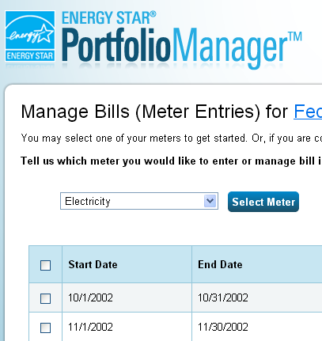
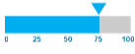
EPA’s 1 – 100 ENERGY STAR scores are based on market data
EPA creates a statistical model that correlates the energy data of the property use details to identify the key drivers of energy use, accounting for weather variations
Nationally representative survey - CBECS gathers data on building characteristics and energy use from thousands of buildings across the U.S.
Compares the actual energy data for a building to the modeled estimate to determine where the building ranks relative to its peers on a 1-100 scale
Notes:
While any building’s energy use can be benchmarked in Portfolio Manager, certain property types can also receive a 1 – 100 ENERGY STAR score, which compares your property’s energy performance to similar properties nationwide. A score of 50 represents median energy performance, while a score of 75 means your building is a top energy performer — and may be eligible for ENERGY STAR certification.
Your building is not compared to the other buildings in Portfolio Manager to determine your ENERGY STAR score. Instead, your building is compared to other buildings nationwide that have the same primary use. Where does this peer group come from?
Every four years, the U.S. Department of Energy’s Energy Information Administration (EIA) conducts a national survey to gather data on building characteristics and energy use from thousands of buildings across the United States. This Commercial Building Energy Consumption Survey (CBECS) is the only national-level source of data on the characteristics and energy use of commercial buildings. For most (but not all) property types located in the United States, your building’s peer group for comparison consists of those buildings in the CBECS survey that are similar to yours.
To develop the score, EPA:
1. Analyzes national survey data
CBECS (Portfolio Manager Data is NOT used as an input)
2. Develops regression models
Normalize for different business activities
Predict the average energy use for a building that operates just like yours (normalized mean)
3. Compares actual energy use with normalized mean from the model
Actual < Normalized Mean → More efficient
4. Creates scoring lookup table
Lower ratio of actual EUI vs normalized mean results in higher ENERGY STAR Score

Slide 4
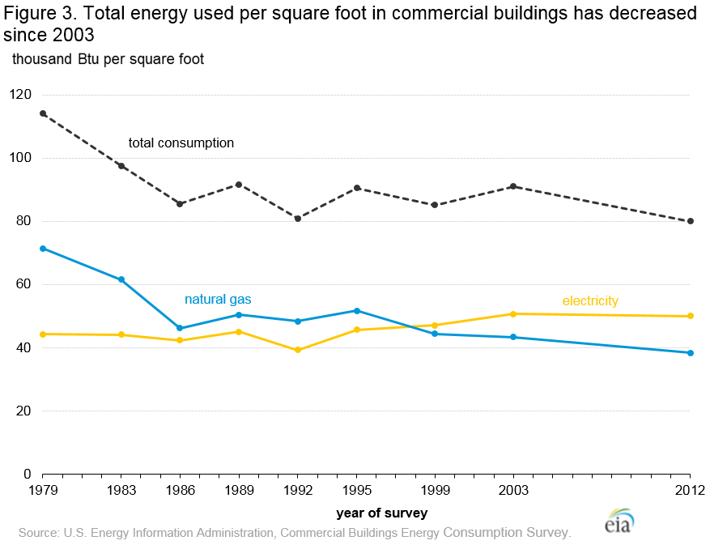
Overall trend in U.S. building energy use (CBECS)
Notes:
What does the latest market data from CBECS tell us?
Long-term trend has been relatively stable over the last 30 years.
2012 survey shows lower aggregate intensity as compared with 2003.
This is a good trend overall, since it reflects the focus and efforts of building owners and managers to reduce their energy use, but it also means that ENERGY STAR scores will shift.

Slide 5
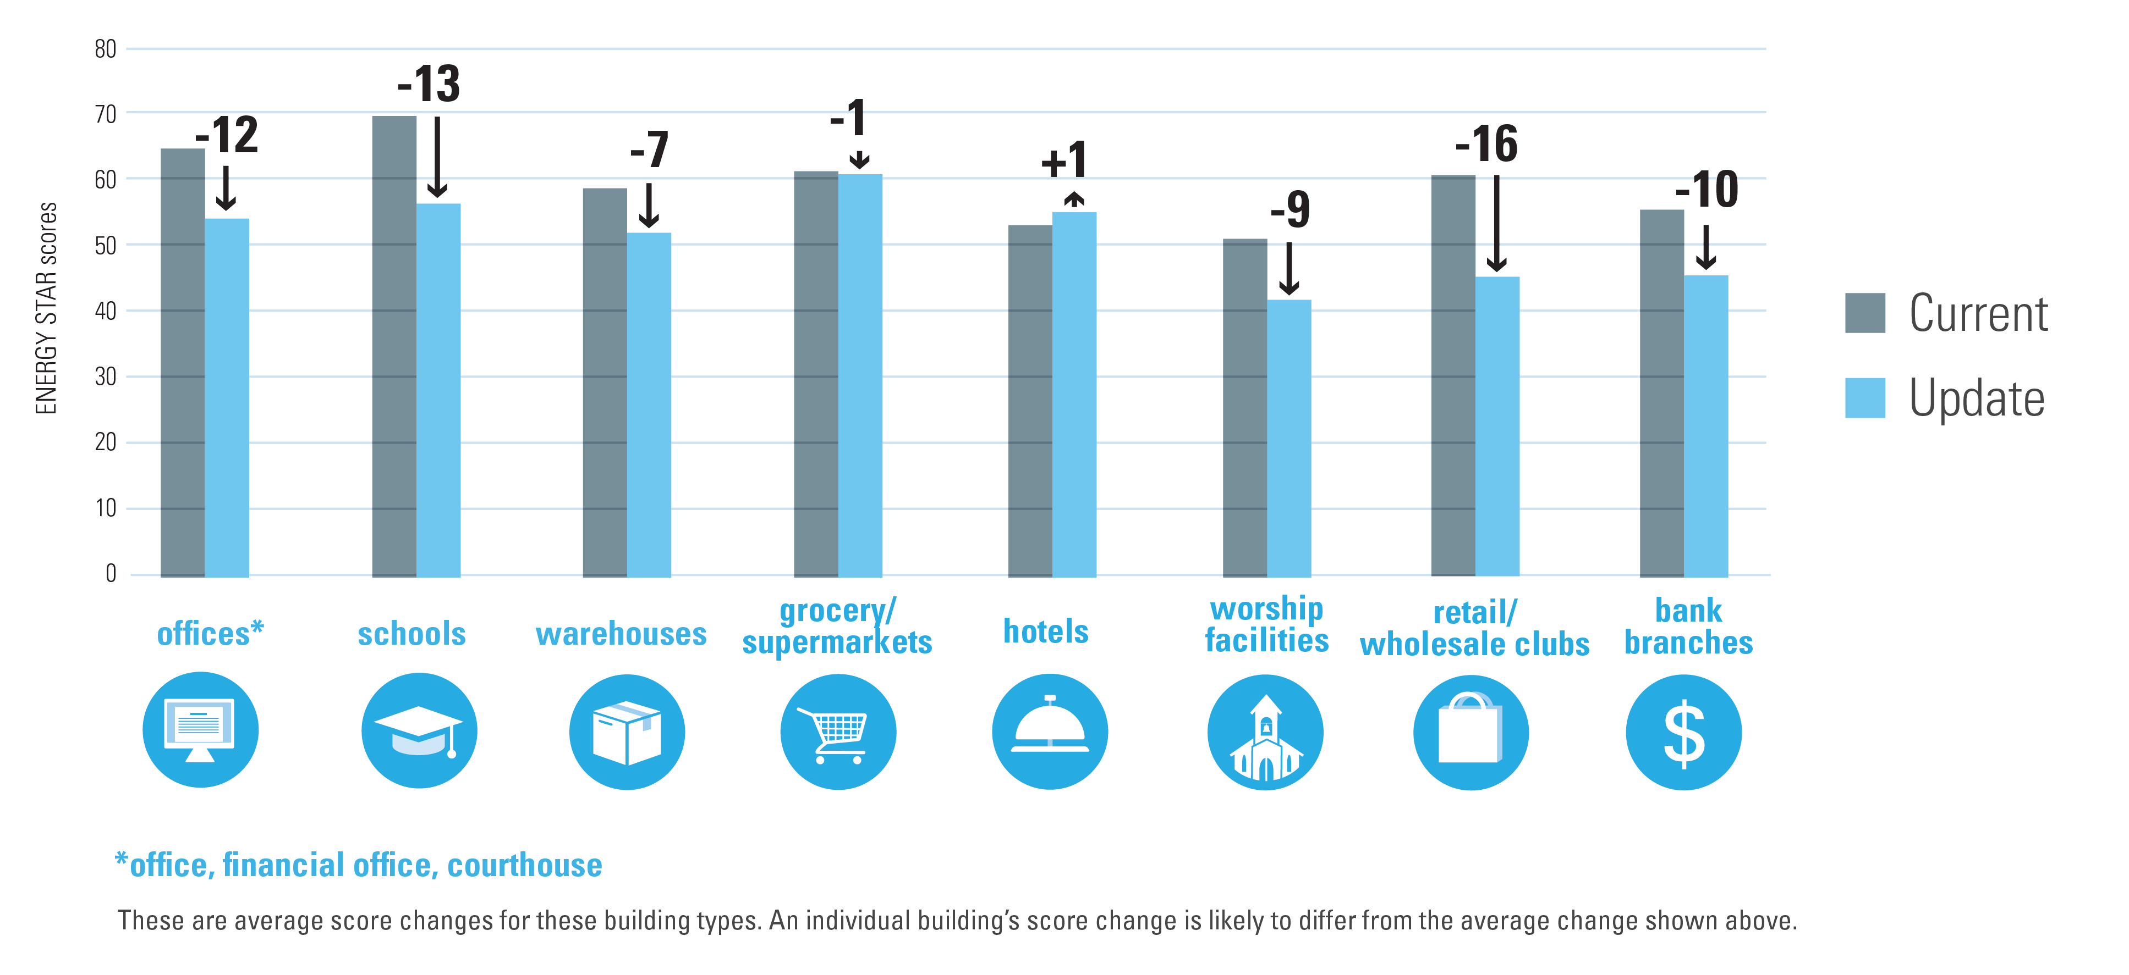
What does this mean for individual buildings?
Because average energy and grid performance is improving, the ENERGY STAR scores and performance metrics of individual buildings will, on average, go down.
Notes:
Because average energy and grid performance is improving, the ENERGY STAR scores and performance metrics of individual buildings will, on average, go down.

Slide 6
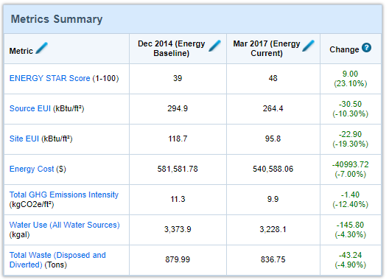
Will this impact your historical scores?
Yes, when EPA updates the methodology, the new calculations will be applied to all time periods.
You’ll maintain the ability to compare performance over time.
  Even if your scores go down, you’ll still see your improvement between the baseline and the current periods
  You’ll continue to be able to analyze differences that are a result of your own activities, not EPA’s methodology
Notes:
When ENERGY STAR metrics are updated on August 26, 2018, the new calculations will be applied across all time periods, which means your scores and metrics for all historical benchmarking data will change.
By applying this update across all time periods, you’ll continue to be able to analyze changes that are a result of your own activities, rather than changes in underlying market data.

Slide 7
How will updated metrics in Portfolio Manager and Target Finder affect commercial new construction projects?
The updates will affect calculations for the following metrics:
  Energy use associated with your selected design target
  ENERGY STAR score calculated for your estimated annual site energy
  Source energy use calculated for your estimated annual site energy
  Estimated GHG emissions
The update will not change the metrics for the following:
  Estimated site energy you entered
  Design target you selected
  Energy cost data (unless you chose the default values)
All metrics will be recalculated and applied retroactively to design projects stored in Portfolio Manager
The updates may affect eligibility for Designed to Earn the ENERGY STAR Recognition on new projects
For more details, see FAQ How will the metrics update affect design projects?

Slide 8
Any other changes in August?
Data center energy estimates
New option: Estimated data center energy use
  Designed for smaller data centers, within another property type, and where it is not practical to measure IT Energy
  If IT energy is not metered, users will have the chance to apply estimates generated by Portfolio Manager
  Estimate capped at 10% of the building area
New use details in Portfolio Manager
Warehouse
  Percentage of gross floor area used for cold storage (New in August)
  Percent that can be cooled and percent that can be heated (New in August for refrigerated warehouses)
Worship Facilities
  Gross floor area used for food preparation (New in August)
  Percent that can be cooled and percent that can be heated (New in August)
K-12 Schools
  Number of workers on main shift
    Exists now, but will be required in August
Supermarket
  Number of open or closed refrigeration/freezer units
    Exists now, but will be required in August
Notes:
There are a few additional changes included in the August metric updates.
First, there will be a new option for properties with data centers. The existing and recommended option is to measure and enter IT energy use. This is an industry best practice and provides the most accurate and complete measurement. New in August, you’ll have the option to use Estimated IT Energy for your Data Center to get a score and certification. These estimates will be calculated by Portfolio Manager based on the Gross Floor Area (GFA) of your Data Center. The Data Center estimates can be applied to a maximum of 10% of your property's total GFA.
Secondly, based on the analysis of key energy drivers in the latest CBECS data, there will be new, or newly required, use details for some property types.

Slide 9
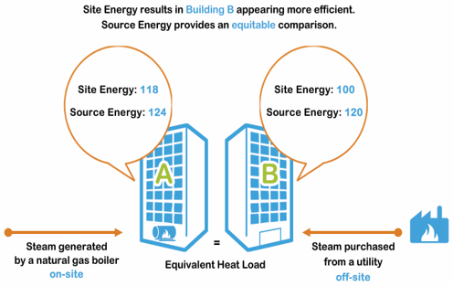
Any other changes in August?
Update to Source Energy Factor
Source energy traces the heat and electricity requirements of the building back to the raw fuel input
  Level playing field for different fuel types
Portfolio Manager delivers several key performance indicators in source energy:
  Weather normalized source EUI
  ENERGY STAR score
New approach
  Offsite renewables lower the national average electric source factor. Electricity generated from renewable energy sources has lower raw fuel inputs than electricity generated from fossil fuels.
Updated electric source factor releasing Aug 26, 2018
  Dropping from 3.1 to 2.8 (more efficient grid)
  Will impact ENERGY STAR score & all source energy metrics
  ENERGY STAR score could increase or decrease depending on a building’s fuel-mix ratio
  Changes based on this update alone will be small in magnitude comparatively
Notes:
Lastly, there will be an update to the source energy factor. Source energy traces the heat and electricity requirements of the building back to the raw fuel input, which levels the playing field for different fuel types. It incorporates all types of electric generation: Coal, Gas, Wind, Hydro, etc…
Portfolio Manager delivers several key performance indicators in Source Energy, including weather normalized source EUI and the ENERGY STAR score.
Under the past approach, EIA publications treated renewable energy as equivalent to fossil fuel energy.
Under the new approach, renewable energy sources are not subject to generation losses at the power plant, like fossil fuel (no combustion). This means that the new electric source factor:
Will drop from 3.1 to 2.8 (more efficient grid)
Will impact ENERGY STAR score & all source energy metrics
Could causes ENERGY STAR scores to increase or decrease depending on a building’s fuel-mix ratio
Changes based on this update alone will be small in magnitude comparatively.

Slide 10
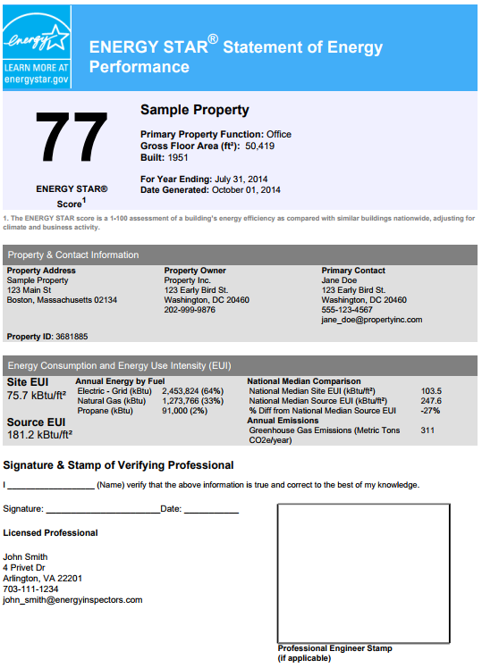
Preparing for the metric updates
If needed, document pre-update metrics with Portfolio Manager reports
  “Performance Highlight” Report
    Portfolio-level, multi-year
  Statement of Energy Performance
    Building-level, represents 12-month performance period
Notes:
So, what should you do to prepare for the August metric updates?
First, it’s important to note that after the metric updates are implemented, EPA will not be able to provide “before and after” score changes for individual buildings or portfolios. If you anticipate needing to document changes, you can download your pre- and post-update metrics in Excel using Portfolio Manager reports.
To record this information and calculate changes, you’ll need to download the report prior to the August update and again after the update. This may be relevant if you’re participating in third-party certifications or incentives.
The following reports may be helpful:
“Performance Highlight” Report (for a portfolio-level, multi-year summary)
Statement of Energy Performance (for a building-level, 12-month performance period)

Slide 11

Preparing for the updates
Apply for ENERGY STAR certification (policy for 2018 only):
  If you earned 2017 ENERGY STAR certification for your building, you may apply for 2018 certification using a period ending date of April 30, 2018, or earlier. Applications submitted:
    Before July 26, 2018 and which require no significant follow-up or changes, will be guaranteed to be approved and awarded certification using the existing score models.
    July 26, 2018 – August 26, 2018 may be evaluated using the updated score models, especially if significant follow-up or changes to the application are required.
    After August 26, 2018 will be evaluated using the updated score models.
Notes:
Apply for ENERGY STAR certification
One-time rule change: If you earned 2017 ENERGY STAR certification for your building, you may apply for 2018 certification using a period ending date of April 30, 2018, or earlier. Applications submitted:
Before July 26, 2018 and which require no significant follow-up or changes, will be guaranteed to be approved and awarded certification using the existing score models.
July 26, 2018 – August 26, 2018 may be evaluated using the updated score models, especially if significant follow-up or changes to the application are required.
After August 26, 2018 will be evaluated using the updated score models.
2019 Certifications will all be based on updated ENERGY STAR scores.
(Note that EPA will not rescind prior ENERGY STAR certifications.)

Slide 12
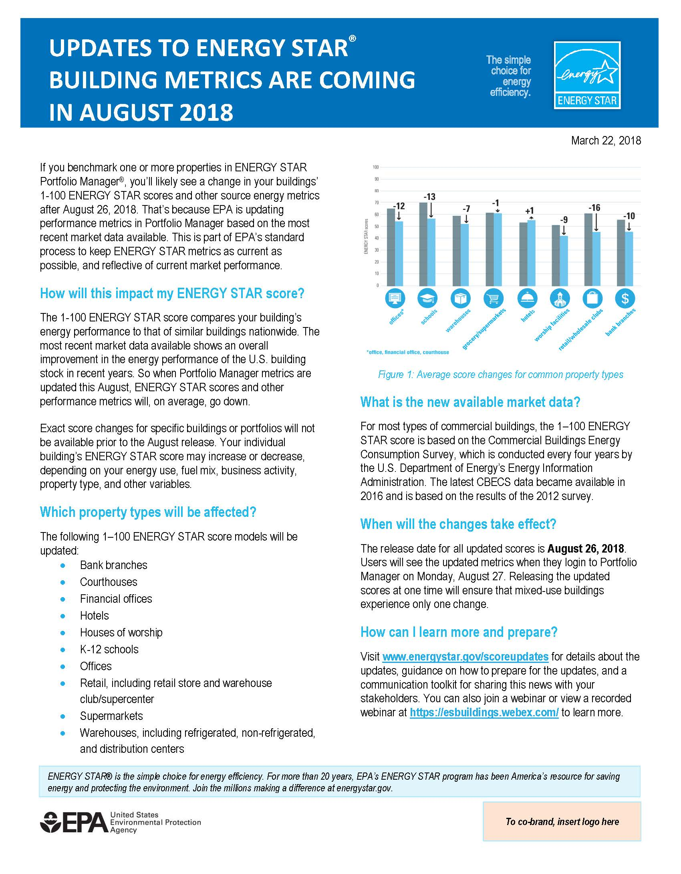
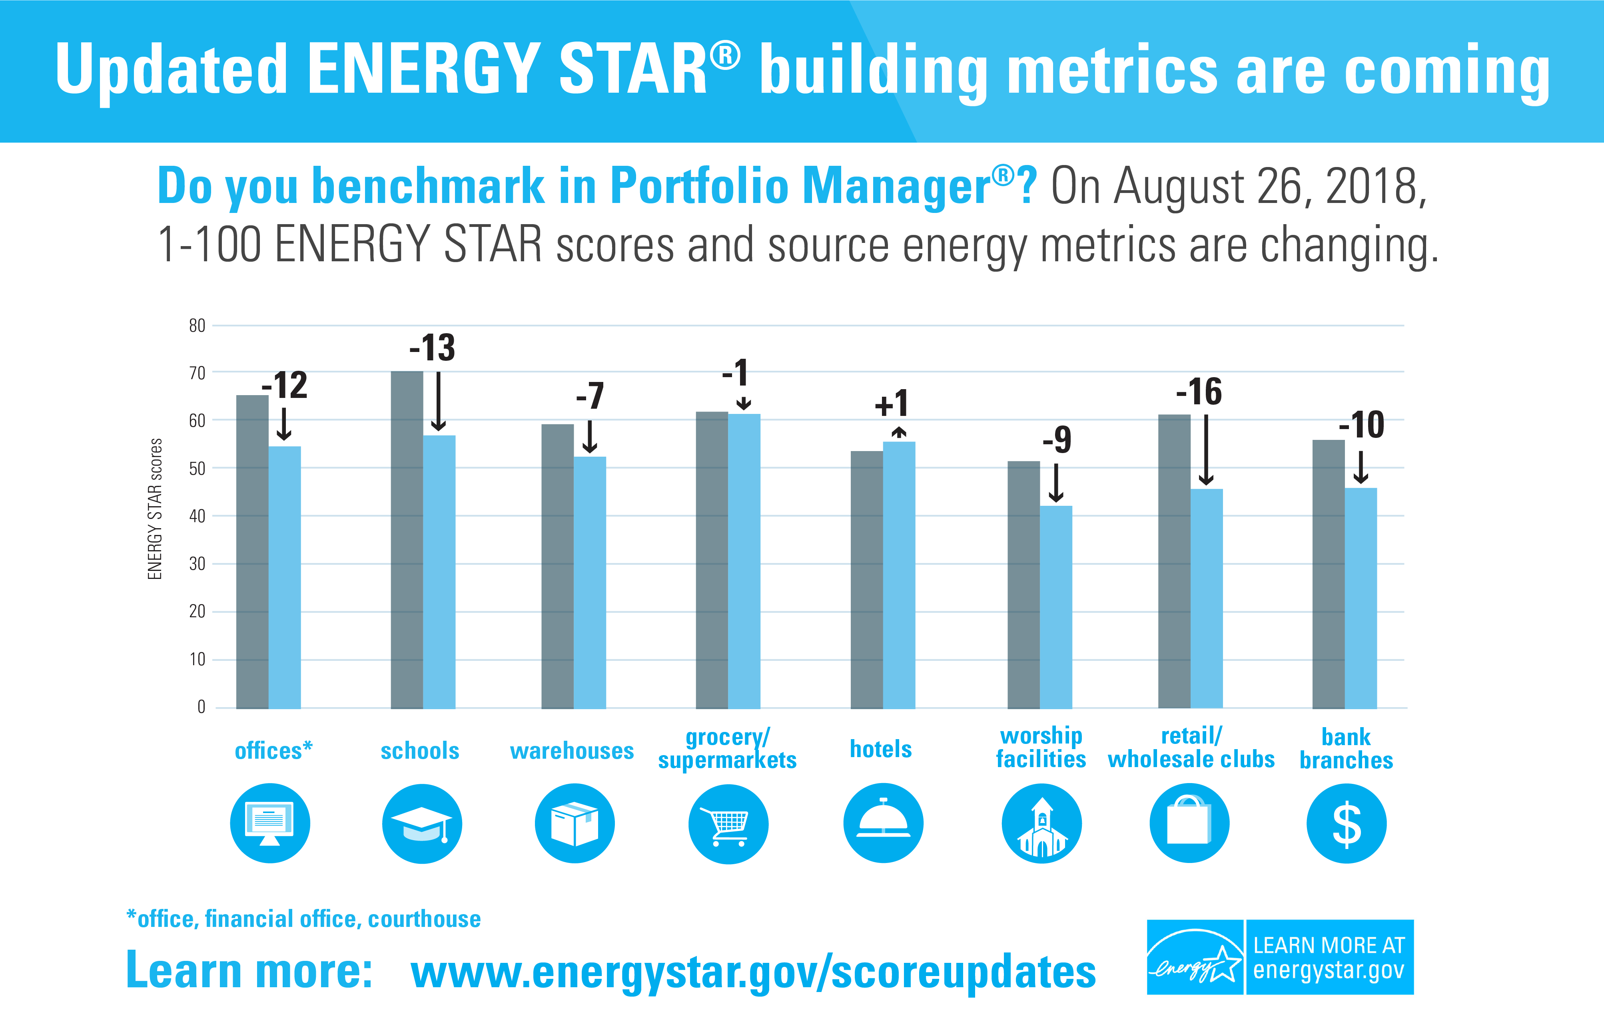
Preparing for the updates
Communicate the metric updates to colleagues, clients, stakeholders, etc.
  Download template materials: www.energystar.gov/scoreupdates
Notes:
Spread the word
EPA also has a communications toolkit available online that includes:
Shareable graphic(s) that summarizes key changes
Co-brandable fact sheet
Slide deck for trainers
Social media template posts
Download it and use it to communicate the upcoming metric changes to your stakeholders.

Slide 13
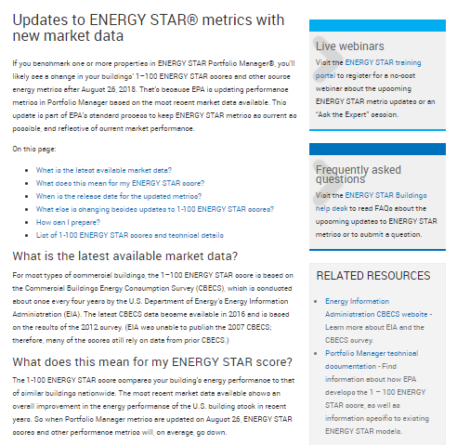
Learn more
energystar.gov/scoreupdates
Summary of changes
Timeline
Guidance on how to prepare
Links to FAQs
Links to register for an EPA informational webinar on 4/26 or 6/20
Slides from previous webinars
  Embedded video of recorded first webinar
  Links to six recorded sector-specific update webinars
Communications toolkit
  Fact sheet, shareable graphic, template social media, template training slides
Notes:
Lastly, visit energystar.gov/scoreupdates for:
A summary of changes
Details about the timing
Guidance on how to prepare for the updates
Links to frequently asked questions
Links to register for an EPA informational webinar on 4/26 or 6/20
Slides from previous webinars
Link to register for next webinar
Embedded video of recorded first webinar
Links to six recorded sector-specific update webinars
Communications toolkit that contains templates to make it easier for you to share information about the upcoming score changes with your stakeholders.

