Slide 1
Your program, powered by ENERGY STAR
Make your energy program simple and effective with America’s top energy efficiency brand

Slide 2
Contents
The picture of success
ENERGY STAR … your guide to energy savings
Why choose ENERGY STAR?
Choose your own adventure

Slide 3
The picture of success

Slide 4

The ideal …
clean air
green jobs
growing economy
resilience
4

Slide 5

The reality …
huge scope
short timeframe
limited resources
resistance to change
5

Slide 6
The path to success
Ways to motivate people to save
Broad reach
Transparency
Demonstrate results in 18 months or less
6
Notes:
How to bridge the gap between the ideal and the reality you’re facing? Each of your programs will likely look very different at the end of the day, but they’ll have a few key similarities.
- First, you need ways to engage people, not buildings. At the end of the day, you need to make a human connection. You have to motivate people to save energy and persuade them to make decisions that save energy.
Lots of people impact energy decisions, from who’s using it, to when it’s being used, to who’s paying for it. For that reason, you also need a program that can reach a broad range of stakeholders, whether you’re targeting facility managers, building owners, company leadership, tenants, or anyone else impacts energy decisions.
You need transparency, whether it’s bringing transparency to an owner or manager about how their building is performing, transparency about building energy performance generally in your community, as well as transparency of your program’s effectiveness.
Speaking of, you need to demonstrate real results in a very short timeframe.
So, how are you going to get there? And is there anyone that’s walked this path before that can guide you?

Slide 7
ENERGY STAR … your guide to energy savings

Slide 8




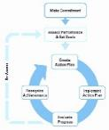


… more than just Portfolio Manager
transparency
energy
Step 1:
Step 2:
Collect the data
Communicate the data to the right people at the right time in the right way to motivate action
8
Notes:
(Note: animated in six steps)
I know what you’re thinking. How is Portfolio Manager going to do all those things?
Part of the reason everyone is here today is the belief that energy transparency can lead to market transformation.
But energy transparency is really two steps. (click)
The first step (click) is to collect the data, which is what Portfolio Manager is all about.
But if you’re only doing the first part, you’re only halfway there. The critical second step (click) is reaching people with the information they need in a way that motivates them to save energy.
That’s what ENERGY STAR is really about. (click)

Slide 9




The biggest little label in energy efficiency
7 billion products
2.3 million new homes
41,000 buildings
250 industrial plants
9
Notes:
For more than 25 years, EPA’s ENERGY STAR program has identified the most energy-efficient products, buildings, plants, and new homes – all based on the latest government-backed standards.
Today, every ENERGY STAR label is verified by a rigorous certification process.

Slide 10
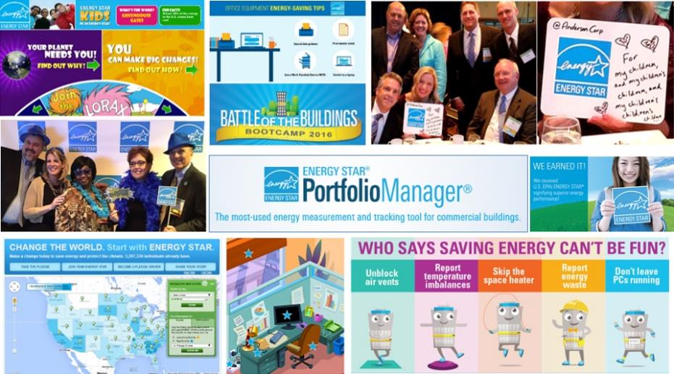
And it’s more than just a label…
ENERGY STAR … your guide to energy savings
Notes:
ENERGY STAR is more than just a label. It’s an entire framework upon which thousands of organizations have built their energy management programs. It’s also proven to be a bridge between engineering and facilities teams and everyone else---be they building occupants, employees, management, or customers.
Everyone has a role to play in saving energy, and ENERGY STAR is what brings them in by making energy efficiency fun and accessible.

Slide 11
Why choose ENERGY STAR?

Slide 12
ENERGY STAR is …
low-risk
simple
cost-effective
12
Notes:
(low-risk, simple, cost-effective are each animated)

Slide 13
low-risk simple cost-effective
An established program.
20-year track record
Bi-partisan market support
Proven results
13
Notes:
First reason: it’s low-risk is because it’s an established program.

Slide 14
low-risk simple cost-effective
Every year, ENERGY STAR certified buildings and plants save more than 118 MMTCO2e.
That’s equal to the emissions from nearly 18 million homes every year (electricity).
… or from nearly 25 million passenger vehicles
… or from 33 coal-fired power plants
You’d have to grow 3 billion tree seedlings for 10 years to sequester that much carbon.
Notes:
ENERGY STAR is protecting the environment and providing financial value in real, measurable ways.
Every year, the savings from just our certified buildings and plants are equivalent to powering down 33 coal-fired power plants.
Programmatically, these numbers are almost double. If you add in the savings from ENERGY STAR certified products and homes, ENERGY STAR as a whole saves more than 227 MMTCO2e … or from 60 coal-fired power plants

Slide 15
low-risk simple cost-effective
A top American brand.
ENERGY STAR enjoys wide trust and acceptance.
You don’t need to spend time or resources building awareness, understanding, or credibility.
15
Notes:
Second reason: it’s low-risk is because it’s a top American brand. In fact, over 90% of the American public recognizes the ENERGY STAR, so you have instant awareness, understanding, and credibility about energy efficiency.
But what does it really mean to reach 85% of the American public? What does that look like?

Slide 16
ENERGY STAR reaches
low-risk simple cost-effective
1.5 billion
people every month
16
Notes:
In fact, between print, online, social media, and broadcast TV… ENERGY STAR reaches a potential audience of more than 1.5 billion people every month (on average).

Slide 17
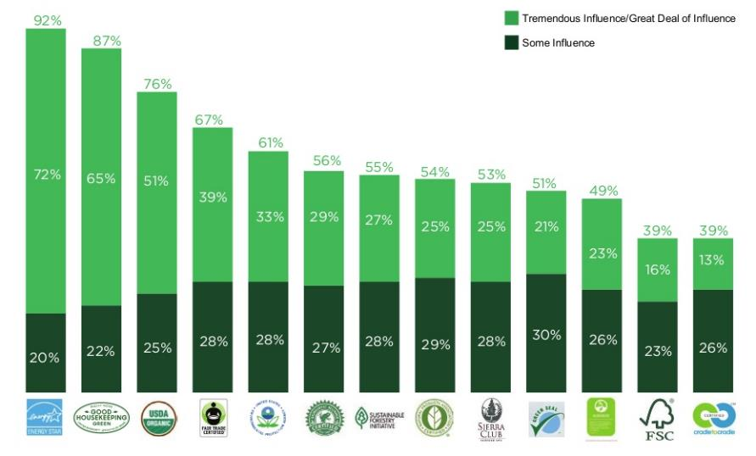
Minimize risk
low-risk simple cost-effective
17
Notes:
ENERGY STAR is a trusted environmental brand, ranking first among other green labels. 92% of survey respondents report that seeing the ENERGY STAR on a product influences their purchasing decisions. The vast majority of them report that it exerts a “tremendous among of influence.”

Slide 18
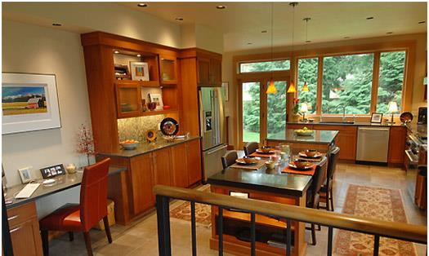


low-risk simple cost-effective
18
Notes:
(Animated – just refrigerator shows, then the rest)
As consumers, the people you’re trying to reach see ENERGY STAR in their daily lives. On their refrigerator, and a whole lot of other places.

Slide 19
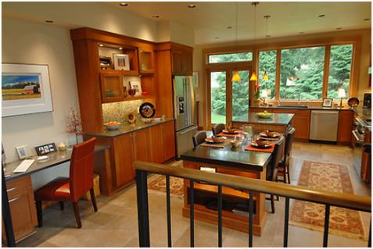
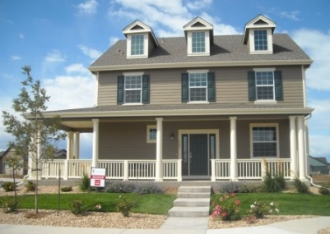




low-risk simple cost-effective
19
Notes:
They see it in their homes, on their office building, and as they sit at work all day.

Slide 20
low-risk simple cost-effective
Your stakeholders
know and trust
ENERGY STAR
20
Notes:
As consumers, your stakeholders already know and trust ENERGY STAR

Slide 21

low-risk simple cost-effective
Instant credibility.
Backed by the U.S. EPA
Conveys objectivity and transparency
21
Notes:
And lastly, it’s low-risk is because it has instant credibility, not only because of its wide brand awareness, but also because it’s a federal program run the US EPA, the same agency that brings miles per gallon calculations and other environmental metrics to the public.

Slide 22
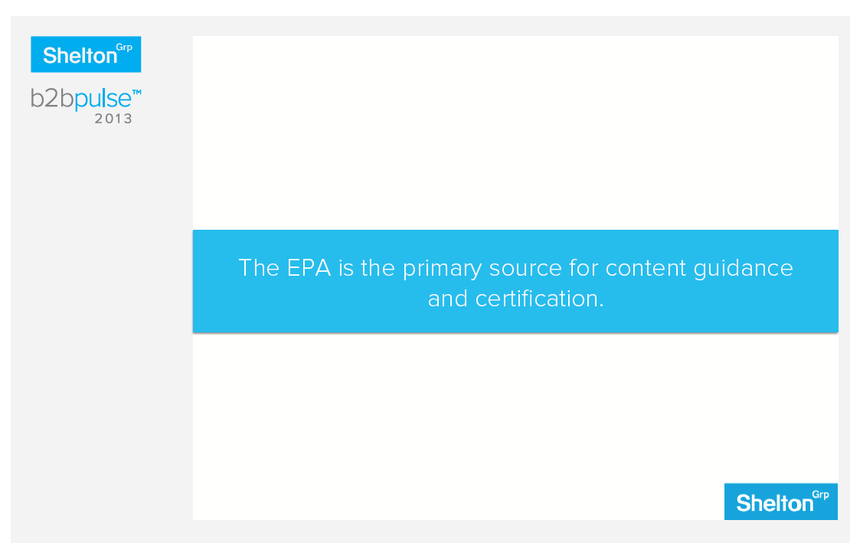
low-risk simple cost-effective
22
Notes:
In fact, a recent B2B survey across sectors found that EPA is the primary source for content guidance and certification for corporate sustainability.

Slide 23

low-risk simple cost-effective
  A common language.
    Understood, accepted, and actionable by consumers, businesses, utilities, tenants, managers, and the media
23
Notes:
It’s not only low-risk, it’s simple to convey. ENERGY STAR gives you a common language to communicate with a wide range of audiences …

Slide 24
low-risk simple cost-effective
Real savings: ENERGY STAR certified buildings use, on average 35% less energy
Environmental benefit: They cause, on average, 35% fewer greenhouse gas emissions
Higher Rent: ENERGY STAR certified buildings rent for 6.5% more
Higher Selling Prices: ENERGY STAR certified buildings sell for 12.9% more
Financial Performance: A $1-per-sq. ft. savings in office buildings increases cash flow by $0.95 and asset value by $13 per square foot
24
Notes:
… whether those audiences are interested in talking in terms of environmental benefit, financial value, the business case, or an industry equivalence. ENERGY STAR is like the rosetta stone for all these different audiences interested in energy efficiency for very different reasons.

Slide 25

low-risk simple cost-effective
  A common platform.
  Free
  Performance metrics and information
  Industry-standard benchmarking tool
25
Notes:
In addition to a common language, it gives you a common platform.
Widely accepted and adopted
40% of commercial building space uses it
Used to benchmark all building types

Slide 26

low-risk simple cost-effective
26
Notes:
In practice, this means Portfolio Manager is the common interface used by commercial building owners and managers, industries, energy service companies, utilities, and local, state, and federal government

Slide 27
An active network.
low-risk simple cost-effective
  A network of peers who can help you avoid pitfalls and costly mistakes
  A ready-made network of supporters, on the ground, in your state or city
27
Notes:
And lastly, it gives you a ready-made network of stakeholders that are already interested and active in energy efficiency.

Slide 28
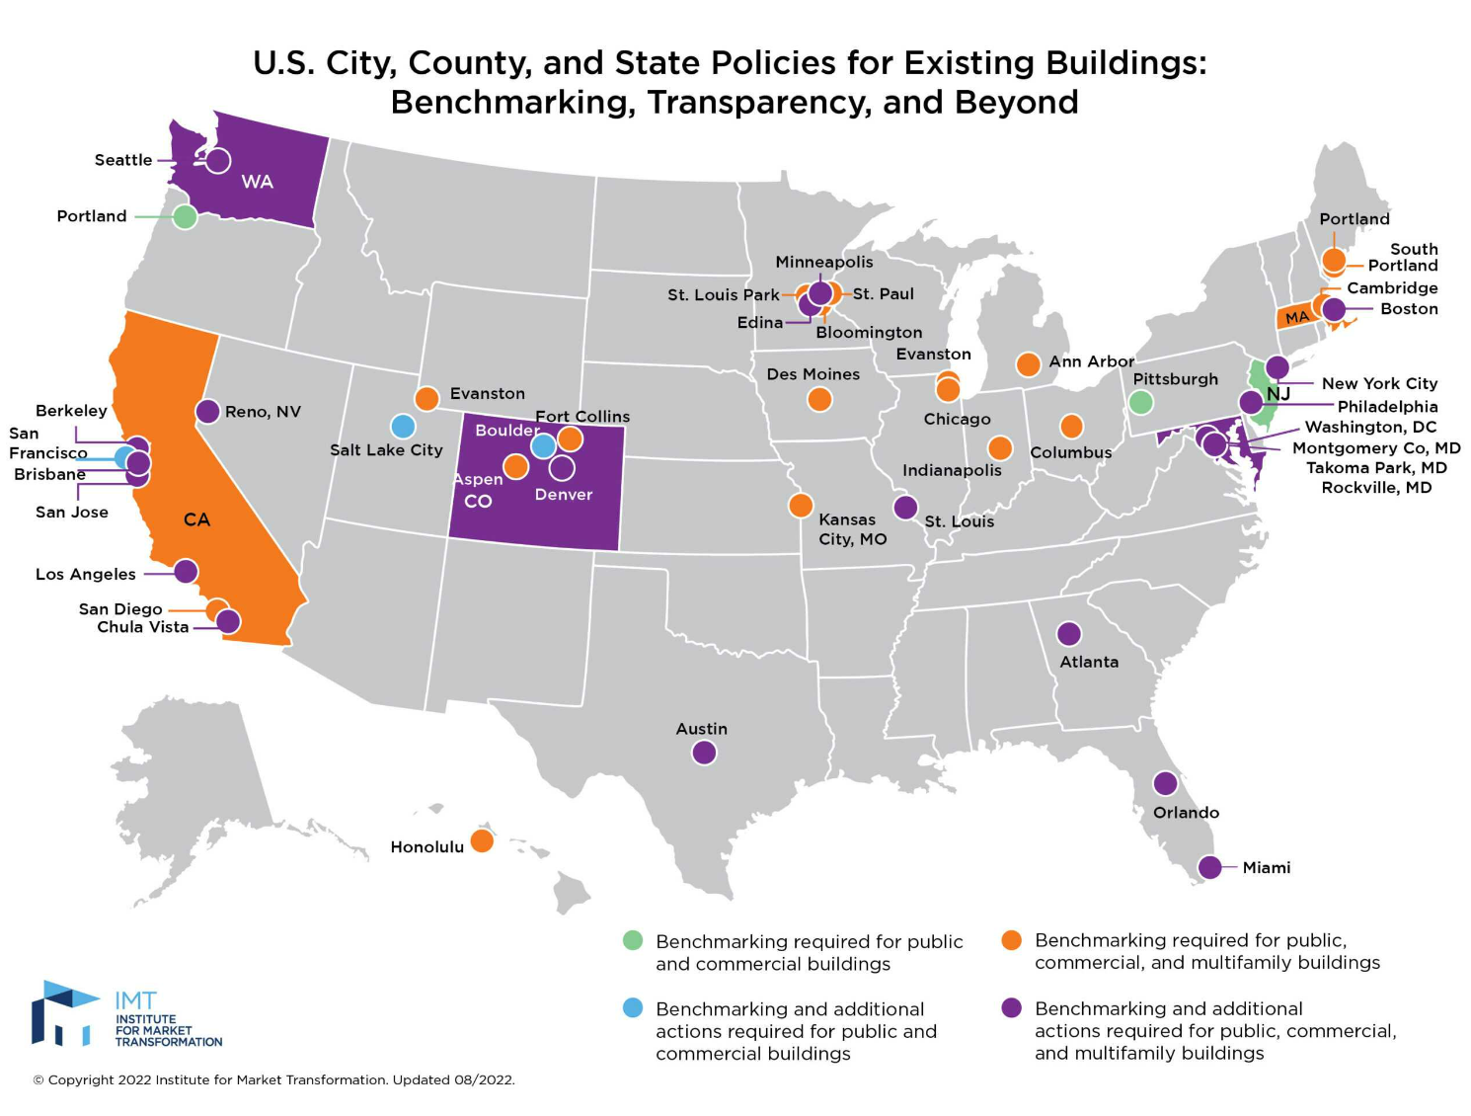
Imt.org/public-policy/building-performance-policy-center
28
Notes:
Federal agencies and state and local governments across the country are taking bold steps to protect the environment, lower energy costs, and grow clean energy jobs by adopting policies that leverage EPA’s ENERGY STAR tools.
This map shows a spreading trend to include ENERGY STAR Portfolio Manager benchmarking in a wide variety of energy efficiency campaigns, policies, and grant programs.

Slide 29
























www.energystar.gov/JoinBuildings
Notes:
More than 7,200 organizations Partner with ENERGY STAR for Commercial Buildings
More than 30% of the Fortune 500® is working with EPA to improve financial value, boost their bottom line, and manage risk by improving their facilities’ energy performance through ENERGY STAR.
So are eight of the 10 largest U.S. healthcare organizations, major league sports teams, colleges and universities, small businesses, and entire cities.
In total, more than 7,200 organizations are working with EPA and ENERGY STAR to make their properties more energy efficient.

Slide 30
Save time, effort and money.
low-risk simple cost-effective
  A proven platform that works
  The largest, most highly leveraged government-sponsored energy program in history
  We’ve helped cities like yours do the same
30
Notes:
And last, but not least, ENERGY STAR can help you save time, effort, and money. We’ve spent 20 years creating the largest, most highly leveraged government-sponsored energy program in history

Slide 31
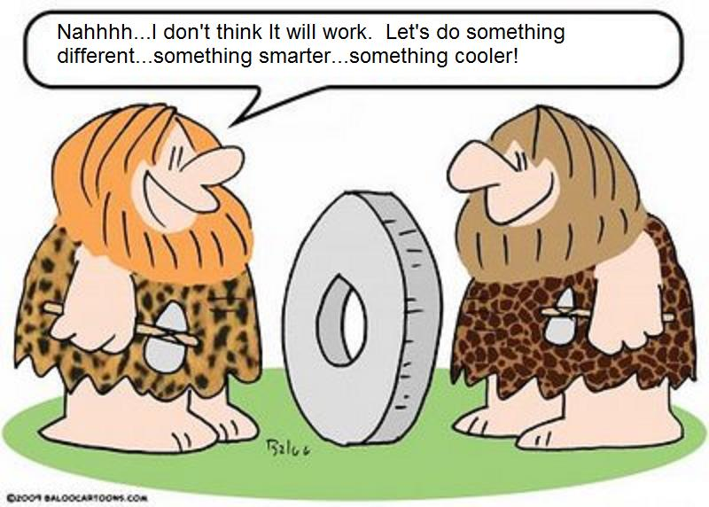
low-risk simple cost-effective
31
Notes:
In other words, don’t spend time reinventing the wheel!

Slide 32

low-risk simple cost-effective
  We are here to help you. We have no other agenda.
32

Slide 33
Choose your own adventure

Slide 34
What do you want to do?
Unlock the power
of information
Go Beyond Benchmarking
Transform
your market
Recommendations/best practices: benchmarking programs
Unlock the power of information, plus:
Unlock the power of information, Go beyond benchmarking,
plus:
ENERGY STAR Portfolio Manager
Template energy mgmt. plan
Recommendations/best practices: communicating and motivating
1 – 100 ENERGY STAR score, plus 80 other metrics
EPA co-branded recognition
Off-the-shelf building improvement tools and resources
Energy efficiency competition
ENERGY STAR brand
Harness ENERGY STAR service and product provider network
Recommendations/best practices: get utilities to help
Harness ENERGY STAR utility network
34

Slide 35
Recommendations & best practices: Implementing voluntary or mandatory benchmarking programs
Unlock the power
of information
Recommendations/best practices: benchmarking programs
ENERGY STAR Portfolio Manager
1 – 100 ENERGY STAR score, plus 80 other metrics
ENERGY STAR brand
35

Slide 36
Unlock the power
of information
Recommendations/best practices: benchmarking programs
ENERGY STAR Portfolio Manager
1 – 100 ENERGY STAR score, plus 80 other metrics
ENERGY STAR brand
36

Slide 37

…plus 80 other metrics!
Unlock the power
of information
The 1-100 ENERGY STAR score
Recommendations/best practices: benchmarking programs
85
1
50
100
ENERGY STAR Portfolio Manager
1 – 100 ENERGY STAR score, plus 80 other metrics
ENERGY STAR brand
37

Slide 38
ENERGY STAR brand
Unlock the power
of information
Recommendations/best practices: benchmarking programs
Your program name
Your program name, powered by ENERGY STAR
An ENERGY STAR program
ENERGY STAR Portfolio Manager
1 – 100 ENERGY STAR score, plus 80 other metrics
ENERGY STAR brand
38
Notes:
You can choose how much to co-brand with ENERGY STAR. We think it’s a pretty valuable brand, but we understand you may be committed to your own brand. That’s okay,
Just like there’s “Intel Inside,” you can have “ENERGY STAR Inside” and use whatever tools and resources you want to help you do your job and implement your program.
Or, you might choose to co-brand with ENERGY STAR, and reinforce your own program brand with the weight of the ENERGY STAR brand.
Or lastly, you might choose to take ENERGY STAR wholesale and just run an ENERGY STAR program in your own organization. The choice is yours.

Slide 39
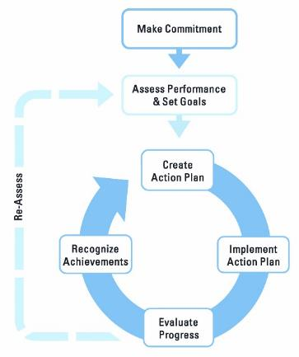
Template energy management plan
Go beyond
benchmarking
Unlock the power of information, plus:
Template energy mgmt. plan
EPA co-branded recognition
Off-the-shelf building improvement tools and resources
Harness ENERGY STAR service and product provider network
39

Slide 40
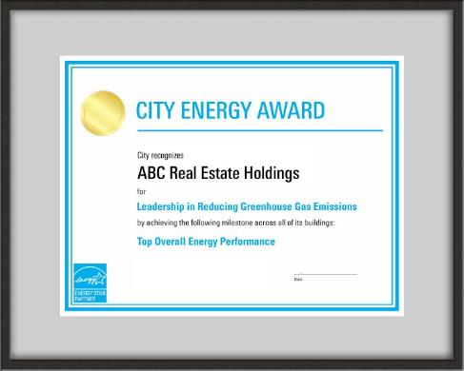
EPA co-branded recognition
Go beyond
benchmarking
Unlock the power of information, plus:
Template energy mgmt. plan
EPA co-branded recognition
Off-the-shelf building improvement tools and resources
Harness ENERGY STAR service and product provider network
40

Slide 41
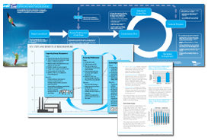
Off-the-shelf building improvement tools and resources
Go beyond
benchmarking
Unlock the power of information, plus:
Template energy mgmt. plan
EPA co-branded recognition
Off-the-shelf building improvement tools and resources
Harness ENERGY STAR service and product provider network
41

Slide 42

Harness ENERGY STAR service and product provider network
Go beyond
benchmarking
Unlock the power of information, plus:
Template energy mgmt. plan
EPA co-branded recognition
Off-the-shelf building improvement tools and resources
Harness ENERGY STAR service and product provider network
42

Slide 43

Recommendations/best practices: communicating and motivating
Transform
your market
Unlock the power of information, Go beyond benchmarking,
plus:
Recommendations/best practices: communicating and motivating
Energy efficiency competition
Recommendations/best practices: get utilities to help
Harness ENERGY STAR utility network
43

Slide 44
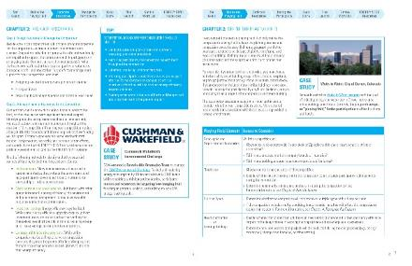

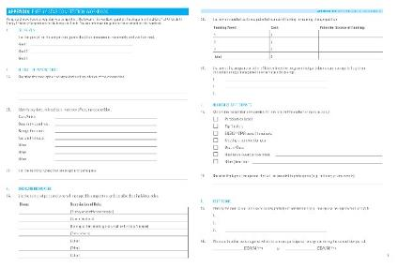
Energy efficiency competition
Transform
your market
Unlock the power of information, Go beyond benchmarking,
plus:
Recommendations/best practices: communicating and motivating
Energy efficiency competition
Recommendations/best practices: get utilities to help
Harness ENERGY STAR utility network
44

Slide 45

Energy efficiency competition
Transform
your market
Unlock the power of information, Go beyond benchmarking,
plus:
Recommendations/best practices: communicating and motivating
Energy efficiency competition
Recommendations/best practices: get utilities to help
Harness ENERGY STAR utility network
45

Slide 46
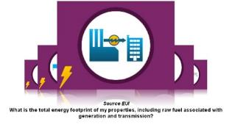
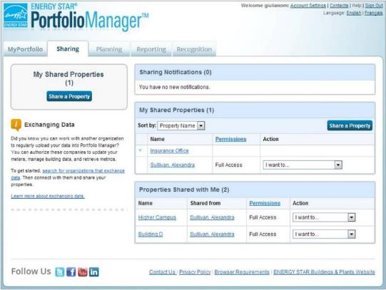
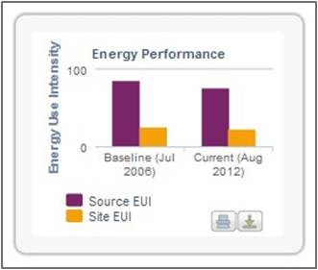
Recommendations/best practices:
Get utilities to help
Transform
your market
Unlock the power of information, Go beyond benchmarking,
plus:
Recommendations/best practices: communicating and motivating
Energy efficiency competition
Recommendations/best practices: get utilities to help
Harness ENERGY STAR utility network
46

Slide 47

Harness the ENERGY STAR utility network
Transform
your market
Unlock the power of information, Go beyond benchmarking,
plus:
Recommendations/best practices: communicating and motivating
Energy efficiency competition
Recommendations/best practices: get utilities to help
Harness ENERGY STAR utility network
47

Slide 48
Customize your program
Go beyond
benchmarking
Unlock the power
of information
Go Beyond Benchmarking
Transform
your market
Recommendations/best practices: benchmarking programs
Unlock the power of information, plus:
Unlock the power of information, Go beyond benchmarking,
plus:
ENERGY STAR Portfolio Manager
Template energy mgmt. plan
Recommendations/best practices: communicating and motivating
EPA co-branded recognition
1 – 100 ENERGY STAR score, plus 80 other metrics
Off-the-shelf building improvement tools and resources
Energy efficiency competition
Harness ENERGY STAR service and product provider network
Recommendations/best practices: get utilities to help
Harness ENERGY STAR utility network
48

Slide 49
Notes:
In the past 5-10 years, the value of ENERGY STAR has gone far beyond its original purpose of a label. It’s now a standalone brand representing environmental protection and financial savings.
And unlike most other strong brands, ENERGY STAR is a US government asset, which means that it belongs to all American individuals and organizations.
You have an incredible opportunity here to capitalize on this brand, and strengthen your own credentials through association.

